Slide 1

Diagnostic Assessment .Delta 3
Unit 8
Simultaneous Equations by
Eliminations
Substitution
Graphically
Equations of Linear Graphs
Graphing Inequalities

Slide 2
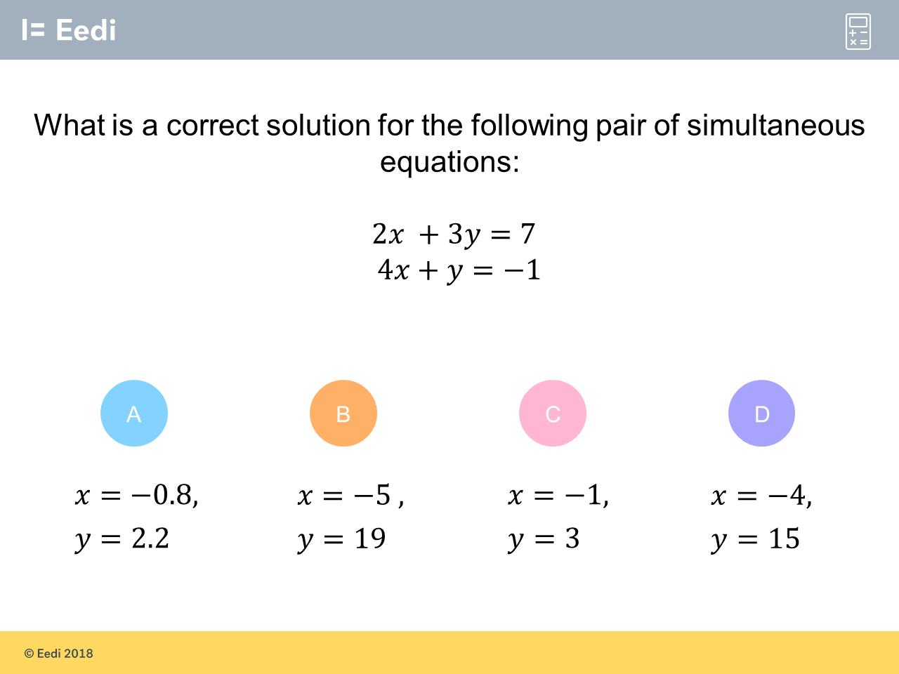
Question 1 – Simultaneous Equations by Eliminations
What are the solutions for the simultaneous equations?

Slide 3
Answer 1 – Simultaneous Equations by Eliminations
What are the solutions for the simultaneous equations?
CORRECT ANSWER | CORRECT EXPLANATION
x = -1 y = 3 | We multiply the second equation by 3 to get 12x + 3y = -3. Subtracting the equations then gives 2x - 12x = 7 - -3 which becomes -10x = 10. This gives x =-1, and we can substitute this into the second equation to get 4(-1) + y = -1. This rearranges to gives y = -1 + 4 = 3.
COMMON MISTAKES | WHAT MIGHT BE YOUR MISTAKE
x = -0.8 y = 2.2 | The student has forgotten to multiply the -1 by 3 as well as the y and 4x.
x = -5 y = 19 | The student has forgotten to multiply the 4x by 3 as well as the y and -1.
x = -4 y = 15 | The student has forgotten to multiply the 4x and 7 by 3 as well as the y.

Slide 4
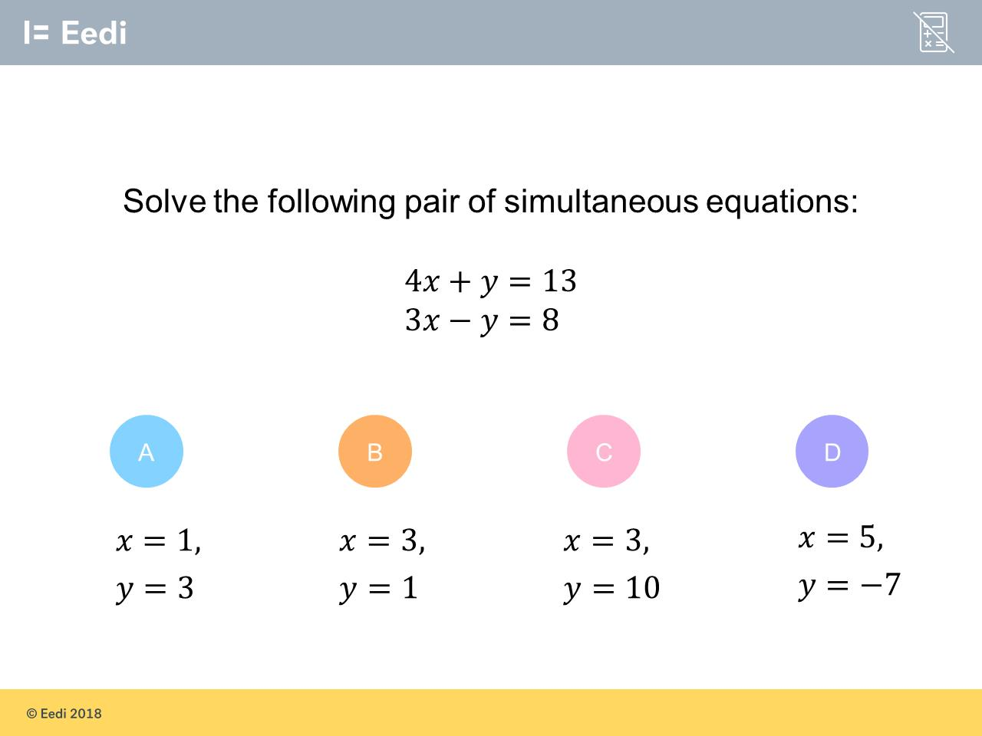
Question 2 – Simultaneous Equations by Eliminations

Slide 5
Answer 2 – Simultaneous Equations by Eliminations
CORRECT ANSWER | CORRECT EXPLANATION
x = 3 y = 1 | Adding the equations together gives 7x = 21, and then we have x = 3. Solving 4x + y = 13 for x = 3 gives 4(3) + y = 13 and then y = 13 - 12 = 1.
COMMON MISTAKES | WHAT MIGHT BE YOUR MISTAKE
x = 1 y = 3 | The student has written the solutions the wrong way around.
x = 3 y = 10 | The student has calculated x correctly, but then used x rather than 4x in the first equation to solve for y.
x = 5 y = -7 | The student has subtracted the equations, rather than adding, to find x.

Slide 6
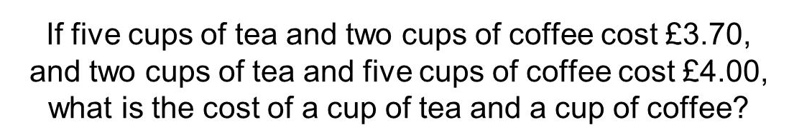
Question 3 – Simultaneous Equations by Eliminations

Slide 7
Answer 3 – Simultaneous Equations by Eliminations
CORRECT ANSWER | CORRECT EXPLANATION
Tea = 50p Coffee = 60p | The student is correct. It is likely that the student will have set up two simultaneous equations 5t + 2c = 370 and 2t + 5c = 400 and solved them correctly.
COMMON MISTAKES | WHAT MIGHT BE YOUR MISTAKE
Tea = 0.5 Coffee = 0.6 | This is incorrect. Two simultaneous equations need to be set up and solved. These are 5t + 2c = 370 and 2t + 5c = 400. Solving these by multiplying the first equation by 2 and the second by 5 and subtracting them would give the correct solution of t = 50 and c = 60.
Tea = 30p Coffee = £1.10 | This is incorrect. Two simultaneous equations need to be set up and solved. These are 5t + 2c = 370 and 2t + 5c = 400. Solving these by multiplying the first equation by 2 and the second by 5 and subtracting them would give the correct solution of t = 50 and c = 60.
Tea = 60p Coffee = 50p | This is incorrect. Two simultaneous equations need to be set up and solved. These are 5t + 2c = 370 and 2t + 5c = 400. Solving these by multiplying the first equation by 2 and the second by 5 and subtracting them would give the correct solution of t = 50 and c = 60.

Slide 8
Question 4 – Simultaneous Equations by Substitution
Solve the following simultaneous equations
y = 3 – x
2x + 7y = -4

Slide 9
Answer 4 – Simultaneous Equations by Substitution
Solve the following simultaneous equations
y = 3 – x
2x + 7y = –4
CORRECT ANSWER | CORRECT EXPLANATION
x = 5 y = -2 | 2x + 7(3 – x) = -4 hence 2x + 21 – 7x = -4 therefore –5x = –25 If x = 5 then y = 3 – 5 = -2
COMMON MISTAKES | WHAT MIGHT BE YOUR MISTAKE
x = -5 y = 8 | The student thought -5x = -25 becomes x = 5. Negative divided by a negative makes a positive
x = 25 y = -22 | The only multiplied the 3 by 7 and did not multiply the –x by 7 as well. 2x + 7(3 – x) = -4 hence 2x + 21 – x = -4

Slide 10
Question 5 – Simultaneous Equations by Substitution
Solve the following simultaneous equations
y = 2x
x + 2y = 15

Slide 11
Answer 5 – Simultaneous Equations by Substitution
Solve the following simultaneous equations
y = 2x
x + 2y = 15
CORRECT ANSWER | CORRECT EXPLANATION
x = 3 y = 6 | x + 2(2x) = 15 hence x + 4x = 15 therefore 5x = 15 If x = 3 then y = 2(3) = 6
COMMON MISTAKES | WHAT MIGHT BE YOUR MISTAKE
x = 3 y = 23 | The student worked out x correctly but calculate y incorrectly
x = 7.5 y = 15 | The student substituted 2y instead of 2x

Slide 12
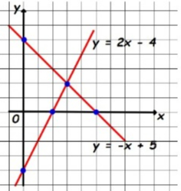
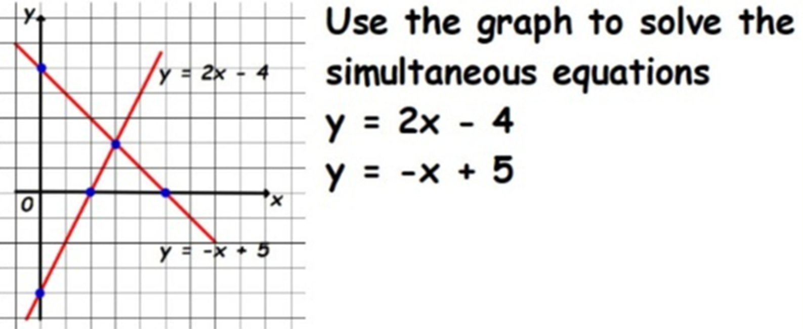
Question 6 – Simultaneous Equations by Graphically

Slide 13
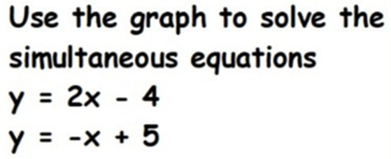
Answer 6 – Simultaneous Equations by Graphically
CORRECT ANSWER | CORRECT EXPLANATION
x = 3 y = 2 | Intersection is when x = 3 and y = 2
COMMON MISTAKES | WHAT MIGHT BE YOUR MISTAKE
x = 2 y = 3 | You got your x and y coordinates mixed up.
(3, 2) | While this is correct in that the point of intersection of the lines is (3,2), we want to know what each of the VARIABLES is; ie x = 3, y = 2.
x = 5 y = 5 | You've found the x and y intercepts of each line. This is not where the lines meet.

Slide 14
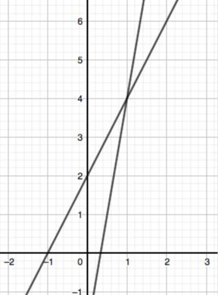
Question 7 – Simultaneous Equations by Graphically
Solve the following
simultaneous equations
y = 2x + 2
y = 6x - 2

Slide 15
Answer 7 – Simultaneous Equations by Graphically
Solve the following
simultaneous equations
y = 2x + 2
y = 6x - 2
CORRECT ANSWER | CORRECT EXPLANATION
x = 1 y = 4 | The co-ordinate where the graphs intersect is (1, 4)
COMMON MISTAKES | WHAT MIGHT BE YOUR MISTAKE
x = 4 y = 1 | misreading the coordinates of the crossing point
x = 0 y = 2 | y-axis intersect i.e. the value of y when x is equal to 0
x = 0.25 y = 0 | x-axis intersect i.e, the value of x when y is equal to 0

Slide 16
Question 8 – Equations of Linear Graphs
What is the equation of the line that passes through the points (0,4) and (2,-6)?

Slide 17
Answer 8 – Equations of Linear Graphs
What is the equation of the line that passes through the points (0,4) and (2,-6)?
CORRECT ANSWER | CORRECT EXPLANATION
y = –5x + 4 | The gradient between the two points is (-6 -4)/(2- 0) = -10/2 = -5 and the y intercept is 4. This makes the equation of the line y = -5x + 4
COMMON MISTAKES | WHAT MIGHT BE YOUR MISTAKE
y = 5x – 4 | The student has the signs the wrong way around.
y = 2x – 10 | The student has worked out the difference in x and the difference in y.
y = –10x + 4 | The student has not divided by 2 when finding the gradient.

Slide 18
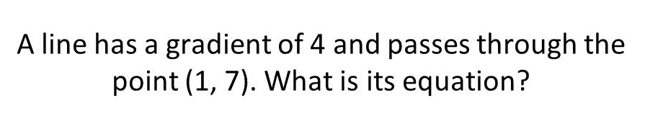
Question 9 – Equations of Linear Graphs

Slide 19
Answer 9 – Equations of Linear Graphs
CORRECT ANSWER | CORRECT EXPLANATION
y = 4x + 3 | m = 4 so 𝑦 = 4𝑥 + c, when you substitute in 𝑦 = 7 and 𝑥 = 1, c = 3
COMMON MISTAKES | WHAT MIGHT BE YOUR MISTAKE
y = 7x + 4 | The student has put the gradient as the 𝑦 intercept and the 𝑦 coordinate as the gradient
y = 4x + 7 | The student has used the 𝑦 coordinate as the 𝑦 intercept and ignored the 𝑥=1
y = 4x + 6 | The student has subtracted the 𝑥 coordinate from the 𝑦 coordinate to try to get the 𝑦 intercept

Slide 20
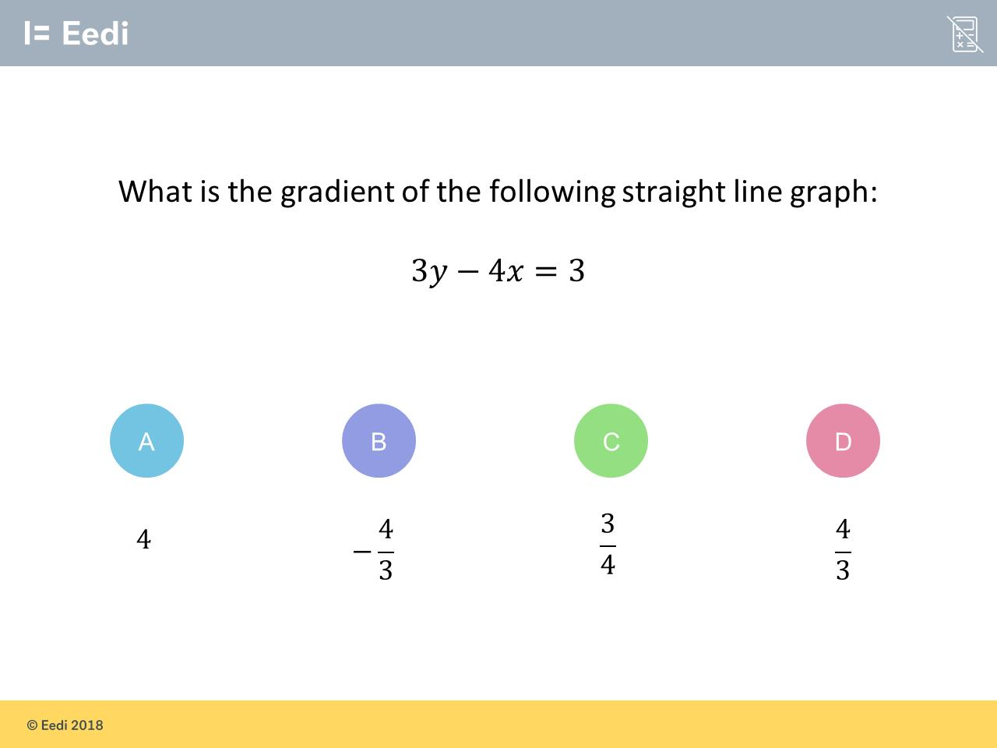
Question 10 – Equations of Linear Graphs

Slide 21
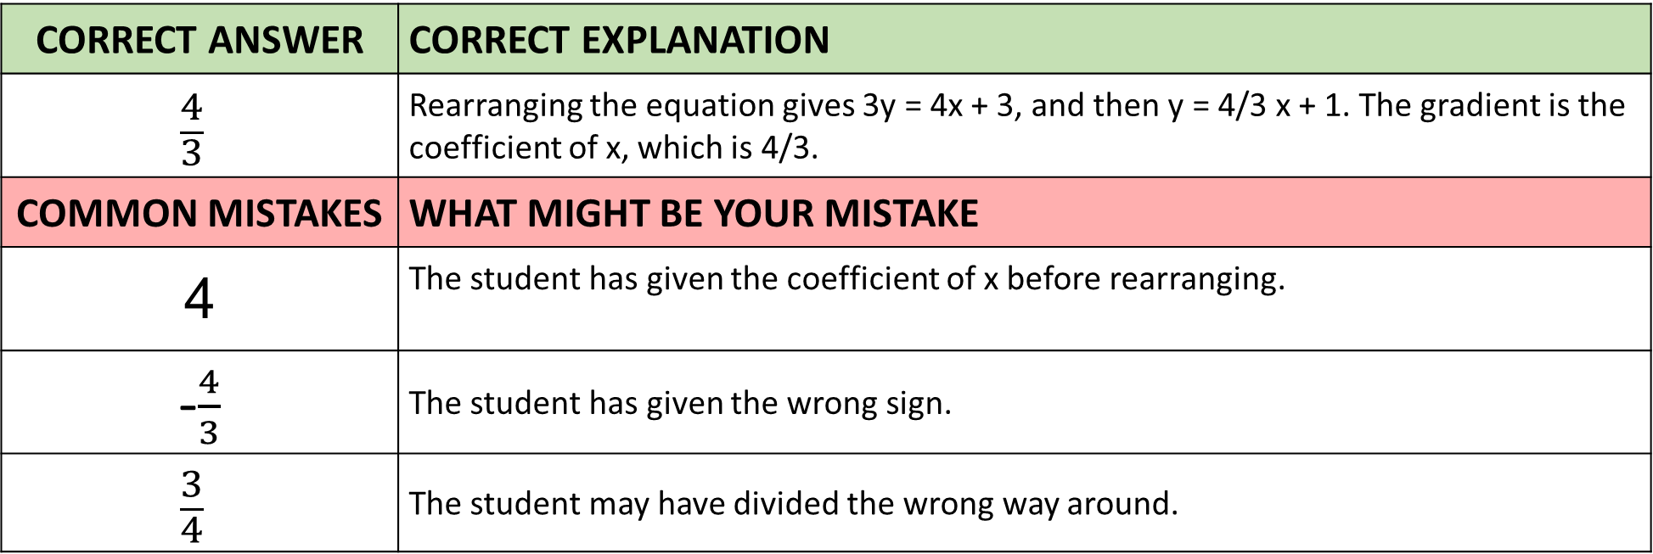
Answer 10 – Equations of Linear Graphs
CORRECT ANSWER | CORRECT EXPLANATION
$$\frac{4}{3}$$ | Rearranging the equation gives 3y = 4x + 3, and then y = 4/3 x + 1. The gradient is the coefficient of x, which is 4/3.
COMMON MISTAKES | WHAT MIGHT BE YOUR MISTAKE
4 | The student has given the coefficient of x before rearranging.
-$\frac{4}{3}$ | The student has given the wrong sign.
$$\frac{3}{4}$$ | The student may have divided the wrong way around.

Slide 22
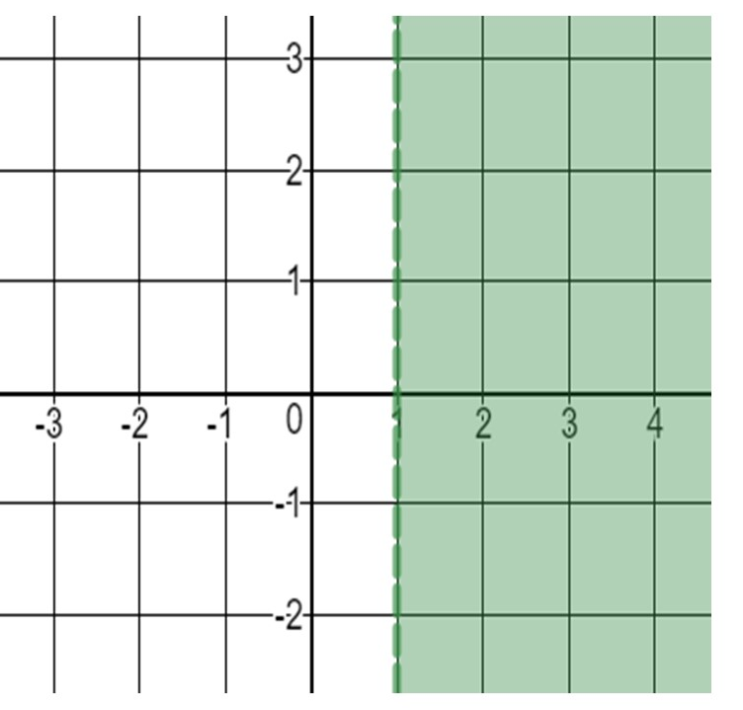
Question 11 – Graphing Inequalities
Which inequality represent the shaded green region?

Slide 23
Answer 11 – Graphing Inequalities
Which inequality represent the shaded green region?
CORRECT ANSWER | CORRECT EXPLANATION
x > 1 | All co-ordinates in the green region have an x value greater than 1
COMMON MISTAKES | WHAT MIGHT BE YOUR MISTAKE
x ≥ 1 | The student did not notice that the line was dotted and therefore is not included.
x < 1 | The student has described the unshaded (white) region of the graph
y > 1 | The student has described the wrong line. They used y instead of x

Slide 24
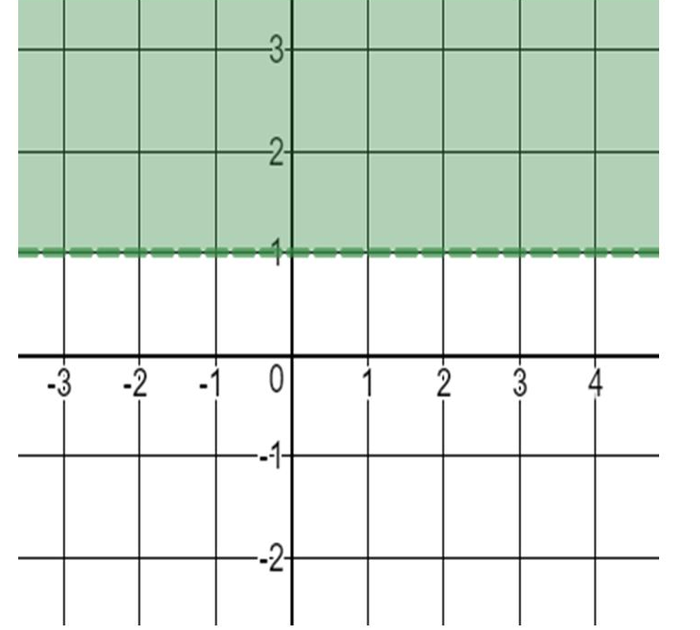
Question 12 – Graphing Inequalities
Which inequality represent the shaded green region?

Slide 25
Answer 12 – Graphing Inequalities
Which inequality represent the shaded green region?
CORRECT ANSWER | CORRECT EXPLANATION
y > 1 | As we have y > 1, we need a dashed, horizontal line where the region above is shaded.
COMMON MISTAKES | WHAT MIGHT BE YOUR MISTAKE
x < 1 | The student has mistaken this for the line x = 1.
y < 1 | The student has written the symbol the wrong way around.
x > 1 | The student has mistaken this for the line x = 1.

Slide 26
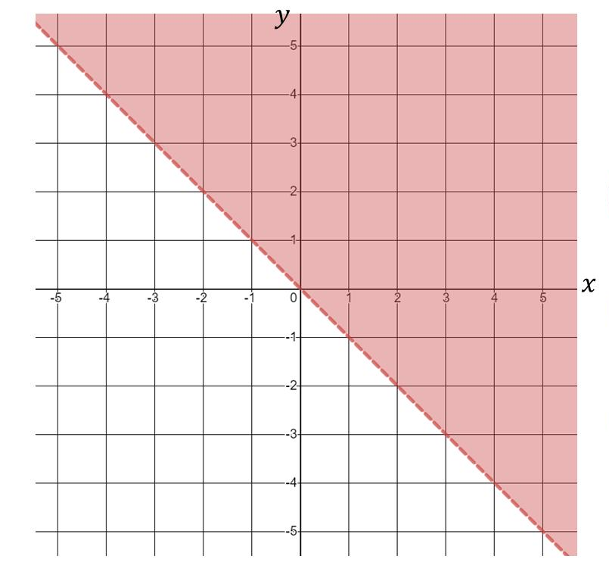
Question 13 – Graphing Inequalities
Which inequalities represent the unshaded region?

Slide 27
Answer 13 – Graphing Inequalities
Which inequalities represent the unshaded region?
CORRECT ANSWER | CORRECT EXPLANATION
y > -x | The dotted line is y = -x and the shading is above the line
COMMON MISTAKES | WHAT MIGHT BE YOUR MISTAKE
y > x | The student has done the linear line with a positive gradient instead of a negative.
y < x | The student has done the linear line with a positive gradient instead of a negative plus they have descried the unshaded region.
y > -x | The student has describe the unshaded region.

Slide 28
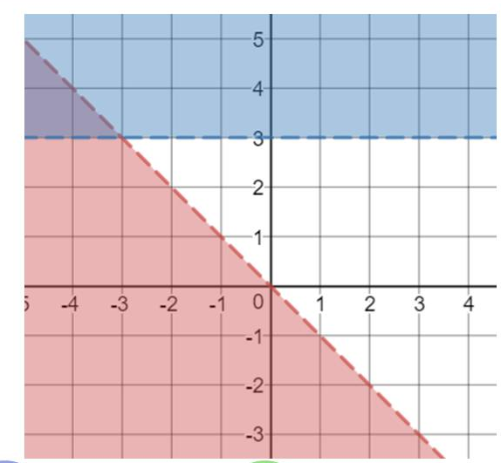
Question 14 – Graphing Inequalities
Which inequalities represent the unshaded region?

Slide 29
Answer 14 – Graphing Inequalities
Which inequalities represent the unshaded region?
CORRECT ANSWER | CORRECT EXPLANATION
y > -x y < 3 | The blue section represents y > 3, as everything above y = 3 is shaded. The red section represents y < -x, as the left hand side of the line y = -x is shaded. The unshaded region is then y < 3 and y >-x.
COMMON MISTAKES | WHAT MIGHT BE YOUR MISTAKE
y > -x y < 3 | The student has given the inequalities for the shaded region.
y > -x y < 3 | The student has given the wrong direction on the first inequality.
y > -x y < 3 | The student has given the wrong direction on the second inequality.

