Slide 1
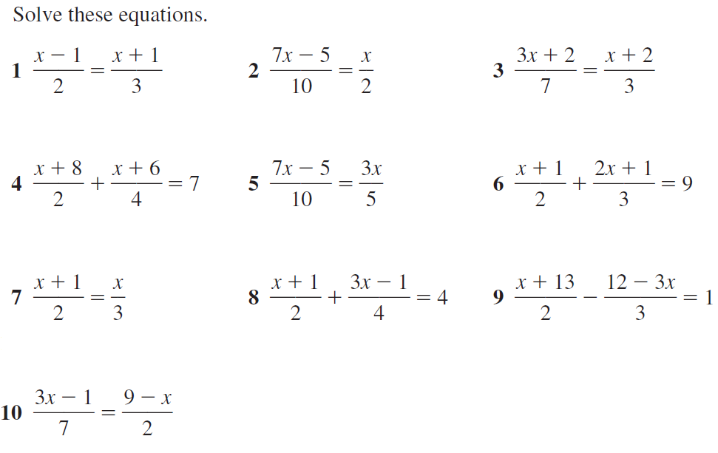
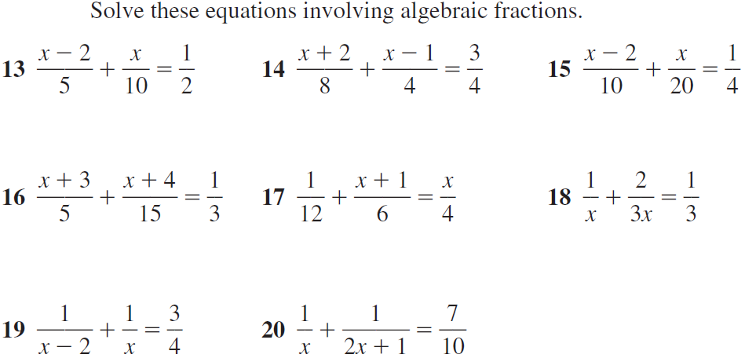
7
8
9
10
11
12

Slide 2
ANSWERS

Slide 3
x = 5
x = 2.5
x = 4
x = 2
x = 5
x = 7
7
8
9
x = 3
x = 2
x = 3
10
11
12
x = -2
x = 3
x = 5

