Slide 1
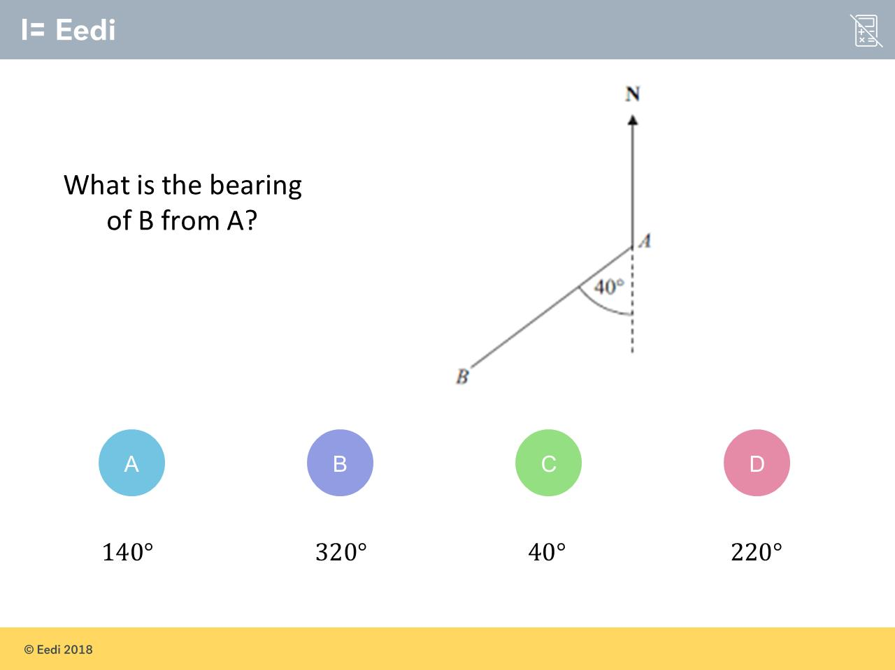
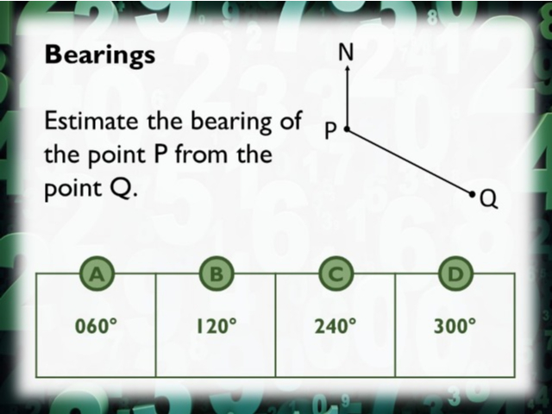
Worst answered question?
Most common wrong answer?

Slide 2
ANSWERS

Slide 3

Worst answered question?

Slide 4
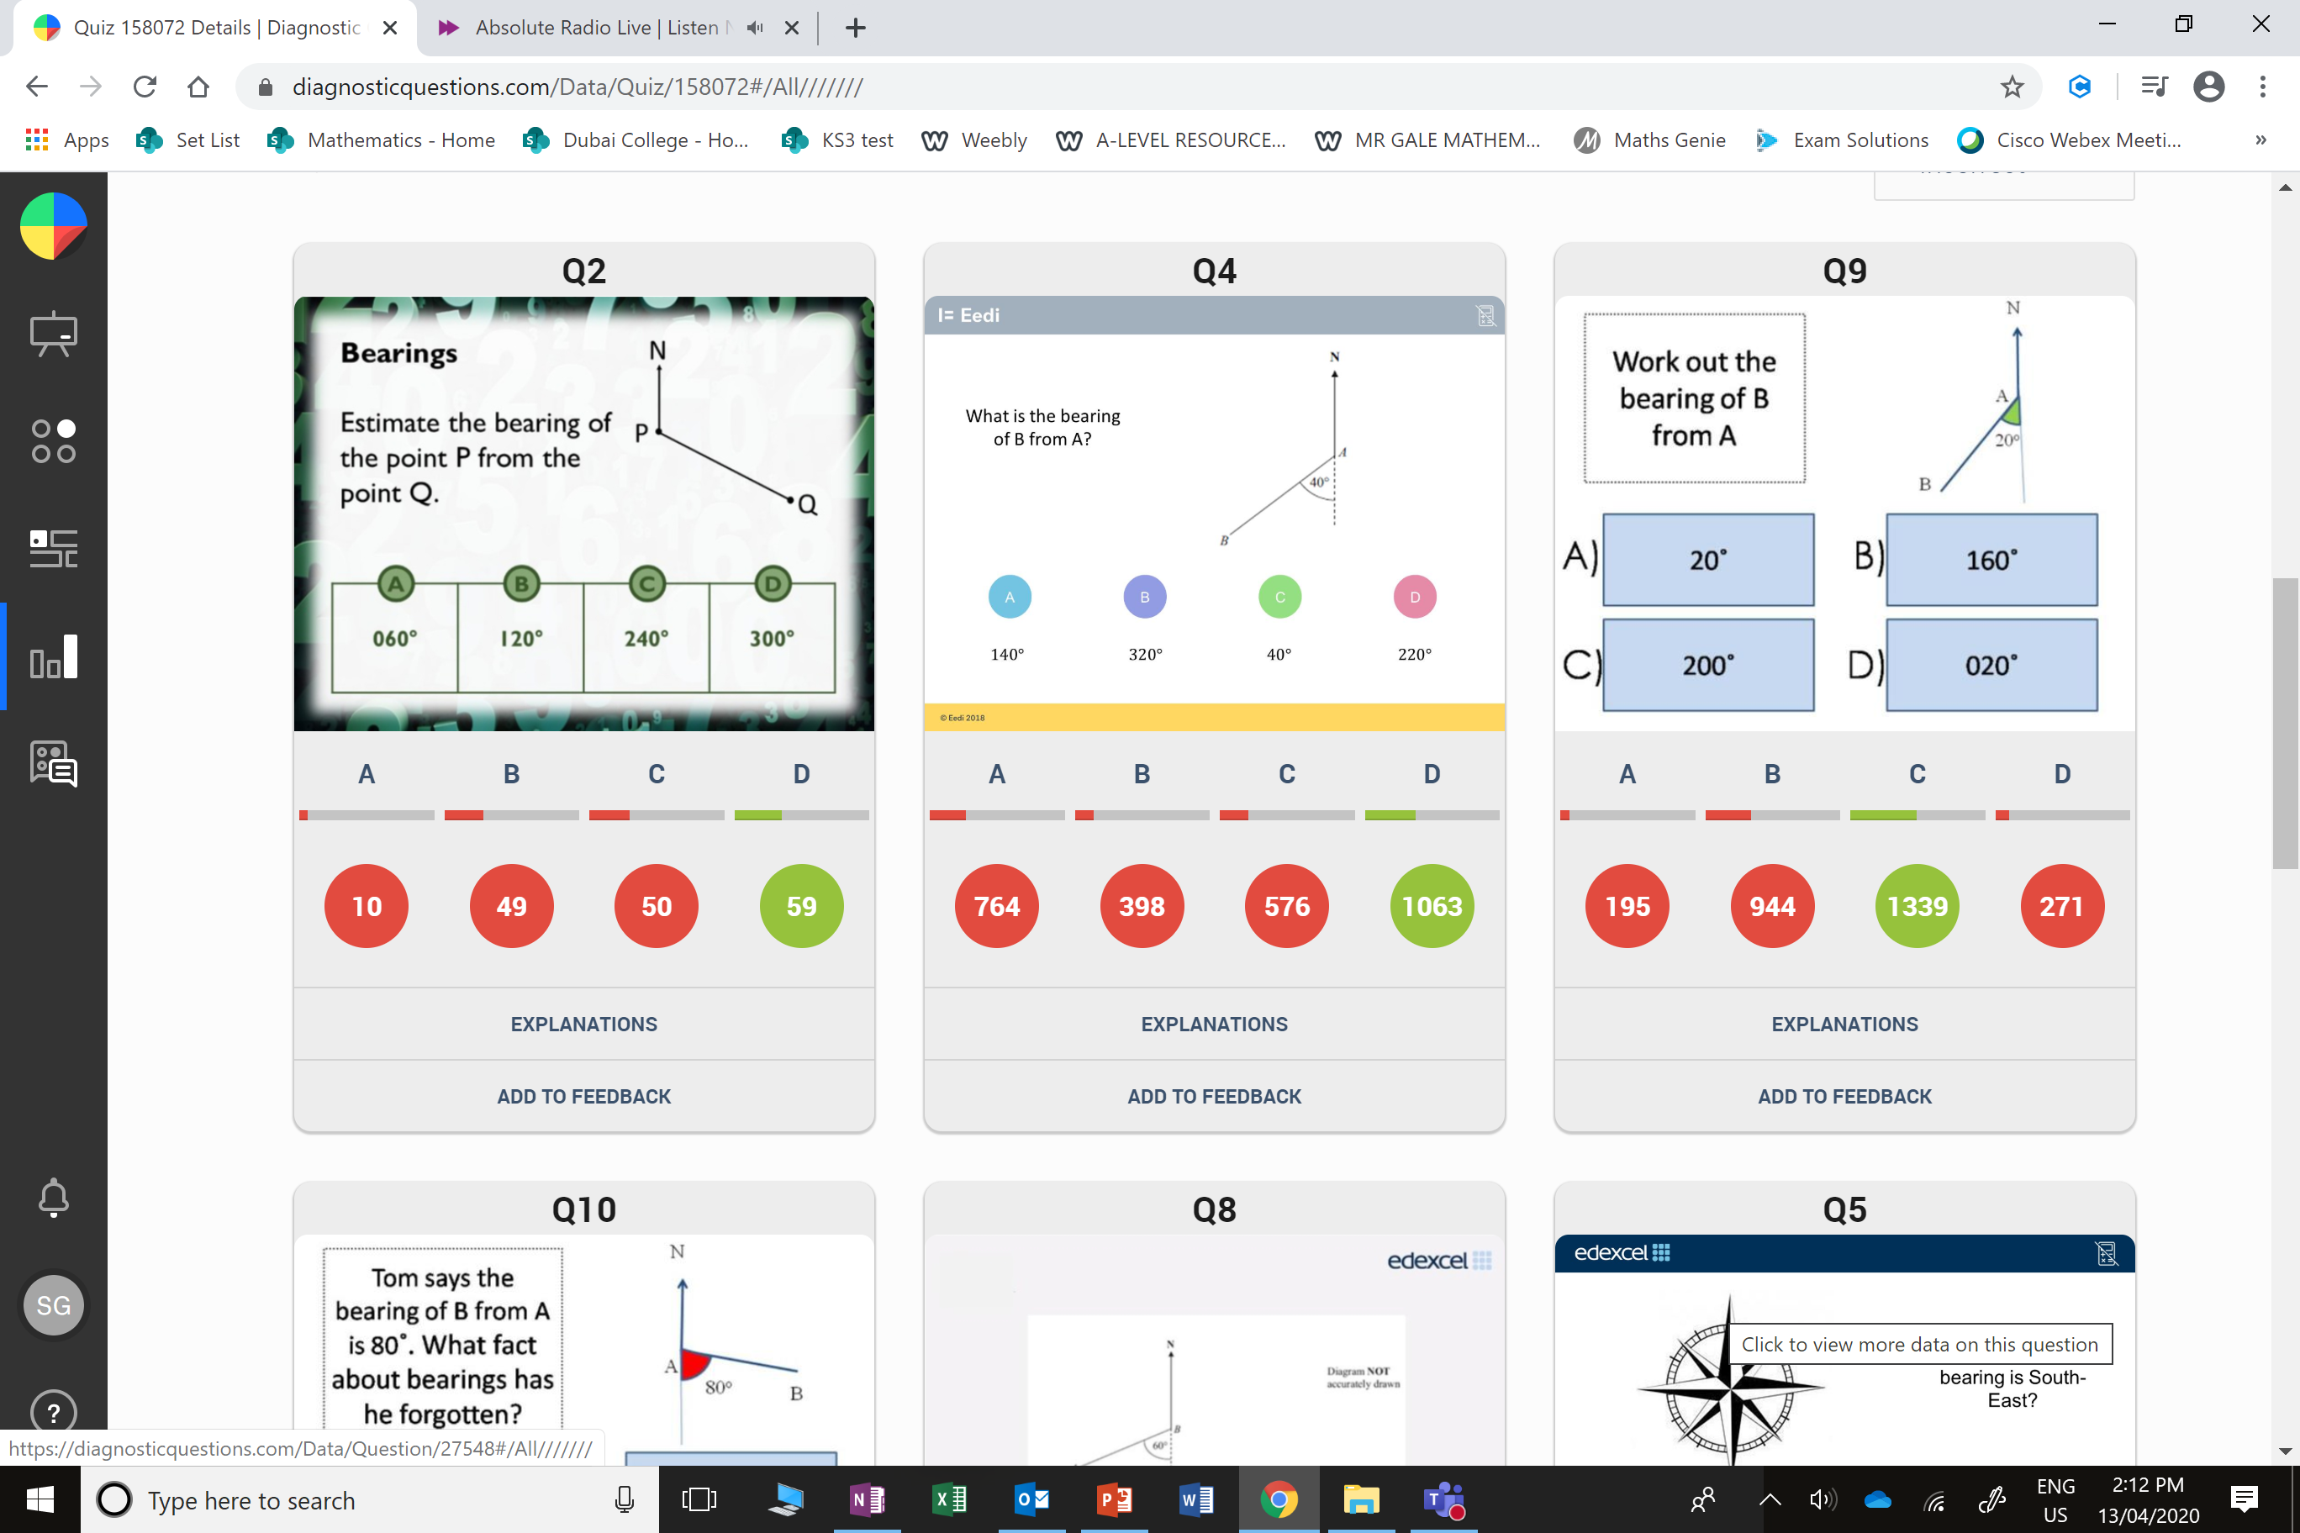
C
They have estimates the angle anti-clockwise from the north line.

Slide 5
C
They have forgotten to measure from the north line.

