Slide 1
Differentiation
Gradient Functions
Chapter 12
(Part 4 of 8)

Slide 2
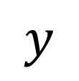
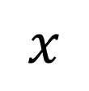

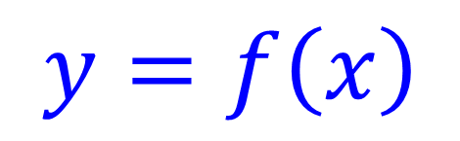
For what values of x is $f\left(x\right)$increasing?
$$y$$
$$y=f\left(x\right)$$
x > 4
$$x$$
4

Slide 3
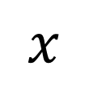

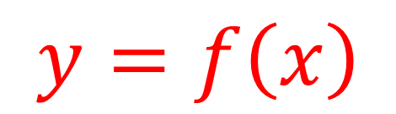
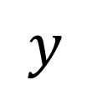
For what values of x is $f\left(x\right)$decreasing?
$$y$$
$$y=f\left(x\right)$$
x < 4
$$x$$
4

Slide 4
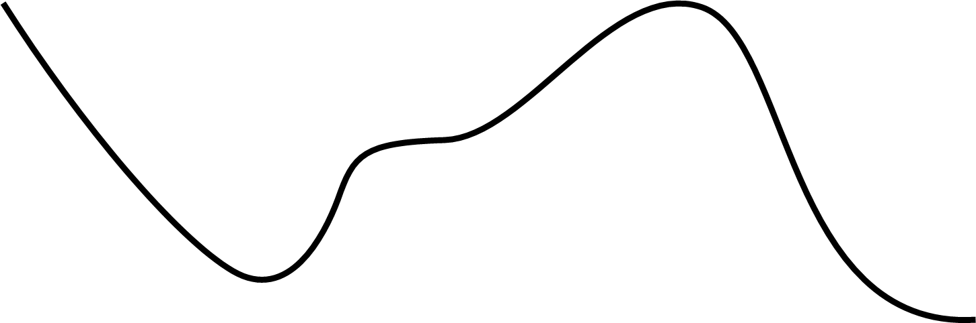
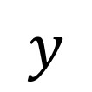
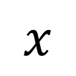

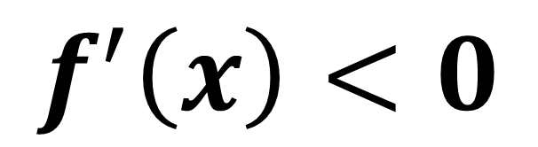
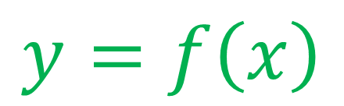
For what values of $f^{′}\left(x\right)$ is f(x) decreasing?
$$y$$
$$f^{′}\left(x\right)<0$$
$$y=f\left(x\right)$$
$$x$$

Slide 5

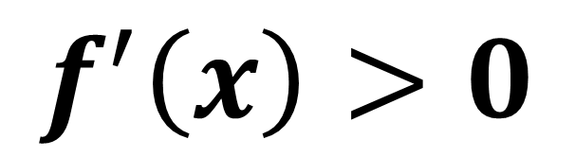
For what values of $f^{′}\left(x\right)$ is f(x) increasing?
$$y$$
$$f^{′}\left(x\right)>0$$
$$y=f\left(x\right)$$
$$x$$

Slide 6
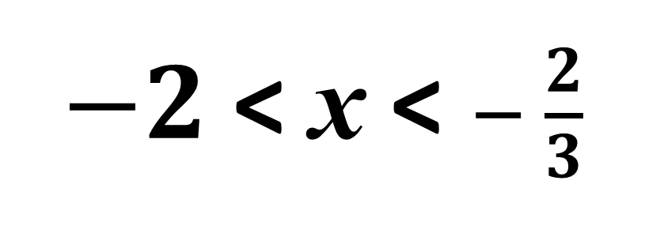
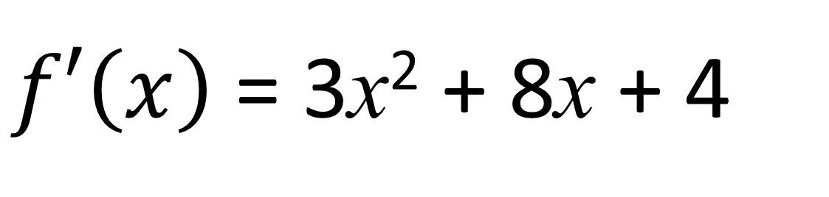

$f\left(x\right)$ = x³ + 4x² + 4x
For what values of x is f(x) decreasing?
$f′\left(x\right)$ = 3x² + 8x + 4
3x² + 8x + 4 < 0
$−2$ < x < $− \frac{2}{3}$

Slide 7
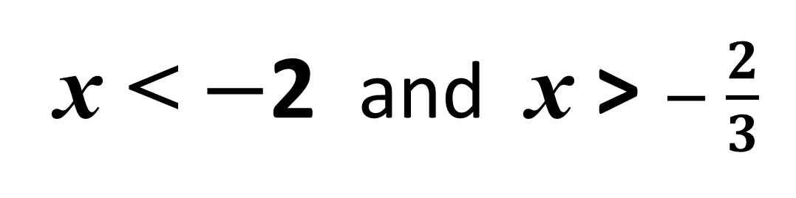
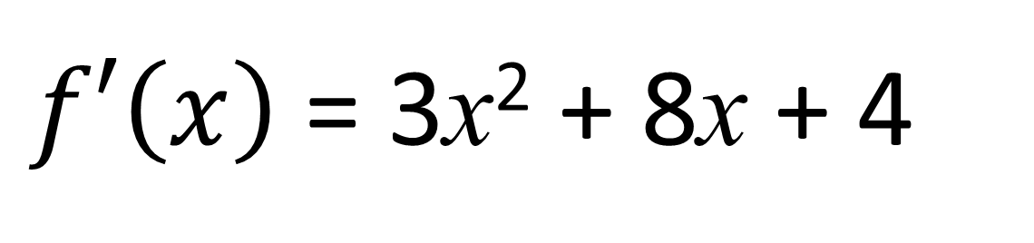

$f\left(x\right)$ = x³ + 4x² + 4x
For what values of x is f(x) increasing?
$f′\left(x\right)$ = 3x² + 8x + 4
3x² + 8x + 4 > 0
x < $−$2 and x > $− \frac{2}{3}$

Slide 8
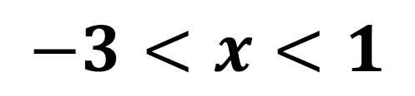
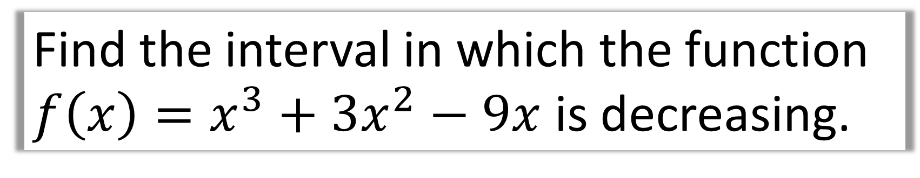
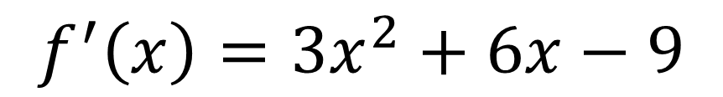
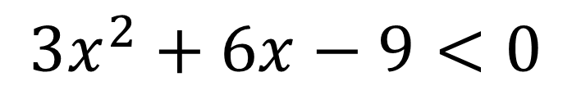
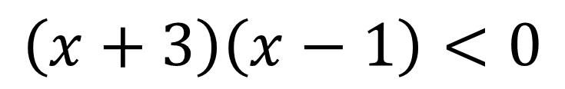
Find the interval in which the function $f\left(x\right)=x^{3}+3x^{2}−9x$ is decreasing.
$$f^{′}\left(x\right)=3x^{2}+6x−9$$
$$3x^{2}+6x−9<0$$
$$\left(x+3\right)\left(x−1\right)<0$$
$$−3<x<1$$

Slide 9
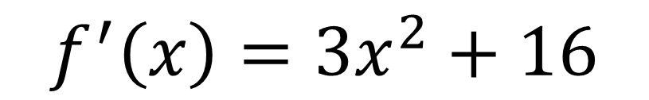
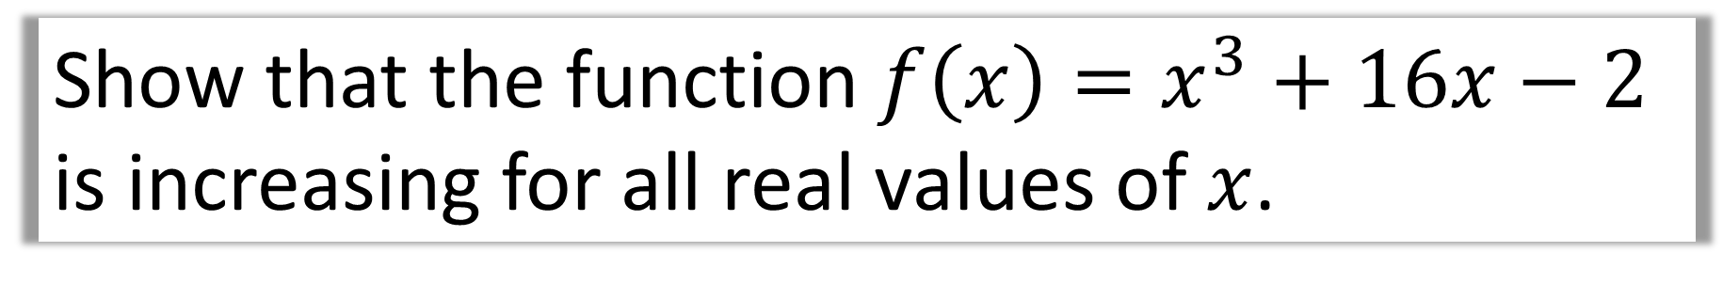
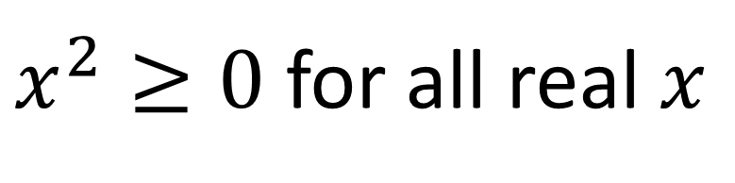
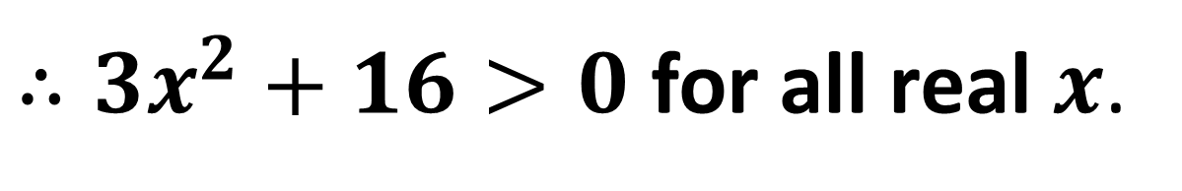
Show that the function $f\left(x\right)=x^{3}+16x−2$
is increasing for all real values of $x$.
$$f^{′}\left(x\right)=3x^{2}+16$$
$x^{2}≥0$ for all real $x$
$∴3x^{2}+16>0$ for all real $x$.
Therefore $f(x)$ is an increasing function for all real $x$.

Slide 10
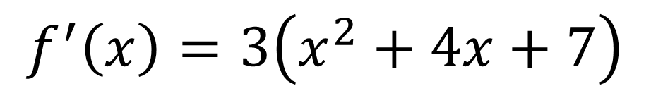
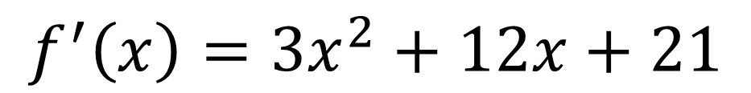
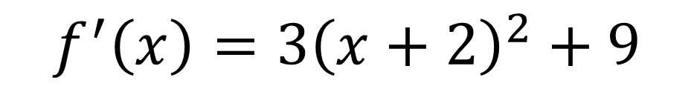
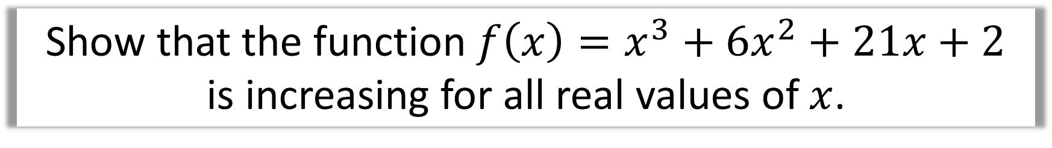
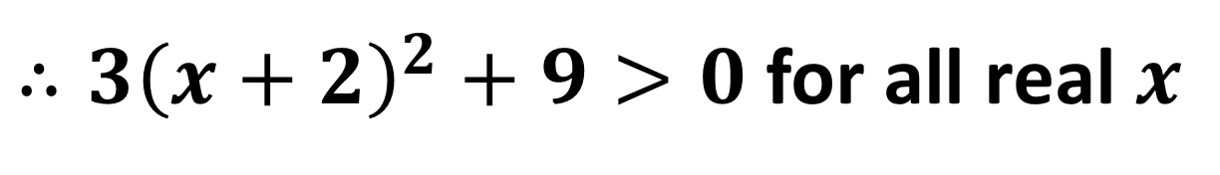
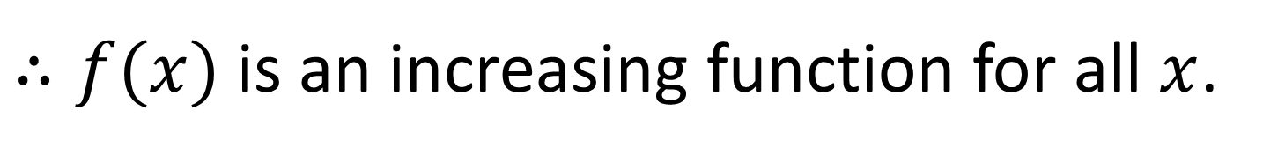
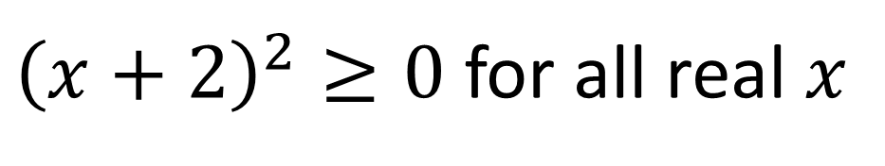
Show that the function $f\left(x\right)=x^{3}+6x^{2}+21x+2$
is increasing for all real values of $x$.
$$f^{′}\left(x\right)=3x^{2}+12x+21$$
$$f^{′}\left(x\right)=3\left(x^{2}+4x+7\right)$$
$$f^{′}\left(x\right)=3{\left(x+2\right)}^{2}+9$$
${\left(x+2\right)}^{2}≥0$ for all real $x$
$∴3{\left(x+2\right)}^{2}+9>0$ for all real $x$
$∴f(x)$ is an increasing function for all $x$.

