Slide 1
Differentiation
Second Derivative
Chapter 9
(Part 9 of 10)

Slide 2
Concave
(positive to negative
gradient)
Point of Inflection
(gradient is 0)
Convex
(negative to positive gradient)

Slide 3
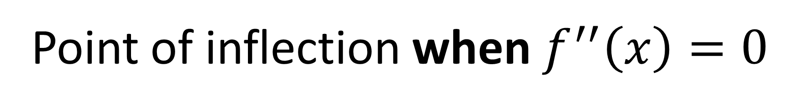


Second Derivative
$f(x)$ concave when $f^{′′}\left(x\right)≤0$
$f(x)$ convex when $f^{′′}\left(x\right)≥0$
Point of inflection when $f^{′′}\left(x\right)=0$

Slide 4




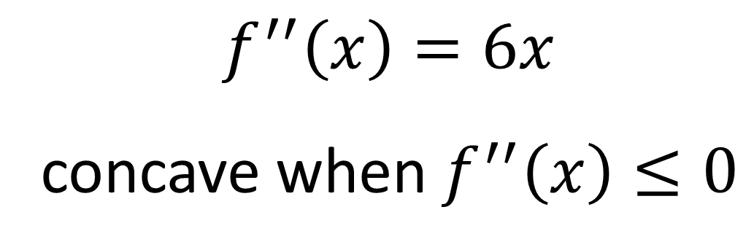
Find the interval on which the function
$f\left(x\right)=x^{3}+4x+3$ is concave.
$$f^{′\left(x\right)}=3x^{2}+4$$
$$f^{′′}\left(x\right)=6x$$
concave when $f^{′′}\left(x\right)≤0$
$$6x≤0$$
$$x≤0$$

Slide 5
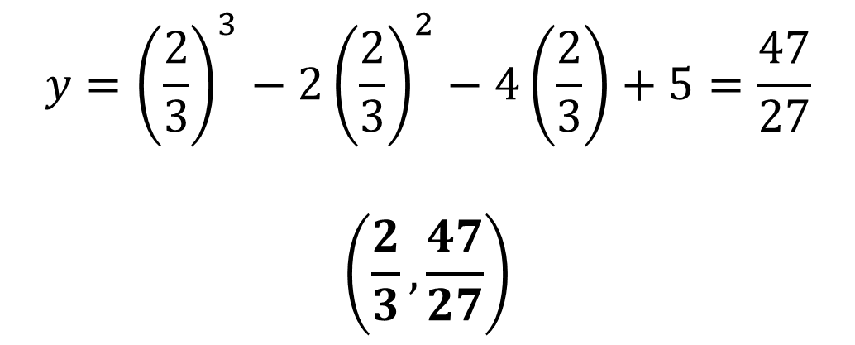
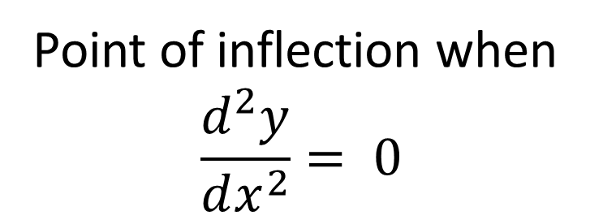


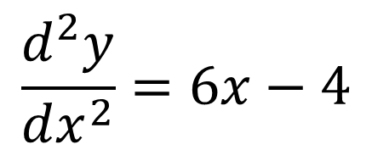
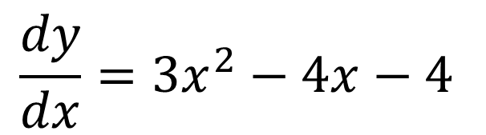
The curve $C$ has equation $y=x^{3}−2x^{2}−4x+5$
Find the coordinate of the point of inflection.
$$\frac{dy}{dx}=3x^{2}−4x−4$$
$$6x−4=0$$
$$x=\frac{2}{3}$$
$$\frac{d^{2}y}{dx^{2}}=6x−4$$
$$y={\left(\frac{2}{3}\right)}^{3}−2{\left(\frac{2}{3}\right)}^{2}−4\left(\frac{2}{3}\right)+5=\frac{47}{27}$$
$$\left(\frac{2}{3},\frac{47}{27}\right)$$
Point of inflection when
$$\frac{d^{2}y}{dx^{2}}= 0$$

Slide 6



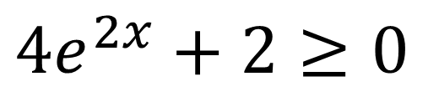
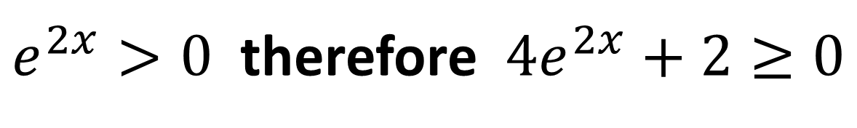

Show that $f\left(x\right)=e^{2x}+x^{2}$
is convex for all real values of $x$.
$$f^{′}\left(x\right)=2e^{2x}+2x$$
$$f^{′′}\left(x\right)=4e^{2x}+2$$
$$4e^{2x}+2≥0$$
$e^{2x}>0$ therefore $4e^{2x}+2≥0$
Hence $f(x)$ convex as $f^{′′}\left(x\right)≥0$

