Slide 1
Momentum and Impulse
Momentum as a Vector
Chapter 1
(Part 3 of 3)

Slide 2
Vectors
Scale
Only
Magnitudes
Force
Velocity
Momentum
Impulse
Time
Mass
Speed
Distance

Slide 3
To find the magnitude of a
vector use Pythagoras
To find the direction of a vector use trigonometry.

Slide 4
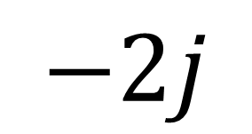
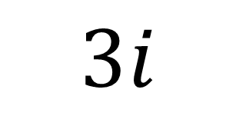
Two dimensional
(i and j components)
$$3i$$
$$−2j$$

Slide 5

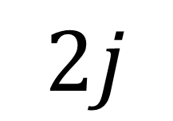
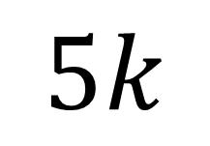
Three dimensional
(i, j and k components)
$$2j$$
$$4i$$
$$5k$$

Slide 6
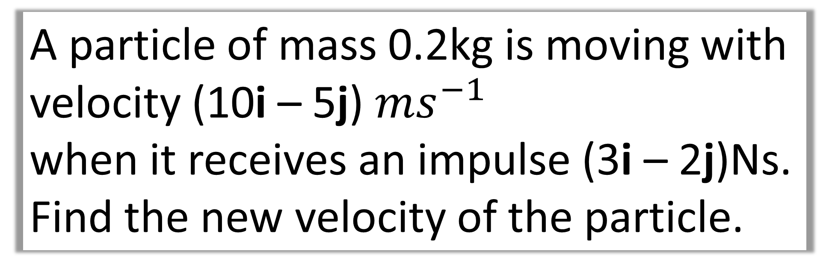
Question A
A particle of mass 0.2kg is moving with velocity (10i – 5j) ${ms}^{−1}$
when it receives an impulse (3i – 2j)Ns.
Find the new velocity of the particle.

Slide 7
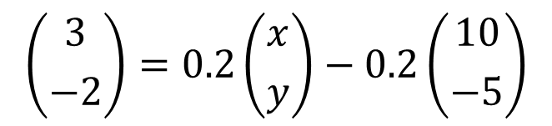
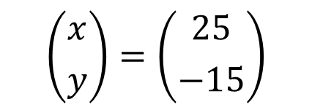
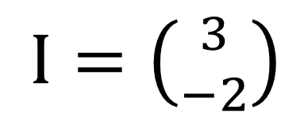
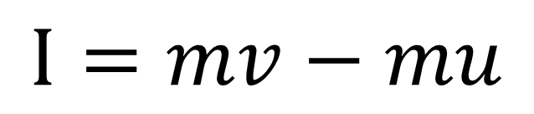
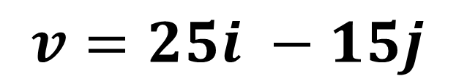
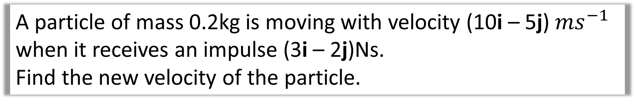
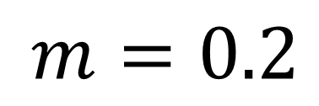
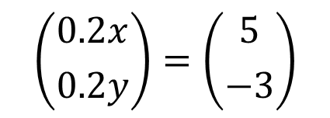
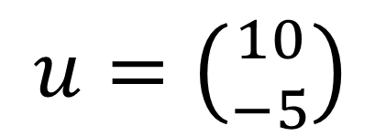
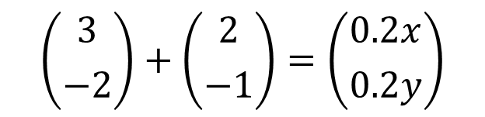
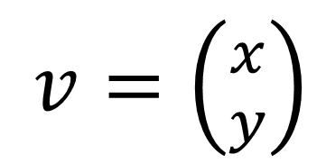
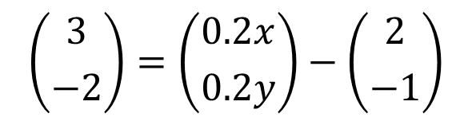
Question A
A particle of mass 0.2kg is moving with velocity (10i – 5j) ${ms}^{−1}$ when it receives an impulse (3i – 2j)Ns.
Find the new velocity of the particle.
$u=\left({10 \atop −5}\right)$
$$I=mv−mu$$
$v=\left({x \atop y}\right)$
$$\left({3 \atop −2}\right)=0.2\left({x \atop y}\right)−0.2\left({10 \atop −5}\right)$$
$$\left({0.2x \atop 0.2y}\right)=\left({5 \atop −3}\right)$$
$$\left({3 \atop −2}\right)=\left({0.2x \atop 0.2y}\right)−\left({2 \atop −1}\right)$$
$$\left({x \atop y}\right)=\left({25 \atop −15}\right)$$
$I=\left({3 \atop −2}\right)$
$m=0.2$
$$\left({3 \atop −2}\right)+\left({2 \atop −1}\right)=\left({0.2x \atop 0.2y}\right)$$
$$v=25i −15j$$

Slide 8
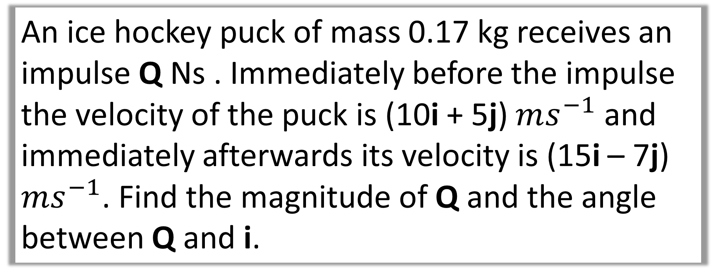
Question B
An ice hockey puck of mass 0.17 kg receives an impulse Q Ns . Immediately before the impulse the velocity of the puck is (10i + 5j) $ms^{−1}$ and immediately afterwards its velocity is (15i – 7j) $ms^{−1}$. Find the magnitude of Q and the angle between Q and i.

Slide 9
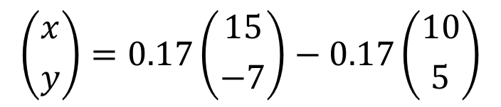
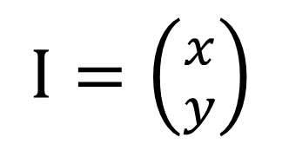
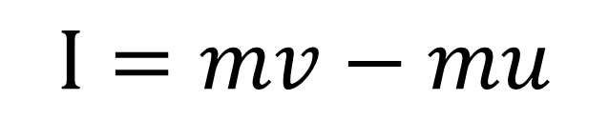
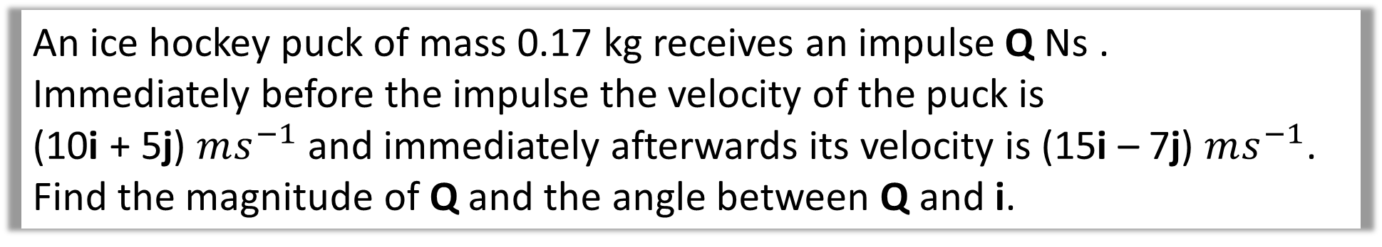
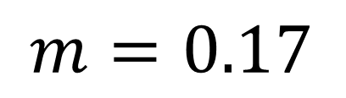
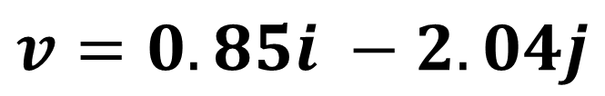
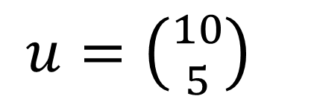
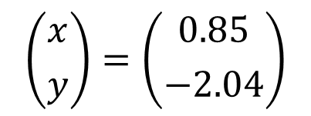
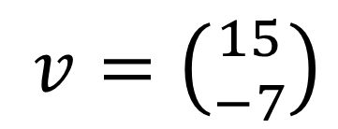
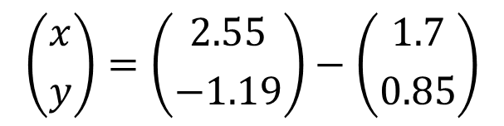
Question B
An ice hockey puck of mass 0.17 kg receives an impulse Q Ns .
Immediately before the impulse the velocity of the puck is
(10i + 5j) $ms^{−1}$ and immediately afterwards its velocity is (15i – 7j) $ms^{−1}$.
Find the magnitude of Q and the angle between Q and i.
$u=\left({10 \atop 5}\right)$
$$I=mv−mu$$
$$\left({x \atop y}\right)=0.17\left({15 \atop −7}\right)−0.17\left({10 \atop 5}\right)$$
$v=\left({15 \atop −7}\right)$
$$\left({x \atop y}\right)=\left({2.55 \atop −1.19}\right)−\left({1.7 \atop 0.85}\right)$$
$I=\left({x \atop y}\right)$
$$\left({x \atop y}\right)=\left({0.85 \atop −2.04}\right)$$
$$v=0.85i −2.04j$$
$m=0.17$

Slide 10
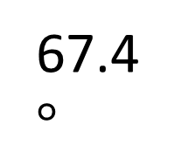
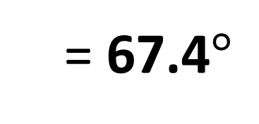

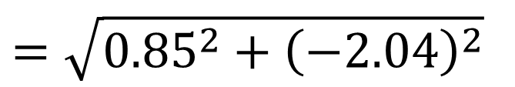
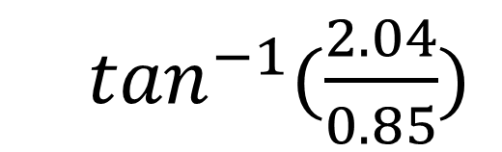
Question B
An ice hockey puck of mass 0.17 kg receives an impulse Q Ns .
Immediately before the impulse the velocity of the puck is
(10i + 5j) $ms^{−1}$ and immediately afterwards its velocity is (15i – 7j) $ms^{−1}$.
Find the magnitude of Q and the angle between Q and i.
Magnitude of Q
Direction of Q
$$=\sqrt{{0.85}^{2}+{\left(−2.04\right)}^{2}}$$
0.85
  $\tan^{−1}{(\frac{2.04}{0.85})}$
67.4$°$
$$=2.21$$
2.04
Q
  = 67.4$°$

Slide 11

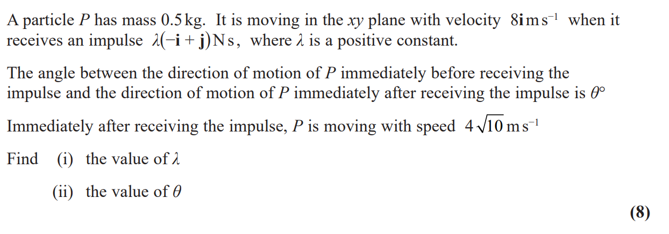
Question C

Slide 12
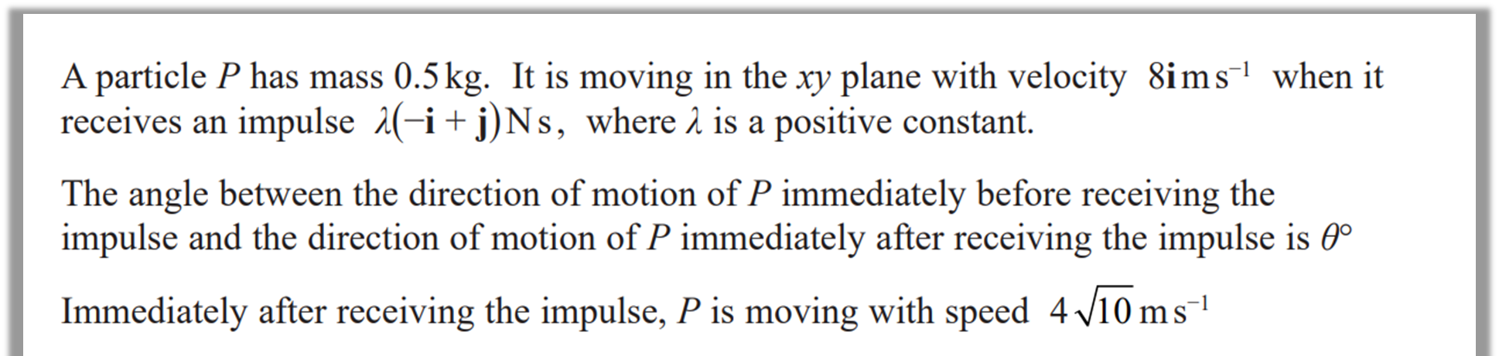
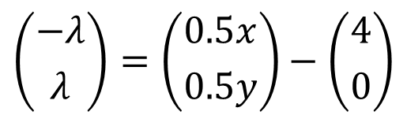
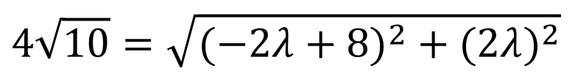

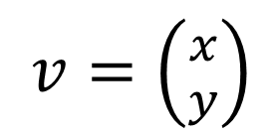
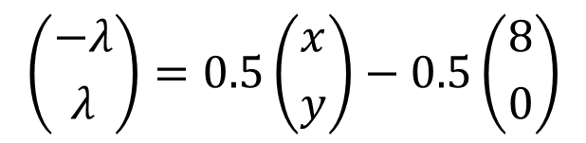
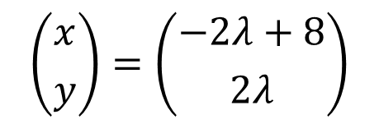

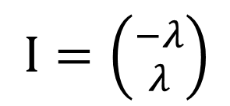

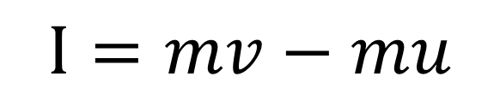
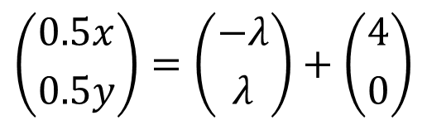

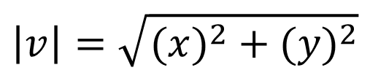
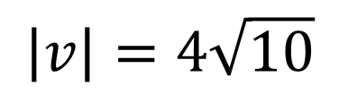
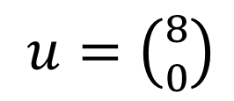

Question C
$$\left|v\right|=4\sqrt{10}$$
a
$$\left|v\right|=\sqrt{({x)}^{2}+{(y)}^{2}}$$
$u=\left({8 \atop 0}\right)$
$$I=mv−mu$$
$$4\sqrt{10}=\sqrt{({−2λ+8)}^{2}+{(2λ)}^{2}}$$
$$\left({−λ \atop λ}\right)=0.5\left({x \atop y}\right)−0.5\left({8 \atop 0}\right)$$
$v=\left({x \atop y}\right)$
$$160={4λ}^{2}−32λ+64+{4λ}^{2}$$
$$\left|v\right|=4\sqrt{10}$$
$$\left({−λ \atop λ}\right)=\left({0.5x \atop 0.5y}\right)−\left({4 \atop 0}\right)$$
$${8λ}^{2}−32λ−96=0$$
$I=\left({−λ \atop λ}\right)$
$$\left({0.5x \atop 0.5y}\right)=\left({−λ \atop λ}\right)+\left({4 \atop 0}\right)$$
$$λ=6$$
$m=0.5$
$$\left({x \atop y}\right)=\left({−2λ+8 \atop 2λ}\right)$$

Slide 13
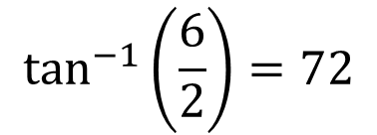
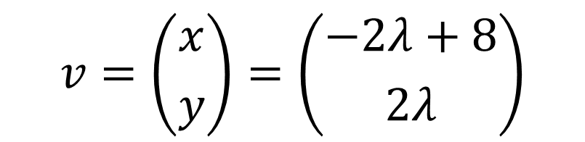



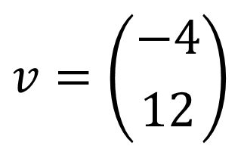

Question C
b
$$v=\left({x \atop y}\right)=\left({−2λ+8 \atop 2λ}\right)$$
Momentum Vectors
$$−2i$$
$$v=\left({−4 \atop 12}\right)$$
$$6j$$
$$4i$$
$$\tan^{−1}\left(\frac{6}{2}\right)=72$$
$$180 −72=108$$

