Slide 1
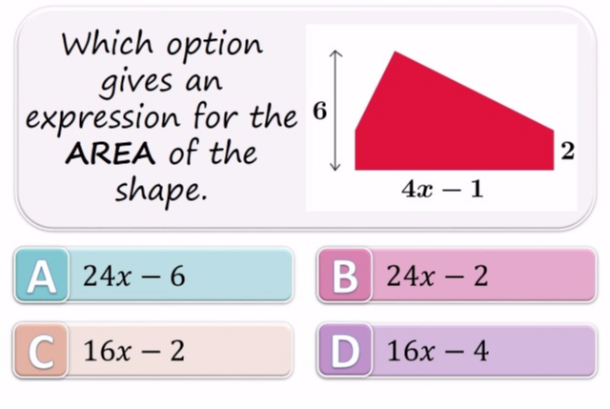
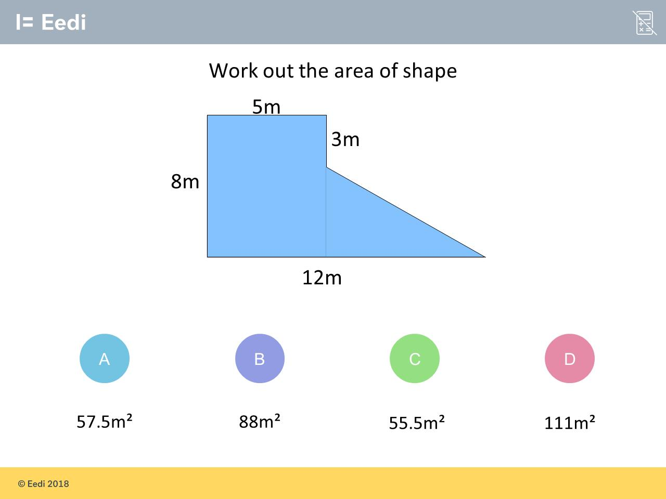
Worst answered question?
Most common wrong answer?

Slide 2
ANSWERS

Slide 3
Worst answered question?

Slide 4
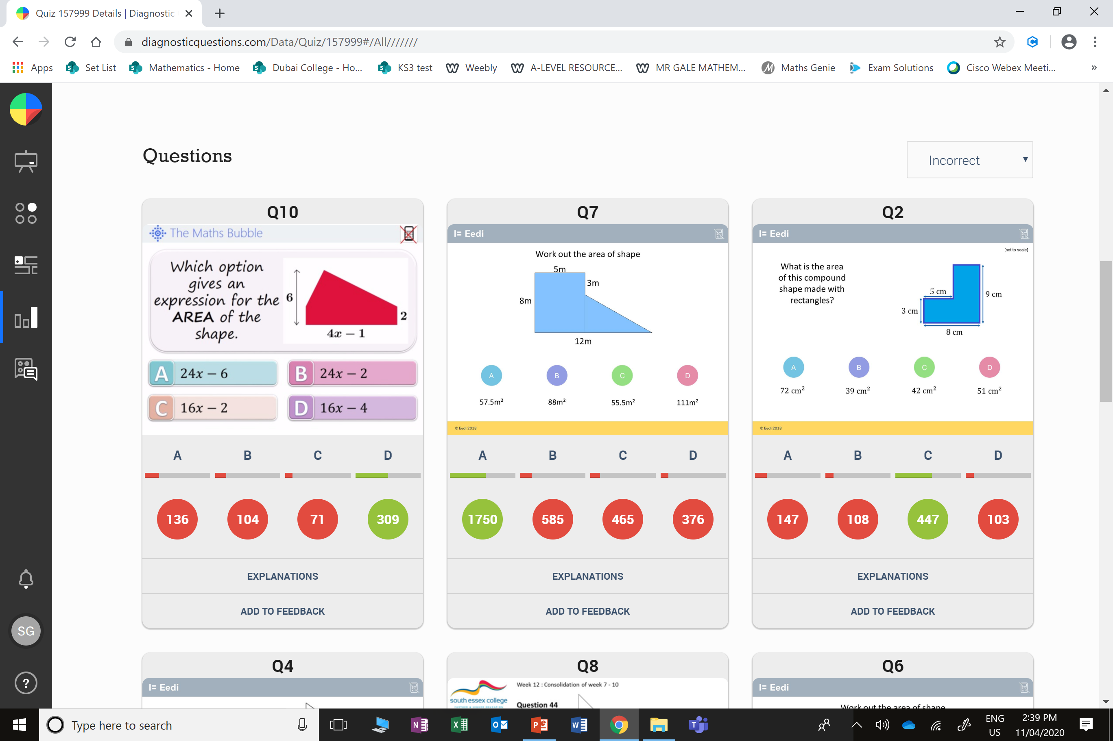
A
They have simply done 6 multiplied
with 4x - 1

Slide 5
B
The student has used the
wrong base
for the triangle.

