Slide 1
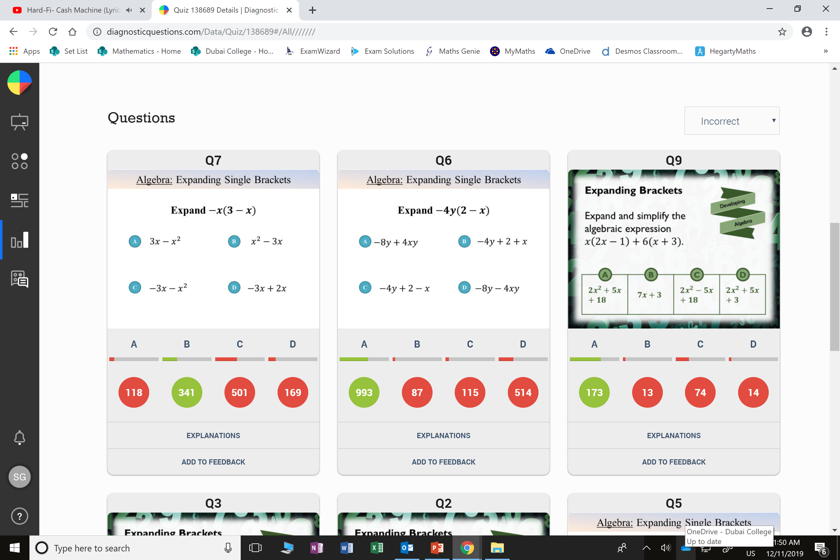
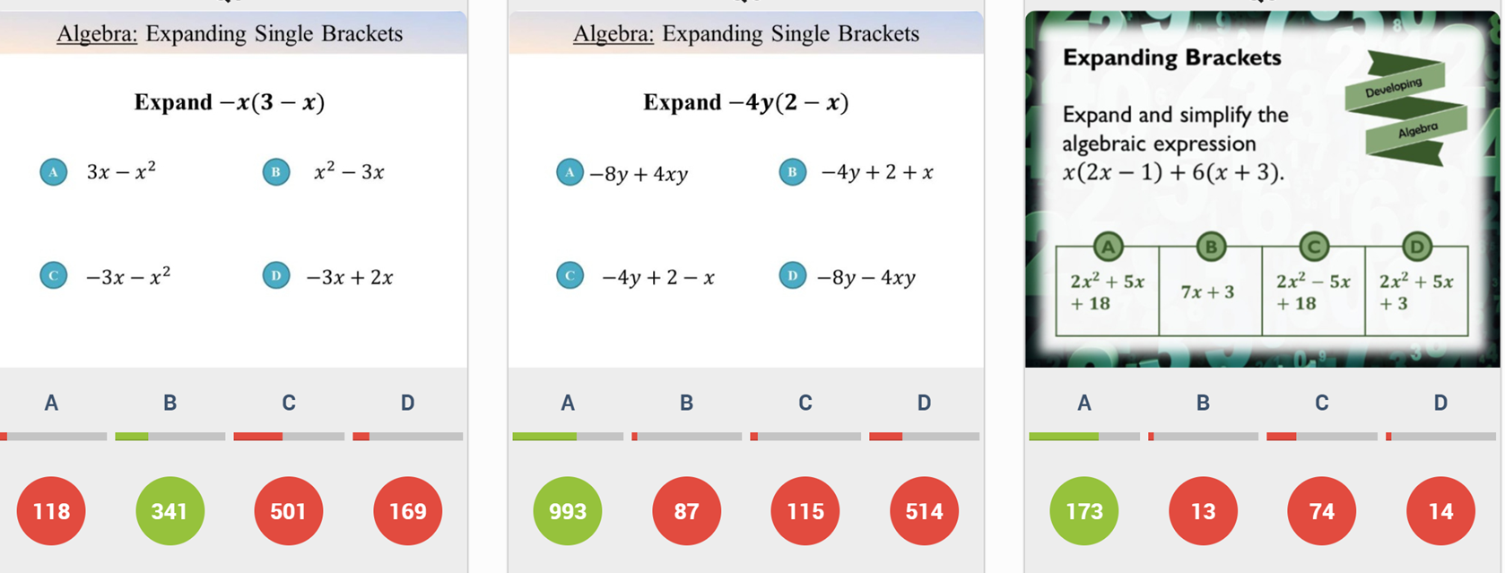
Which question had the lowest percentage of
correct answers?
For each question, what was the most common
wrong answer?

Slide 2
ANSWERS

Slide 3
Which question had the lowest percentage of
correct answers?

Slide 4
C
- x²
should be
+ x²

Slide 5
C
It should be
+ 5x

