Slide 1
LO: Horizontal
and Vertical Lines

Slide 2
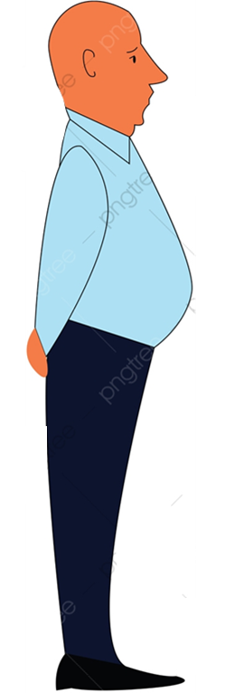


Horizontal
Vertical

Slide 3
To plot a coordinate you need to know
an x and y value.
(3, 5)
x = 3
y = 5

Slide 4
x = 4
Write down four co-ordinates
that lie on the green line.
y
5
4 5
( |  | , |  | )
( |  | , |  | )
( |  | , |  | )
( |  | , |  | )
4
3
4 1
2
1
4 -1
x
4
-5
-4
-3
-2
-1
1
2
3
5
-1
4 -3
-2
-3
What do you notice?
-4
What label could be
given to the green line?
-5

Slide 5
Write down four co-ordinates
that lie on the purple line.
y
5
5 3
y = 3
( |  | , |  | )
( |  | , |  | )
( |  | , |  | )
( |  | , |  | )
4
3
2 3
2
1
-1 3
x
-5
-4
-3
-2
-1
1
2
3
4
5
-1
-4 3
-2
-3
What do you notice?
-4
What label could be
given to the green line?
-5

Slide 6
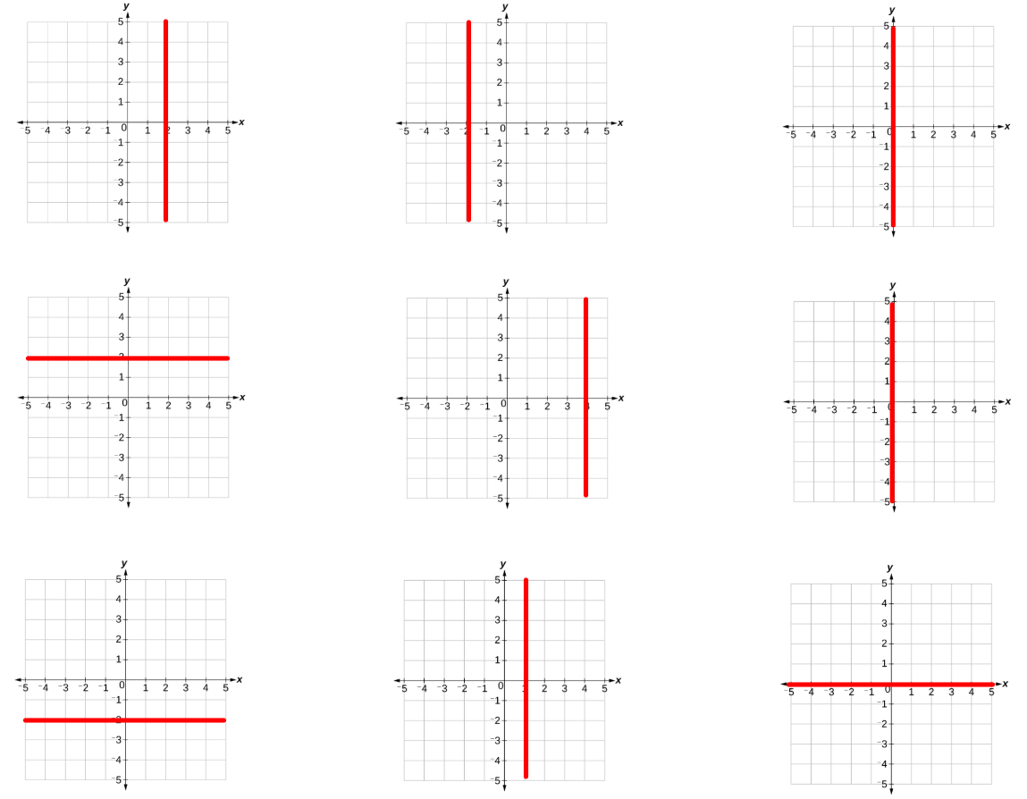

$$y=2$$
True or False

Slide 7

$$y=2$$
True or False

Slide 8
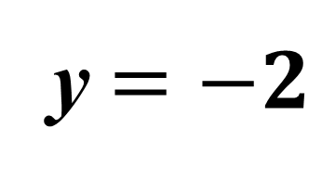
True or False
y $=−2$

Slide 9

$$x=2$$
True or False

Slide 10
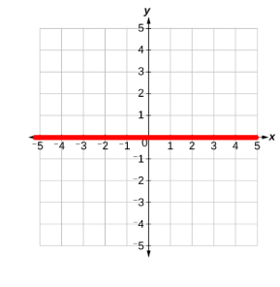

$$x=0$$
True or False

Slide 11
Write an equation for each line.
y
5
x | = | -4
4
3
2
1
x
-5
-4
-3
-2
-1
1
2
3
4
5
-1
-2
-3
-4
-5

Slide 12
Write an equation for each line.
y
5
y | = | 5
4
3
2
1
x
-5
-4
-3
-2
-1
1
2
3
4
5
-1
-2
-3
-4
-5

Slide 13
Write an equation for each line.
y
5
x | = | 3
4
3
2
1
x
-5
-4
-3
-2
-1
1
2
3
4
5
-1
-2
-3
-4
-5

Slide 14
Write an equation for each line.
y
5
y | = | 0
4
3
2
1
x
-5
-4
-3
-2
-1
1
2
3
4
5
-1
-2
-3
-4
-5

Slide 15
Write an equation for each line.
y
5
x | = | 0
4
3
2
1
x
-5
-4
-3
-2
-1
1
2
3
4
5
-1
-2
-3
-4
-5

