Slide 1



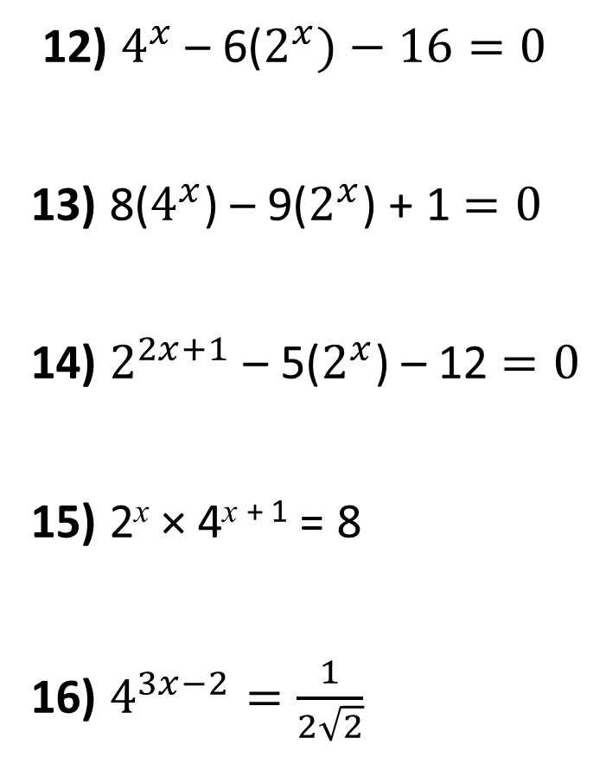

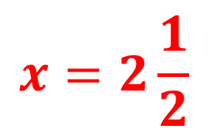

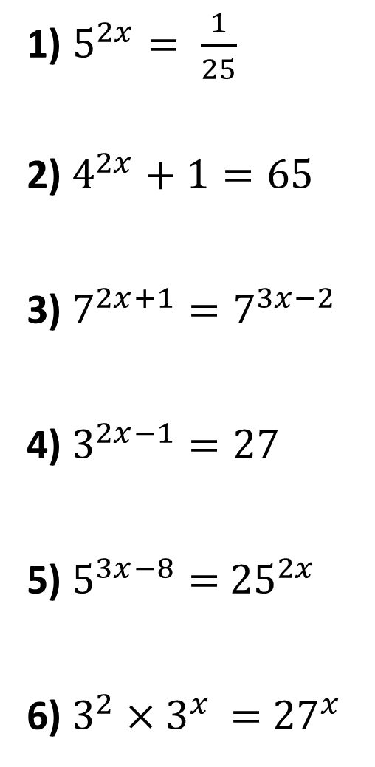

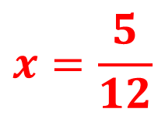
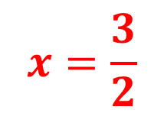
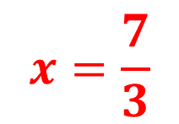

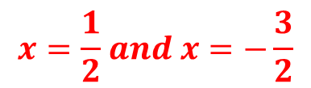

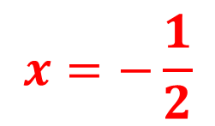
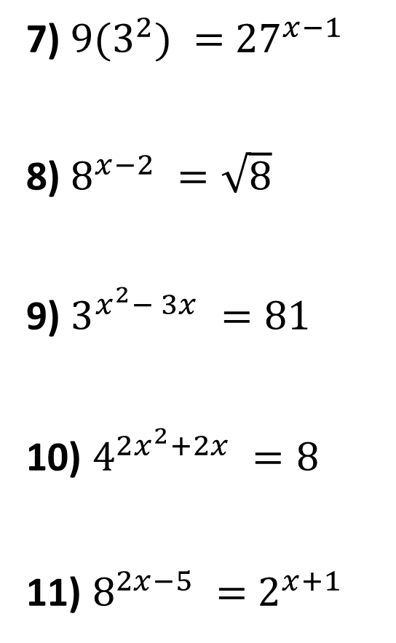

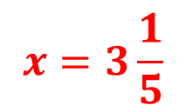
1) $5^{2x}= \frac{1}{25}$
2) $4^{2x}+1=65$
3) $7^{2x+1}=7^{3x−2}$
4) $3^{2x−1}=27$
5) $5^{3x−8}=$ ${25}^{2x}$
6) $3^{2}×3^{x }=$ ${27}^{x}$
7) ${9(3}^{2}) =$ ${27}^{x−1}$
8) $8^{x−2} =\sqrt{8}$
9) $3^{x^{2}− 3x} =81$
10) $4^{2x^{2}+2x} =8$
11) $8^{2x−5} =$ $2^{x+1}$
$$x=−1$$
12) $4^{x}$ – 6($2^{x})−16=0$
13) 8($4^{x}$) – 9($2^{x}$) + 1 $=0$
14) $2^{2x+1}$ – 5($2^{x}$) – 12 $=0$
15) 2^{x} × 4^{x + 1} = 8
16) $4^{3x−2}=\frac{1}{2\sqrt{2}}$
$$x=\frac{7}{3}$$
$$x=3$$
$$x=\frac{3}{2}$$
$$x=2\frac{1}{2}$$
$$x=0 and x=−3$$
$$x=3$$
$$x=4 and x=−1$$
$$x=2$$
$$x=2$$
$$x=\frac{1}{2} and x=−\frac{3}{2}$$
$$x=−\frac{1}{2}$$
$$x=−8$$
$$x=3\frac{1}{5}$$
$$x=\frac{5}{12}$$
$$x=1$$

Slide 2
SOLUTIONS

Slide 3
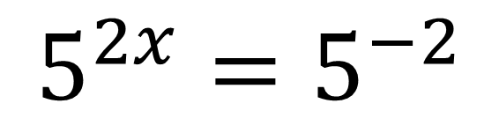
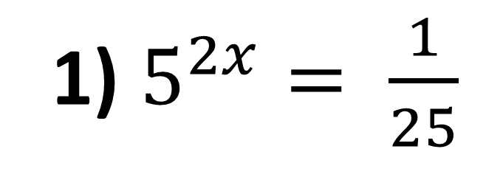
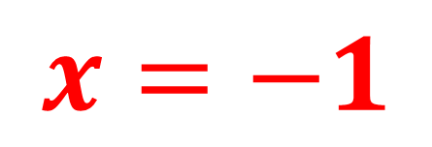
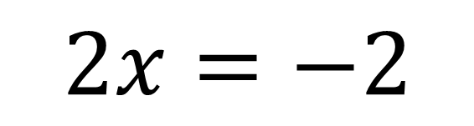
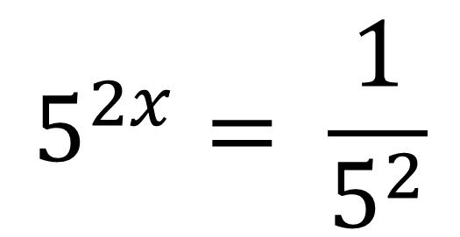
1) $5^{2x}= \frac{1}{25}$
$$2x=−2$$
$$5^{2x}= \frac{1}{5^{2}}$$
$$x=−1$$
$$5^{2x}=5^{−2}$$

Slide 4
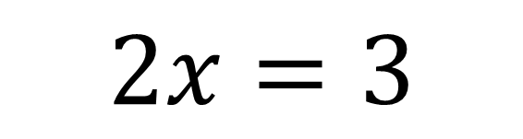
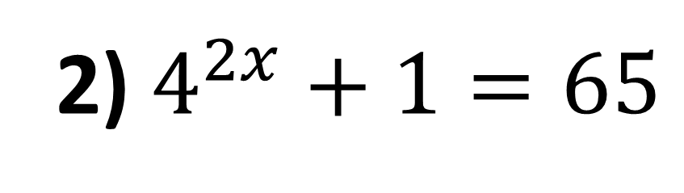
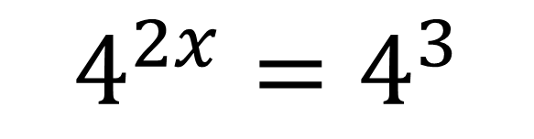
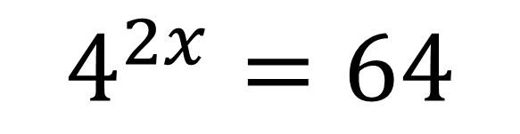
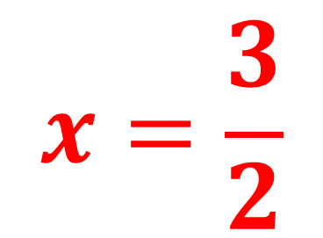
2) $4^{2x}+1=65$
$$2x=3$$
$$4^{2x}=64$$
$$x=\frac{3}{2}$$
$$4^{2x}=4^{3}$$

Slide 5
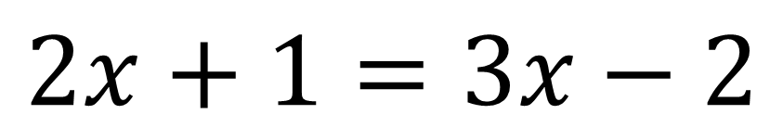
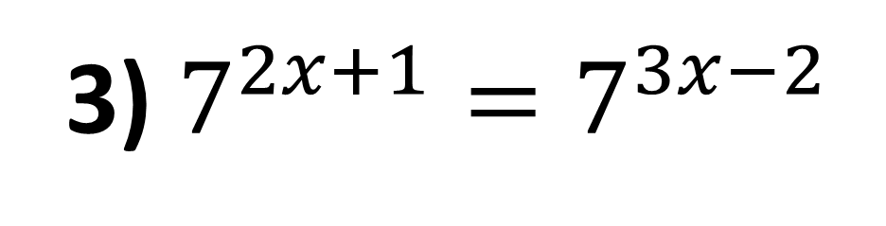
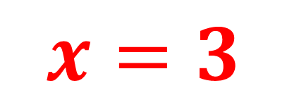
3) $7^{2x+1}=7^{3x−2}$
$$2x+1=3x−2$$
$$x=3$$

Slide 6

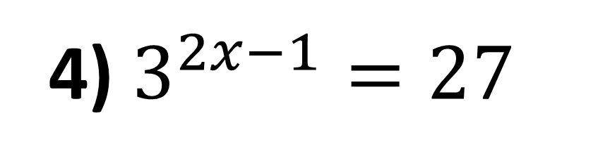
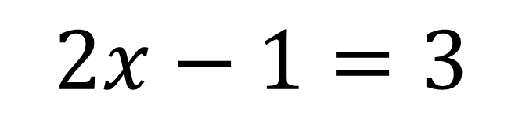
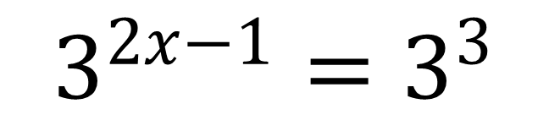
4) $3^{2x−1}=27$
$$x=2$$
$$3^{2x−1}=3^{3}$$
$$2x−1=3$$

Slide 7
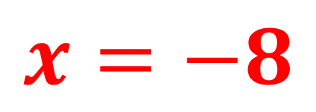
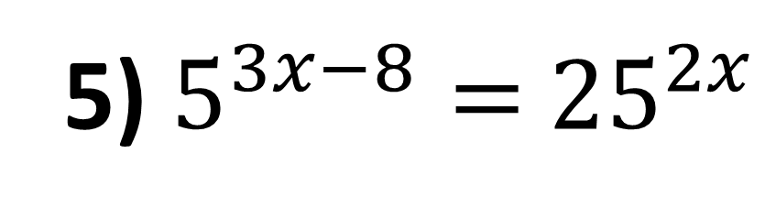
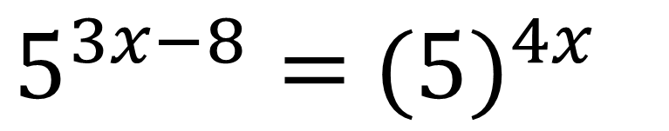
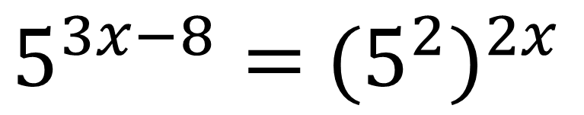
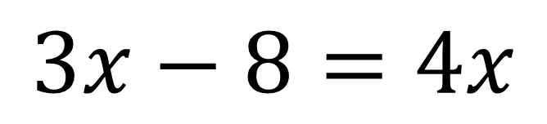
5) $5^{3x−8}=$ ${25}^{2x}$
$$3x−8=4x$$
$5^{3x−8}=$ ${{(5}^{2})}^{2x}$
$$x=−8$$
$5^{3x−8}=$ ${(5)}^{4x}$

Slide 8
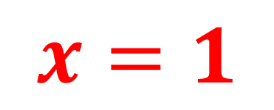
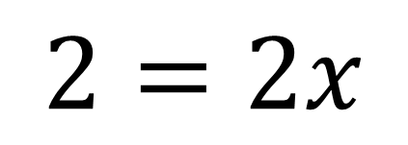
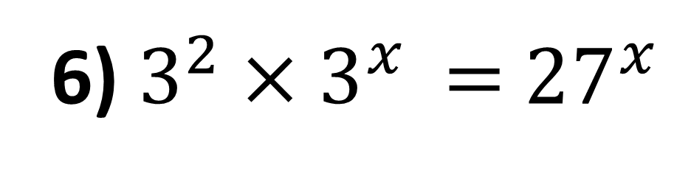
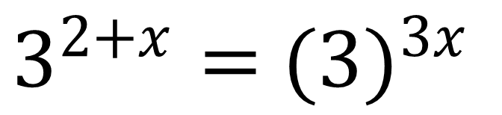
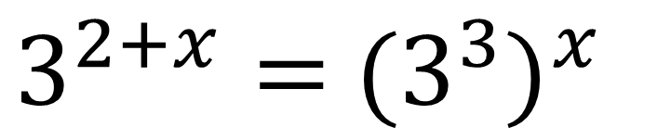
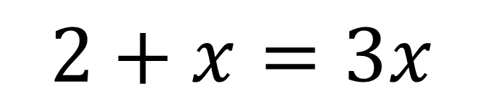
6) $3^{2}×3^{x }=$ ${27}^{x}$
$$2+x=3x$$
$$2=2x$$
$3^{2+x}=$ ${{(3}^{3})}^{x}$
$$x=1$$
$3^{2+x}=$ ${(3)}^{3x}$

Slide 9
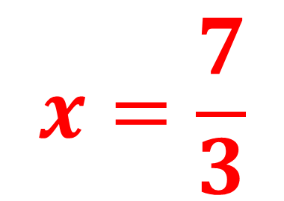
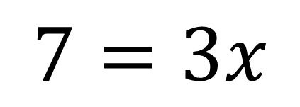
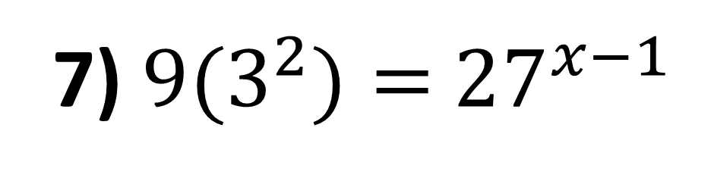
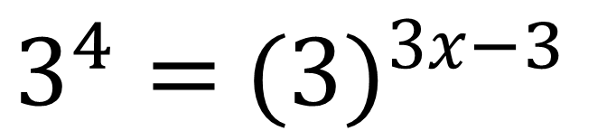
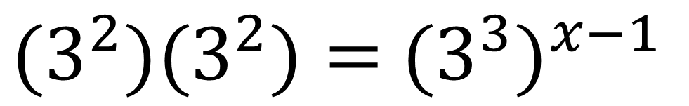
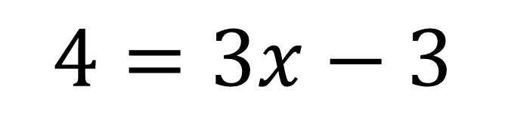
7) ${9(3}^{2})=$ ${27}^{x−1}$
$$4=3x−3$$
${{(3}^{2})(3}^{2})=$ ${{(3}^{3})}^{x−1}$
$$7=3x$$
$3^{4}=$ ${(3)}^{3x−3}$
$$x=\frac{7}{3}$$

Slide 10
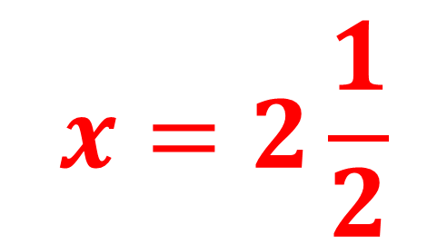
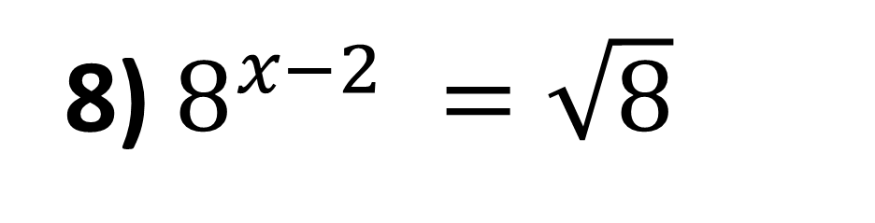
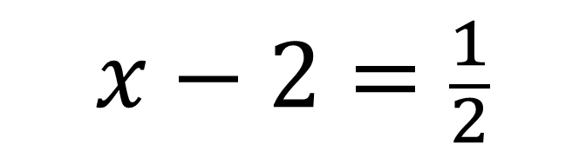
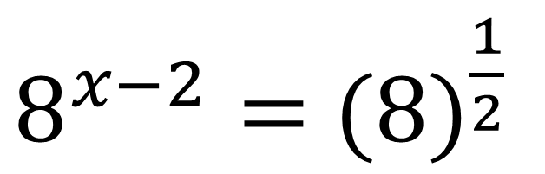
8) $8^{x−2} =\sqrt{8}$
$$x=2\frac{1}{2}$$
$8^{x−2}=$ ${(8)}^{\frac{1}{2}}$
$$x−2=\frac{1}{2}$$

Slide 11
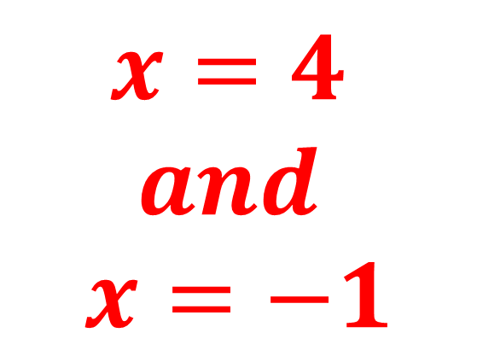
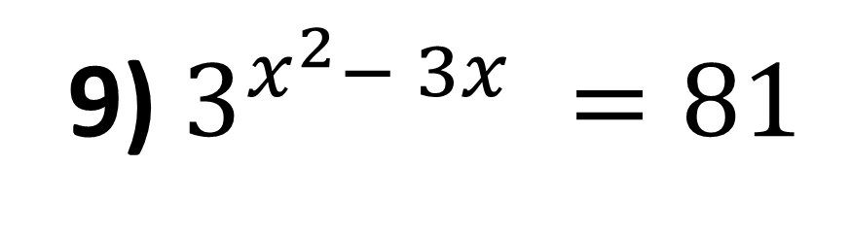
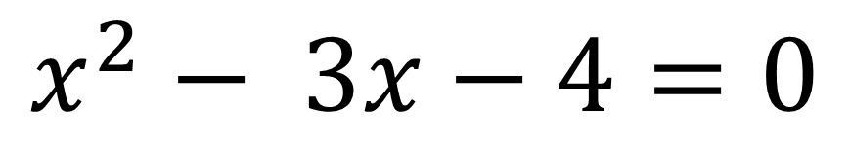


9) $3^{x^{2}− 3x} =81$
$$x^{2}− 3x−4=0$$
$$x=4$$
$$and$$
$$x=−1$$
$3^{x^{2}− 3x}=$ $3^{4}$
$$x^{2}− 3x=4$$

Slide 12






10) $4^{2x^{2}+2x} =8$
$${4x}^{2}+4x−3=0$$
$$x=\frac{1}{2}$$
$$and$$
$$x=−\frac{3}{2}$$
$${(2^{2})}^{2x^{2}+2x} =2^{3}$$
$${(2)}^{4x^{2}+4x} =2^{3}$$
$${4x}^{2}+4x=3$$

Slide 13






11) $8^{2x−5} =$ $2^{x+1}$
$$5x=16$$
$${(2^{3})}^{2x−5} =2^{x+1}$$
$$x=3\frac{1}{5}$$
$${(2)}^{6x−15} =2^{x+1}$$
$$6x−15=x+1$$

Slide 14









$$y=8$$
12) $4^{x}$ – 6($2^{x})−16=0$
$$2^{x}=8$$
$${(2^{2})}^{x}\text{ – 6(}2^{x})−16=0$$
$$x=3$$
$${(2^{x})}^{2}\text{ – 6(}2^{x})−16=0$$
$$y=−2$$
$$2^{x}=−2$$
$${(y)}^{2}\text{ – 6(}y)−16=0$$
No Solutions

Slide 15









$$y=8$$
13) 8($4^{x}$) – 9($2^{x}$) + 1 $=0$
$$2^{x}=1$$
$${8(2^{2})}^{x}\text{ – }\text{9}\text{(}2^{x})+1=0$$
$$x=0$$
$$y=\frac{1}{8}$$
$${8(2^{x})}^{2}\text{ – }\text{9}\text{(}2^{x})+1=0$$
$$2^{x}=\frac{1}{8}$$
$${8(y)}^{2}\text{ – }\text{9}\text{(}y)+1=0$$
$$x=−3$$

Slide 16









$$y=8$$
14) $2^{2x+1}$ – 5($2^{x}$) – 12 $=0$
$$2^{x}=4$$
$$x=2$$
$${(2^{1})(2}^{2x})\text{– }\text{5}\text{(}2^{x})−12=0$$
$$y=−\frac{3}{2}$$
$${2(2^{x})}^{2}\text{ – }\text{5}\text{(}2^{x})−12=0$$
$$2^{x}=−\frac{3}{2}$$
$${2(y)}^{2}\text{ – }\text{5}\text{(}y)−12=0$$
No Solutions

Slide 17






15) 2^{x} × 4^{x + 1} = 8
$$3x+2=x+1$$
$$2x=−1$$
$${{(2^{x})(2}^{2})}^{x+1}=2^{x+1}$$
$$x=−\frac{1}{2}$$
$${(2^{x})(2}^{2x+2})=2^{x+1}$$
$$2^{3x+2}=2^{x+1}$$

Slide 18







16) $4^{3x−2}=\frac{1}{2\sqrt{2}}$
$${(2)}^{6x−4}=2^{−1.5}$$
$$6x−4=−1.5$$
$${{(2}^{2})}^{3x−2}=\frac{1}{{2^{1}2}^{0.5}}$$
$$6x=2.5$$
$${{(2}^{2})}^{3x−2}=\frac{1}{2^{1.5}}$$
$$x=\frac{5}{12}$$

