Slide 1
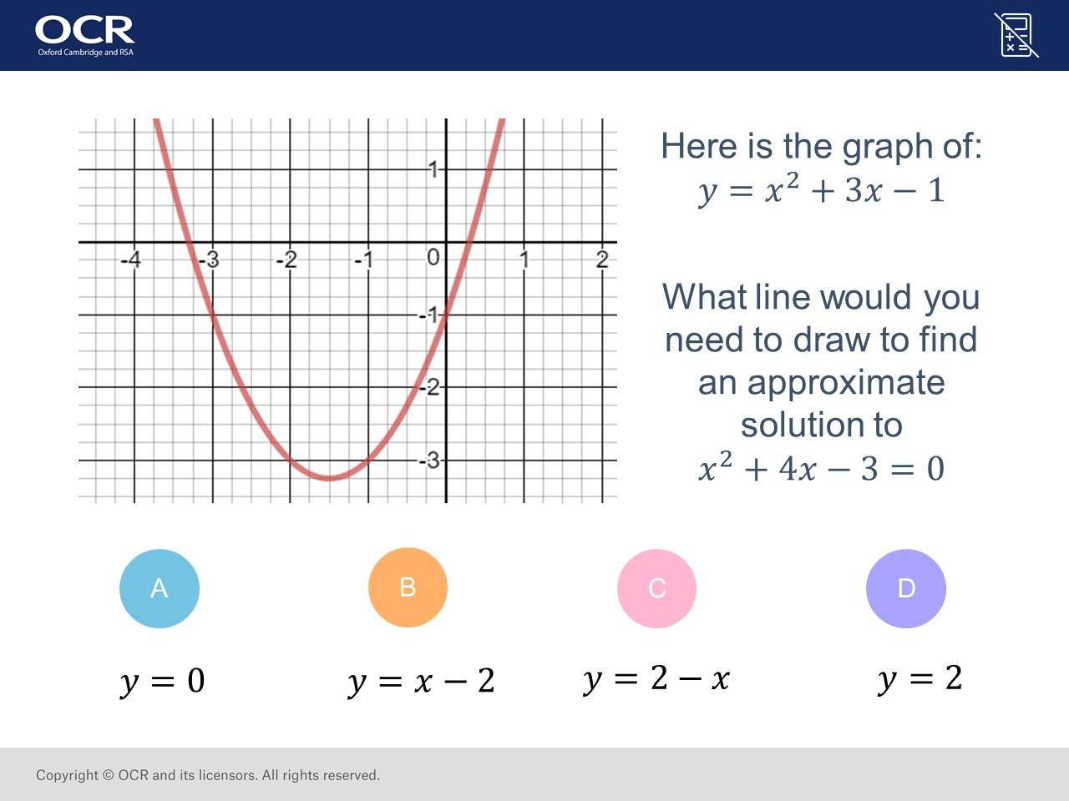
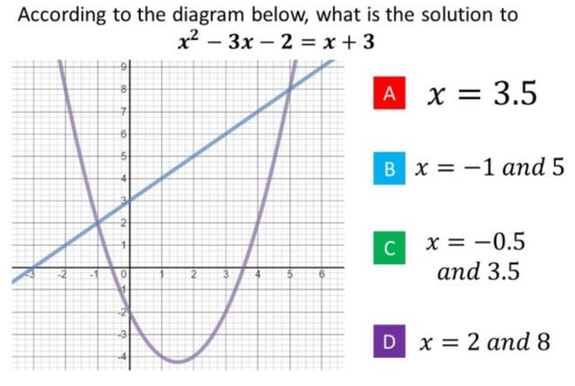
Worst answered question?
Most common wrong answer?

Slide 2
ANSWERS

Slide 3
Worst answered question?

Slide 4
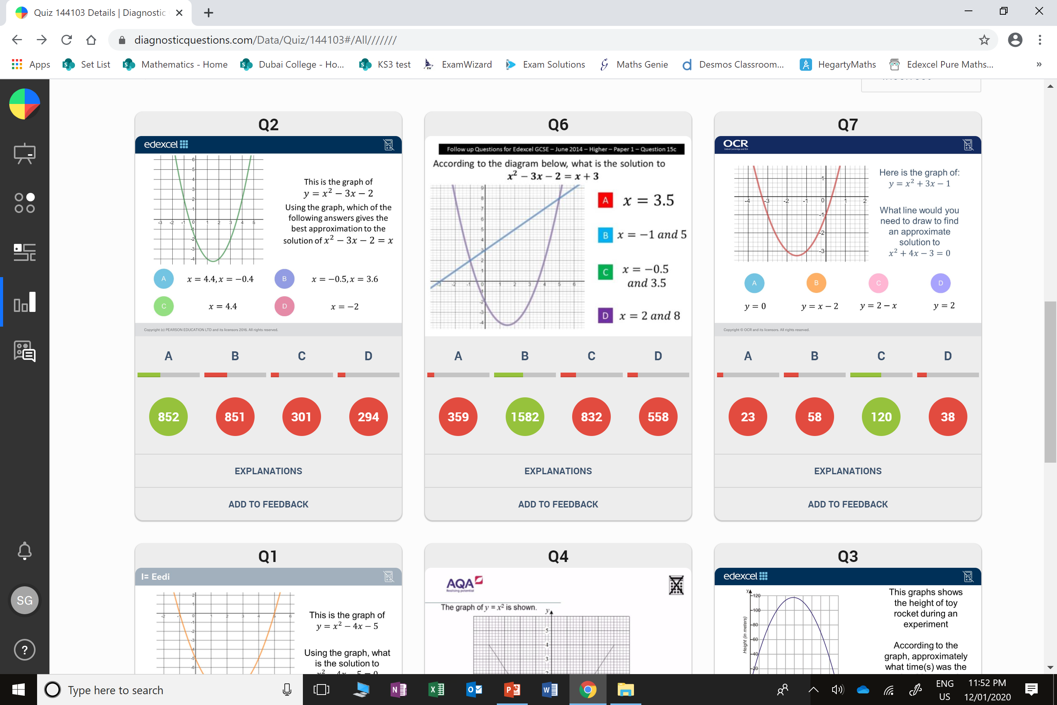
C
They solved
x² – 3x – 2 = 0

Slide 5
B
They changed
y = x² + 3x – 1
Instead of
x² + 4x – 3 = 0

