Slide 1
Who is Pythagoras?

Slide 2
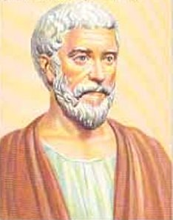
Pythagoras is one of the worlds
most famous mathematician.
Pythagoras lived from about 560 to 500 B.C.
Let’s learn 8 interesting facts about Pythagoras.

Slide 3
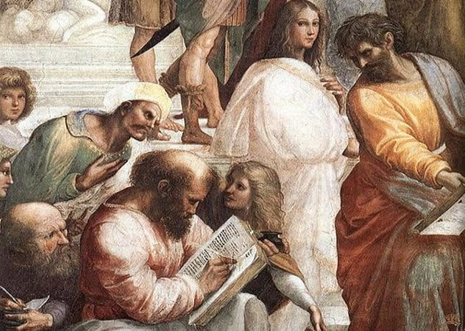
1
Pythagoras Led A Cult That Worshiped Numbers
Pythagoras believed numbers were the elements behind the entire universe. He taught his followers that the world was controlled by mathematical harmonies

Slide 4
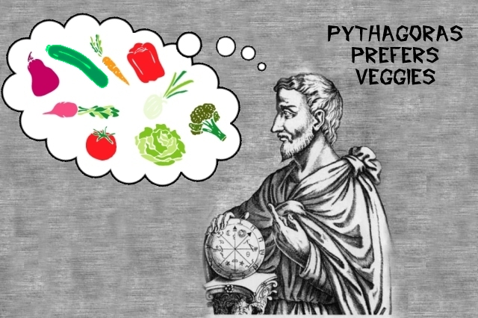
2
Pythagoras Was One Of The Earliest Vegetarians
Pythagoras was one of the first people in Western history to abstain from eating meat for moral reasons.

Slide 5
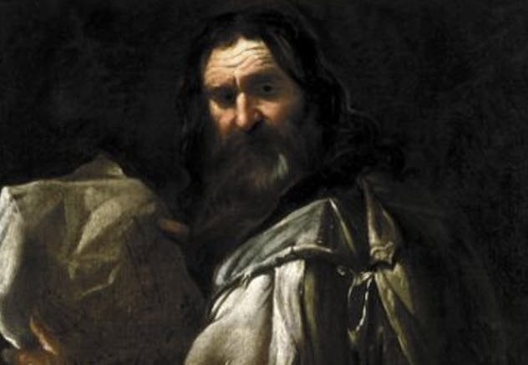
3
New Initiates Had To Spend Five Years In Silence
Pythagoras believed silence was very important. Staying quiet was a way to learn self-control, and so he made sure that anyone who wanted to join his cult could do it. Anyone who signed up had to close his mouth and keep it shut for five years straight.

Slide 6

4
Young Pythagoras traveled the world
Pythagoras was born on the island of Samos,
but travelled to Egypt, Babylon, India, Croton and Syria to further his studies.

Slide 7
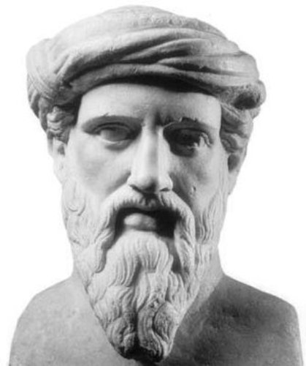
5
Pythagoras Was More Than a Mathematician
Pythagoras gave a lot of contributions to religious mysticism, science, mathematics and modern philosophy

Slide 8

6
Pythagoras Did Not Believe the Word Was Flat
He believed that the earth was spherical and that the sun, moon, and planets moved independently.

Slide 9
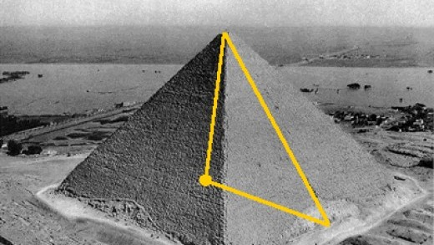
7
Pythagoras Studied The Egyptian Pyramids
In Egypt, Pythagoras studied the pyramids to learn more about Geometry. It was his studies in Egypt that helped him to develop his theorem.

Slide 10
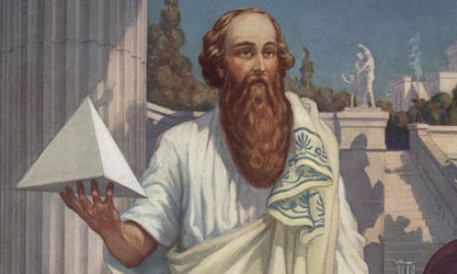
8
Pythagoras May Have Stolen His Theorem
Some people believe that Pythagoras stole the theorem from the Egyptians.

