Slide 1
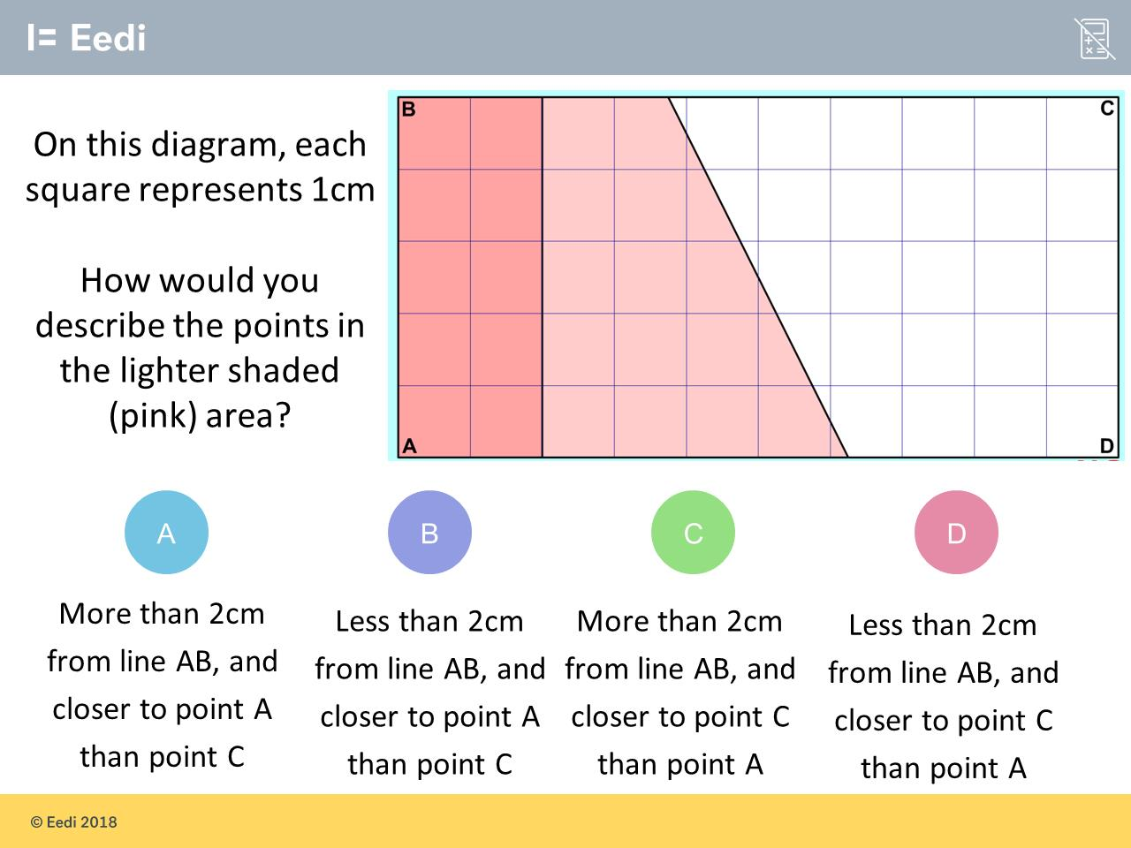
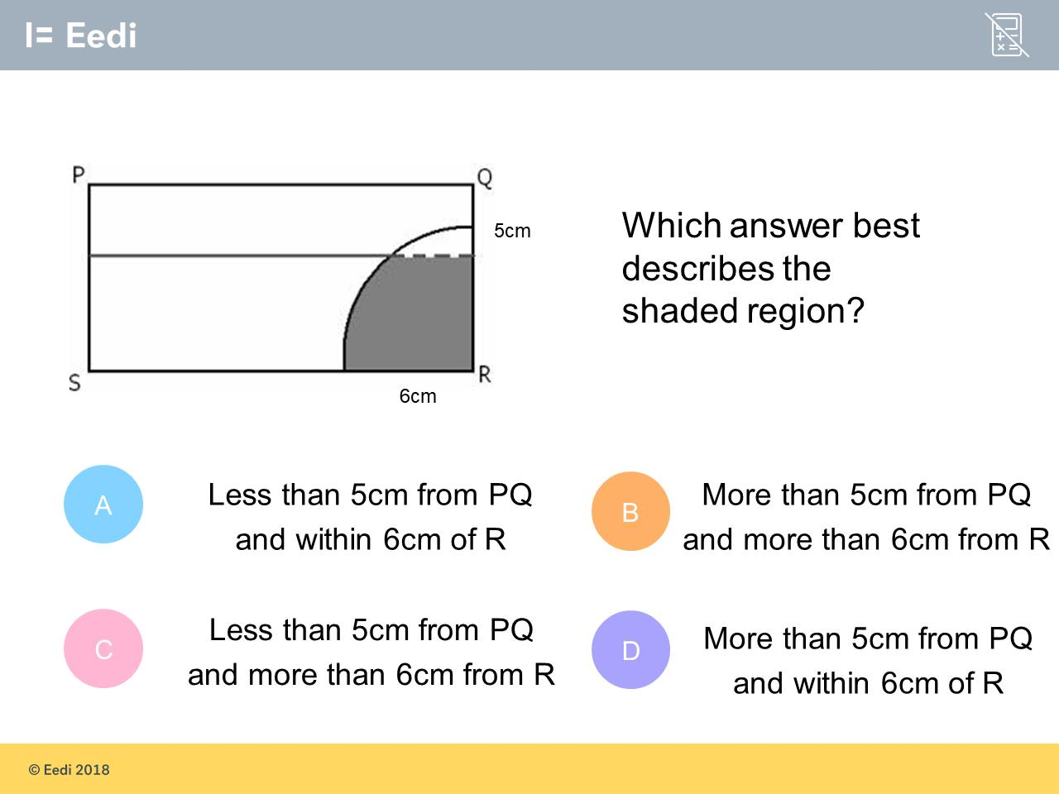
Worst answered question?
Most common wrong answer?

Slide 2
ANSWERS

Slide 3
Worst answered question?

Slide 4
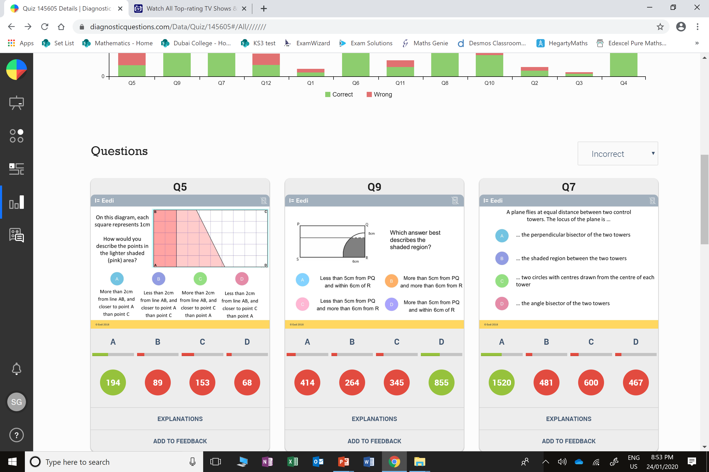
C
They got the wrong side of the line.

Slide 5
A
They got the wrong side of the line.

