Slide 1
LO: Dividing
Decimals

Slide 2
There are a few different methods that you can use to divide decimals.
0.72 ÷ 3
0.72 ÷ 0.03
0.72 ÷ 0.3

Slide 3
Method 1: Short Division
0.72 ÷ 3
0
2
4
 | 0
3 | 0 | 7 | 2
¹

Slide 4
Is 0.75 the same value as 0.7500000?
Yes

Slide 5
Method 1: Short Division
0.75 ÷ 4
0
1
8
7
5
 | 0
4 | 0 | 7 | 5 | 0 | 0
³
³
²

Slide 6
Method 2: Equivalent
32 ÷ 0.4
80
320 ÷ 4 =

Slide 7
Method 2: Equivalent
51 ÷ 0.3
170
510 ÷ 3 =

Slide 8
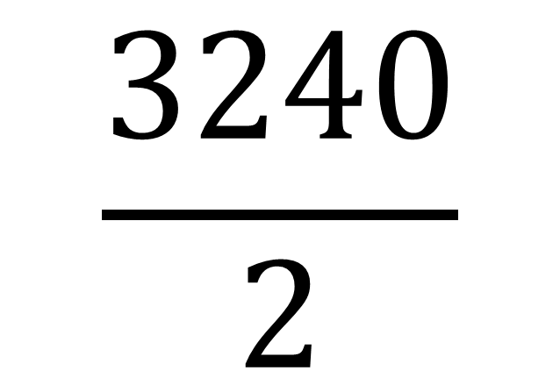
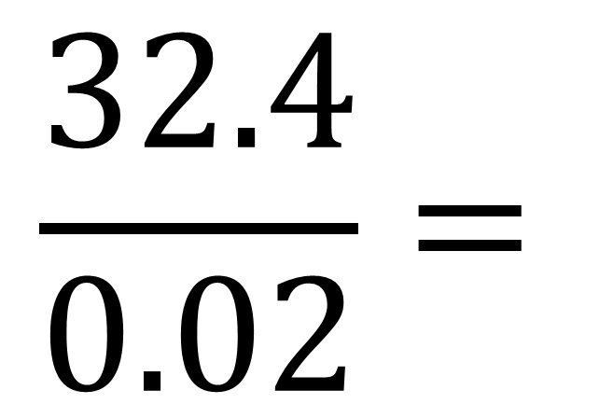
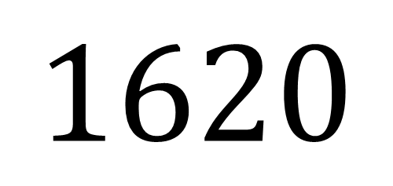

Method 2: Equivalent
$$\frac{32.4}{0.02}=$$
$$\frac{3240}{2}$$
$$=$$
$$1620$$

