Slide 1
LO: Box Plots

Slide 2
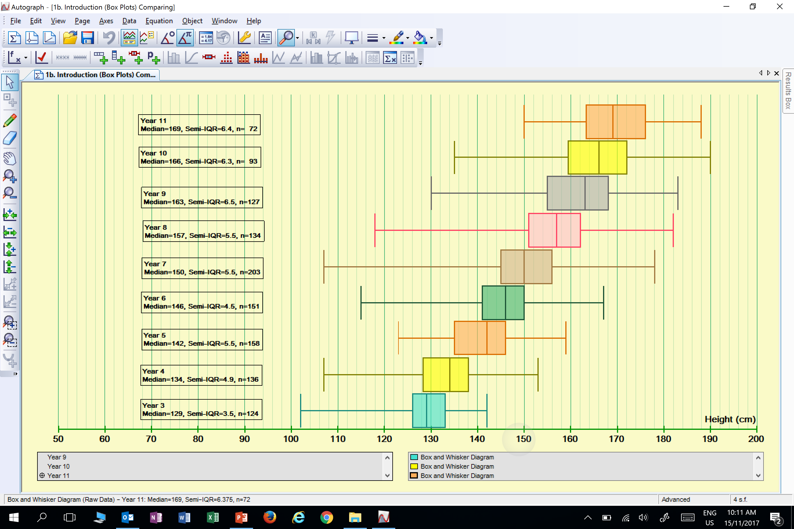
Box plots are good for showing how
wide the data is spread.
Year 6
Year 5
Year 4
Year 3
Height
(cm)

Slide 4
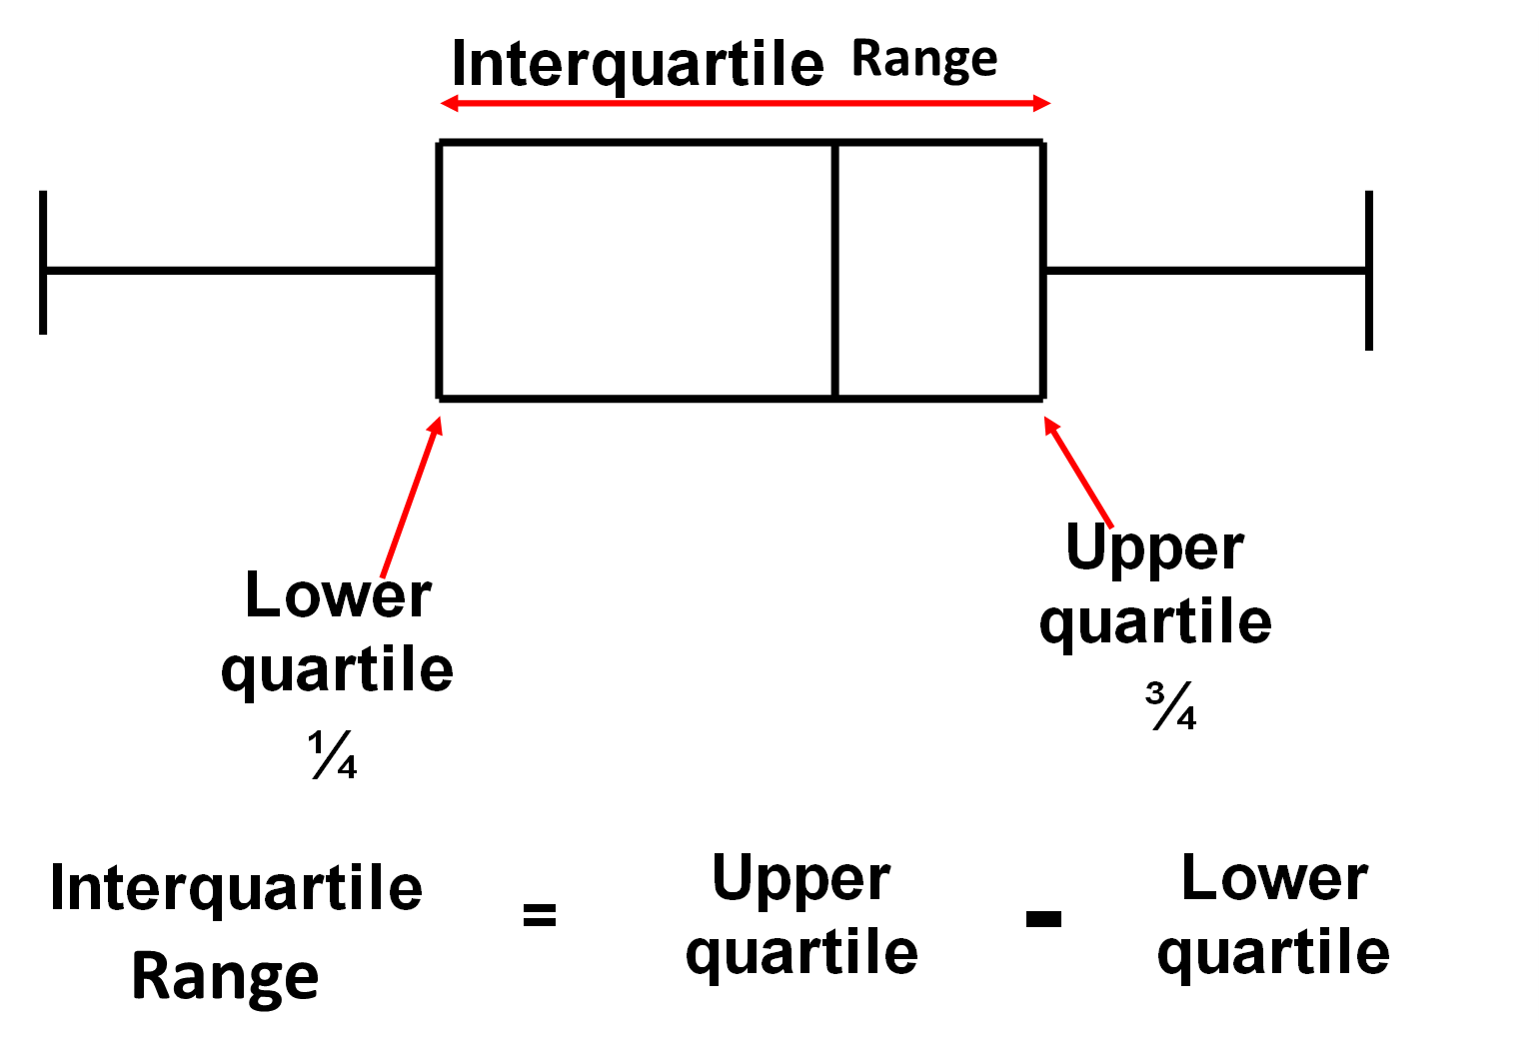

Slide 5
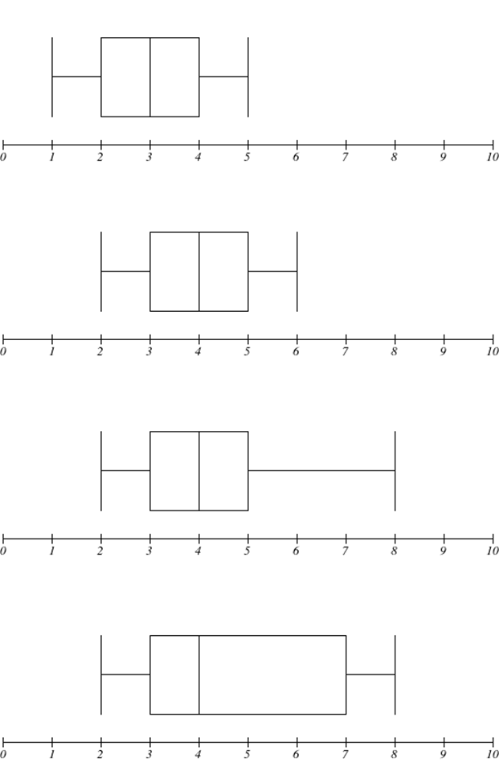
Complete the table.
Median | Range | Interquartile range
3
4
2

Slide 6
Complete the table.
Median | Range | Interquartile range
4
4
2

Slide 7
Complete the table.
Median | Range | Interquartile range
4
6
2

Slide 8
Complete the table.
Median | Range | Interquartile range
4
6
4

Slide 9
Can you identify the required information for the list?
11 | 12 | 31 | 33 | 34 | 38 | 40 | 50 | 59 | 63 | 68 | 69
?
?
?
Smallest Value = | 11
Biggest Value = |  |  |  | 69
Median = | 39
?
?
Lower Quartile = | 32
Upper Quartile = | 61
?
Interquartile Range = | 29

Slide 10

John kept a record of the number of calculators he sells over nine days.
Sun | Mon | Tue | Wed | Thu | Fri | Sat | Sun | Mon
26 | 3 | 7 | 12 | 15 | 13 | 30 | 24 | 5
Rearrange the data into order of size.
3 | 5 | 7 | 12 | 13 | 15 | 24 | 26 | 30
Smallest Number = 3
Lower Quartile = 6
Median = 13
Upper Quartile = 25
Largest Number = 30
0
5
10
15
20
25
30
35
Calculators Sold

Slide 11









Why calculate the interquartile range?
Range
= 2.2 – 0.4
= 1.8m
1.8m
0.4m
0.6m
0.8m
1.1m
1.4m
1.6m
1.8m
2.0m
2.2m
1.2m
Interquartile Range
= 1.9 – 0.7
= 1.2m
0.4m
0.6m
0.8m
1.1m
1.4m
1.6m
1.8m
2.0m
2.2m

Slide 12


0.4m
0.6m
0.8m
1.1m
1.4m
1.6m
1.8m
2.0m
2.2m
Smallest
= 0.4
LQ
= 0.7
Median
= 1.4
UQ
= 1.9
Largest
= 2.2
0
0.5
1
1.5
2
2.5
Height

Slide 13
When you have two box plots or more on the same scale
you can now make comparisons.
Below is the box plots of Year 11 boys and girls heights.
What comparisons can you make?

Slide 14
The box plots show the response times of two ambulance services.
What service would you call if you needed an ambulance?

Slide 15

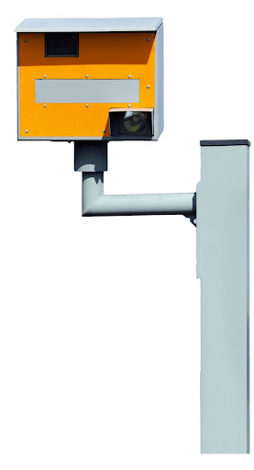
The police are trying to decide which 30mph limit roads they are going to put a speed camera on.
They have collected data on the possible roads and have the money for 2 speed cameras.
Can you look at the data and decide which roads to put a camera on, explaining your reasons thoroughly?
Road A
Road B
Road C
Road D
Road E
mph
0
5
10
15
20
25
30
35
40
45
50

