Slide 1
Vectors
Describing Vectors
Chapter 12
(Part 1 of 6)

Slide 2


Writing Vectors
2D Vectors uses $i and j compents.$
j
i
$$8i−2j$$

Slide 3
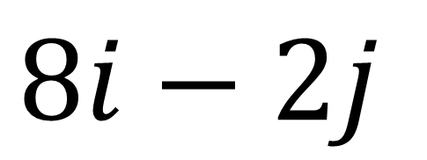
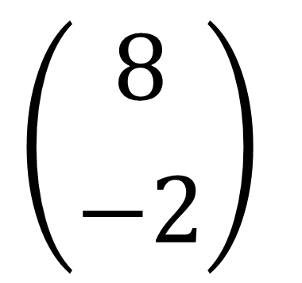
Writing Vectors as a Column Vector
j
$$\left({8 \atop −2}\right)$$
i
$$8i−2j$$

Slide 4
The Origin will be labelled with a O
j
i
O

Slide 5

Giving Vectors a Label
j
There are
3 ways
you can
label a vector.
A
2
$$a$$
i
O
3

Slide 6
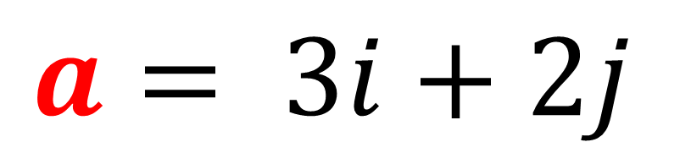
Giving Vectors a Label
j
A
2
$$a$$
$$a= 3i+2j$$
i
O
3

Slide 7
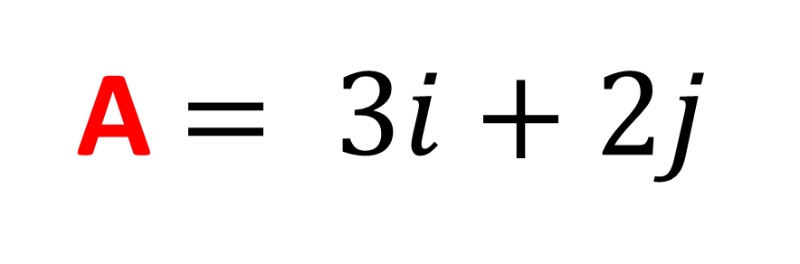
Giving Vectors a Label
j
A
2
$$a$$
A $= 3i+2j$
i
O
3

Slide 8
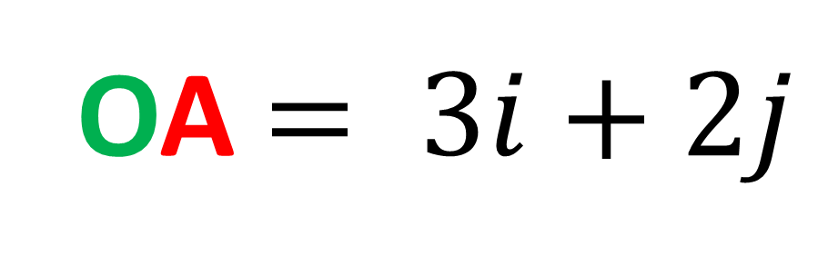
Giving Vectors a Label
j
A
2
$$a$$
OA $= 3i+2j$
i
O
3

Slide 9
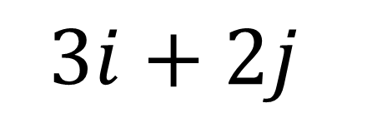
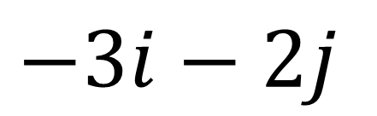
Changing Direction
j
OA =
$$3i+2j$$
A
2
AO =
$$−3i−2j$$
i
O
3
Changing direction means you change the signs.

Slide 10
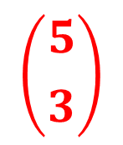
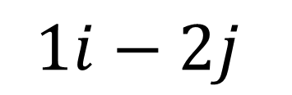
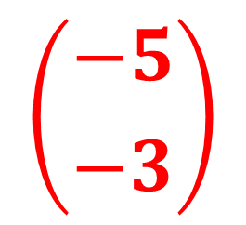
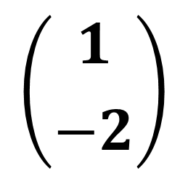
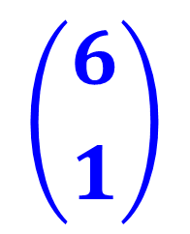
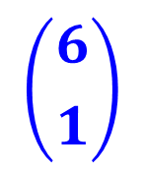
Adding Vectors
AB =
A0 + 0B
$$\left({5 \atop 3}\right)$$
A
=
$$\left({−5 \atop −3}\right)$$
+
$$\left({6 \atop 1}\right)$$
3
$$1i−2j$$
B
$$\left({6 \atop 1}\right)$$
1
$$\left({1 \atop −2}\right)$$
=
O
5
6

