Slide 1
LO: Distance-Time Graphs
Notes:
This animation shows a distance-time graph being plotted in real time. Start by choosing a different starting speed for each swimmer and pressing go.
Change the speed of the swimmers as the race progresses and note what happens on the graph. To make a swimmer stop altogether change his speed to 0.
You could ask one volunteer to vary the speeds of the swimmers and another to provide a race commentary, stating when one swimmer overtakes another, for example.

Slide 2
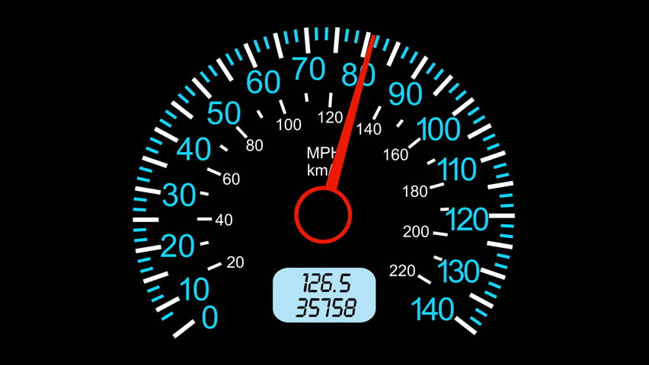

Slide 3
15miles in 30mins
What is the speed (mph)?
30mph

Slide 4
8miles in 15mins
What is the speed (mph)?
32mph

Slide 5
12km in 10mins
What is the speed (kmph)?
72mph

Slide 6
30miles in 45mins
What is the speed (mph)?
40mph

Slide 7

Two snails, Bob and Tom, have a race.
Tom
Bob
30
Commentate on the race from start to finish.
Distance (cm)
20
10
You should include
key distances,
times and speeds.
0
10
20
30
40
50
60
Time (mins)

Slide 8

Describe the each section of a car journey.
A
Travels away from the starting position
D
B
Stationary
C
E
C
Distance
Travels further away
B
D
Stationary
A
E
Travels all the way back to the starting position
0
Time

Slide 9
E
Travels away
form home
Travels towards
home
Distance from home
Travels at a steady speed
Not Moving
Impossible Journey
Slowing Down
Speeding Up
Stop Suddenly
Time

Slide 10
D
Travels away
form home
Travels towards
home
Distance from home
Travels at a steady speed
Not Moving
Impossible Journey
Slowing Down
Speeding Up
Stop Suddenly
Time

Slide 11
F
Travels away
form home
Travels towards
home
Distance from home
Travels at a steady speed
Not Moving
Impossible Journey
Slowing Down
Speeding Up
Stop Suddenly
Time

Slide 12
Travels away
form home
Travels towards
home
G
Distance from home
Travels at a steady speed
Not Moving
Impossible Journey
Slowing Down
Speeding Up
Stop Suddenly
Time

Slide 13
Travels away
form home
Travels towards
home
I
Distance from home
Travels at a steady speed
Not Moving
Impossible Journey
Slowing Down
Speeding Up
Stop Suddenly
Time

Slide 14

What is the Speed in mph?
Distance (miles)
Time (hours)

Slide 15
What is the Speed in mph?
Distance (miles)
Time (hours)

Slide 16
What is the Speed in mph?
Distance from home (miles)
Time (hours)

Slide 17
What is the Speed in mph?
Distance from home (miles)
2
Time (hours)

Slide 18
What is the Speed in mph?
Distance from home (miles)
Time (hours)

Slide 19
John takes his car to visit a friend.
What is the total distance of the journey?
20
15
40 Miles
distance (miles)
10
5
0
0
15
30
45
60
75
90
105
120
time (mins)

Slide 20
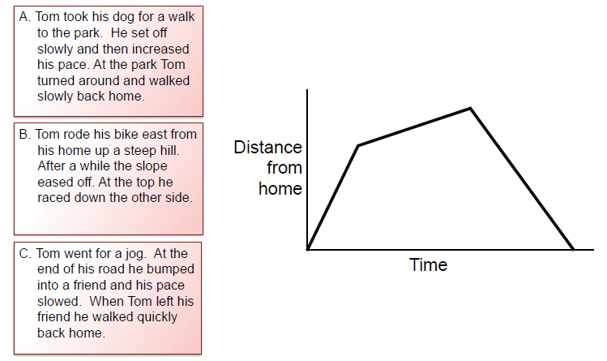
Match the statement with the Graph
Lower speed
Higher speed
Higher speed
Notes:
Adapted from a resource by the Mathematics Assessment Project

