Slide 1
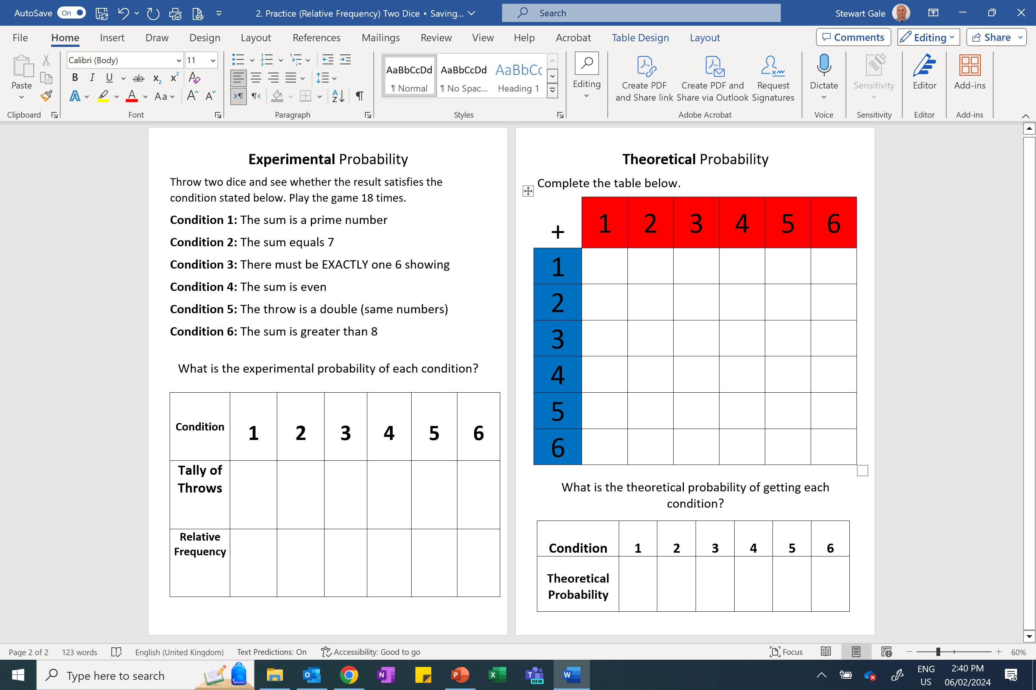

Slide 2
ANSWERS

Slide 3
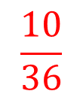
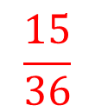
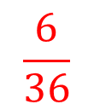
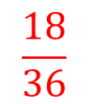
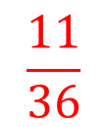
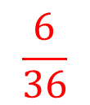
2
3
4
5
6
7
3
4
5
6
7
8
4
5
6
7
8
9
5
6
7
8
9
10
6
7
8
9
10
11
7
8
9
10
11
12
$$\frac{15}{36}$$
$$\frac{6}{36}$$
$$\frac{11}{36}$$
$$\frac{18}{36}$$
$$\frac{6}{36}$$
$$\frac{10}{36}$$

