Slide 1
Binomial Expansion
Estimation
Chapter 8
(Part 3 of 4)

Slide 2

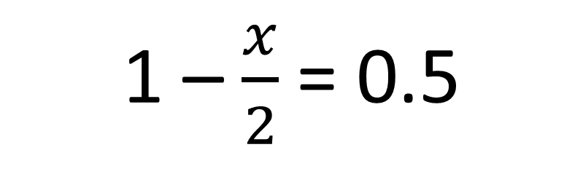
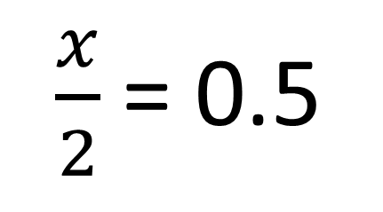
(1 – $\frac{x}{2}$)¹⁰ = (0.5)¹⁰
Can you work out the value of x?
1 – $\frac{x}{2}$= 0.5
$\frac{x}{2}$= 0.5
x = 1

Slide 3

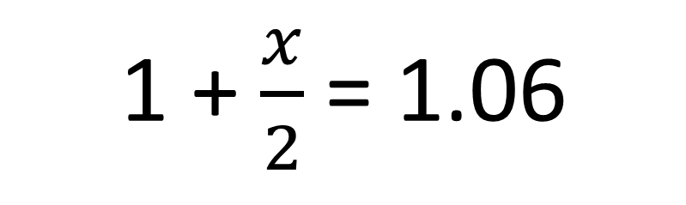
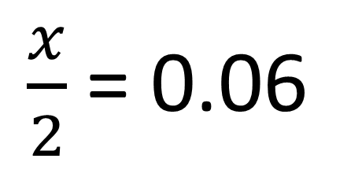
(1 + $\frac{x}{2}$)¹⁰ = (1.06)¹⁰
Can you work out the value of x?
1 + $\frac{x}{2}$= 1.06
$\frac{x}{2}$= 0.06
x = 0.12

Slide 4

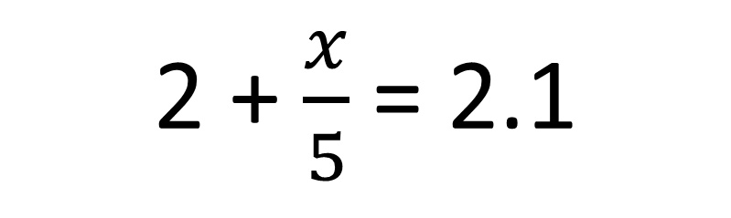
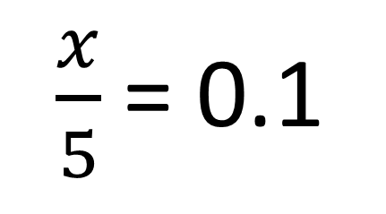
(2 + $\frac{x}{5}$)¹⁰ = (2.1)¹⁰
Can you work out the value of x?
2 + $\frac{x}{5}$= 2.1
$\frac{x}{5}$= 0.1
x = 0.5

Slide 5

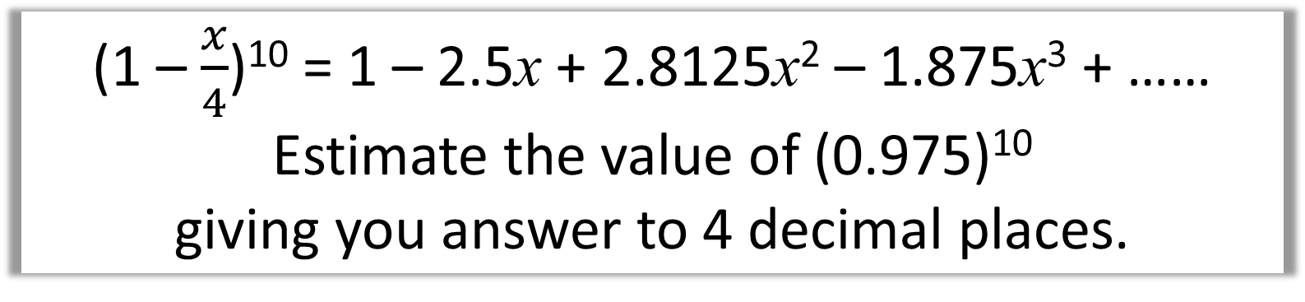
(1 – $\frac{x}{4}$)¹⁰ = 1 – 2.5x + 2.8125x² – 1.875x³ + ……
Estimate the value of (0.975)¹⁰
giving you answer to 4 decimal places.
x = 0.1
(0.975)¹⁰ = 1 – 2.5x + 2.8125x² – 1.875x³ + ……
(0.975)¹⁰ 1 – 2.5(0.1) + 2.8125(0.1)² – 1.875(0.1)³
(0.975)¹⁰
0.7763 (4 d.p.)

Slide 6
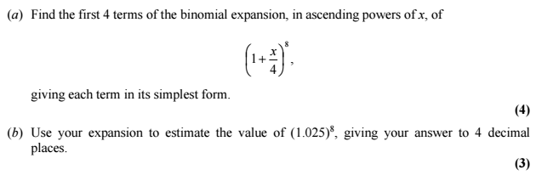
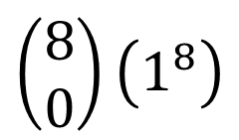
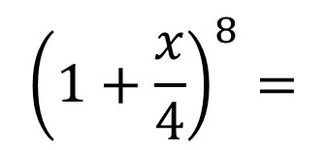
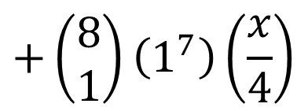
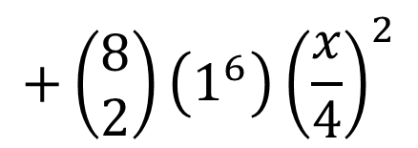
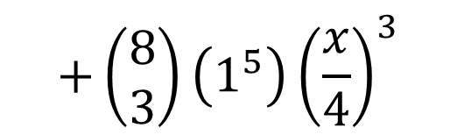
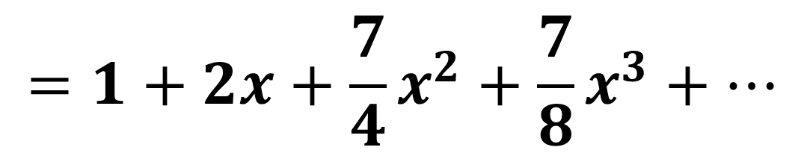
$${\left(1+\frac{x}{4}\right)}^{8}=$$
$$\left(\begin{matrix}8 \\ 0\end{matrix}\right)\left(1^{8}\right)$$
$$+\left(\begin{matrix}8 \\ 1\end{matrix}\right)\left(1^{7}\right)\left(\frac{x}{4}\right)$$
$$+\left(\begin{matrix}8 \\ 2\end{matrix}\right)\left(1^{6}\right){\left(\frac{x}{4}\right)}^{2}$$
$$+\left(\begin{matrix}8 \\ 3\end{matrix}\right)\left(1^{5}\right){\left(\frac{x}{4}\right)}^{3}$$
a)
$$=1+2x+\frac{7}{4}x^{2}+\frac{7}{8}x^{3}+…$$

Slide 7

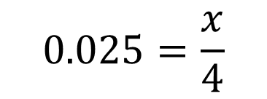
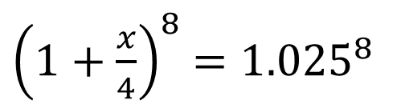
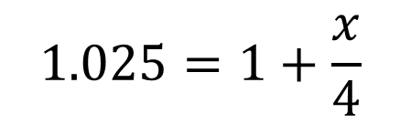

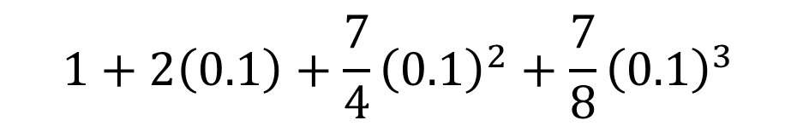
b)
${\left(1+\frac{x}{4}\right)}^{8}$ ${=1.025}^{8}$
$$x=0.1$$
$$1.025=1+\frac{x}{4}$$
$$1+2\left(0.1\right)+\frac{7}{4}{\left(0.1\right)}^{2}+\frac{7}{8}{\left(0.1\right)}^{3}$$
$$0.025=\frac{x}{4}$$
$$=1.2184 to 4dp$$

Slide 8
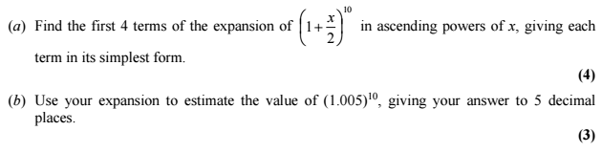
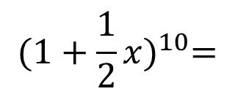
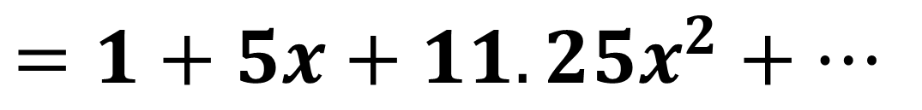
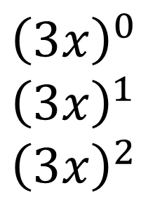

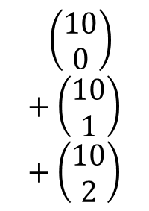
$${(1+\frac{1}{2}x)}^{10}=$$
a)
$$\left(\begin{matrix}10 \\ 0\end{matrix}\right) \\ +\left(\begin{matrix}10 \\ 1\end{matrix}\right) \\ +\left(\begin{matrix}10 \\ 2\end{matrix}\right)$$
$${\left(1\right)}^{10} \\ {\left(1\right)}^{9} \\ {\left(1\right)}^{8}$$
$${\left(3x\right)}^{0}$$
$${\left(3x\right)}^{1} \\ {\left(3x\right)}^{2}$$
$$=1+5x+11.25x^{2}+…$$

Slide 9
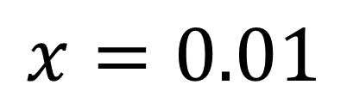
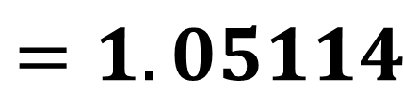
$$x=0.01$$
b)
$$=1+5\left(0.01\right)+11.25{\left(0.01\right)}^{2}+15{\left(0.01\right)}^{3}$$
$$=1+0.05+0.001125+0.000015$$
$$=1.05114$$

