Slide 1
LO: Estimating
Calculations

Slide 2
2.897
2.897
Round to 1 significant figure.
3

Slide 3
0.897
0.897
Round to 1 significant figure.
0.9

Slide 4
0.0897
0.0897
Round to 1 significant figure.
0.09

Slide 5
103.89
103.89
Round to 1 significant figure.
100

Slide 6
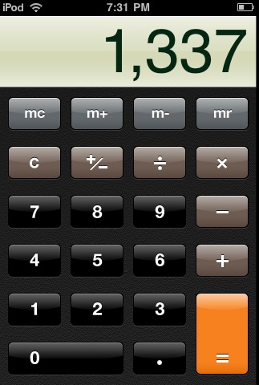
Someone used a calculator to work out 39 x 72
Does this look correct?

Slide 7
Can you estimate an answers for 39 x 72?
39 x 72 ≈
40 x 70 =
2800

Slide 8
The golden rule when estimating calculations
is to round each number to
1 significant figures.

Slide 9
Estimate an answer.
5.9 × 7.1 ≈
6 × 7 =
42

Slide 10
Estimate an answer.
15.9 × 1.3 ≈
20 × 1 =
20

Slide 11
Estimate an answer.
8.23 × 0.48 ≈
8 × 0.5 =
4

Slide 12
Estimate an answer.
10.43 × 0.512 ≈
10 × 0.5 =
5

Slide 13
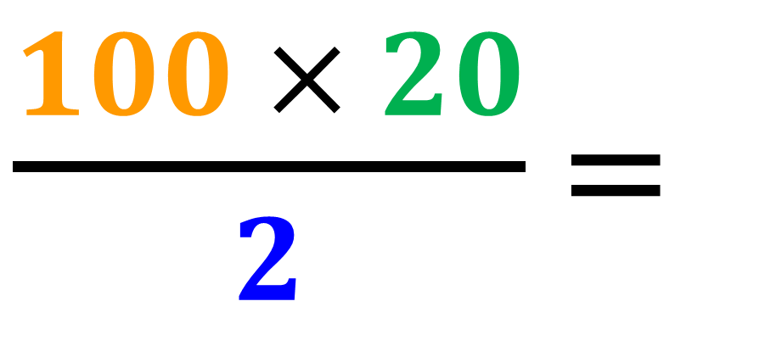
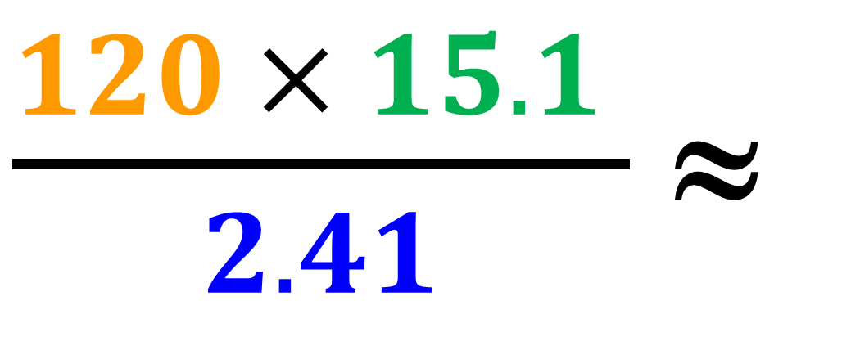
Estimate an answer.
$\frac{120 × 15.1 }{2.41}$ ≈
$\frac{100 × 20}{2}$ =
1000

Slide 14
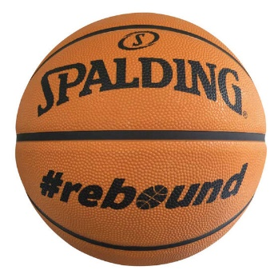
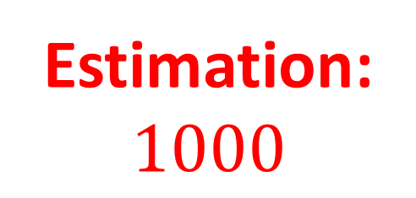
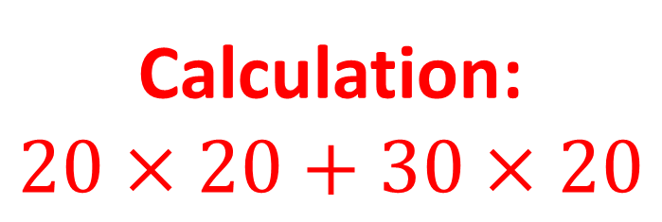
You have two containers of basketballs:
Container 1 contains 18 boxes; each box contains 23 balls.
Container 2 contains 34 boxes; each box contains 17 balls.
You have to send out 1500 basketballs that have been ordered. Is there enough balls to fulfil my orders?
Calculation:
$$20×20+30×20$$
Estimation:
$$1000$$
Answer:
No, you don’t
have enough

