Slide 1
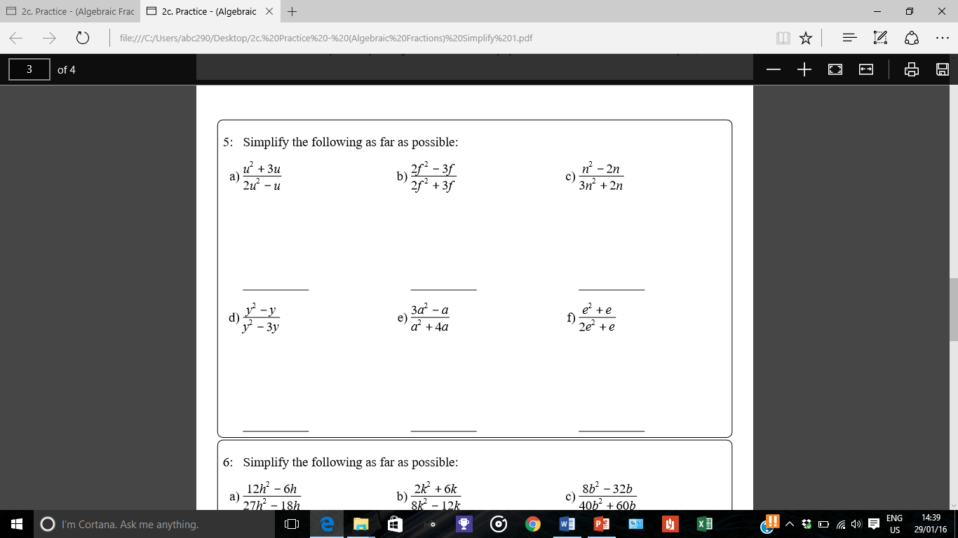
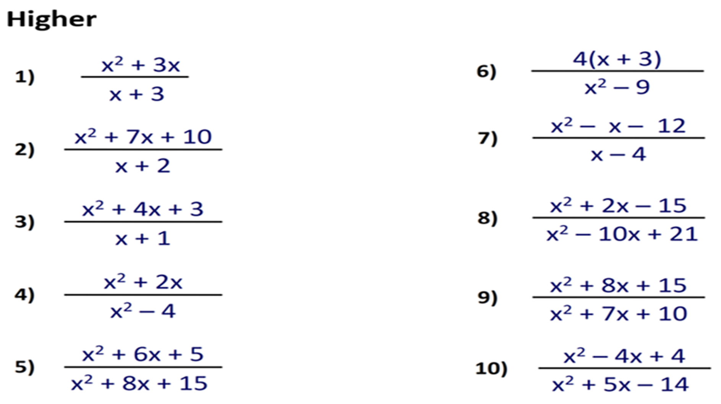
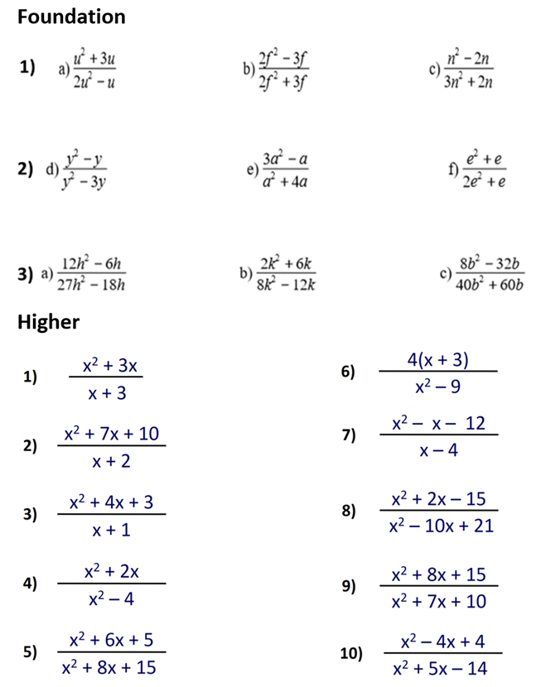
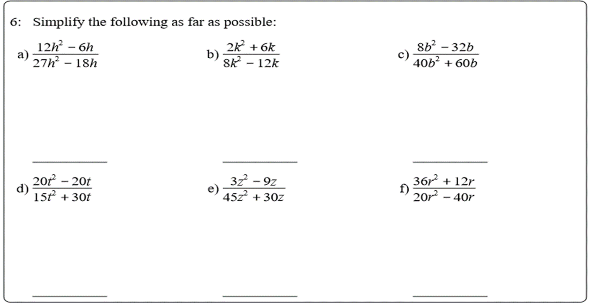
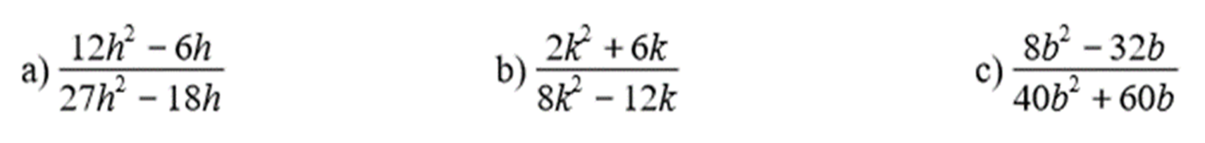
Foundation
Higher
1)
2)

Slide 2
ANSWERS

Slide 3
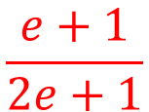
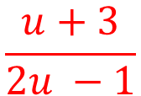
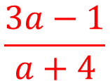
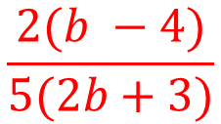
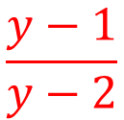
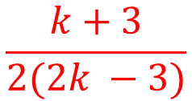
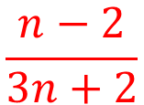
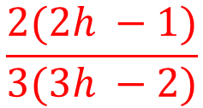
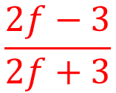
Simplify the algebraic fractions.
1)
$$\frac{u+3}{2u −1}$$
$$\frac{2f−3}{2f+3}$$
$$\frac{n−2}{3n+2}$$
$$\frac{y−1}{y−2}$$
$$\frac{3a−1}{a+4}$$
$$\frac{e+1}{2e+1}$$
2)
$$\frac{2(2h −1)}{3(3h −2)}$$
$$\frac{k+3}{2(2k −3)}$$
$$\frac{2(b −4)}{5(2b+3)}$$

Slide 4
Simplify these expressions as far as possible.
x² + 3x
x(x + 3)
1)
=
=
x
x + 3
(x + 3)
x² + 7x + 10
(x + 5)(x + 2)
2)
=
=
(x + 5)
x + 2
(x + 2)
x² + 4x + 3
(x + 3)(x + 1)
3)
=
=
(x + 3)
x + 1
(x + 1)
x² + 2x
x(x + 2)
x
4)
=
=
x² – 4
(x + 2)(x – 2)
(x – 2)
x² + 6x + 5
(x + 5)(x + 1)
(x + 1)
5)
=
=
x² + 8x + 15
(x + 3)(x + 5)
(x + 3)

Slide 5
Simplify these expressions as far as possible.
4(x + 3)
4(x + 3)
4
6)
=
=
x² – 9
(x + 3)(x – 3)
(x - 3)
x² – x – 12
(x – 4)(x + 3)
7)
=
=
(x + 3)
x – 4
(x – 4)
x² + 2x – 15
(x + 5)(x – 3)
(x + 5)
8)
=
=
x² – 10x + 21
(x – 3)(x – 7)
(x – 7)
x² + 8x + 15
(x + 3)(x + 5)
x + 3
=
=
9)
x² + 7x + 10
(x + 2)(x + 5)
x + 2
x² – 4x + 4
(x – 2)(x – 2)
x – 2
10)
=
=
x² + 5x – 14
(x – 2)(x + 7)
x + 7

