Slide 1
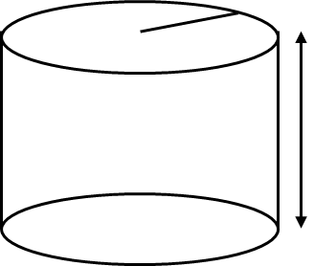
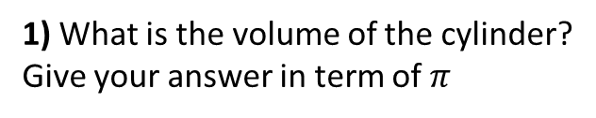
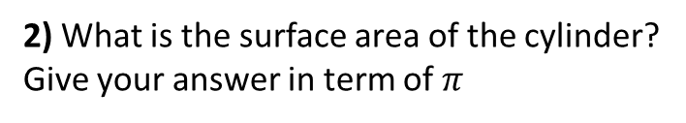
4cm
1) What is the volume of the cylinder?
Give your answer in term of $π$
4cm
2) What is the surface area of the cylinder?
Give your answer in term of $π$
6cm
6cm
3) What is the capacity of the cylinder?
Give your answer in millilitres.
4cm
4) Draw the net of the cylinder.
Label any measurements.
Do not draw to scale.
4cm
6cm
6cm

Slide 2
5) What is the volume of the cylinder?
Give your answer to 2 decimal places
6) What is the surface area of the cylinder?
Give your answer to 2 decimal places
8cm
8cm
10cm
10cm
7) What is the capacity of the cylinder?
Give your answer in litres.
8) What is the ratio of the radius to
the height of the cylinder.
Give you answer in its simplest form.
8cm
8cm
10cm
10cm

Slide 3
ANSWERS

Slide 4
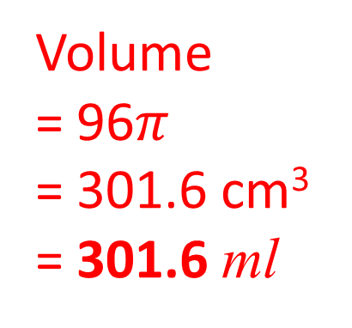
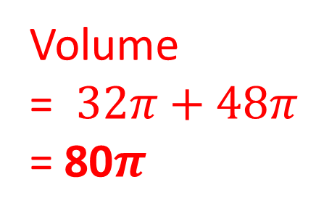
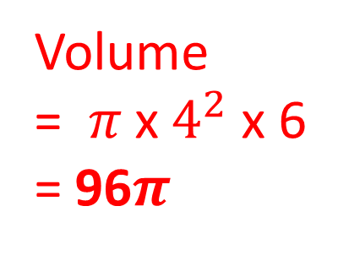
4cm
1) What is the volume of the cylinder?
Give your answer in term of $π$
4cm
2) What is the surface area of the cylinder?
Give your answer in term of $π$
6cm
6cm
Volume
= $π \text{x} 4^{2}$ $\text{x}$ 6
= 96$π$
Volume
= $32π\text{ + 48}π$
= 80$π$
3) What is the capacity of the cylinder?
Give your answer in millilitres.
4cm
4) Draw the net of the cylinder.
Label any measurements.
Do not draw to scale.
4cm
6cm
6cm
Volume
= 96$π$
= 301.6 cm³
= 301.6 ml
4cm
6cm

Slide 5
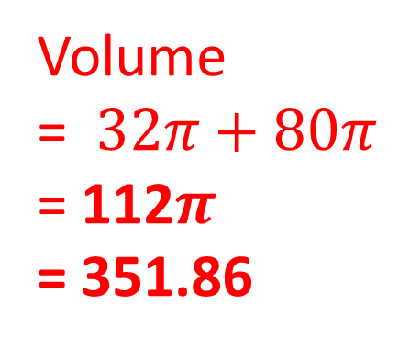
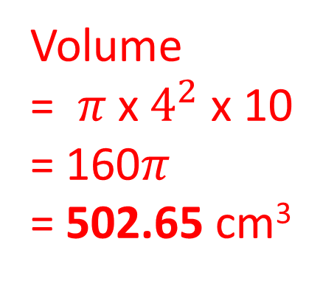
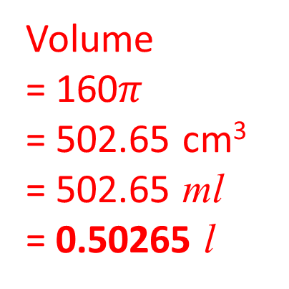
5) What is the volume of the cylinder?
Give your answer to 2 decimal places
6) What is the surface area of the cylinder?
Give your answer to 2 decimal places
8cm
8cm
10cm
10cm
Volume
= $π \text{x} 4^{2}$ $\text{x}$ 10
= 160$π$
= 502.65 cm³
Volume
= $32π\text{ + }80π$
= 112$π$
= 351.86
7) What is the capacity of the cylinder?
Give your answer in litres.
8) What is the ratio of the radius to
the height of the cylinder.
Give you answer in its simplest form.
8cm
8cm
10cm
Volume
= 160$π$
= 502.65 cm³
= 502.65 ml
= 0.50265 l
10cm
4:10
2:5

