Slide 1
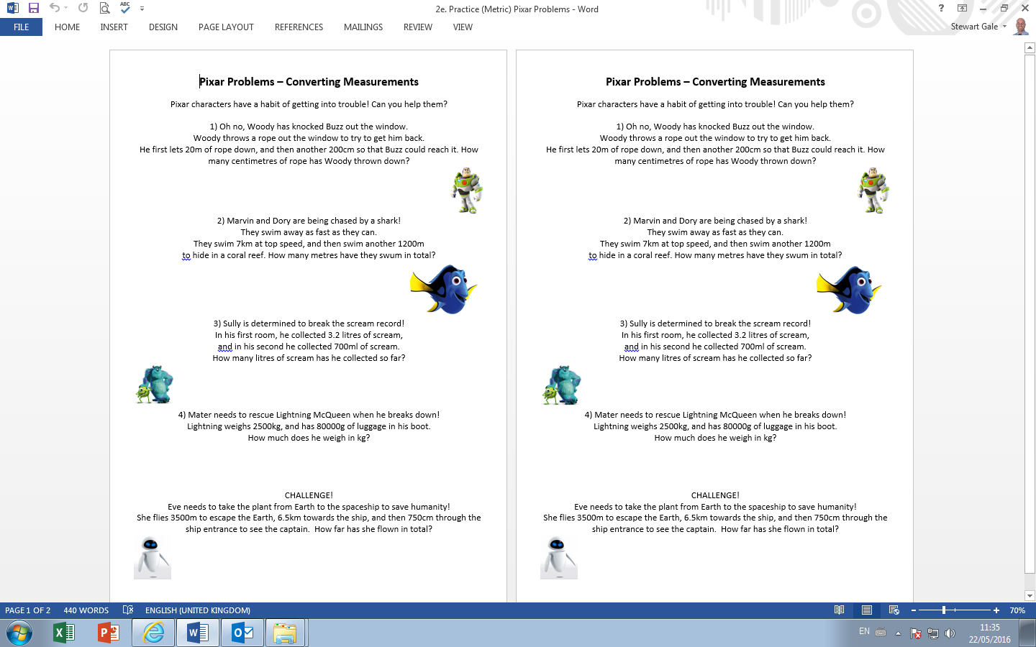

Slide 2
ANSWERS

Slide 3
2000 + 200 = 2200m
7000 + 1200 = 8200m
3200 + 700 = 3900ml = 3.9l
80 + 2500 = 2580kg
3500 + 6500 + 7.5 = 10007.5

