Slide 1
LO: Mutually
Exclusive Events and Venn Diagrams

Slide 2

What is meant by
mutually exclusive events?
Events that cannot
happen at the same time.

Slide 3

Mutually Exclusive or Not?
Rolling a 5 and a 6 with
one roll of a dice.
Mutually Exclusive

Slide 4
Mutually Exclusive or Not?
Rolling a 5 and a odd number with one roll of a dice.
Not

Slide 5
Mutually Exclusive or Not?
Rolling a 5 and a even number with one roll of a dice.
Mutually Exclusive

Slide 6

Mutually Exclusive or Not?
Getting a head and a tail
with one throw of a coin.
Mutually Exclusive

Slide 7
Mutually Exclusive or Not?
Rolling a 3 and
a number less than 5.
Not

Slide 8

Make a statement that is
mutually exclusive.

Slide 9
Make a statement that is
not mutually exclusive

Slide 10
An ordinary 6-sided dice is rolled once.
What are the missing numbers?
Even Number
Odd Numbers
2
1
6
3
4
5
Are the two events mutually exclusive?
Yes

Slide 11
An ordinary 6-sided dice is rolled once.
What are the missing numbers?
Prime Number
Numbers bigger than 3
2
6
5
3
4
1
Are the two events mutually exclusive?
No

Slide 12
Which two events are mutually exclusive?
A+B
Event B
5
2
5
2
2
Event A
8
Event C

Slide 13
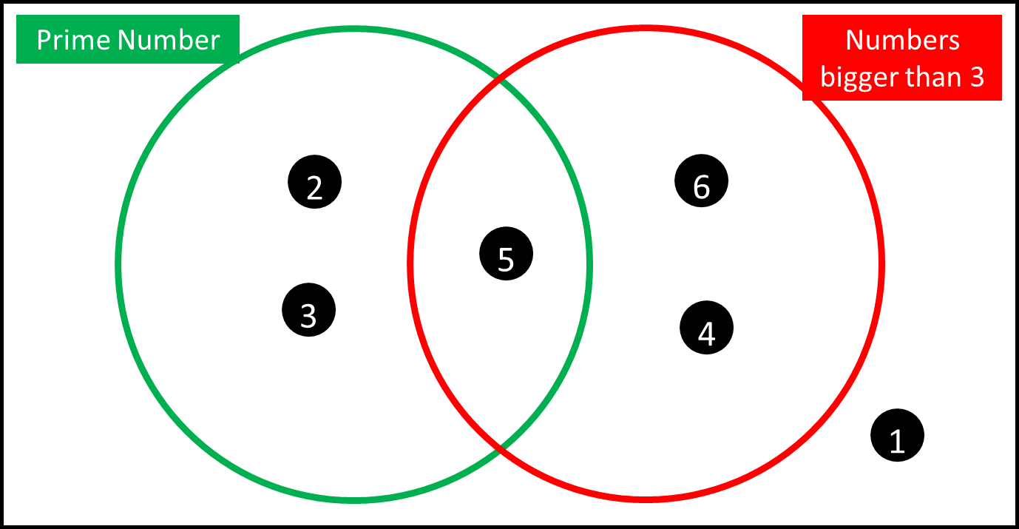




$$\frac{3}{6}$$
$$\frac{3}{6}$$
P(Prime number) =
P (a number bigger than 3) =
P(Prime number or
a number bigger than 3) =
$$\frac{5}{6}$$
P(Prime number and
a number bigger than 3) =
$$\frac{1}{6}$$

