Slide 1
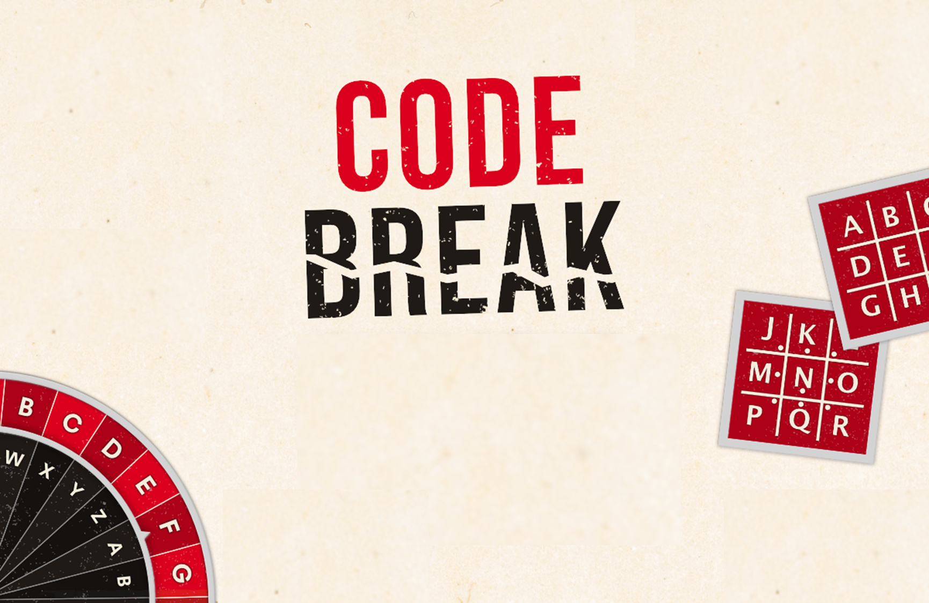
CHALLENGE
ANSWERS

Slide 2
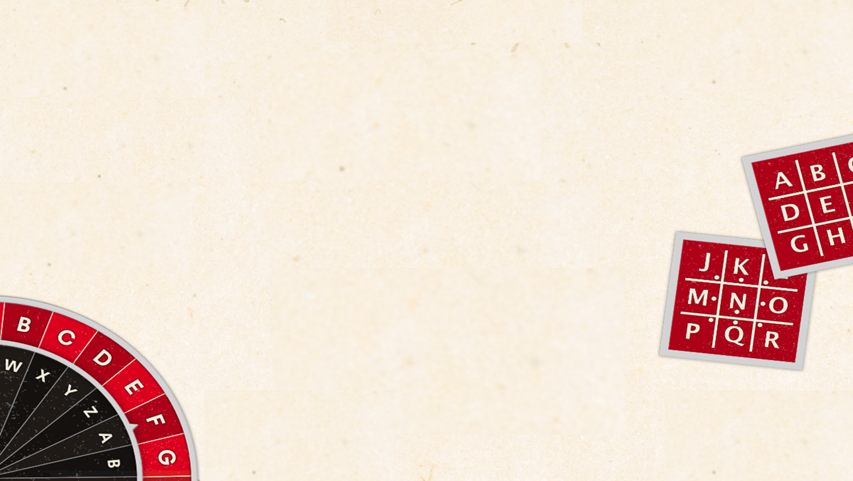
Code Challenge Level 1
Clue 1 answer:
Rectangle
Clue 4 answer:
Prism (Mirror Writing)
Clue 2 answer:
(Pigpen)
Pentagon
Clue 5 answer:
(Transposition Cipher)
Parallel
Clue 3 answer:
(Morse Code)
Regular
Clue 6 answer:
(Ceaser A – Z, B – Y, C – X etc)
Success

Slide 3

Code Challenge Level 2
Clue 1 answer:
(Ceaser Shift)
Substitute
Clue 4 answer:
(1 = A , 2 = B etc)
Cipher
Clue 2 answer:
(Pair of letters need to be swapped)
Swapped
Clue 5 answer:
(First dancing man = A etc)
Sherlock
Cue 3 answer:
(Read the text backwards)
Backwards
Clue 6 answer:
(Transposition cipher 4 by 8)
Genius

Slide 4
Code Challenge Level 3
Clue 1 answer: (Read the message backwards) The murder weapon was not a metal object
Clue 2 answer: (Transposition - swap every 2 grouping of letters around) The murderer had a top on that had stripes
Clue 3 answer: (Caesar Shift A to E) The room the murder took place in is an even number
Clue 4 answer: (Pigpen Code) The room the murder was committed in was a prime number

Slide 5

Code Challenge Level 3
Clue 5 answer: (Morse Code 1 represents a dash, 0 represents a dot) There is a textbook missing
Clue 6 answer: (Transposition Encryption - 4 by 15)
This room the murder took place in is a number many people consider lucky (this is 7)

Slide 6
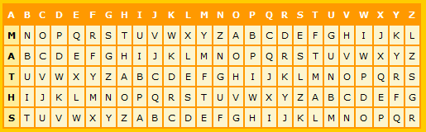
Code Challenge Level 3
Clue 7 answer: (Vigenere Cipher) The murderer was wearing trousers
Clue number 8 answer: (Upside down mirror writing) The number of stripes on the t shirt is an even prime number

Slide 7
Code Challenge Level 3
Murderer – Al Jabra
Room - 7
Murder Weapon – Textbook
Code number: 165

Slide 8
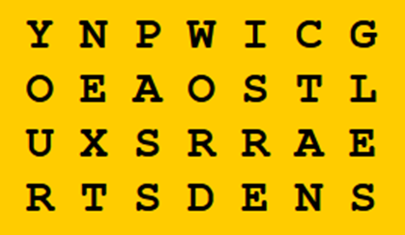
Code Challenge Level 4
Code 1 answer: (Pigpen)
How many seconds in a day? 3600
Code 2 answer: (Read backwards)
Well done but they will get harder the next password is a polygon with eight sides
Code 3 answer: (Transposition Encryption - 4 by 4)
Your next password is rectangles

Slide 9
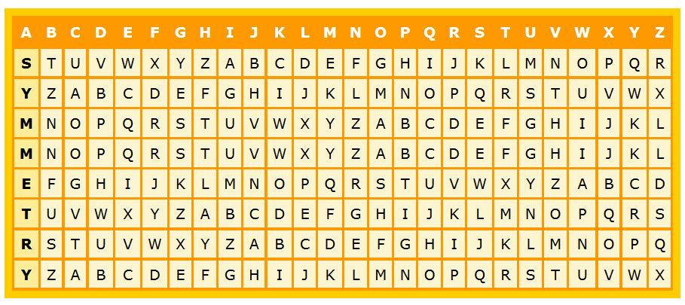
Code Challenge Level 4
Code 4 answer: (Morse code and then use a Caesar cipher shift Right 1)
-- -.. .-- ... --- --.. .-. .-. ...- -. --.- -.-. .... .-. -.. -.- -.. ..- --.. ... -..
M D W S O Z R R V N Q C H R D K D U Z S D
Next password is elevate
Code 5 answer: (Vignere Cipher)
The password is winner

