Slide 1
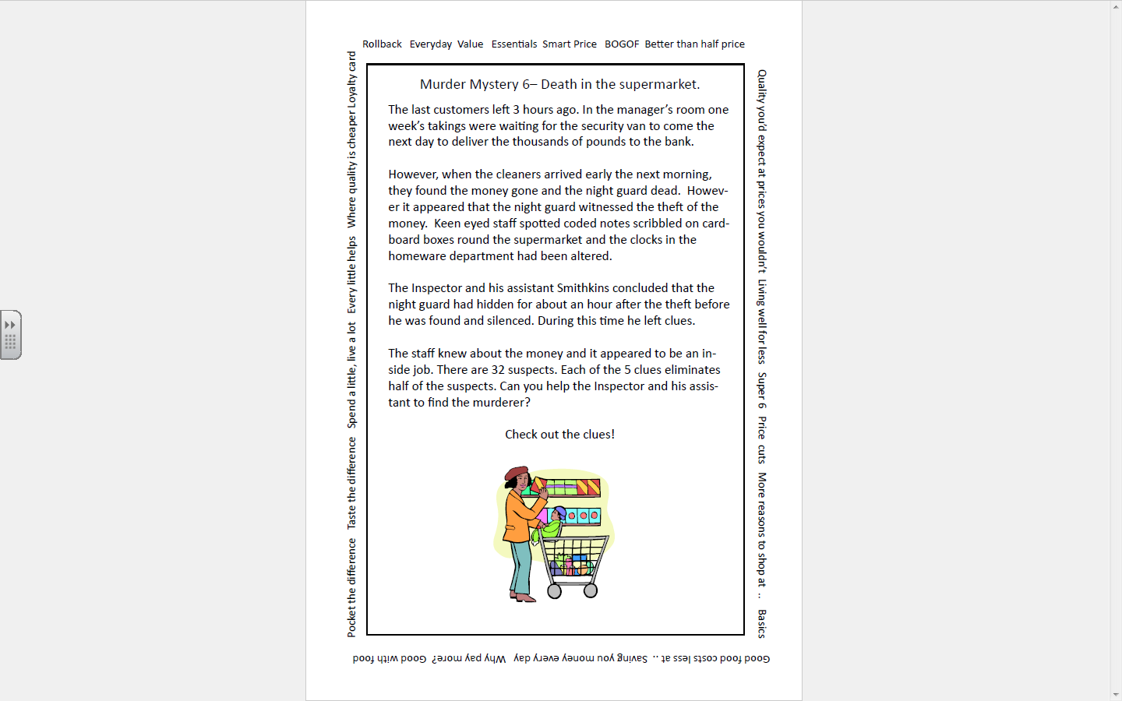
Maths Mystery – Death in the Supermarket!

