Slide 1
LO: Non-Linear Graphs
(Area Under a Graph)

Slide 2
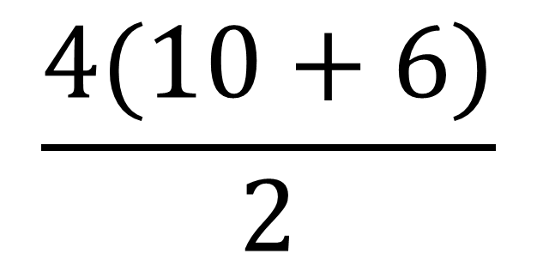
What is the area of the trapezium?
$$\frac{4(10+6)}{2}$$
10
6
= 32
4

Slide 3
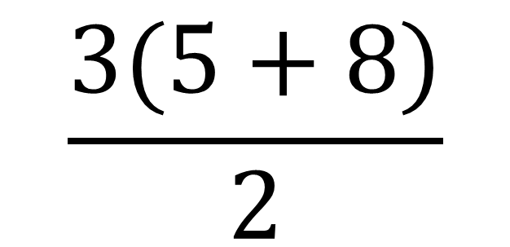
What is the area of the trapezium?
$$\frac{3(5+8)}{2}$$
7
5
= 18
3

Slide 4
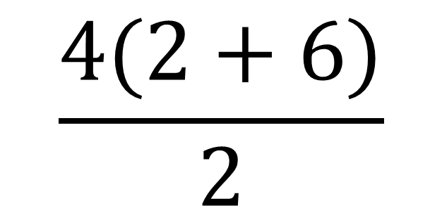
What is the area of the trapezium?
2
$$\frac{4(2+6)}{2}$$
5
4
= 16
6

Slide 5
The area under a velocity-time graph
is equal to the distance travelled.
Velocity
Time

Slide 6

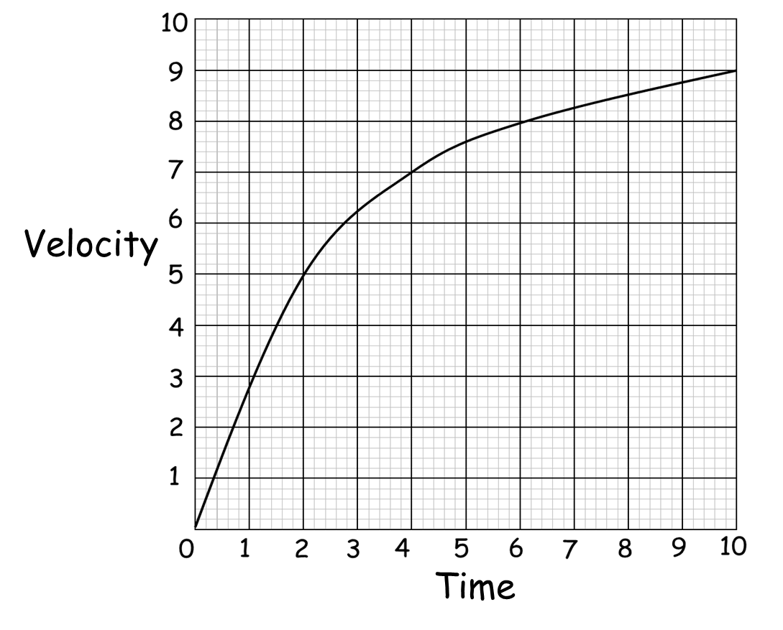
How can you find the area under a graph
if it is a curve?
You will have to estimate using various shapes.

Slide 7
Is a triangle a good option
for this curve?
NO

Slide 8
Is a one rectangle a good option
for this curve?
NO

Slide 9
Are two rectangles a good option
for this curve?
NO

Slide 10
Are 5 rectangles a good option
for this curve?
The more the better

Slide 11
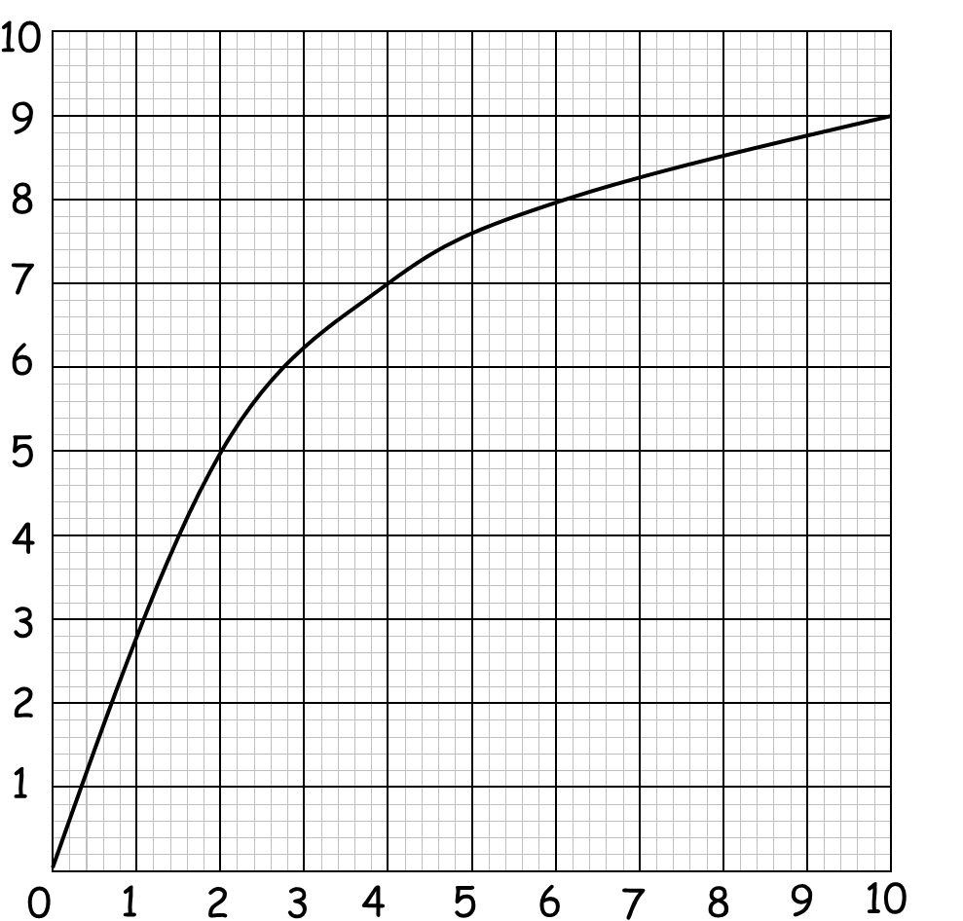
Is 4 trapeziums and a triangle
the best option for this curve?
YES
Velocity
Time

Slide 12
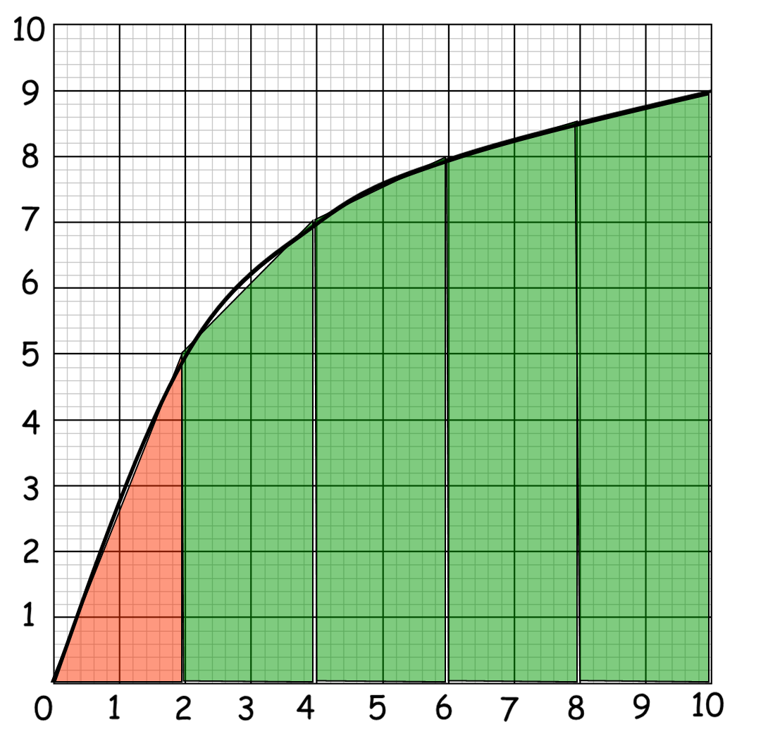
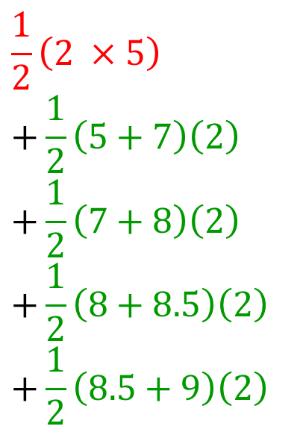
Estimate the distance travelled in these 10 seconds.
Use 5 strips of equal widths.
$$\frac{1}{2}\left(2 ×5\right)$$
$$+\frac{1}{2}\left(5+7\right)\left(2\right)$$
$$+\frac{1}{2}\left(7+8\right)\left(2\right)$$
$$+\frac{1}{2}\left(8+8.5\right)\left(2\right)$$
$$+\frac{1}{2}\left(8.5+9\right)\left(2\right)$$
Velocity (m/s)
Area = 5 + 12 + 15 + 16.5 + 17.5
Area = 66 units²
Distance = 66m
Time (Sec)

Slide 13
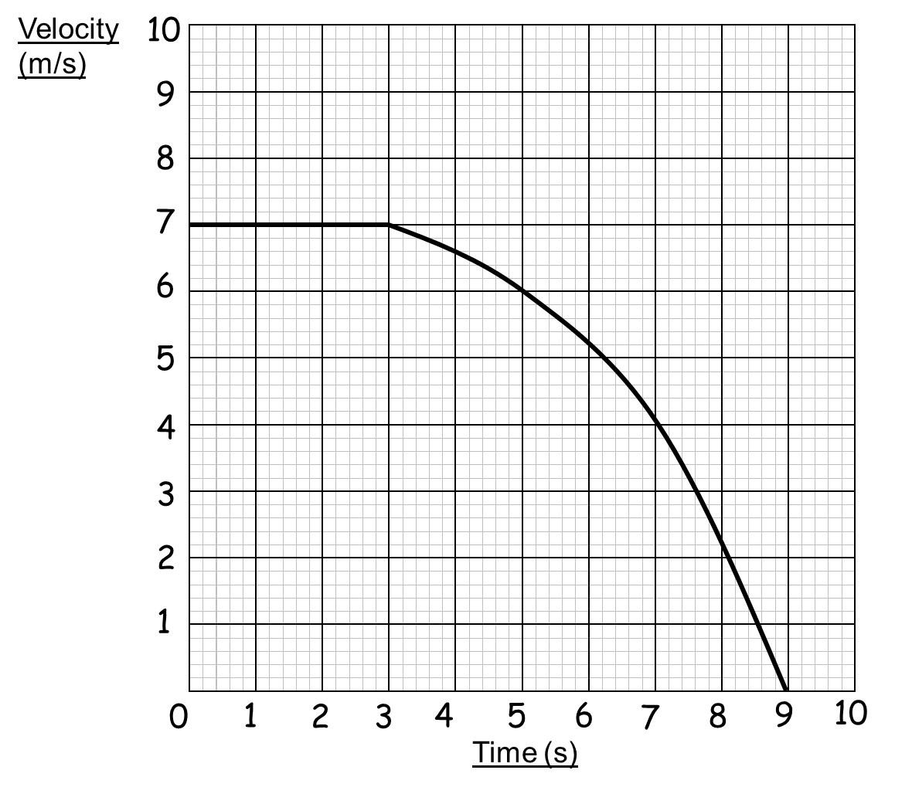
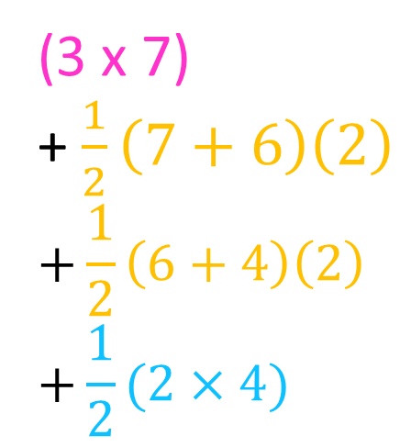
Estimate for the distance travelled these
nine seconds using only 4 strips.
(3 x 7)
+ $\frac{1}{2}\left(7+6\right)\left(2\right)$
$$+\frac{1}{2}\left(6+4\right)\left(2\right)$$
$$+\frac{1}{2}(2×4)$$
Area = 21 + 13 + 10 + 4
Area = 48 units²
Distance = 48m

Slide 14
Overestimate or Underestimate?
Velocity
Underestimate
Time

Slide 15
Overestimate or Underestimate?
Underestimate

Slide 16
Overestimate or Underestimate?
Overestimate

