Slide 1
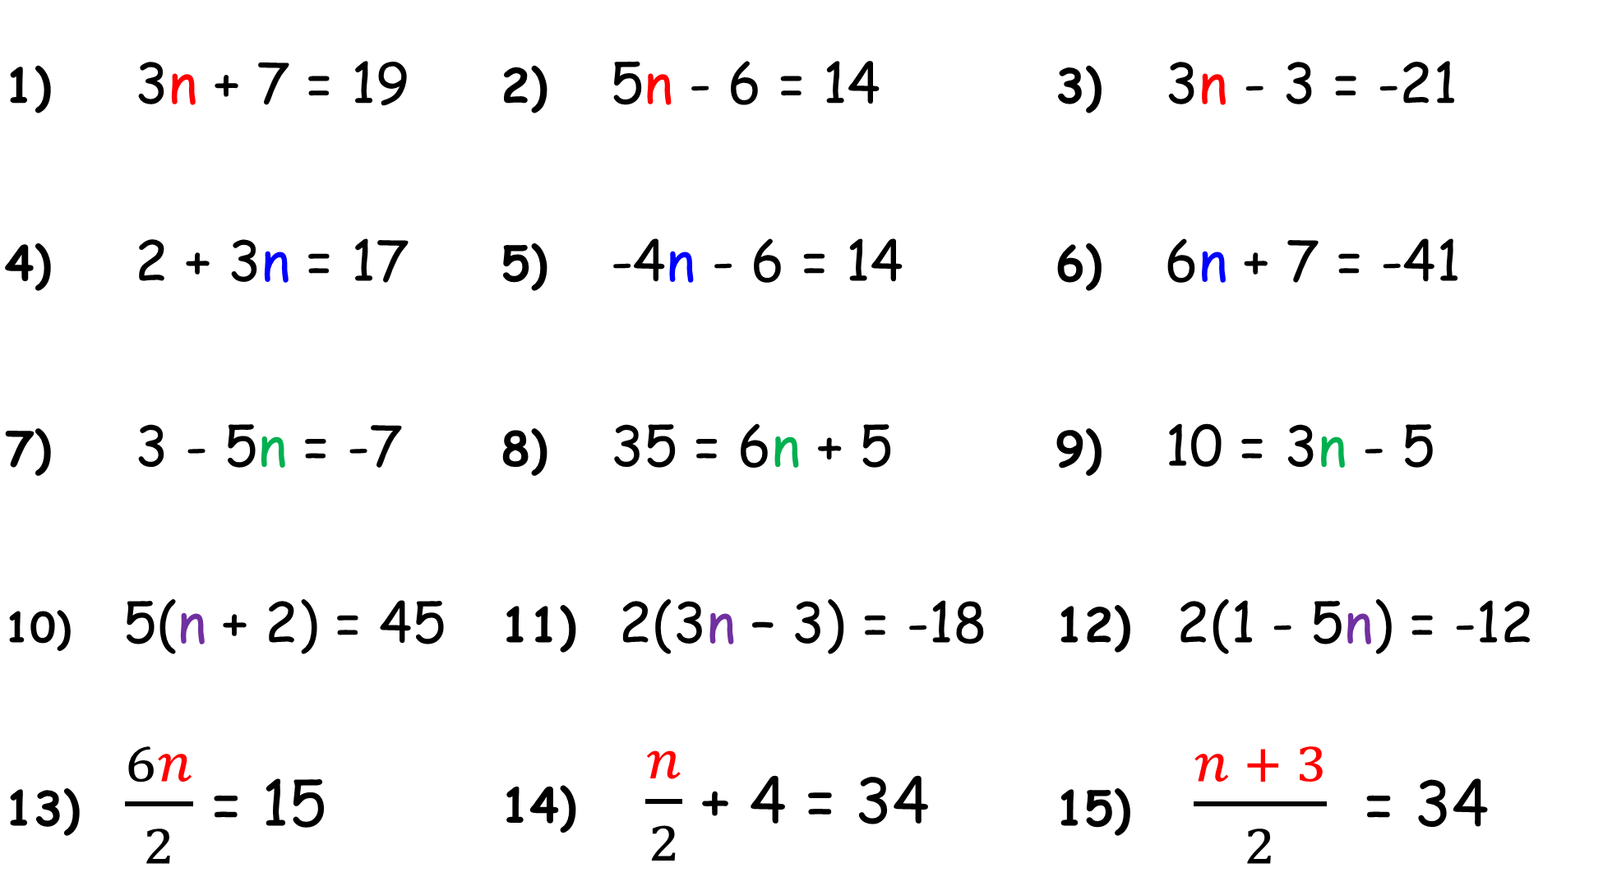
1) 3n + 7 = 19 | 2) 5n - 6 = 14 | 3) 3n - 3 = -21
4) 2 + 3n = 17 | 5) -4n - 6 = 14 | 6) 6n + 7 = -41
7) 3 - 5n = -7 | 8) 35 = 6n + 5 | 9) 10 = 3n - 5
10) 5(n + 2) = 45 | 11) 2(3n – 3) = -18 | 12) 2(1 - 5n) = -12
13) $\frac{6n}{2}$ = 15 | 14) $\frac{n}{2}$ + 4 = 34 | 15) $\frac{n + 3}{2}$ = 34

Slide 2
ANSWERS

Slide 3
1) 3n + 7 = 19 | 2) 5n - 6 = 14 | 3) 3n - 3 = -21
4) 2 + 3n = 17 | 5) -4n - 6 = 14 | 6) 6n + 7 = -41
7) 3 - 5n = -7 | 8) 35 = 6n + 5 | 9) 10 = 3n - 5
n = 4
n = 4
n = -6
n = 5
n = -5
n = -8
n = 2
n = 5
n = 5

Slide 4
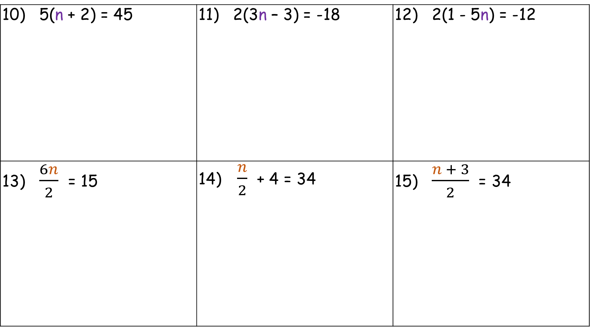
10) 5(n + 2) = 45 | 11) 2(3n – 3) = -18 | 12) 2(1 - 5n) = -12
13) $\frac{6n}{2}$ = 15 | 14) $\frac{n}{2}$ + 4 = 34 | 15) $\frac{n + 3}{2}$ = 34
n = 7
n = 2
n = 1.4
n = 5
n = 60
n = 65

