Slide 1
LO: Pyramid (Volume)

Slide 2

Can you describe a pyramid?
A pyramid is a 3D shape
whose outer surfaces converge to a single point.

Slide 3
Pyramid
Apex
Slant Height
h
Base

Slide 4
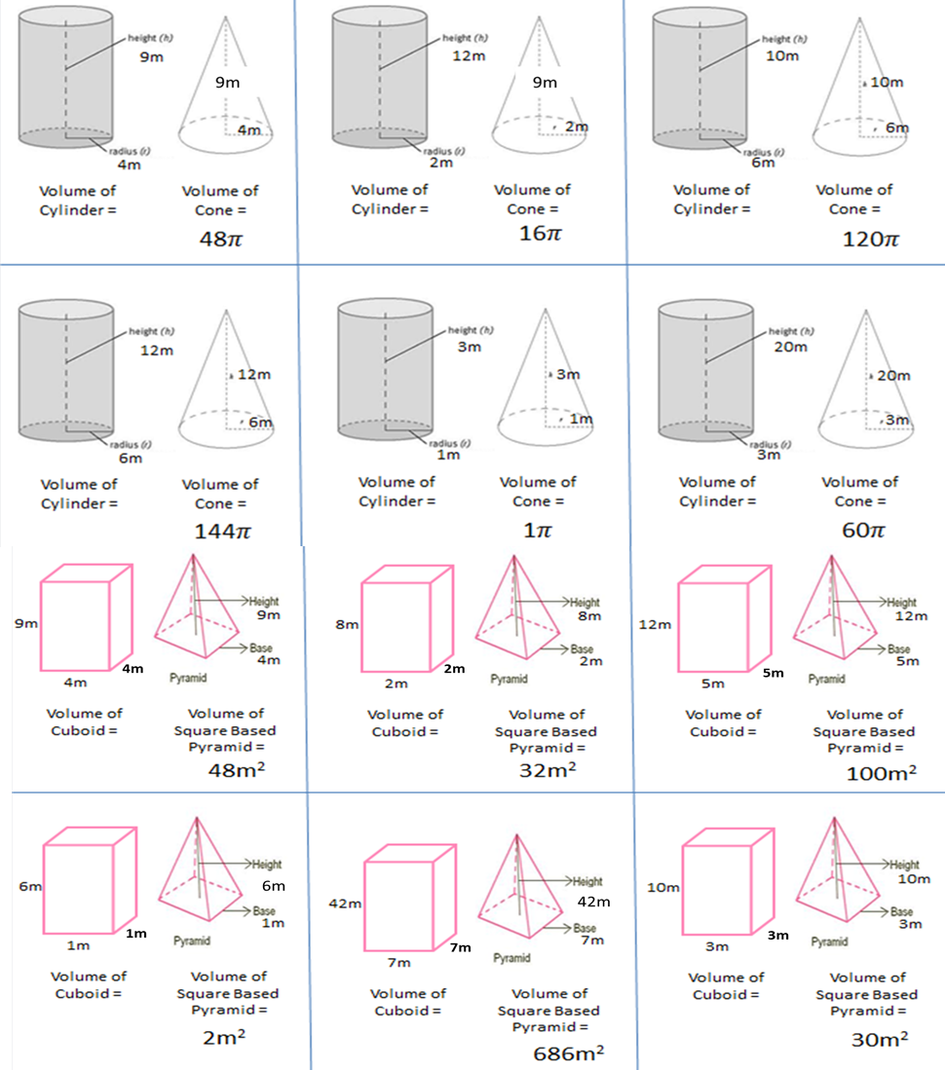
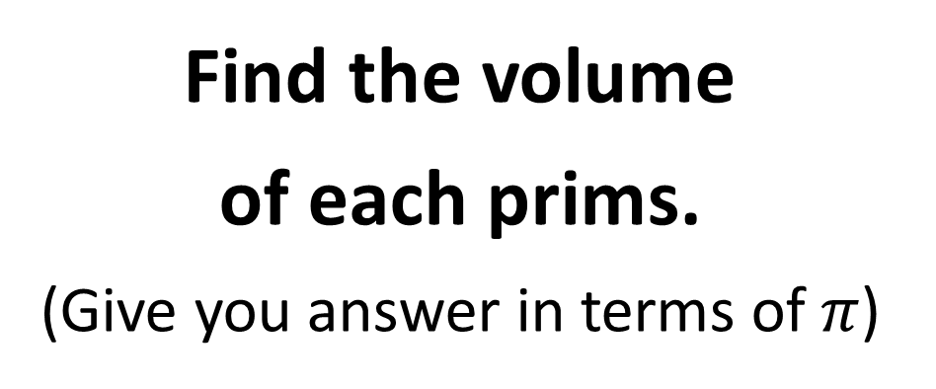
Find the volume
of each prims.
(Give you answer in terms of $π$)
What is the connection
between the volume
of a prism
and
a pyramid?

Slide 5

Find the volume of each prims. (Give you answer in terms of pi)
144𝝅
48𝝅
360𝝅
What is the connection between the volume of a prism and a pyramid?
432𝝅
3𝝅
180𝝅
144
96
300
Volume of a Pyramid is
$\frac{1}{3}$ of the volume of the Prism
6
2058
90

Slide 6

What can you learn from watching this video?
Click the icon above.

Slide 7
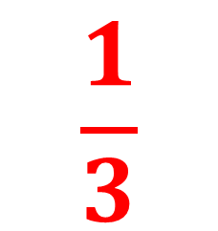
$$\frac{1}{3}$$

Slide 8


$$\frac{1}{3}$$
h
r

Slide 9
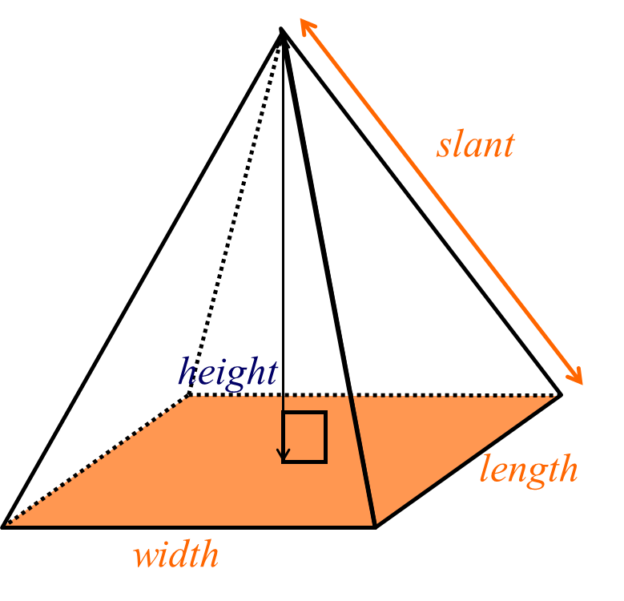

Can you write a formula
for the volume of a pyramid?
Volume = $\frac{1}{3}(lw)h$

Slide 10

Can you write a formula
for the volume of a cone?
Apex
Volume = $\frac{1}{3}(πr^{2})h$
Slant
h
r
Base

Slide 11

Volume of a Pyramid =
$\frac{1}{3}$ x base area x height

Slide 12
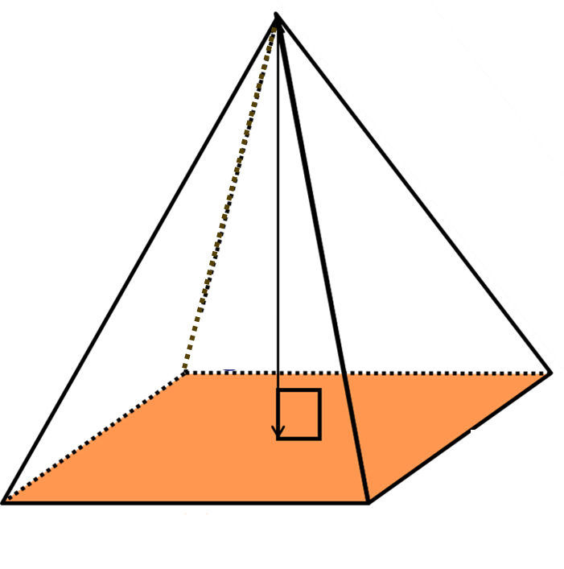

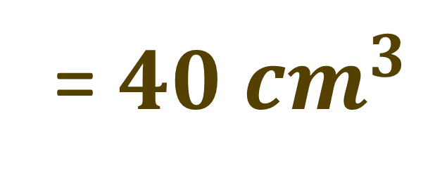
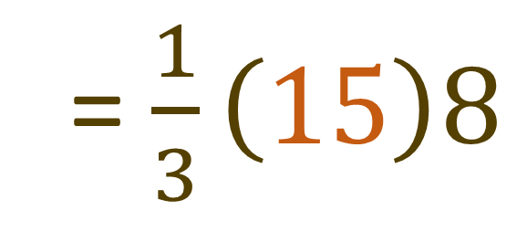
What is the volume of the pyramid?
Volume = $\frac{1}{3}(lw)h$
= $\frac{1}{3}\left(15\right)8$
8cm
3cm
= $40 {cm}^{3}$
5cm

Slide 13
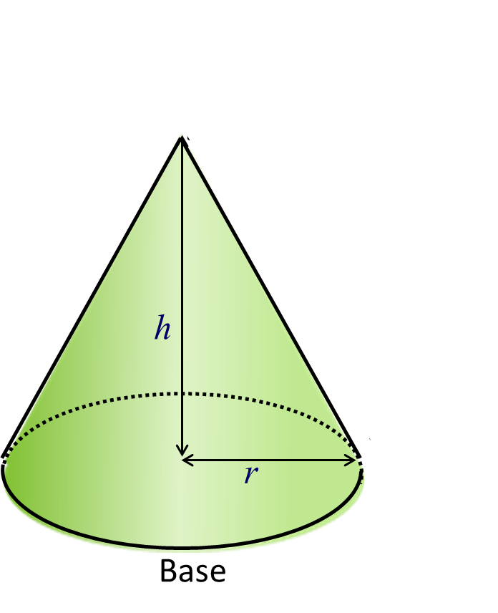


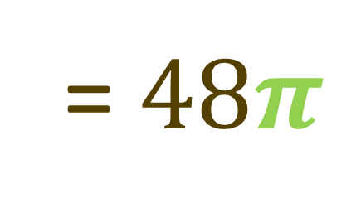
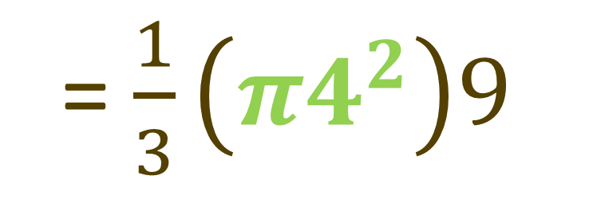
What is the volume of the pyramid?
Give your answer in terms of $π$
Volume = $\frac{1}{3}(πr^{2})h$
9cm
= $\frac{1}{3}\left(π4^{2}\right)9$
4cm
= $48π$

Slide 14

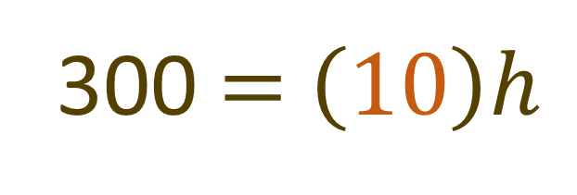

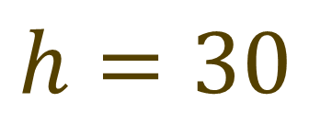
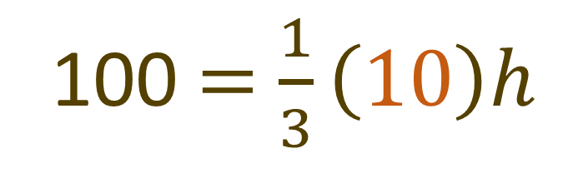
The volume of the pyramid is $100 {cm}^{3}.$
What is the height of the pyramid?
Volume $=$ $\frac{1}{3}(lw)h$
100 $=$ $\frac{1}{3}\left(10\right)h$
h
300 $=$ $\left(10\right)h$
2cm
5cm
$$h=30$$

Slide 15
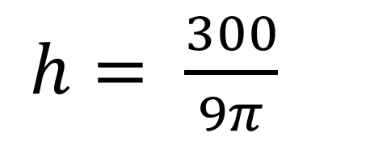


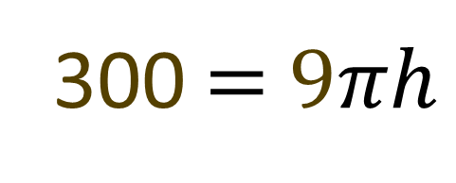
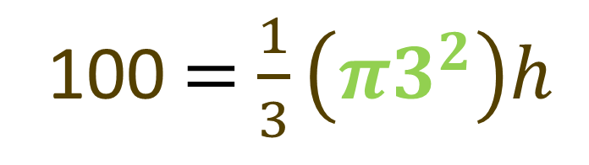
The volume of the cone is $100 {cm}^{3}.$
What is the height of the cone?
Volume $=$ $\frac{1}{3}(πr^{2})h$
100 $=$ $\frac{1}{3}\left(π3^{2}\right)h$
h
300 $=$ $9πh$
3cm
$h= \frac{300}{9π}$

Slide 16
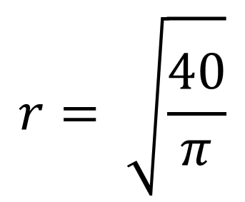
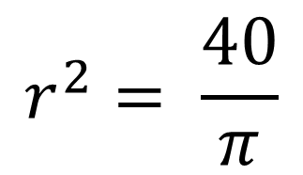


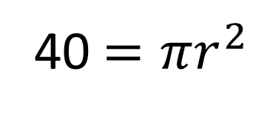
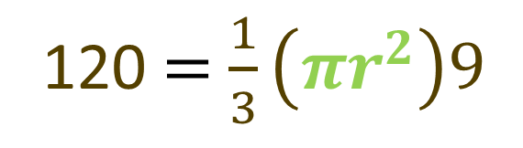
The volume of the cone is $120 {cm}^{3}.$
What is the radius of the cone?
Volume $=$ $\frac{1}{3}(πr^{2})h$
120 $=$ $\frac{1}{3}\left(πr^{2}\right)9$
9cm
40 $=πr^{2}$
$$r= \sqrt{\frac{40}{π}}$$
$$r^{2}= \frac{40}{π}$$
r

