Slide 1
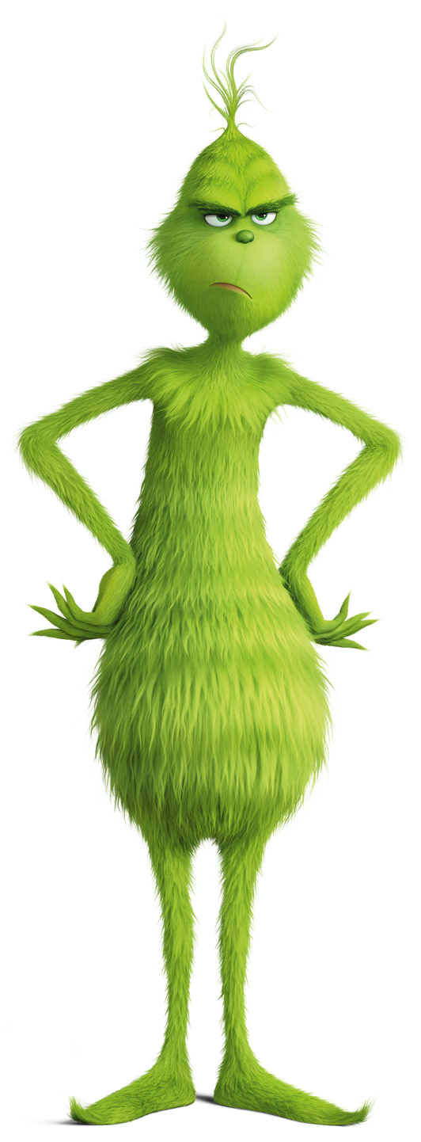

WHO IS THE CHRISTMAS GRINCH?

Slide 2

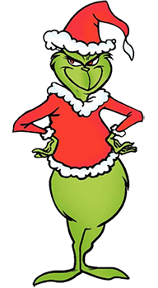
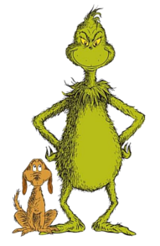
ANSWERS

Slide 3
SANTA’S ELVES ARE GETTING VERY FUSSY
Elf 1 will only deliver multiple of 3 number presents!
Elf 2 will only deliver square number presents!
Elf 3 will only deliver factors of 1,000 number presents!
Elf 4 will only deliver presents whose digits add up to 6 or less!
SANTA’S ELVES
7 + 17 + 19 = 43
= 7
1 | 2 | 3 | 4 | 5
6 | 7 | 8 | 9 | 10
11 | 12 | 13 | 14 | 15
16 | 17 | 18 | 19 | 20
21 | 22 | 23 | 24 | 25
Now add up the remaining numbers and work out the digital root.

Slide 4
Use the pictures clues to help you work out all the missing numbers - Then add them up and work out the digital root!
(360) Degrees in a Circle
(12) Days of Christmas
(7) Days in a Week
(52) Cards in a Pack
(8) Legs on a Spider
(7) Colours in a Rainbow
(50) States in the United States of America
(6) Zero’s in a Million
(2) Wheels on a Bicycle
(24) Hours in a Day
360 +
12 +
7 +
52 +
8 +
7 +
50 +
6 +
2 +
24 =
528 =
15 = 6

Slide 5
Find the answers to the Christmas Cracker Jokes in the grid below!
Why did nobody bid for Rudolph and Vixen on Ebay?
What do you call a cat who works for Santa?
What does Adam say the day before Christmas?
What is white and minty?
What do snowmen like to do at the weekend?
1+2 + 3+1 + 4+3 + 4+1 + 2+3 + 3+2 + 4+2 + 1+4 + 4+4 + 1+1 =
50 = 5
What do snowmen wear on their heads?
What comes at the end of Christmas day?
What do Elves post on social Media?
What vehicle does an elf use?
What do you call a rich elf?
4 | An Icicle | No Idea | Truth or deer | Welfy
3 | The Elf a bet | The Letter Y | Mary Christmas | It's Christmas Eve
2 | They were too dear | Santa Paws | Chill | Ice Caps
1 | Elfies | Claus - traphobia | Santa Claws | A Polo Bear
 | 1 | 2 | 3 | 4

Slide 6






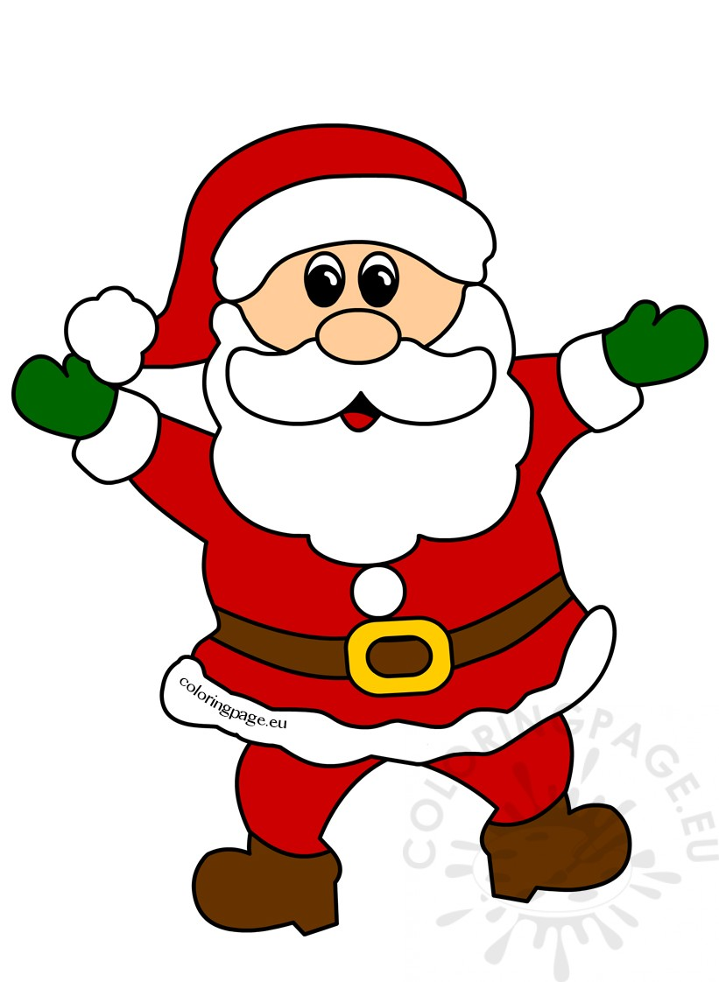
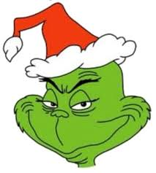
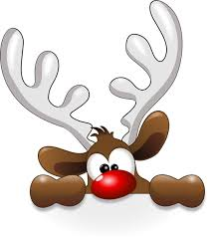

Match the 10 Christmas Items to the digits 0, 1, 2, 3, 4, 5, 6, 7, 8 & 9
CHRISTMAS PUZZLE
6
9
= ___
= ___
+
+
+
+
=
1
2
= ___
= ___
+
=
5
8
+
=
= ___
= ___
+
+
+
=
4
0
= ___
= ___
x
=
7
3
= ___
= ___
-
=
What is Hat x Santa x Holly? Then work out the digital root.
5x8x7 = 280 = 10 = 1
+
=

Slide 7

Christmas - Love is in the Air
Frosty the Snowman
LOVES
The Abominable Snowman
Ebeneezer Scrooge
LOVES
Tiny Tim
Cratchit
Rudolph
LOVES
Santa Claus
The Grinch
LOVES
Christmas
1 4 0 3 3
5 4 3 6
9 7 9
1 6 1 6
7 7 7
1 4 1 4
5 5 5
1 0 1 0
1 1 1
2 2
4
0 0 0 1 2
0 0 1 3
0 1 4
1 5
6
0 2 0 6 1
2 2 6 7
4 8 1 3
1 2 9 4
3 1 1 1 3
4 2 2 4
6 4 6
1 0 1 0
1 1 1
2 2
4
2 1 0 0 2
3 1 0 2
4 1 2
5 3
8
Mother Christmas Loves Father Christmas = 8
8 + 8 + 4 + 6 + 4 = 30 = 3

Slide 8
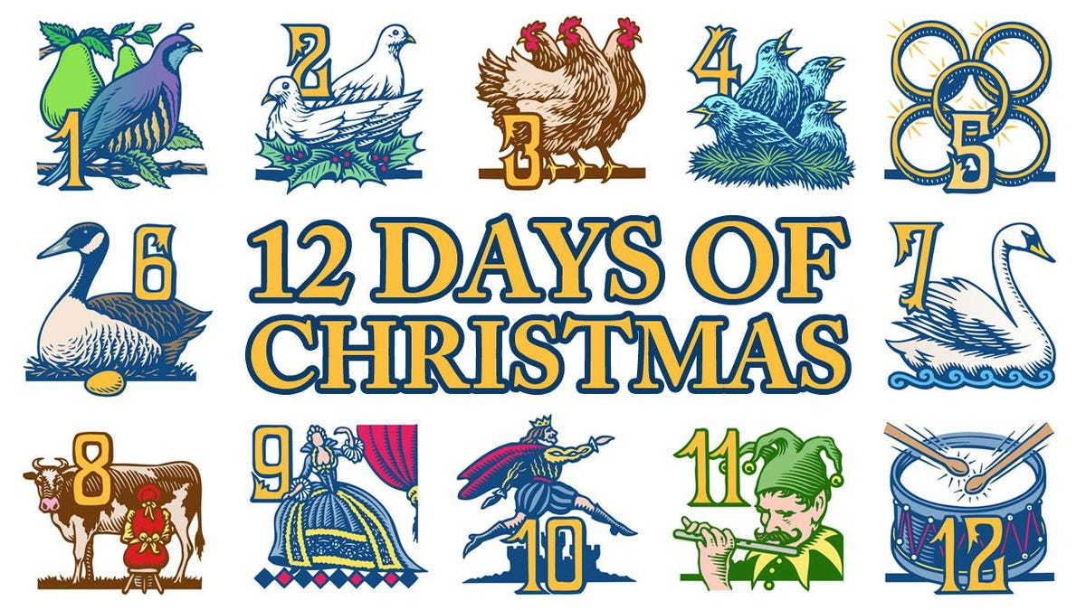
The 12 Days of Christmas
1) How many gifts did I receive on the 2nd day?
3
2) How many gifts did I receive on the 12th day?
78
3) How many gifts did I receive altogether?
364
4) How many golds rings did I receive in total?
40
3 + 78 + 364 + 40 + 23 = 508 = 13 = 4
5) How many birds did I receive on day 12?
23

Slide 9
You have Eliminated
Numbers
7, 5, 1, 6, 3, 4
The Grinch is number 2…

