Slide 1
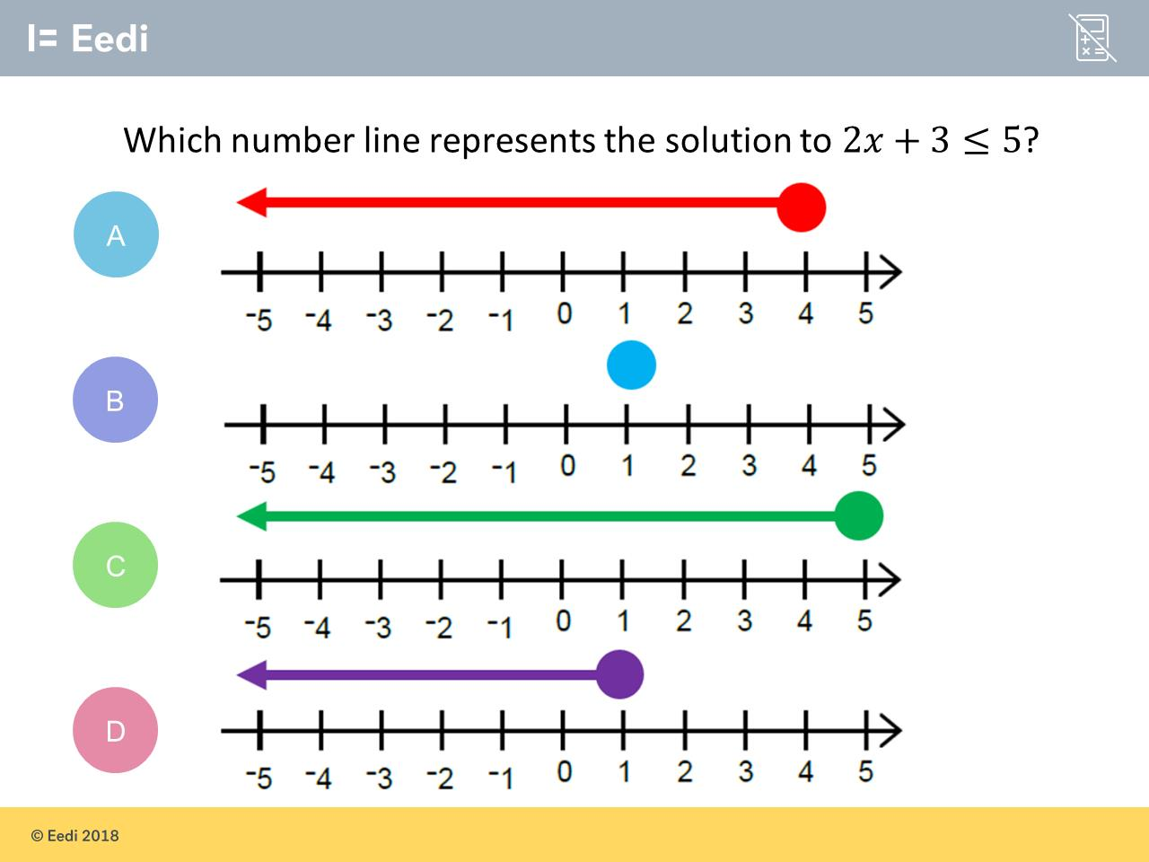
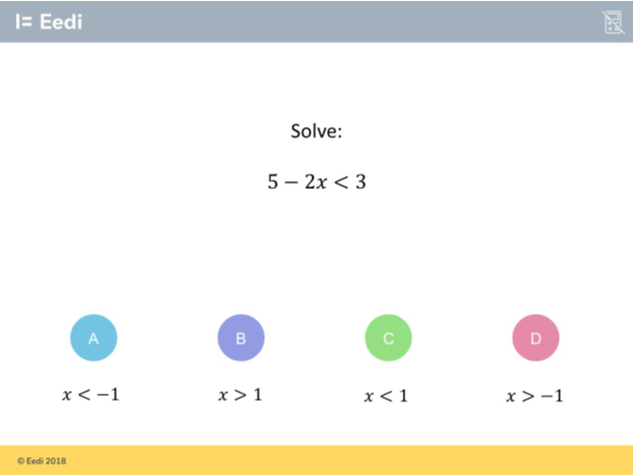
Worst answered question?
Most common wrong answer?

Slide 2
ANSWERS

Slide 3
Worst answered question?

Slide 4
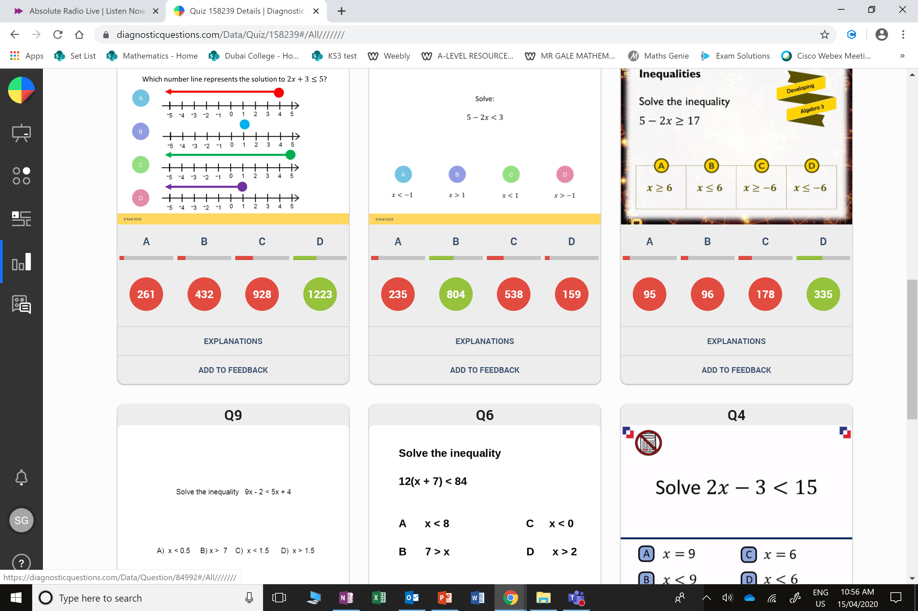
C
They did not solve the equation.
They just did a number line for ≤ 5

Slide 5
C
They forgot
as both sides get multiplied by -1
you need to change
the direction of
the inequality.

