Slide 1
LO: Converting between
Fractions, Decimals
and Percentages

Slide 2
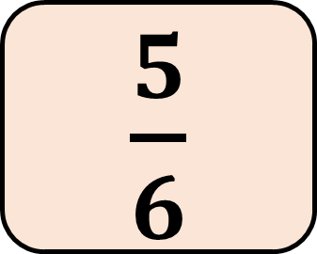
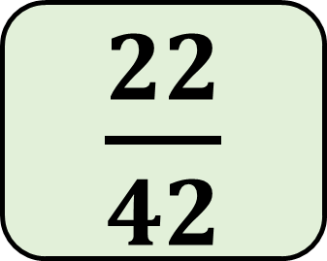
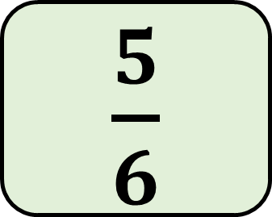
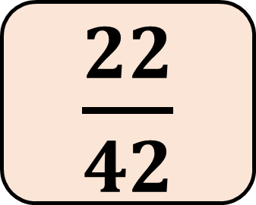
Place the cards in order.
0.5
$\frac{5}{6}$
74%
0.6
$\frac{22}{42}$
0.5
$\frac{22}{42}$
0.6
74%
$\frac{5}{6}$
Notes:
Ask pupils to pick out the smallest fraction, decimal or percentage and place it on the number line. Continue until each one is in place. Discuss how we could express all of these as percentages to order them more easily. Remind pupils that 1 = 100% and 2 = 200%.

Slide 3
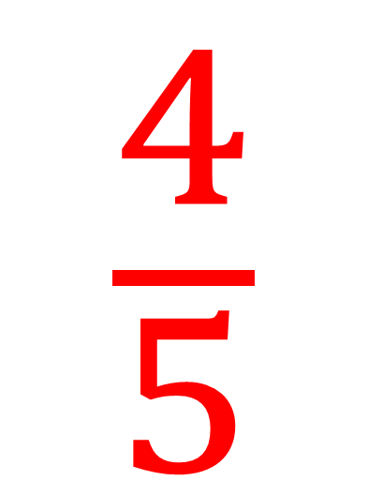
80%
$$\frac{4}{5}$$
0.8

Slide 4
80%
How do you convert 0.8 to 80%?
Multiply
by 100
0.8

Slide 5
80%
Divide
by 100
How do you convert 80% to 0.8?
0.8

Slide 6

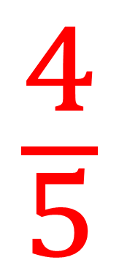
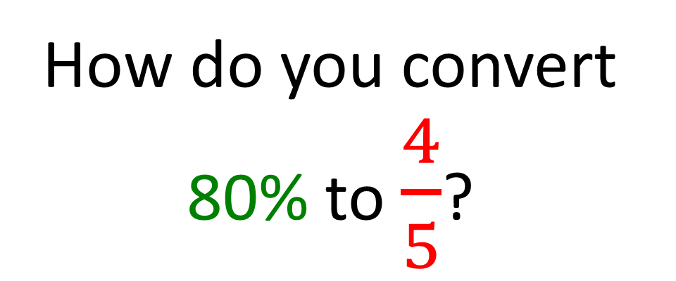
80%
Write as a fraction out of 100
$$\frac{80}{100}$$
(then simplify)
How do you convert 80% to $\frac{4}{5}$?
$$\frac{4}{5}$$

Slide 7
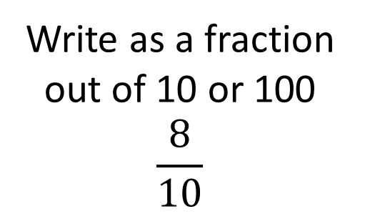
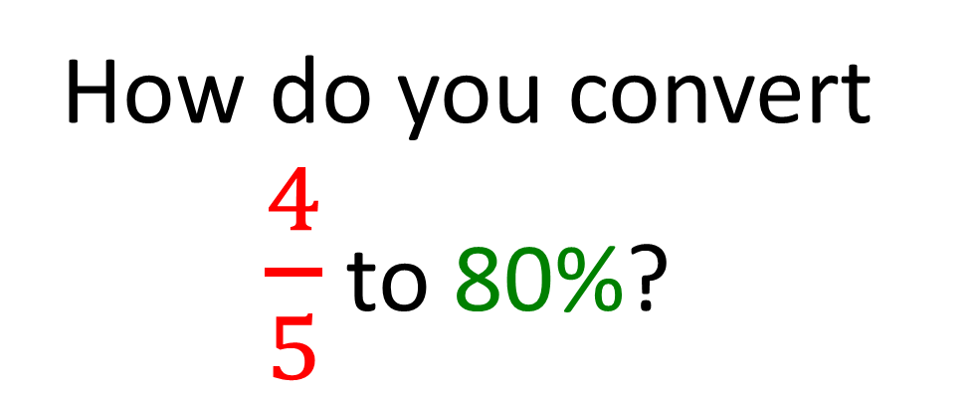
80%
Write as a fraction out of 10 or 100
$$\frac{8}{10}$$
How do you convert $\frac{4}{5}$ to 80%?
$$\frac{4}{5}$$

Slide 8
80%
Turn into a faction out of 10 or 100 and then divide
Divide
by 100
Write as a fraction of 100
(then simplify)
Multiply
by 100
$$\frac{4}{5}$$
0.8

Slide 9
80%
Turn into a faction out of 10 or 100 and then divide
Divide
by 100
Write as a fraction of 100
(then simplify)
Multiply
by 100
$$\frac{4}{5}$$
0.8

Slide 10
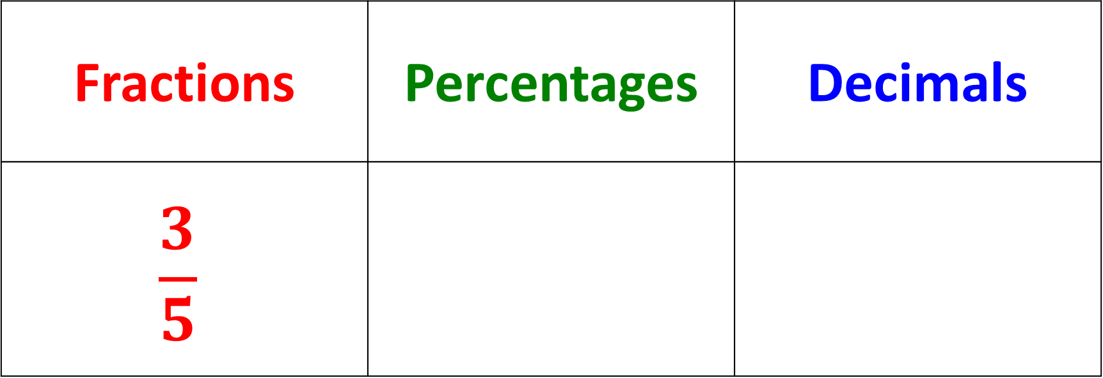
Fractions | Percentages | Decimals
$$\frac{3}{5}$$
60%
0.6

Slide 11


Fractions | Percentages | Decimals
 | 35%
$$\frac{35}{100}$$
$$\frac{7}{20}$$
=
0.35

Slide 12



Fractions | Percentages | Decimals
 |  | 0.005
$$\frac{0.5}{100}$$
$$\frac{5}{1000}$$
$$\frac{1}{200}$$
0.5%
=
=

