Slide 1
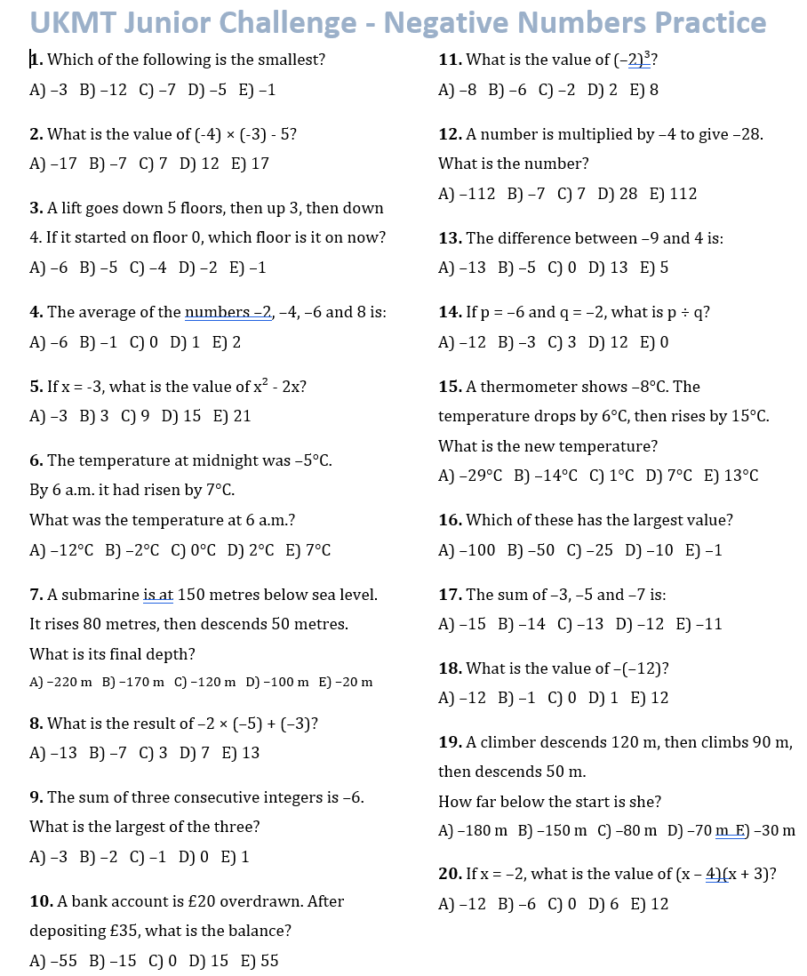

Slide 2
ANSWERS

Slide 3
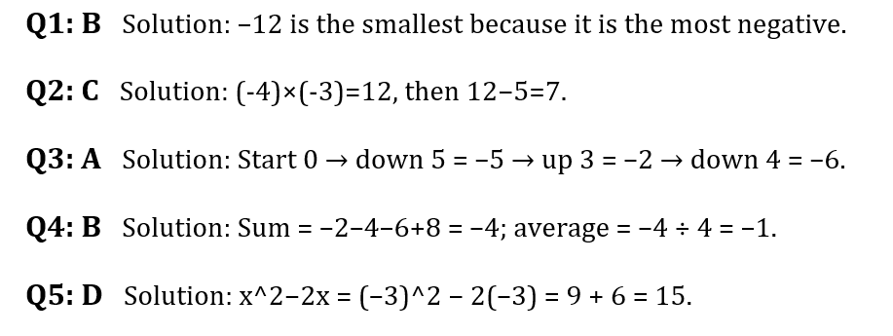
1. Which of the following is the smallest?
A) –3 B) –12 C) –7 D) –5 E) –1
2. What is the value of (-4) × (-3) - 5?
A) –17 B) –7 C) 7 D) 12 E) 17
3. A lift goes down 5 floors, then up 3, then down 4. If it started on floor 0, which floor is it on now?
A) –6 B) –5 C) –4 D) –2 E) –1
4. The average of the numbers –2, –4, –6 and 8 is:
A) –6 B) –1 C) 0 D) 1 E) 2
5. If x = -3, what is the value of x² - 2x?
A) –3 B) 3 C) 9 D) 15 E) 21

Slide 4
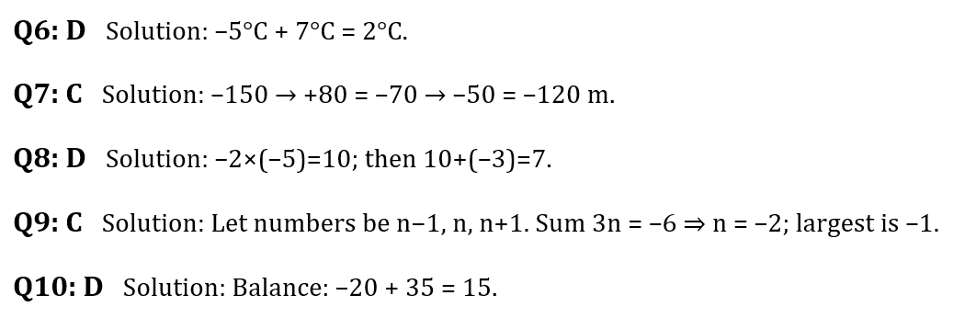
6. The temperature at midnight was –5°C. By 6 a.m. it had risen by 7°C. What was the temperature at 6 a.m.?
A) –12°C B) –2°C C) 0°C D) 2°C E) 7°C
7. A submarine is at 150 metres below sea level. It rises 80 metres, then descends 50 metres. What is its final depth?
A) –220 m B) –170 m C) –120 m D) –100 m E) –20 m
8. What is the result of –2 × (–5) + (–3)?
A) –13 B) –7 C) 3 D) 7 E) 13
9. The sum of three consecutive integers is –6. What is the largest of the three?
A) –3 B) –2 C) –1 D) 0 E) 1
10. A bank account is £20 overdrawn. After depositing £35, what is the balance?
A) –55 B) –15 C) 0 D) 15 E) 55

Slide 5
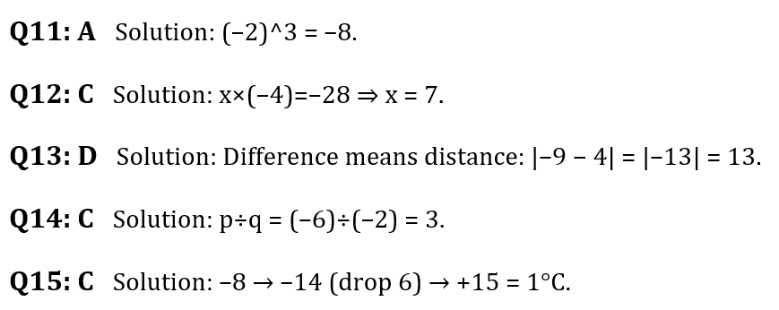
11. What is the value of (–2)³?
A) –8 B) –6 C) –2 D) 2 E) 8
12. A number is multiplied by –4 to give –28. What is the number?
A) –112 B) –7 C) 7 D) 28 E) 112
13. The difference between –9 and 4 is:
A) –13 B) –5 C) 0 D) 13 E) 5
14. If p = –6 and q = –2, what is p ÷ q?
A) –12 B) –3 C) 3 D) 12 E) 0
15. A thermometer shows –8°C. The temperature drops by 6°C, then rises by 15°C. What is the new temperature?
A) –29°C B) –14°C C) 1°C D) 7°C E) 13°C

Slide 6
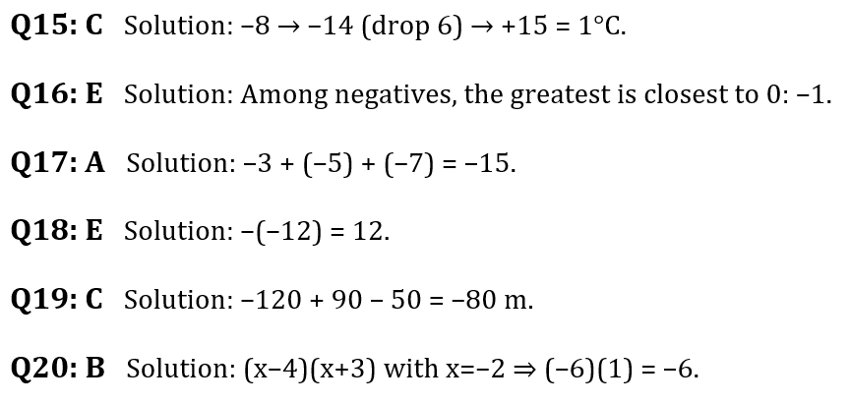
16. Which of these has the largest value?
A) –100 B) –50 C) –25 D) –10 E) –1
17. The sum of –3, –5 and –7 is:
A) –15 B) –14 C) –13 D) –12 E) –11
18. What is the value of –(–12)?
A) –12 B) –1 C) 0 D) 1 E) 12
19. A climber descends 120 m, then climbs 90 m, then descends 50 m. How far below the start is she?
A) –180 m B) –150 m C) –80 m D) –70 m E) –30 m
20. If x = –2, what is the value of (x – 4)(x + 3)?
A) –12 B) –6 C) 0 D) 6 E) 12

