Slide 1
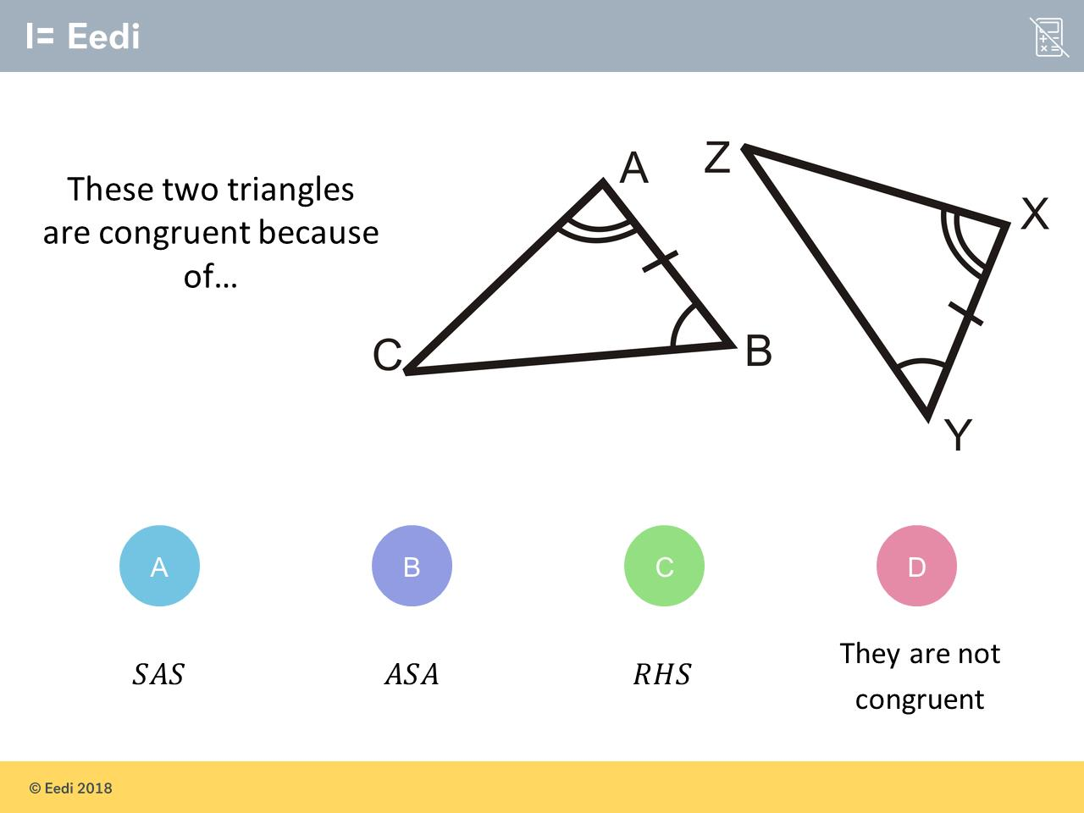
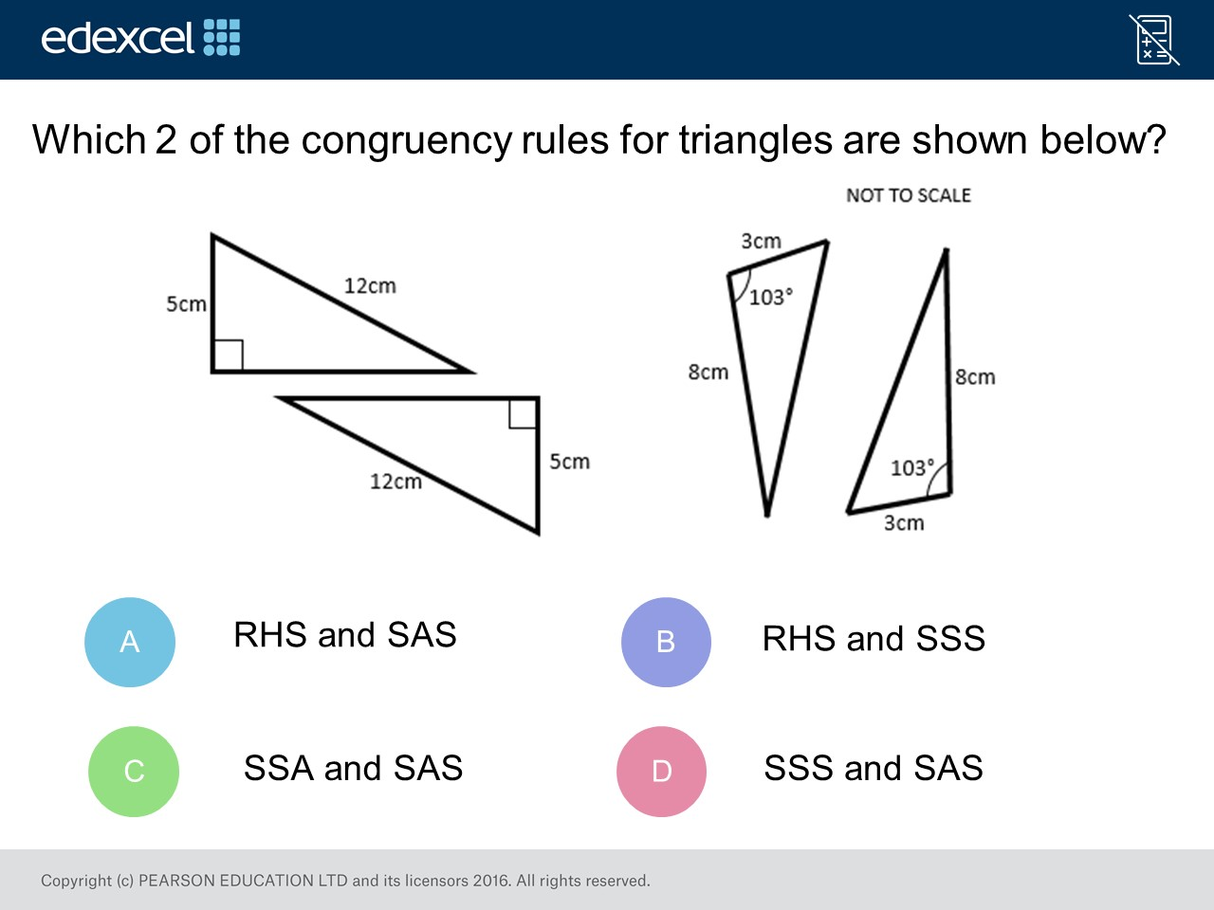
Worst answered question?
Most common wrong answer?

Slide 2
ANSWERS

Slide 3
Worst answered question?

Slide 4
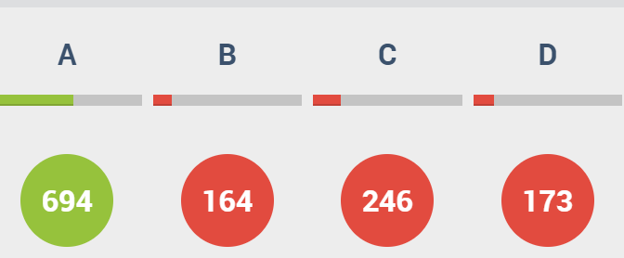
C
They did described
the right angle as
an angle.
Plus they described
the hypotenuse as
only a side.

Slide 5
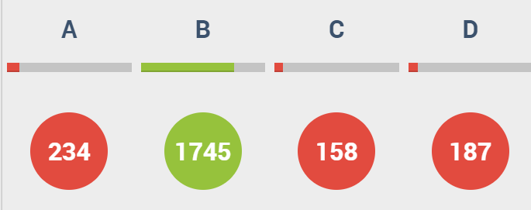
A
They got
the side and angles mixed up.

