Slide 1
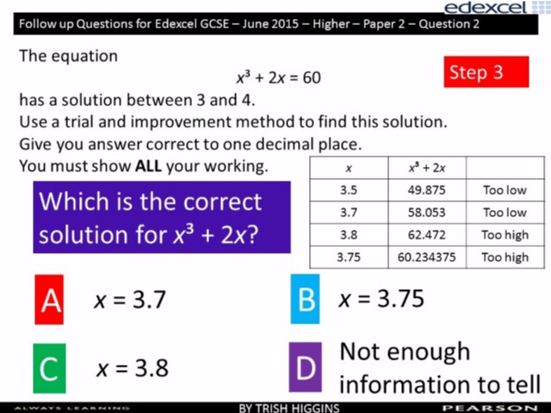
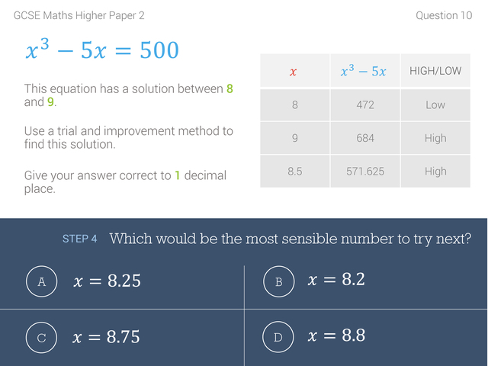
Worst answered question?
Most common wrong answer?

Slide 2
ANSWERS

Slide 3
Worst answered question?

Slide 4
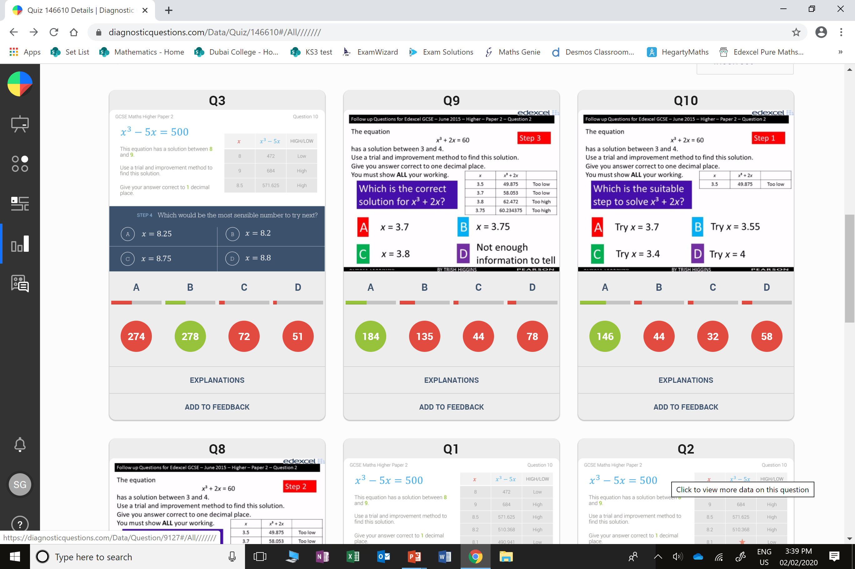
A
They skipped
a step.

Slide 5
B
The answer should be to
1 decimal place.

