Slide 1
LO: Converting Units (Area and Volume)

Slide 2
How do you convert cm to mm?
Multiply by 10

Slide 3
How do you convert
metres to mm?
Multiply by 1000

Slide 4
How do you convert
metres to km?
Divide by 1000

Slide 5
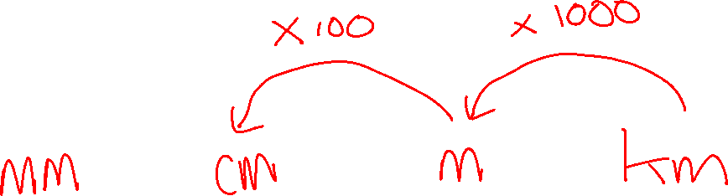

Slide 6
Convert
20
mm
to
cm
2

Slide 7
Convert
4
km
to
metres
4000

Slide 8
Convert
427
cm
to
metres
4.27

Slide 9
Convert
2.4
cm
to
mm
24

Slide 10
What units are area and
which ones are volume?
km³
cm³
mm²
cm²
m³
m²
km²
mm³

Slide 11
How do you know if a unit is
a unit of AREA?
They are squared (mm² cm² km²)
How do you know if a unit is
a unit of VOLUME?
They are cubed (mm³ cm³ km³)

Slide 12
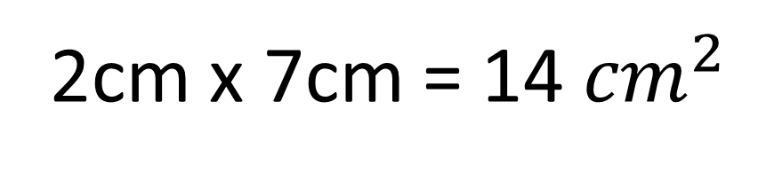
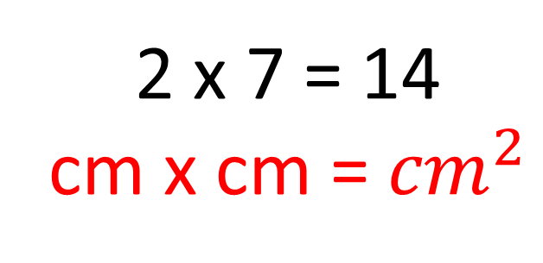
Why are units of area squared?
Because two dimensions get multiplied.
2 x 7 = 14
cm x cm = ${cm}^{2}$
2 cm
2cm x 7cm = 14 ${cm}^{2}$
7 cm

Slide 13
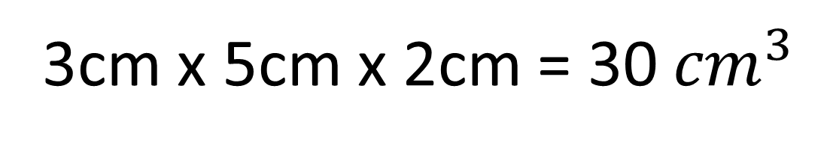
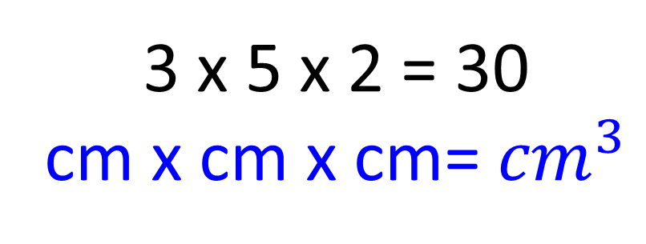
Why are units of volume cubed?
Because three dimensions get multiplied.
5 cm
3 x 5 x 2 = 30
cm x cm x cm= ${cm}^{3}$
3 cm
2 cm
3cm x 5cm x 2cm = 30 ${cm}^{3}$

Slide 14
5 cm
50 mm
5 cm
50 mm
5 x 5 = 25cm²
50 x 50 = 2500mm²

Slide 15
cm to mm
3
30
x 10
cm² to mm²
3
300
x 100

Slide 16
Convert Area Units
20
cm²
to
mm²
2000

Slide 17
Convert Area Units
40
mm²
to
cm²
0.4

Slide 18
Convert Area Units
5
m²
to
mm²
5,000,000

Slide 19
5cm
50mm
5cm
50mm
5cm
50mm
5 x 5 x 5 = 125cm³
50 x 50 x 50 = 125000mm³

Slide 20
cm to mm
5
50
x 10
cm³ to mm³
5
5000
x 1000

Slide 21
Convert Volume Units
125
cm³
to
mm³
125000

Slide 22
Convert Volume Units
6.2
m³
to
cm³
6,200,000

Slide 23
Convert Volume Units
50
cm³
to
m³
0.00005

Slide 24
÷ 10
÷ 100
÷ 1000
Length Conversions
m
km
mm
cm
x 10
x 100
x 1000
÷ 10²
÷ 100²
÷ 1000²
Area Conversions
m²
km²
mm²
cm²
x 10²
x 100²
x 1000²
÷ 10³
÷ 100³
÷ 1000³
Volume Conversions
m³
km³
mm³
cm³
x 10³
x 100³
x 1000³

Slide 25
Area Conversions
Length Conversions squared
Volume Conversions
Length Conversions cubed

