Slide 1
LO: Compound
Measures

Slide 2
cm³
What is measured
with the above unit?
Volume

Slide 3
kg
What is measured
with the above unit?
Mass

Slide 4
cm
What is measured
with the above unit?
Distance

Slide 5
m²
What is measured
with the above unit?
Area

Slide 6
grams
What is measured
with the above unit?
Mass

Slide 7
Newtons
What is measured
with the above unit?
Force

Slide 8
What is a
Compound Measure?
Compound measures
are where the units have
two measurements.

Slide 9
Why are the measurements
grouped the way they are?
Distance
Force
Speed
Volume
Area
Density
Pressure
Mass
Time

Slide 10
Why are the units
grouped the way they are?
km
Newtons
km/h
cm³
cm²
g/cm³
grams
seconds
N/cm²

Slide 11
LO: Compound Measures
What is a compound measure?
Compound measures
are where the units have
two measurements.

Slide 12
Miles per hour
What is measured
with the above unit?
Speed

Slide 13
metres per second
What is measured
with the above unit?
Speed

Slide 14
grams per cm³
What is measured
with the above unit?
Density

Slide 15
Newtons per cm²
What is measured
with the above unit?
Pressure

Slide 16
kg per m³
What is measured
with the above unit?
Density

Slide 17
Newtons per mm²
What is measured
with the above unit?
Pressure

Slide 18
Speed is a compound measure.
km/h
m/h
m/s

Slide 19
Density is a compound measure.
kg/cm³
grams/m³
kg/m³

Slide 20
Pressure is a compound measure.
N/cm²
N/m²
N/km²

Slide 21

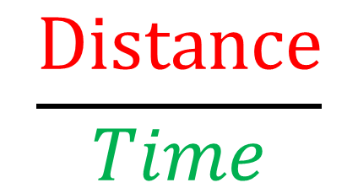
The units of a compound measure
tell you how they are calculated.
mph
$$\frac{Distance}{Time}$$
m/h
Speed =
$$\frac{miles}{hour}$$

Slide 22
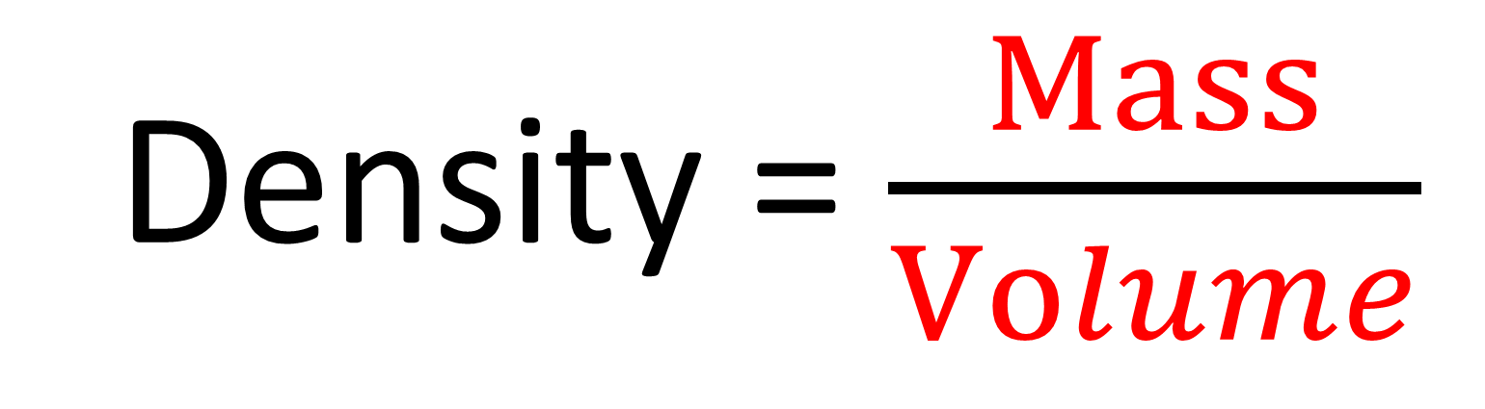
What's the formula?
kg/cm³
Density = $\frac{Mass}{Volume}$

Slide 23
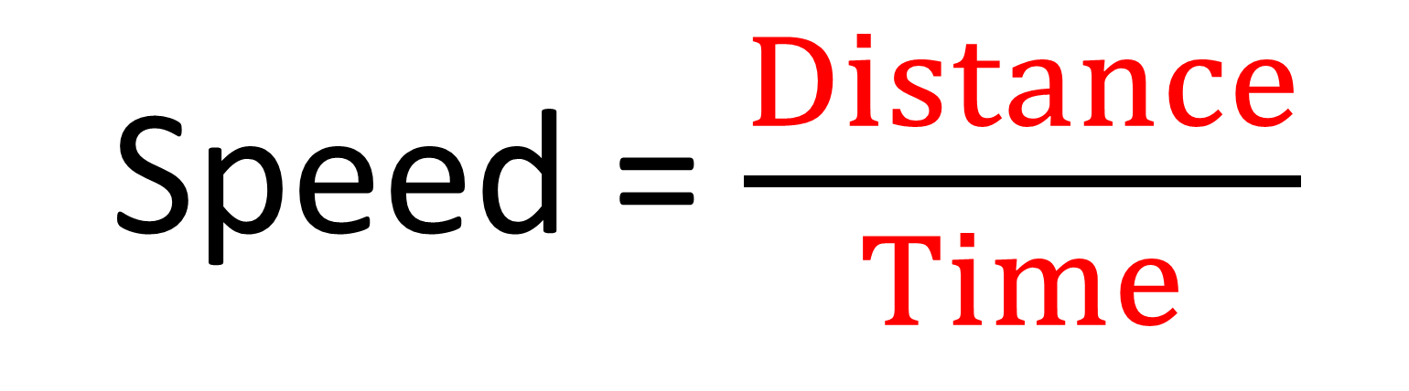
What's the formula?
m/h
Speed = $\frac{Distance}{Time}$

Slide 24
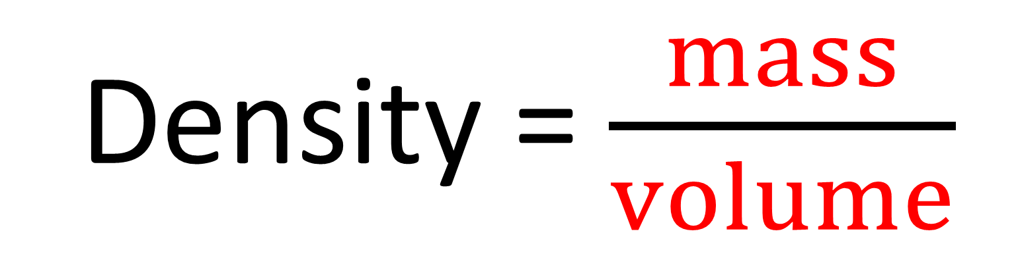
What's the formula?
g/m³
Density = $\frac{mass}{volume}$

Slide 25
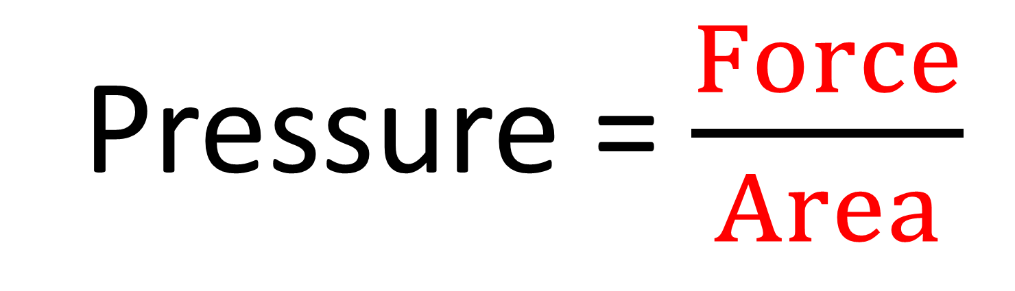
What's the formula?
N/m²
Pressure = $\frac{Force}{Area}$

Slide 26
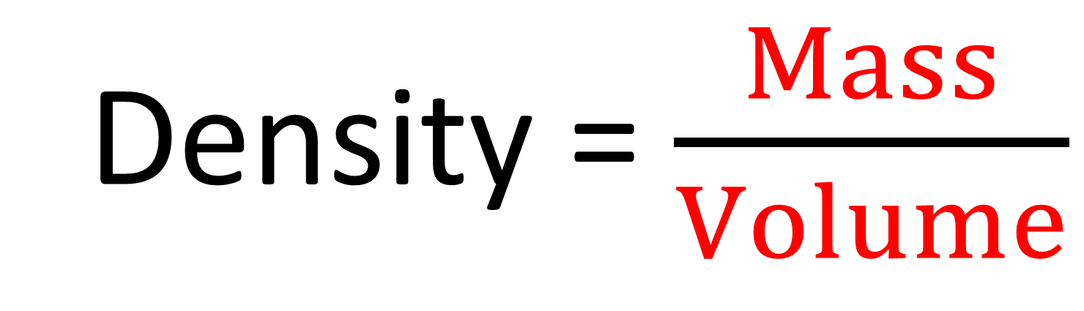
What's the formula?
kg/cm³
Density = $\frac{Mass}{Volume}$

Slide 27
What's the formula?
metres per second
Speed = $\frac{Distance}{Time}$

