Slide 1
LO: Standard Form

Slide 2
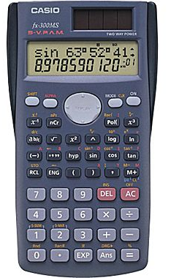
How many digits can your calculator display?
Standard form
is a method for writing
very big number and
very small numbers.

Slide 3
Below are two examples of standard form numbers.
What do you notice about standard form numbers?
5.97 × 10²⁴
1.7 × 10⁻⁶

Slide 4
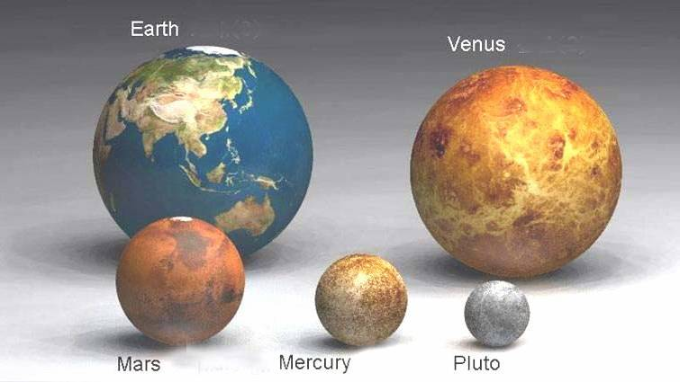
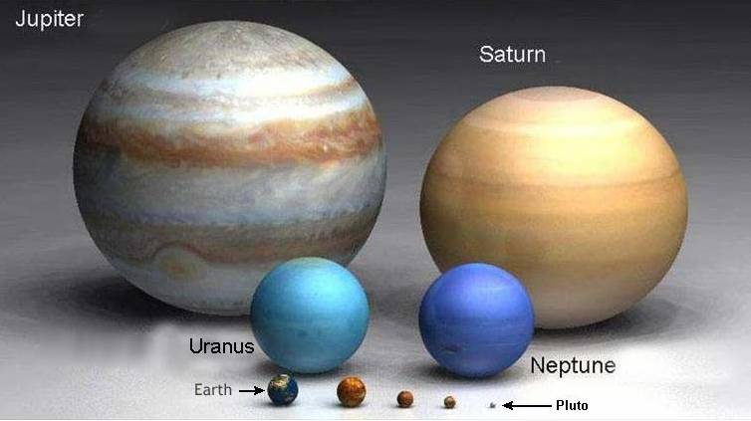
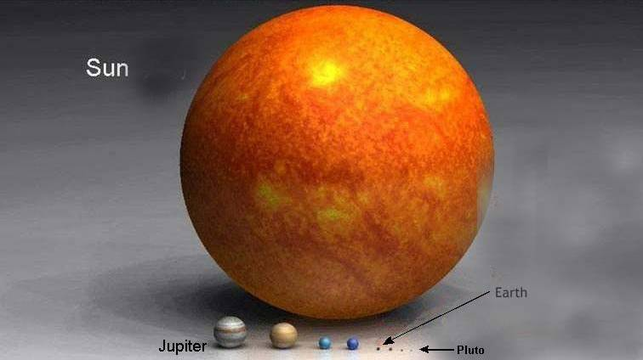
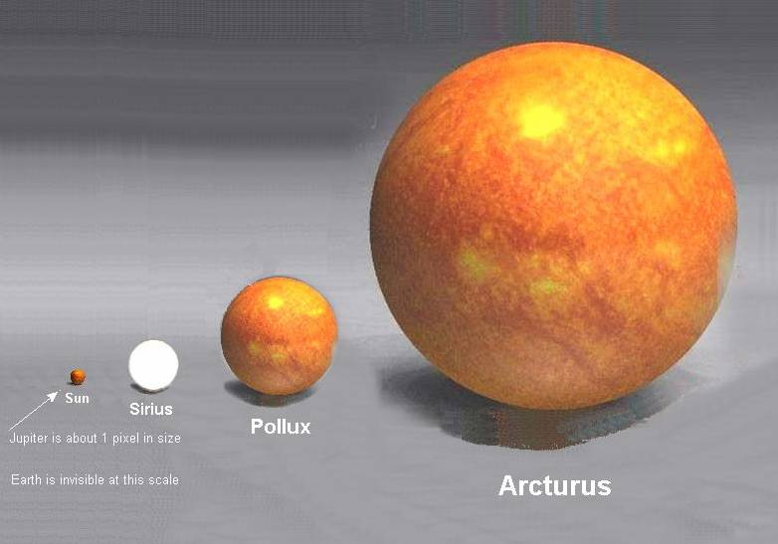
Some calculations require very, very, very, very, extreme numbers!

Slide 5
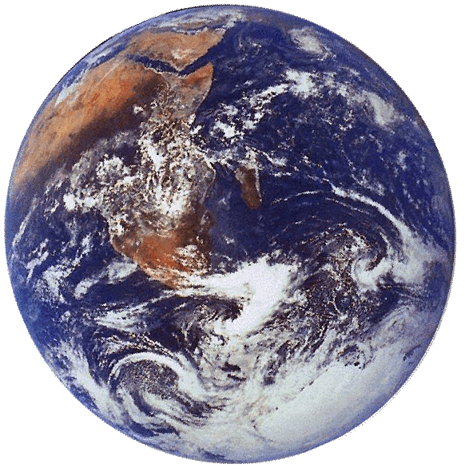
For example, the mass of the planet earth is about
5 970 000 000 000 000 000 000 000 kg.
5.97 × 10²⁴ kg
A power of ten
A number between
1 and 10

Slide 6
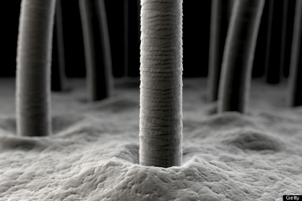
For example, the diameter of a human hair is about
0.0000017m
1.7 × 10 ⁻⁶ m
A power of ten
A number between
1 and 10

Slide 7
Convert the standard form
to an ordinary number
5 × 10¹⁰ =
50 000 000 000

Slide 8
Convert the standard form
to an ordinary number
7.1 × 10⁶ =
7 100 000

Slide 9
Convert the standard form
to an ordinary number
4.28 × 10⁵ =
428 000

Slide 10
Convert the standard form
to an ordinary number
5 × 10⁻⁶ =
0.000005

Slide 11
Convert the standard form
to an ordinary number
7.1 × 10⁻⁴ =
0.00071

Slide 12
Convert the standard form
to an ordinary number
4.28 × 10⁻⁵ =
0.0000428

Slide 13
Convert the ordinary number
to standard form
8 000 000 =
8 × 10⁶

Slide 14
Convert the ordinary number
to standard form
230 000 000 =
2.3 × 10⁸

Slide 15
Convert the ordinary number
to standard form
603 000 =
6.03 × 10⁵

Slide 16
Convert the ordinary number
to standard form
0.0000008 =
8 × 10⁻⁷

Slide 17
Convert the ordinary number
to standard form
0.00000069 =
6.9 × 10⁻⁷

Slide 18
Convert the ordinary number
to standard form
0.000304 =
3.04 × 10⁻⁴

Slide 19
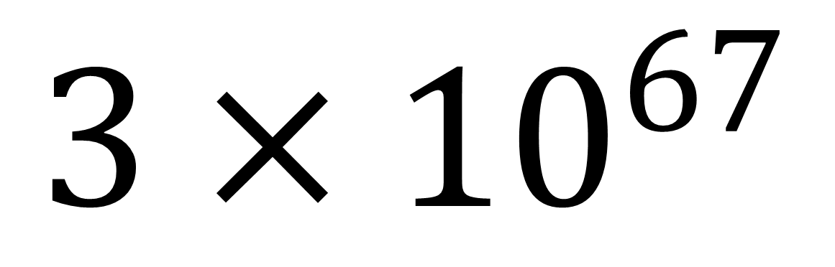
Correct Standard Form
$$3×{10}^{67}$$
True or False

Slide 20
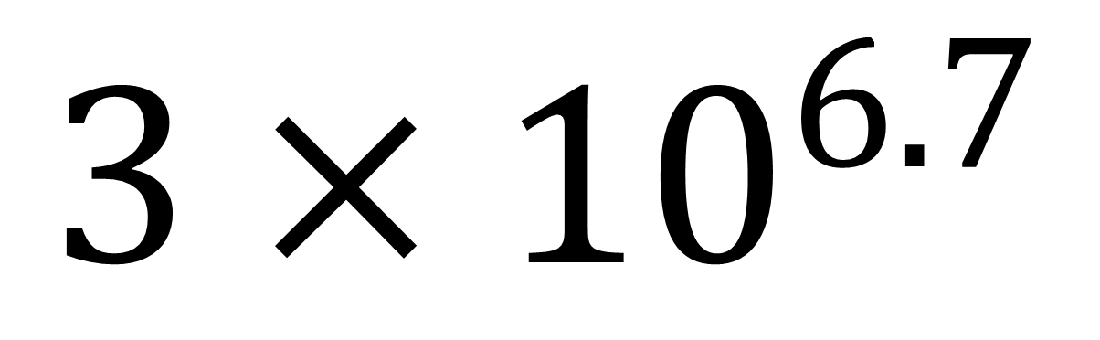
Correct Standard Form
$$3×{10}^{6.7}$$
True or False

Slide 21
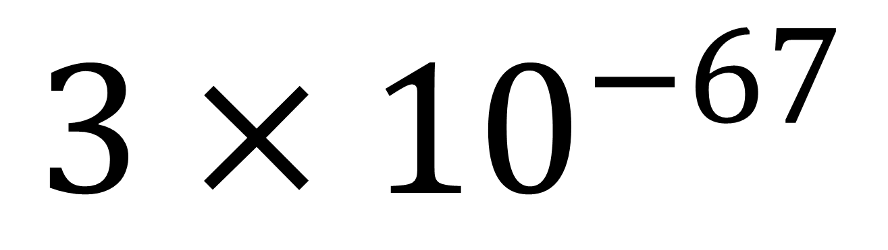
Correct Standard Form
$$3×{10}^{−67}$$
True or False

Slide 22
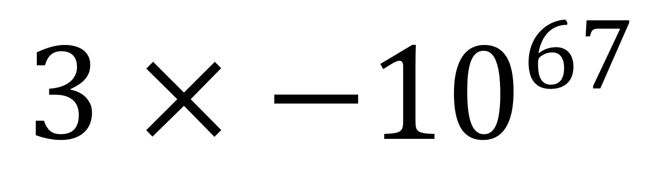
Correct Standard Form
$$3×{−10}^{67}$$
True or False

Slide 23
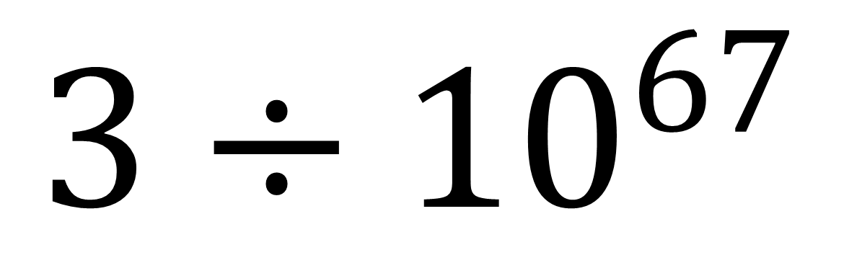
Correct Standard Form
$$3÷{10}^{67}$$
True or False

Slide 24
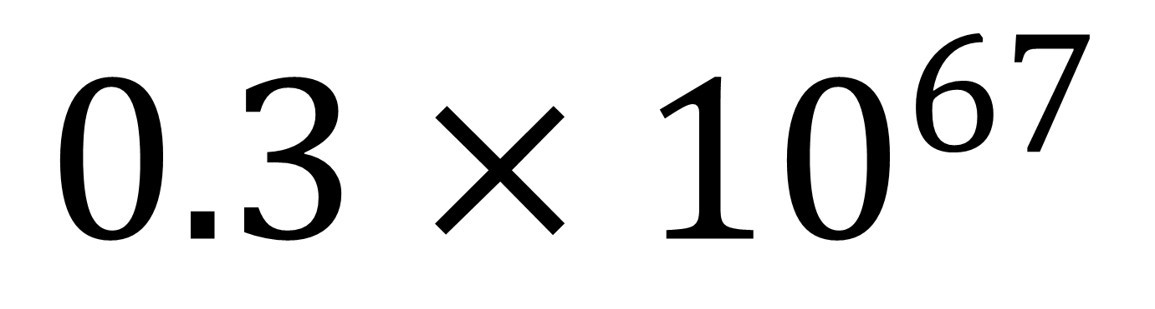
Correct Standard Form
$$0.3×{10}^{67}$$
True or False

Slide 25
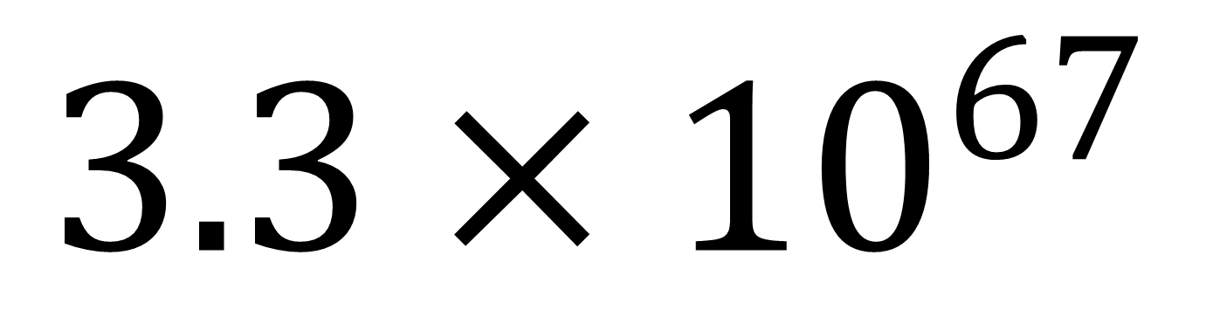
Correct Standard Form
$$3.3×{10}^{67}$$
True or False

Slide 26
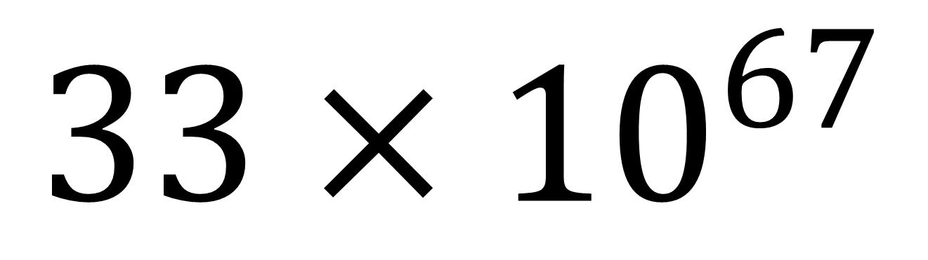
Correct Standard Form
$$33×{10}^{67}$$
True or False

Slide 27
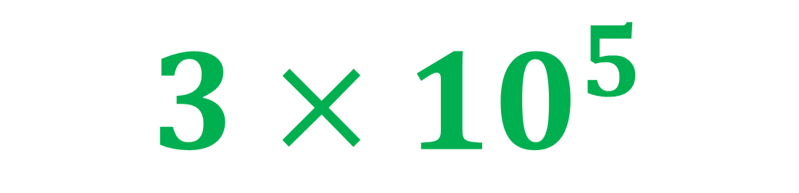
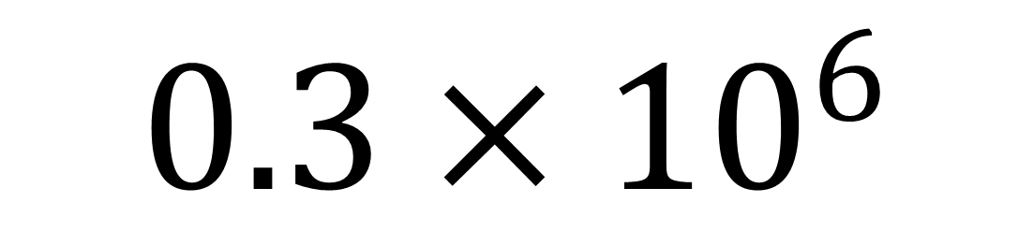
Change into correct Standard Form
$$0.3×{10}^{6}$$
$$3×{10}^{5}$$

Slide 28
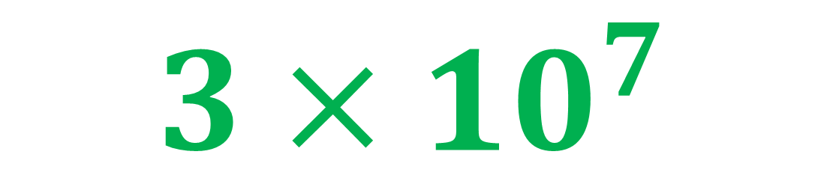
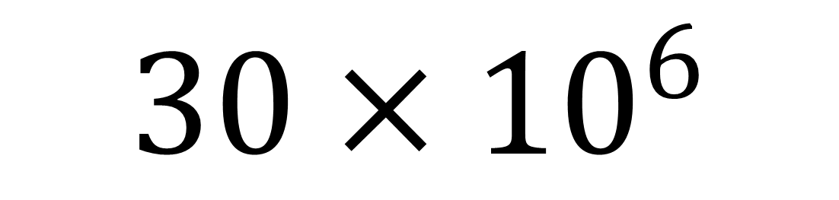
Change into correct Standard Form
$$30×{10}^{6}$$
$$3×{10}^{7}$$

Slide 29
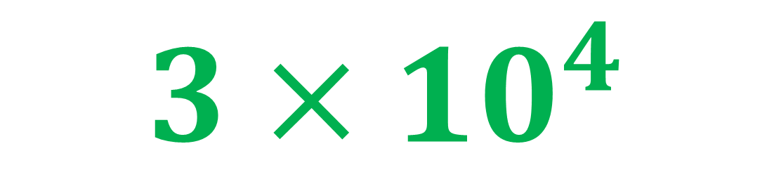
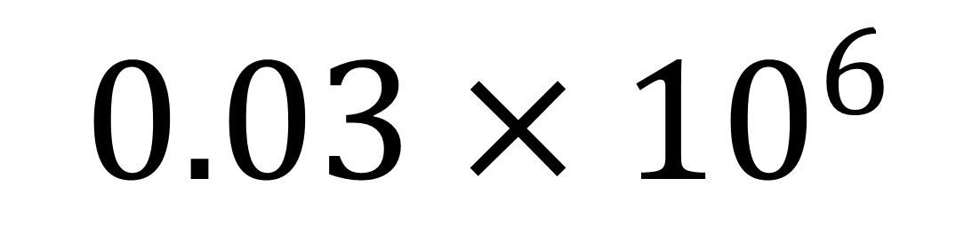
Change into correct Standard Form
$$0.03×{10}^{6}$$
$$3×{10}^{4}$$

Slide 30
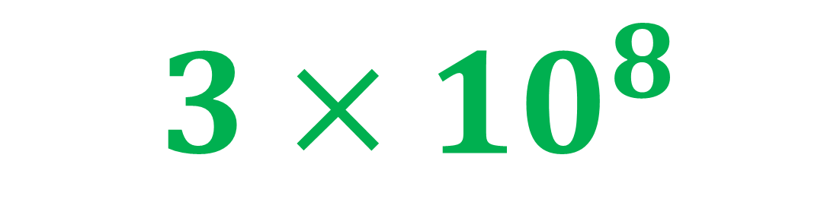
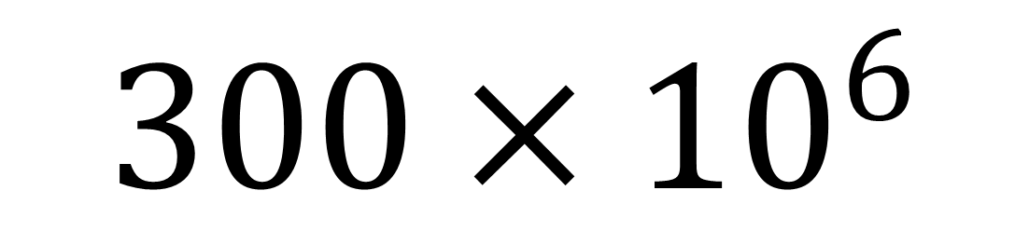
Change into correct Standard Form
$$300×{10}^{6}$$
$$3×{10}^{8}$$

Slide 31
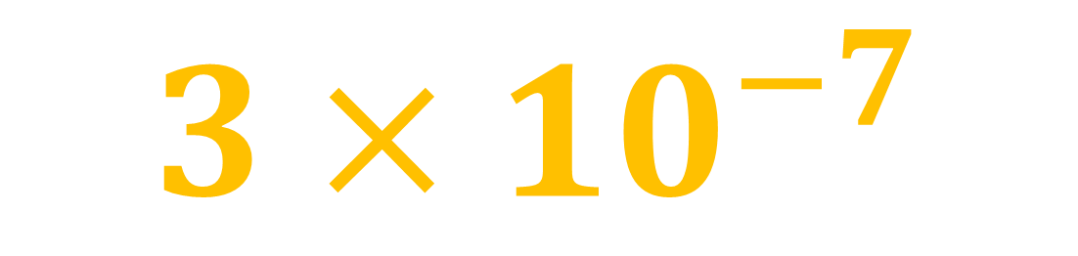
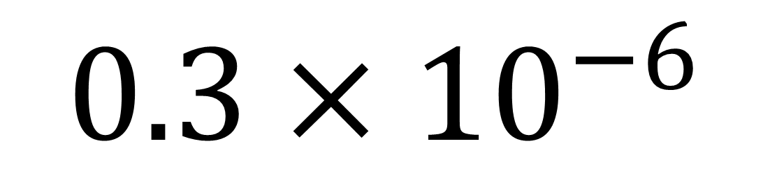
Change into correct Standard Form
$$0.3×{10}^{−6}$$
$$3×{10}^{−7}$$

Slide 32
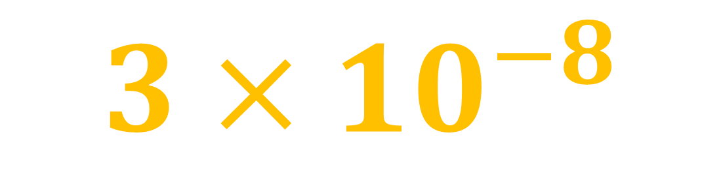
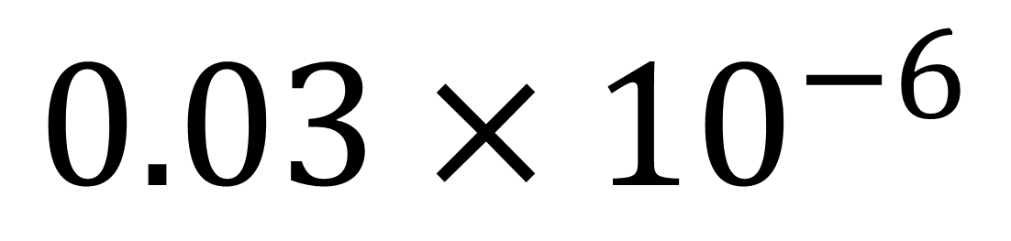
Change into correct Standard Form
$$0.03×{10}^{−6}$$
$$3×{10}^{−8}$$

Slide 33
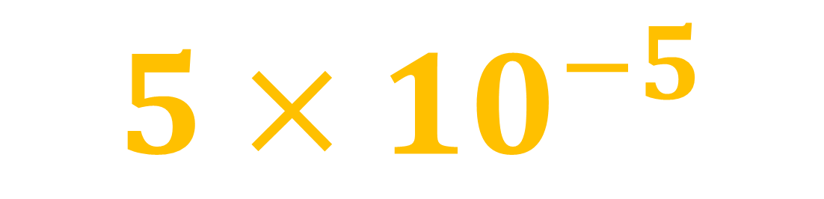
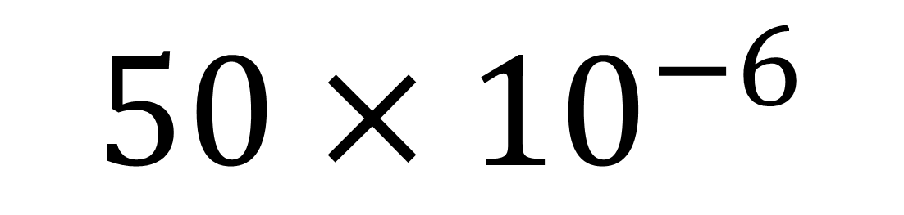
Change into correct Standard Form
$$50×{10}^{−6}$$
$$5×{10}^{−5}$$

Slide 34
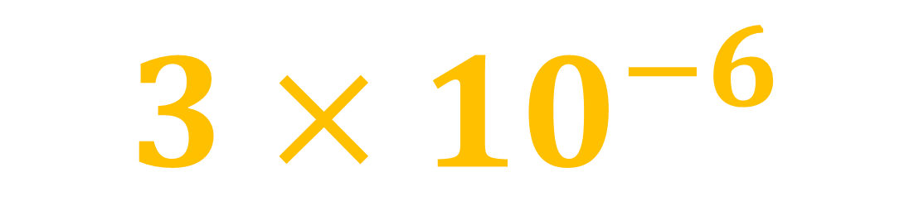
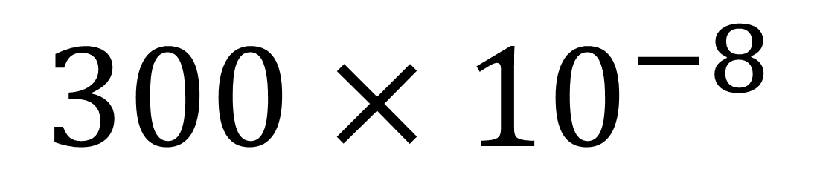
Change into correct Standard Form
$$300×{10}^{−8}$$
$$3×{10}^{−6}$$

