Slide 1
Sketching Graphs
Cubic Graphs
Chapter 4
(Part 1 of 5)

Slide 2
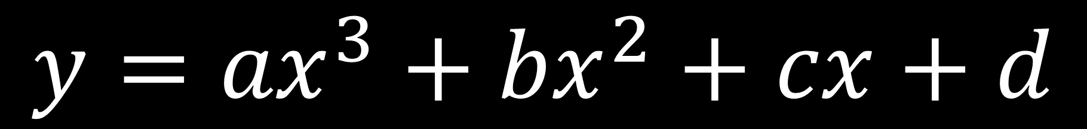
Cubic Graphs
$$y={{ax}^{3}+bx}^{2}+cx+d$$

Slide 3
Questions you should ask yourself
when sketching a cubic graph.
General Shape
Positive or negative gradient?
x Intercepts
Where does the graph cross the x axis?
y Intercept
What is the constant?

Slide 4


Which graph has a positive gradient?
Positive Gradient
Negative Gradient
$$x^{3}$$
$${−x}^{3}$$

Slide 5


Three Roots
The graph will intercept the x axis three times.
$$y$$
$$x$$

Slide 6








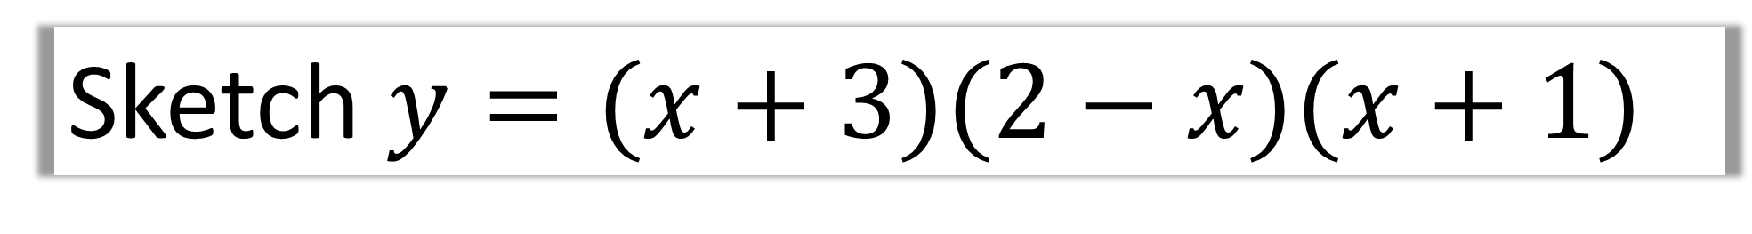

Sketch $y=(x+3)(2−x)(x+1)$
Positive or negative gradient?
$$y$$
$$\left(x\right)\left(−x\right)\left(x\right)= {−x}^{3}$$
Negative
x intercepts?
$$6$$
$$−3, 2, −1$$
$$−3$$
$$−1$$
$$2$$
$$x$$
What is the constant?
$$\left(3\right)\left(2\right)\left(1\right)=6$$

Slide 7


Two Equal Roots
The graph will bounce off the x axis at a double root.
$$y$$
$$x$$

Slide 8



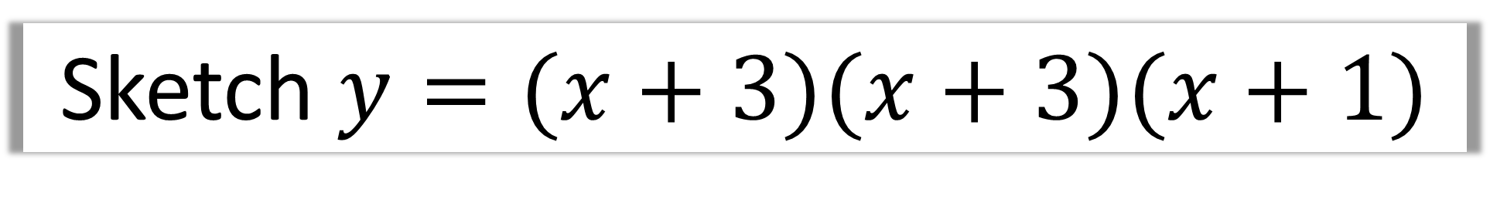




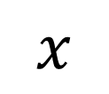
Sketch $y=(x+3)(x+3)(x+1)$
Positive or negative gradient?
$$y$$
$$\left(x\right)\left(x\right)\left(x\right)= x^{3}$$
Positive
$$9$$
x intercepts?
$$−3, −3, −1$$
$$x$$
$$−3$$
$$−1$$
What is the constant?
$$\left(3\right)\left(3\right)\left(1\right)=9$$

Slide 9



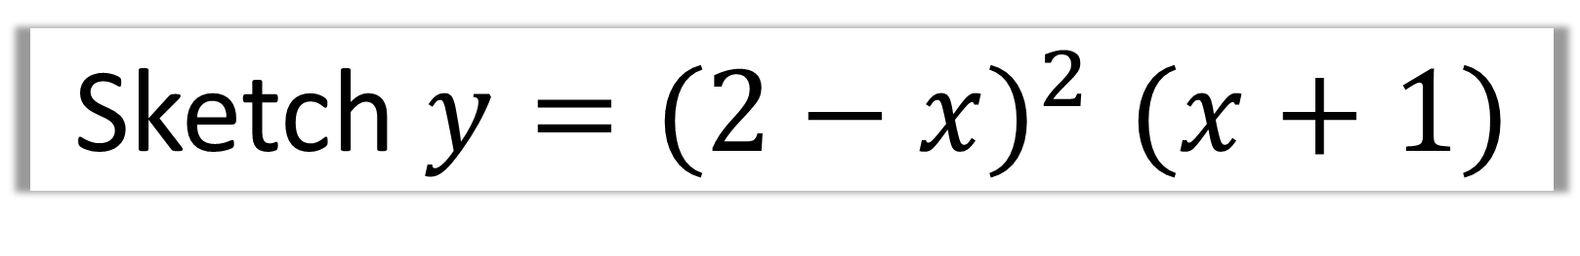




Sketch $y{=(2−x)}^{2}(x+1)$
Positive or negative gradient?
$$y$$
$$\left(−x\right)\left(−x\right)\left(x\right)= x^{3}$$
Positive
$$4$$
x intercepts?
$$2,2, −1$$
$$−1$$
$$2$$
$$x$$
What is the constant?
$$\left(2\right)\left(2\right)\left(1\right)=4$$

Slide 10


Three Equal Roots
The graph will produce a point of inflection.
$$y$$
$$x$$

Slide 11





Sketch $y=(x+3)(x+3)(x+3)$
Positive or negative gradient?
$$y$$
$$\left(x\right)\left(x\right)\left(x\right)= x^{3}$$
Positive
$$27$$
x intercepts?
$$−3,−3, −3$$
$$−3$$
$$x$$
What is the constant?
$$\left(3\right)\left(3\right)\left(3\right)=27$$

Slide 12
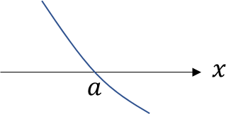
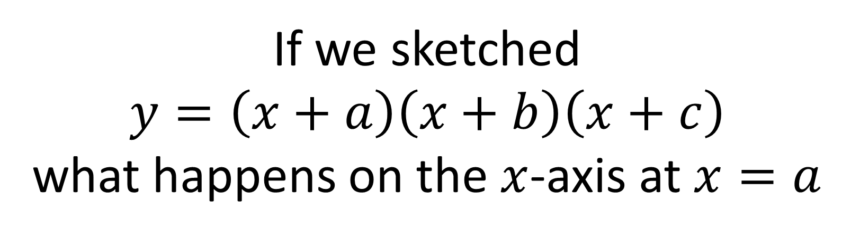
Recap
If we sketched
$$y=\left(x+a\right)\left(x+b\right)\left(x+c\right)$$
what happens on the $x$-axis at $x=a$
The line crosses the axis.

Slide 13
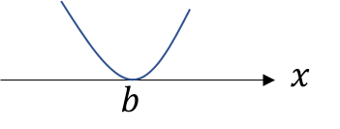
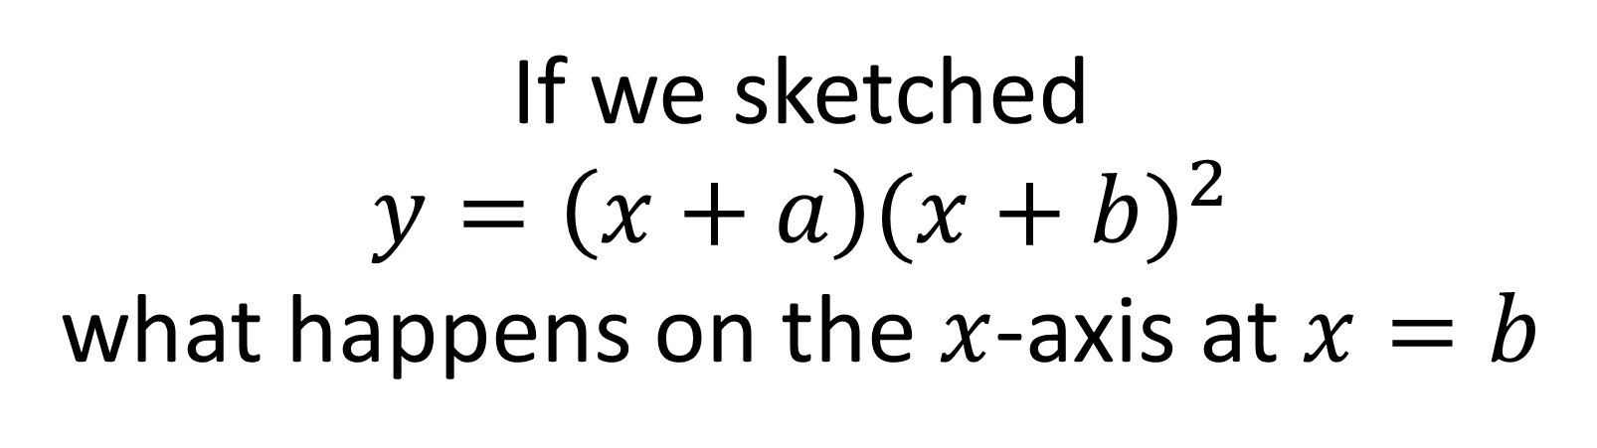
Recap
If we sketched
$$y=\left(x+a\right){(x+b)}^{2}$$
what happens on the $x$-axis at $x=b$
The line touches the axis.

Slide 14
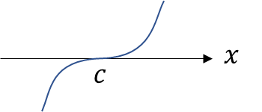
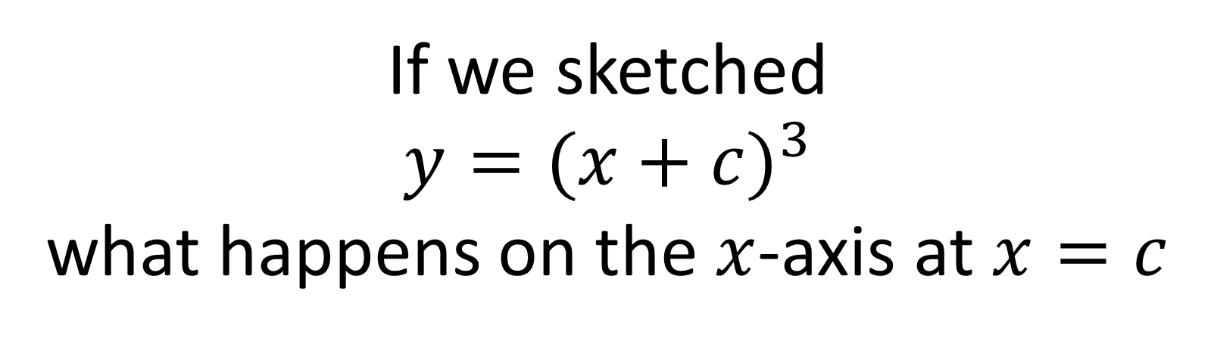
Recap
If we sketched
$$y={(x+c)}^{3}$$
what happens on the $x$-axis at $x=c$
Point of inflection on the axis.

Slide 15

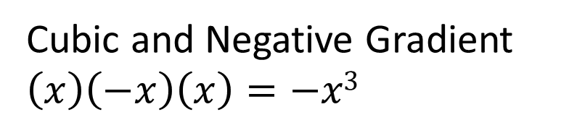

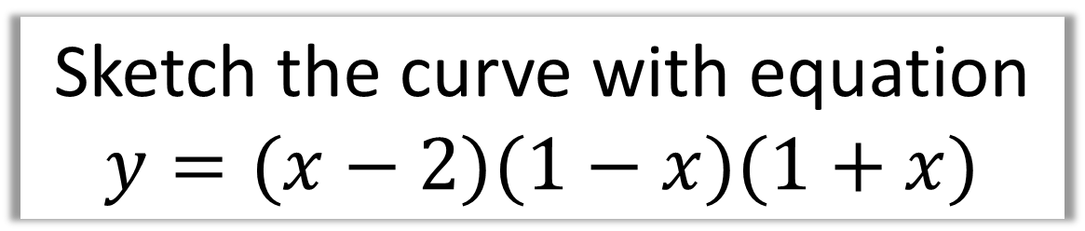




Sketch the curve with equation
$$y=(x−2)(1−x)(1+x)$$
$$y$$
Cubic and Negative Gradient
$\left(x\right)\left(−x\right)\left(x\right)=−x3$
$$x=2, 1 and −1$$
$$x$$
$$y=\left(−2\right)\left(1\right)\left(1\right)=−2$$
$$−1$$
1
2
$$−2$$

Slide 16





Sketch the curve with equation
$$y=x^{2}(x−1)$$
Cubic and Positive
$$y$$
$$x=0 and x=1$$
$$x$$
y = (0)(0)(-1) = 0
$$0$$
1

Slide 17





Sketch the curve with equation
$$y={\left(x−4\right)}^{3}$$
$$y$$
Cubic and Positive
$$x=4$$
$$x$$
$$y=−64$$
4
-64

Slide 18

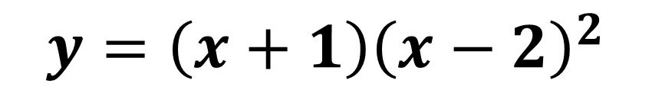
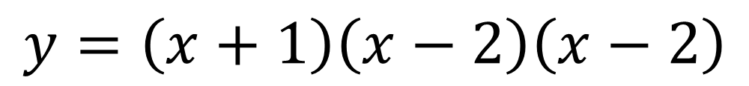
Write the equation of the curve in the diagram
The roots are $−1, 2$ and $2$.
$$y=\left(x+1\right)\left(x−2\right)\left(x−2\right)$$
$$y={\left(x+1\right)\left(x−2\right)}^{2}$$

Slide 19

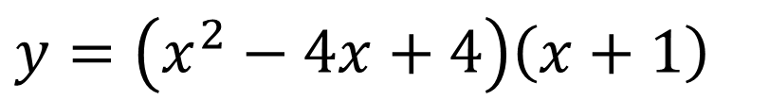


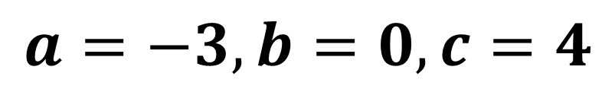
The equation of the curve $C$ can be written in the form.
$$y=x^{3}+ax^{2}+bx+c$$
where $a$, $b$ and $c$ are integers. Calculate the values of $a,b,c$.
$$y={\left(x−2\right)}^{2}\left(x+1\right)$$
$$y=\left(x^{2}−4x+4\right)\left(x+1\right)$$
$$y=x^{3}+x^{2}−4x^{2}−4x+4x+4$$
$$y=x^{3}−3x^{2}+4$$
$$a=−3, b=0, c=4$$

