Slide 1
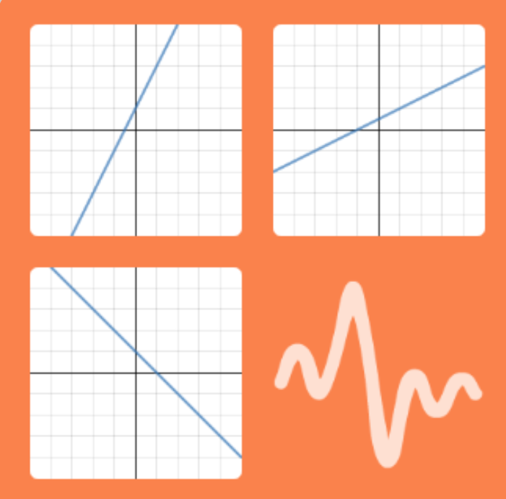
Guess Who
Click Here
Play in two and describe the line.

Slide 2
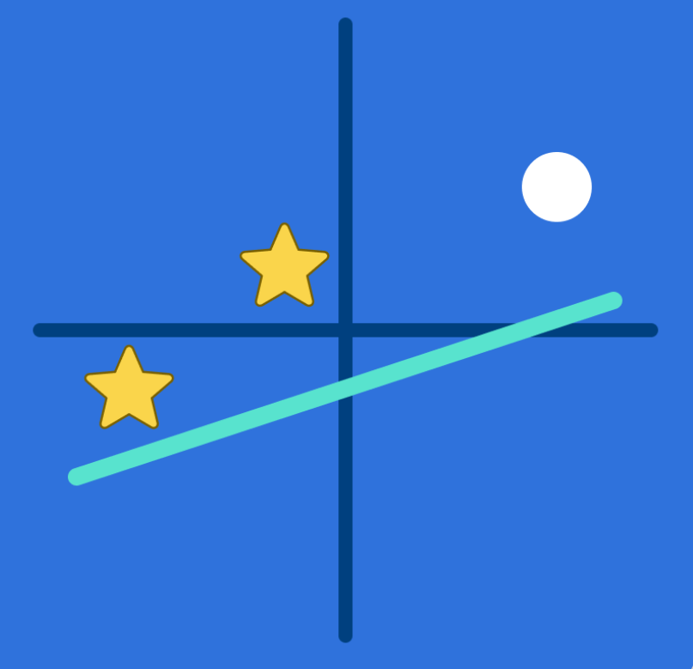
Marble Slides
Click Here
Change equations so that the marbles
go through the stars

