Slide 1

Diagnostic Assessment .Delta 2
Unit 1
HCF and LCM
Indices
Powers of 10
Rounding: Significant Figures
Estimating Calculations

Slide 2
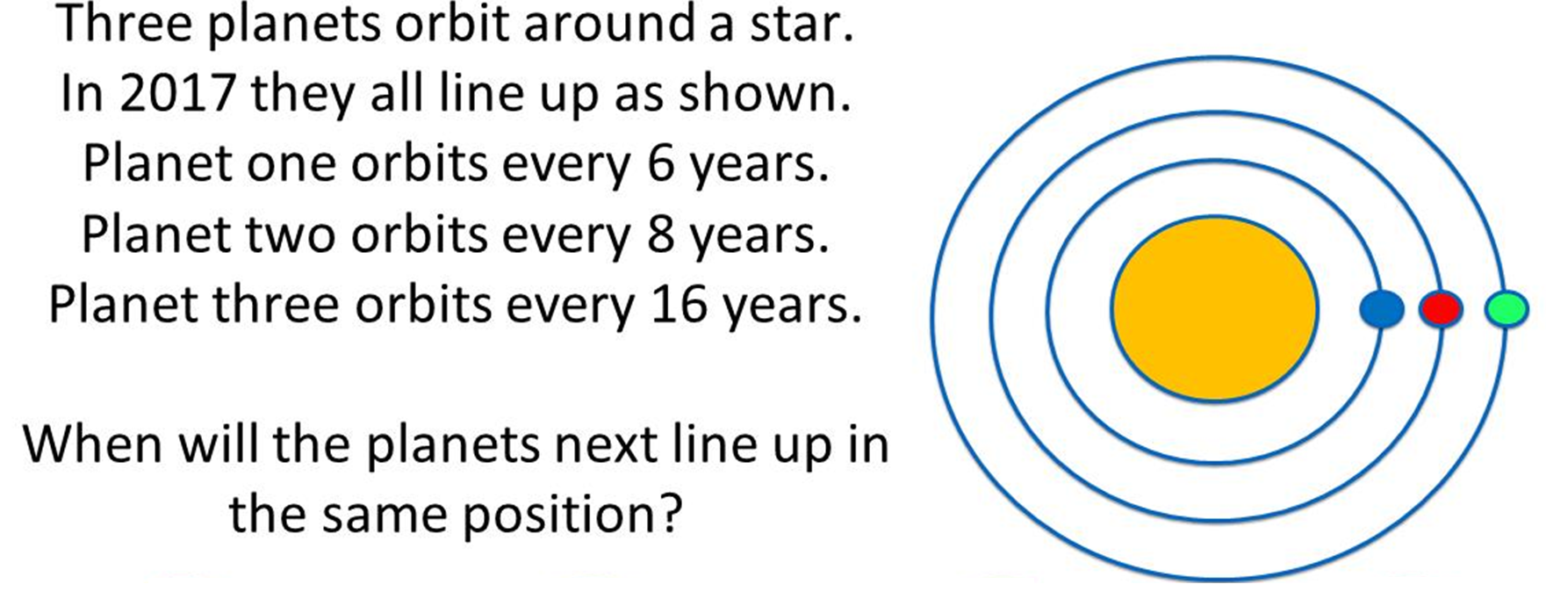
Question 1 – HCF and LCM
How long before the planets
all line up again?

Slide 3
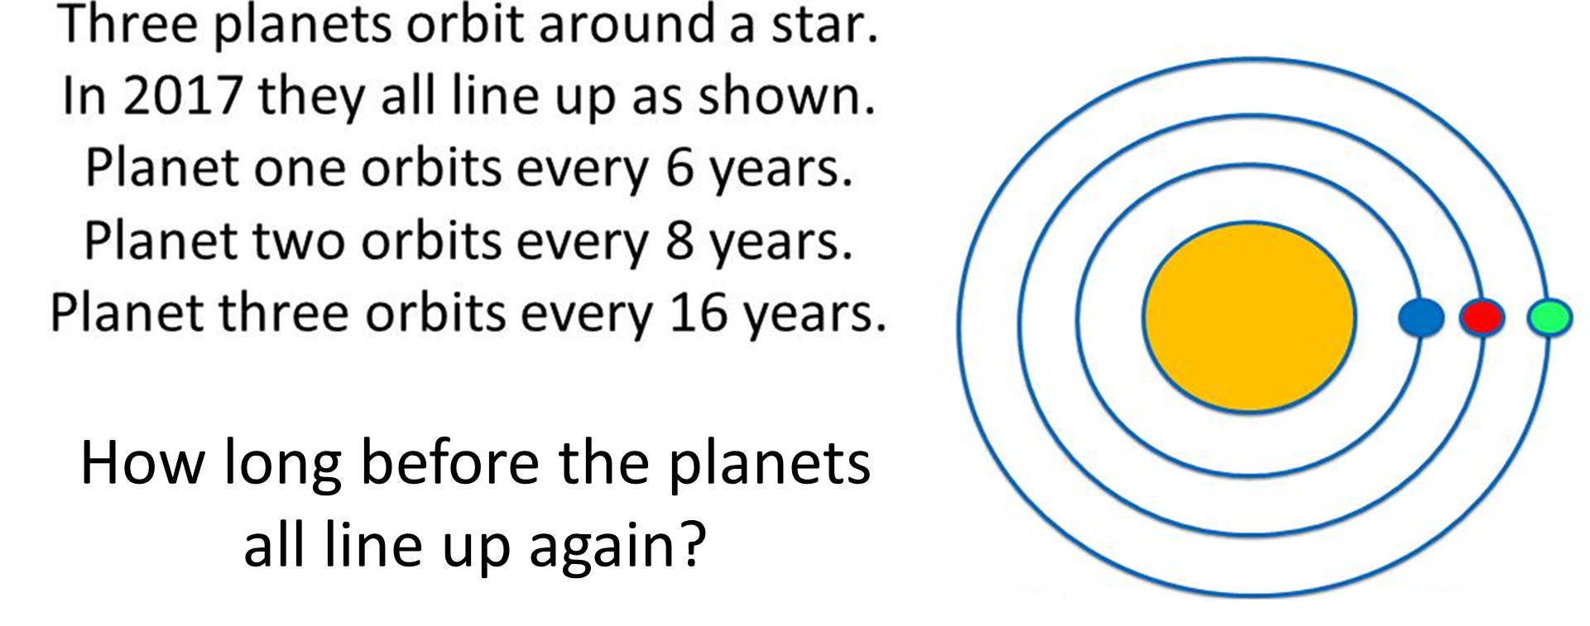
Answer 1 – HCF and LCM
CORRECT ANSWER | CORRECT EXPLANATION
48 | The LCM of 6 and 16 is 48, and as 8 is a factor of 16, the LCM of all 3 numbers is 48.
COMMON MISTAKES | WHAT MIGHT BE YOUR MISTAKE
2 | The student has found the HCF.
768 | The student has added a multiple all the numbers together. 6x8x16
96 | The student has found a common multiple, but not the lowest.

Slide 4
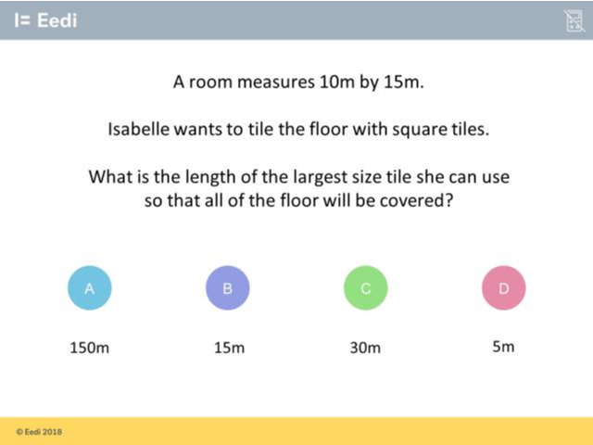
Question 2 –

Slide 5
Answer 2 – HCF and LCM
CORRECT ANSWER | CORRECT EXPLANATION
5 | The largest square tile that could be used to cover the floor exactly is 5mx5m (so 5m long) because 5 is the highest common factor of 10 and 15.
COMMON MISTAKES | WHAT MIGHT BE YOUR MISTAKE
150 | You have learnt how to find the area of the floor (10x15)! :) But this question is asking you for the length of the largest size square tiles that could be used to cover the floor exactly. You're looking for the biggest number that divides exactly into both 10 and 15: you're looking for the highest common factor of 10 and 15.
15 | If the tiles were allowed to be rectangular, then this would be right; there would just be one big 15mx10m tile that covered the whole floor. But Isabelle wants the largest possible square tile. You're looking for the biggest number that divides exactly into both 10 and 15: you're looking for the highest common factor of 10 and 15.
30 | A 30mx30m tile would actually be bigger than the floor. You have successfully learnt how to find the lowest common multiple of two numbers! But, to solve this problem, you need to find the highest common factor instead.

Slide 6
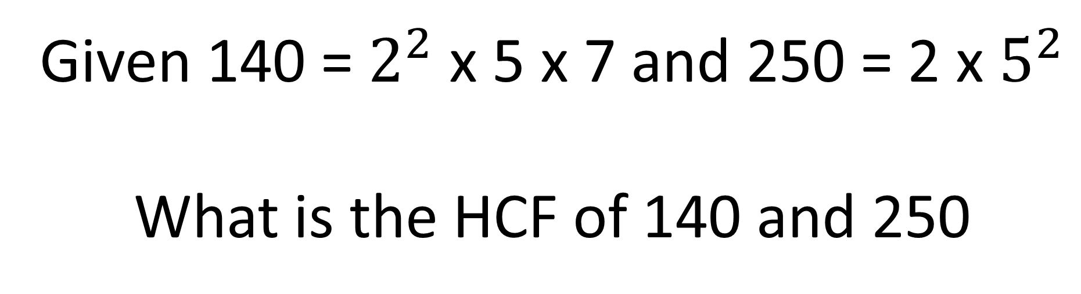
Question 3 – HCF and LCM
Given 140 = $2^{2}$ x 5 x 7 and 250 = 2 x $5^{2}$
What is the HCF of 140 and 250

Slide 7
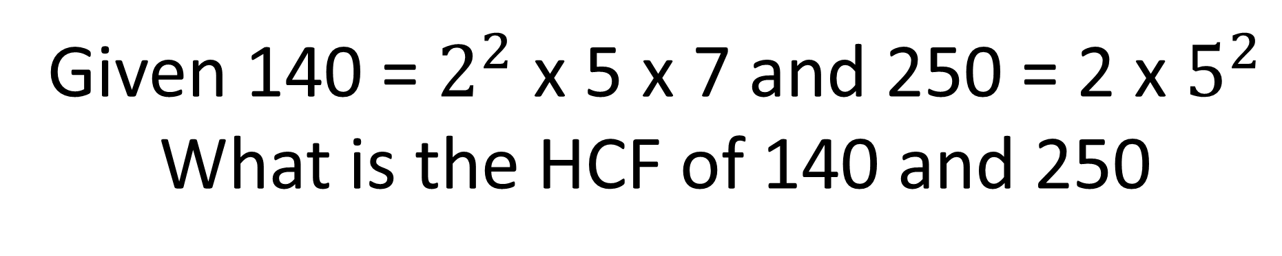
Answer 3 – HCF and LCM
Given 140 = $2^{2}$ x 5 x 7 and 250 = 2 x $5^{2}$
What is the HCF of 140 and 250
CORRECT ANSWER | CORRECT EXPLANATION
10 | 2 x 5 = 10
COMMON MISTAKES | WHAT MIGHT BE YOUR MISTAKE
700 | 2 x 2 x 5 x 5 x 7 = 700 the student has found the LCM

Slide 8
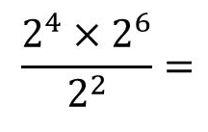
Question 4 – Indices
Simplify

Slide 9
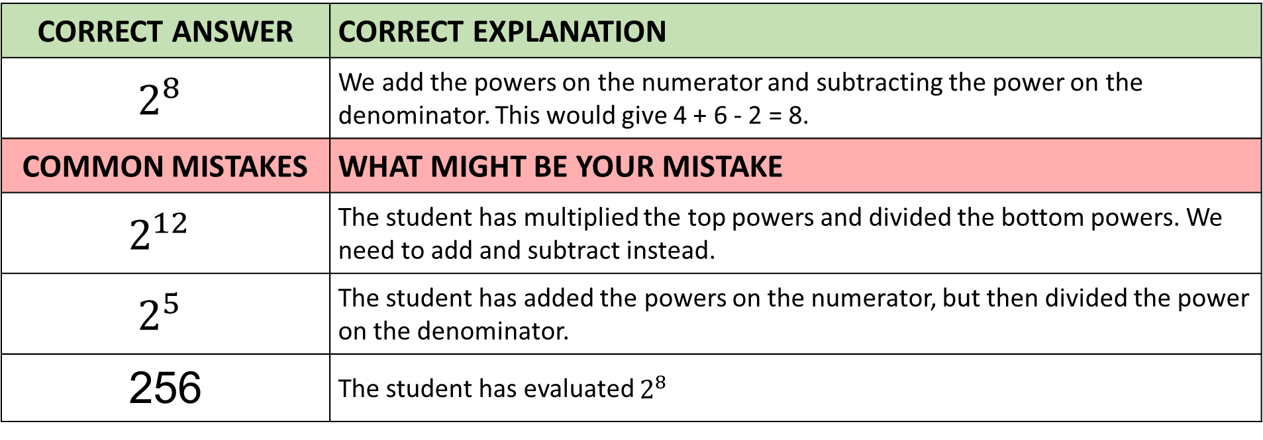
Answer 4 – Indices
Simplify
CORRECT ANSWER | CORRECT EXPLANATION
$$2^{8}$$ | We add the powers on the numerator and subtracting the power on the denominator. This would give 4 + 6 - 2 = 8.
COMMON MISTAKES | WHAT MIGHT BE YOUR MISTAKE
$$2^{12}$$ | The student has multiplied the top powers and divided the bottom powers. We need to add and subtract instead.
$$2^{5}$$ | The student has added the powers on the numerator, but then divided the power on the denominator.
256 | The student has evaluated $2^{8}$

Slide 10
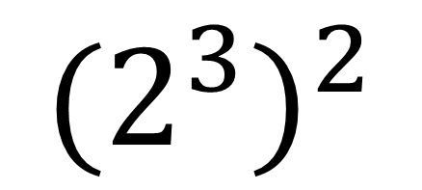
Question 5 – Indices
Evaluate
$${(2^{3})}^{2}$$

Slide 11
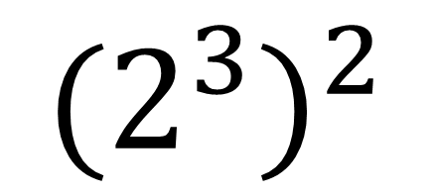
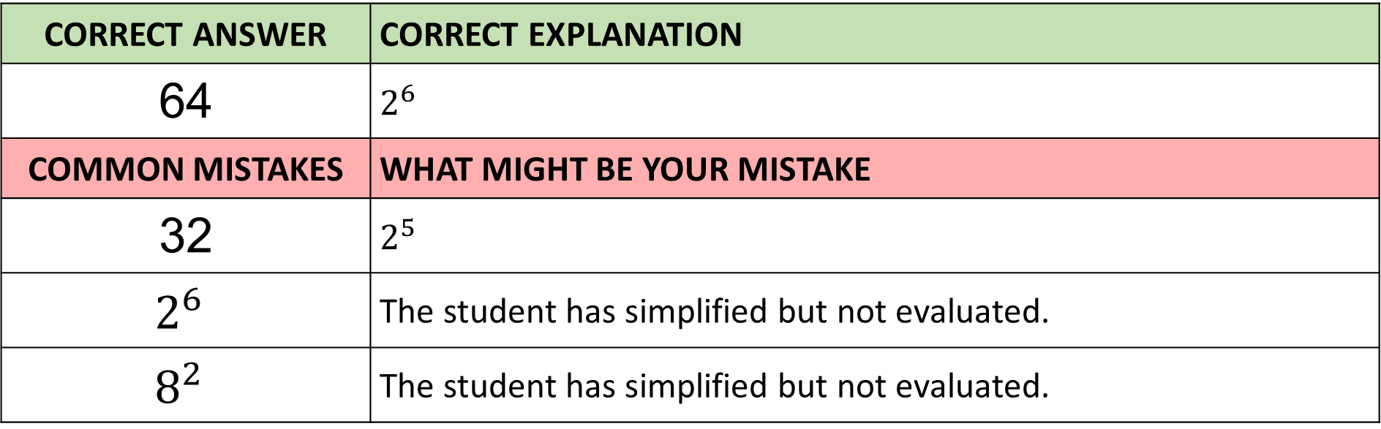
Answer 5 – Indices
Evaluate
$${(2^{3})}^{2}$$
CORRECT ANSWER | CORRECT EXPLANATION
64 | $$2^{6}$$
COMMON MISTAKES | WHAT MIGHT BE YOUR MISTAKE
32 | $$2^{5}$$
$$2^{6}$$ | The student has simplified but not evaluated.
$$8^{2}$$ | The student has simplified but not evaluated.

Slide 12
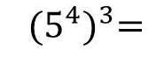
Question 6 – Indices
Simplify

Slide 13
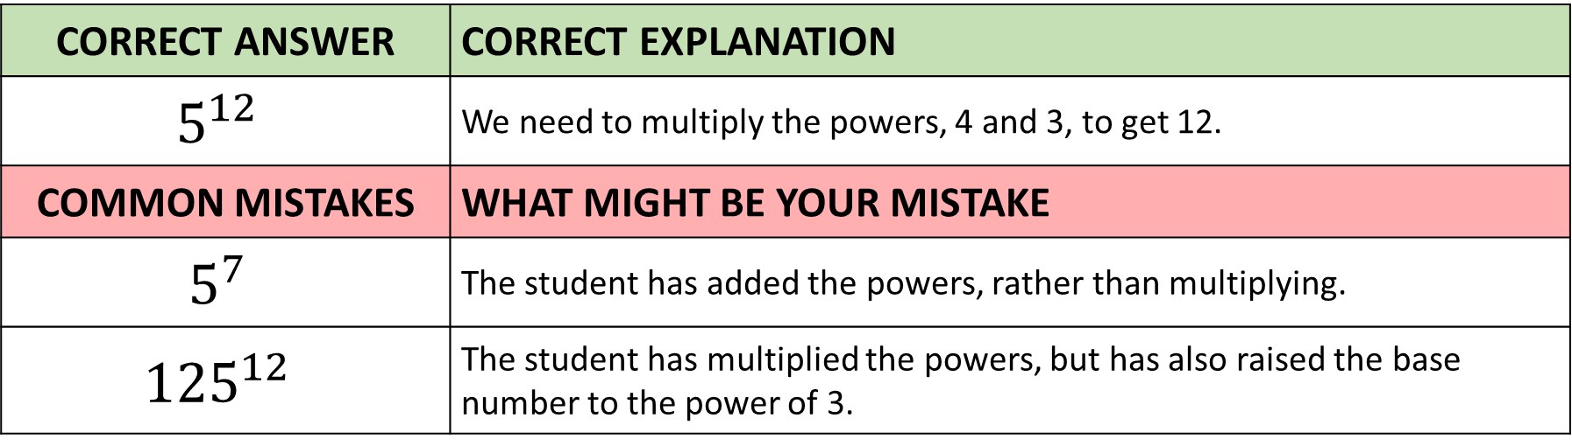
Answer 6 – Indices
Simplify
CORRECT ANSWER | CORRECT EXPLANATION
$$5^{12}$$ | We need to multiply the powers, 4 and 3, to get 12.
COMMON MISTAKES | WHAT MIGHT BE YOUR MISTAKE
$$5^{7}$$ | The student has added the powers, rather than multiplying.
$${125}^{12}$$ | The student has multiplied the powers, but has also raised the base number to the power of 3.

Slide 14
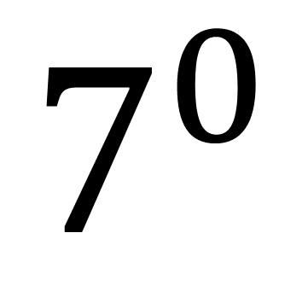
Question 7 – Indices
Evaluate
$$7^{0}$$

Slide 15
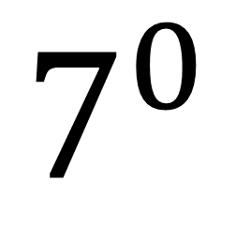
Answer 7 – Indices
$$7^{0}$$
Evaluate
CORRECT ANSWER | CORRECT EXPLANATION
1 | Any number to the power of 0 is 1.
COMMON MISTAKES | WHAT MIGHT BE YOUR MISTAKE
70 | The student has written the power as an integer.
0 | The student has multiplied the power.
7 | The student has added the power.

Slide 16
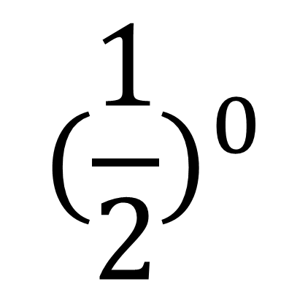
Question 8 – Indices
Evaluate
$$({\frac{1}{2})}^{0}$$

Slide 17
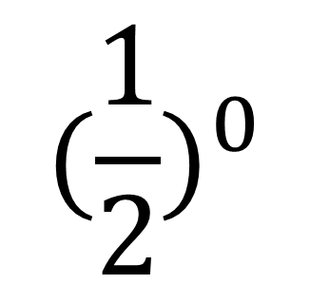
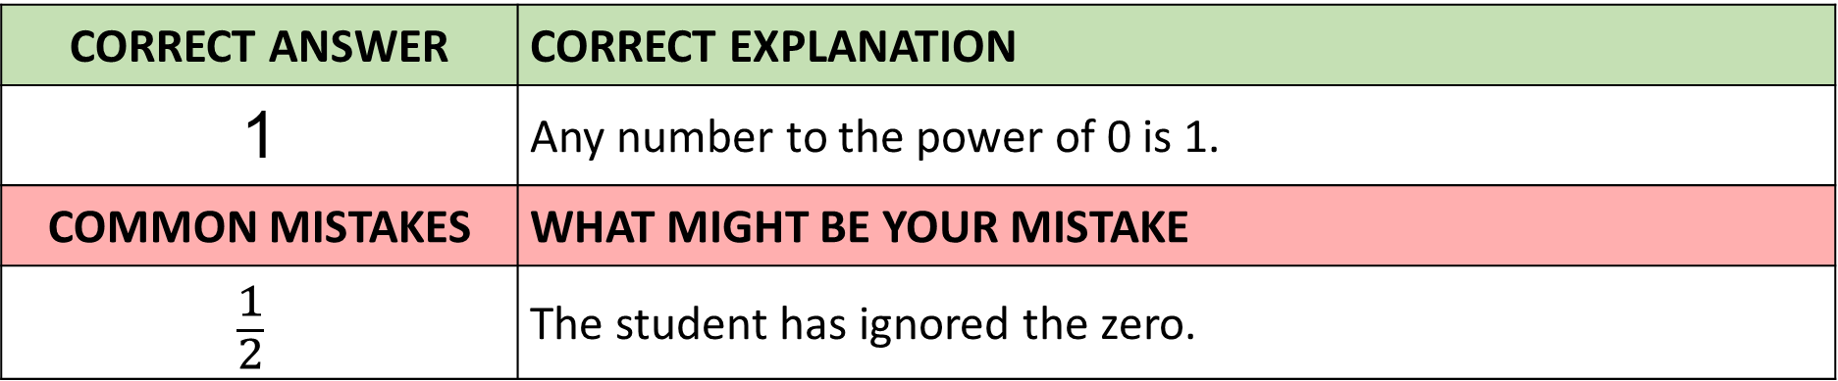
Answer 8 – Indices
$$({\frac{1}{2})}^{0}$$
Evaluate
CORRECT ANSWER | CORRECT EXPLANATION
1 | Any number to the power of 0 is 1.
COMMON MISTAKES | WHAT MIGHT BE YOUR MISTAKE
$$\frac{1}{2}$$ | The student has ignored the zero.

Slide 18
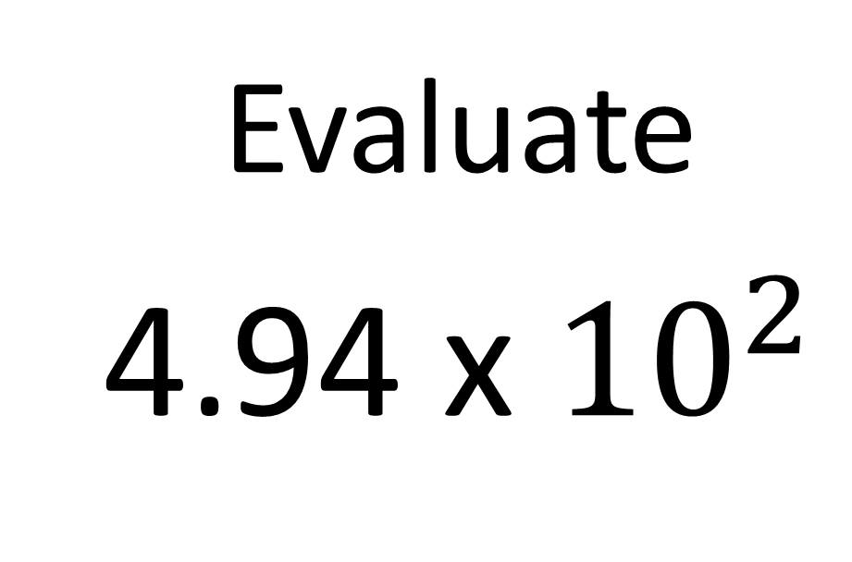
Question 9 – Powers of 10
Evaluate
4.94 x ${10}^{2}$

Slide 19
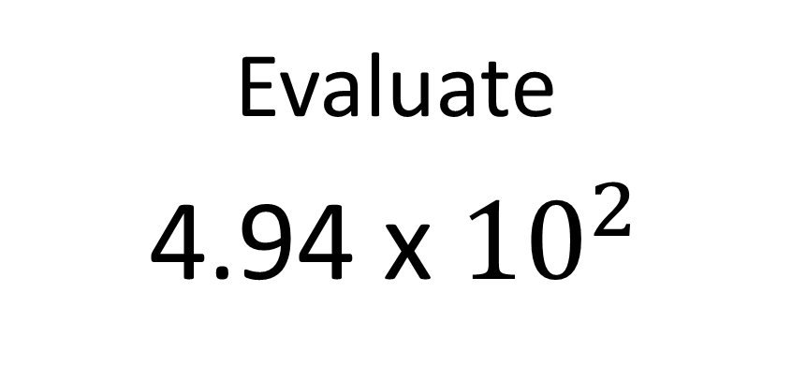
Answer 9 – Powers of 10
Evaluate
4.94 x ${10}^{2}$
CORRECT ANSWER | CORRECT EXPLANATION
494 | The student is correct. 4.94 has been multiplied by 10 twice as indicated by the power of 10.
COMMON MISTAKES | WHAT MIGHT BE YOUR MISTAKE
49400 | This is incorrect. The decimal point has been removed and two zeros have been added. The original number should have been multiplied by 10 twice as indicated by 10².
0.0494 | This is incorrect. The original number has been divided by 100 rather than multiplied by 100.
4.94 | This is incorrect. The original number should have been multiplied by 10 twice as indicated by 10²

Slide 20
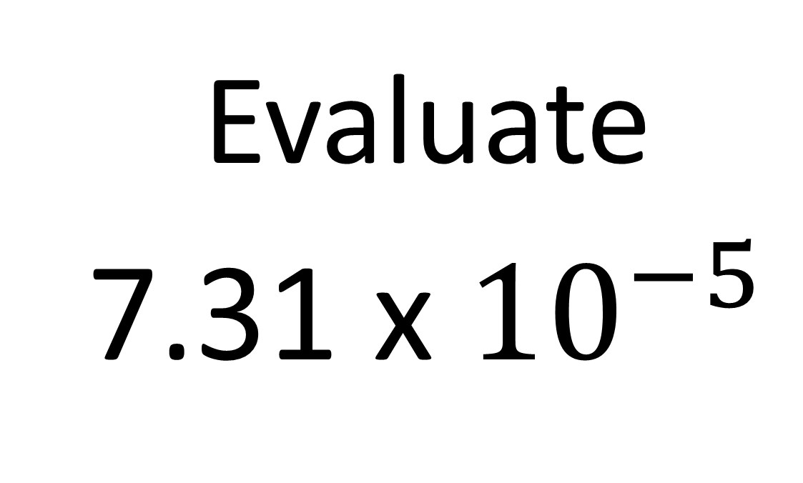
Question 10 – Powers of 10
Evaluate
7.31 x ${10}^{−5}$

Slide 21
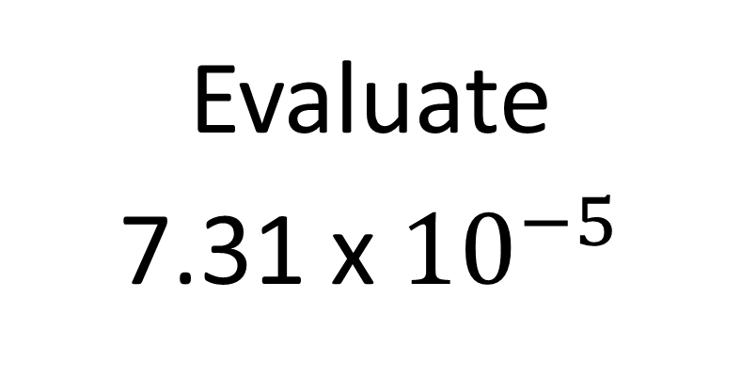
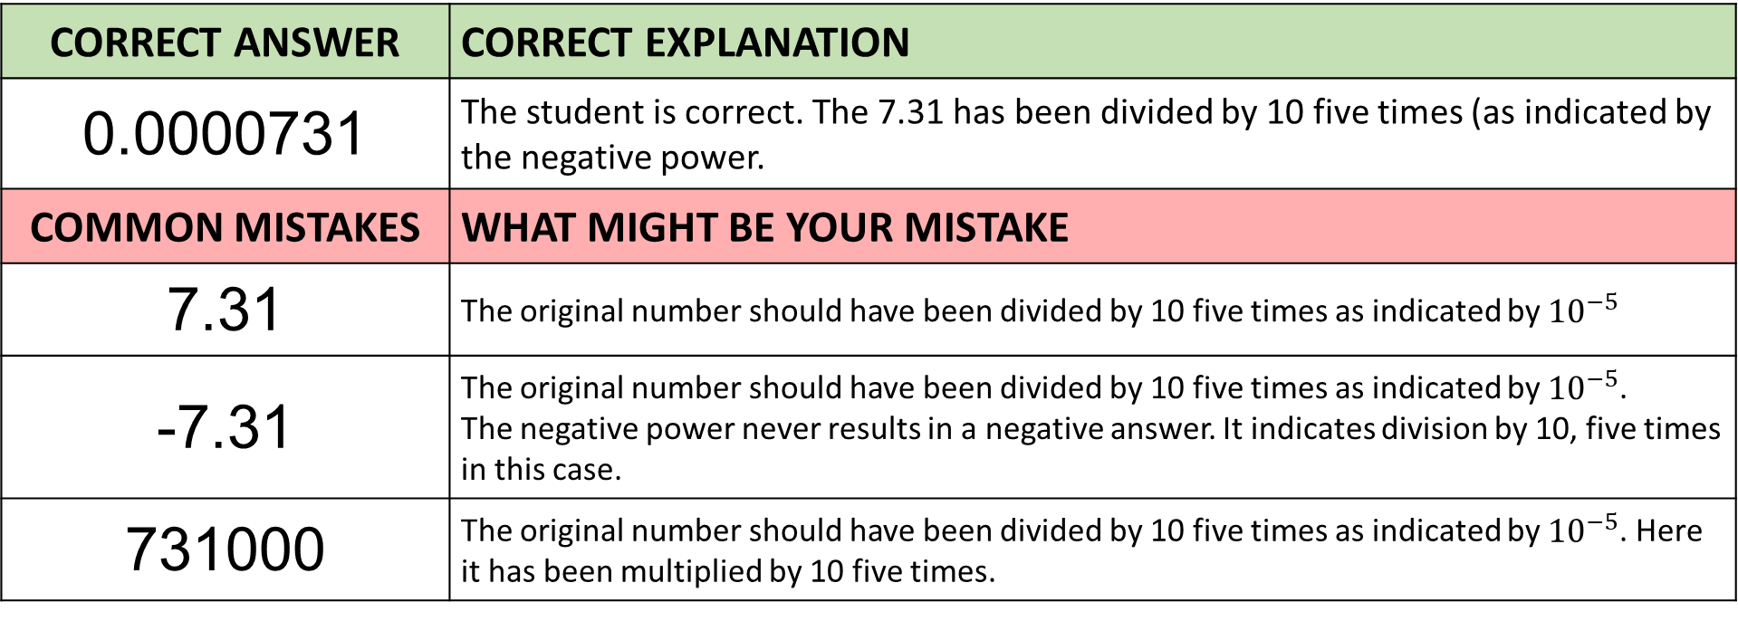
Answer 10 – Powers of 10
Evaluate
7.31 x ${10}^{−5}$
CORRECT ANSWER | CORRECT EXPLANATION
0.0000731 | The student is correct. The 7.31 has been divided by 10 five times (as indicated by the negative power.
COMMON MISTAKES | WHAT MIGHT BE YOUR MISTAKE
7.31 | The original number should have been divided by 10 five times as indicated by ${10}^{−5}$
-7.31 | The original number should have been divided by 10 five times as indicated by ${10}^{−5}$. The negative power never results in a negative answer. It indicates division by 10, five times in this case.
731000 | The original number should have been divided by 10 five times as indicated by ${10}^{−5}$. Here it has been multiplied by 10 five times.

Slide 22
Question 11 – Rounding Significant Numbers
Round 0.0567
to 1 significant figure.

Slide 23
Answer 11 – Rounding Significant Numbers
Round 0.0567
to 1 significant figure.
CORRECT ANSWER | CORRECT EXPLANATION
0.06 | The first significant digit is 5, so we round up to 0.06 as the second digit is 6.
COMMON MISTAKES | WHAT MIGHT BE YOUR MISTAKE
0.05 | The student has not rounded down, instead of up.
0.0 | The student has rounded to 1 decimal place, instead of 1 significant figure, and has rounded down.
0.1 | The student has rounded to 1 decimal place, instead of 1 significant figure.

Slide 24
Question 12 – Rounding Significant Numbers
Round 38377
to 3 significant figures.

Slide 25
Answer 12 – Rounding Significant Numbers
Round 38377
to 3 significant figures.
CORRECT ANSWER | CORRECT EXPLANATION
38400 | The fourth digit is 7, so we round up to 38400.
COMMON MISTAKES | WHAT MIGHT BE YOUR MISTAKE
383 | The student has not included the last 2 digits.
38300 | The student has rounded down, instead of up.
383 | The student has missed the last 2 digits, and has rounded down instead of up.

Slide 26
Question 13 – Estimating Calculations
Estimate
3269 x 138

Slide 27
Answer 13 – Estimating Calculations
Estimate
3269 x 138
CORRECT ANSWER | CORRECT EXPLANATION
300 000 | We estimate by rounding each number to 1 significant figure. This gives 3000 × 100 = 300,000.
COMMON MISTAKES | WHAT MIGHT BE YOUR MISTAKE
420 000 | The student has rounded 138 to the nearest ten, not 1 significant figure.
330 000 | The student has rounded 3269 to the nearest hundred, not 1 significant figure.
451 122 | The student has worked out the exact answer, rather than estimating.

Slide 28
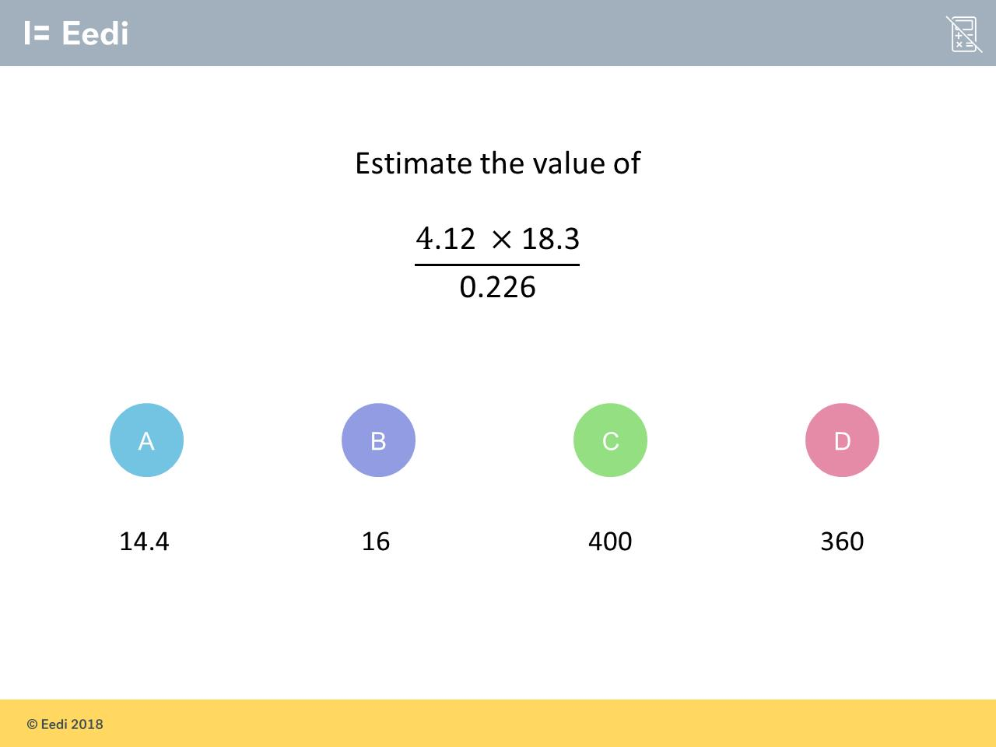
Question 14 – Estimating Calculations

Slide 29
Answer 14 – Estimating Calculations
CORRECT ANSWER | CORRECT EXPLANATION
400 | We round each number to 1 significant figure, and estimate using ( 4 × 20 )/0.2 = 80 × 5 = 400.
COMMON MISTAKES | WHAT MIGHT BE YOUR MISTAKE
14.4 | The student has rounded to the nearest whole number, rather than 1 significant figure, and has divided by 5 rather than 0.2.
16 | The student has divided by 5, instead of 0.2.
360 | The student has rounded to the nearest whole number, rather than 1 significant figure.

Slide 30
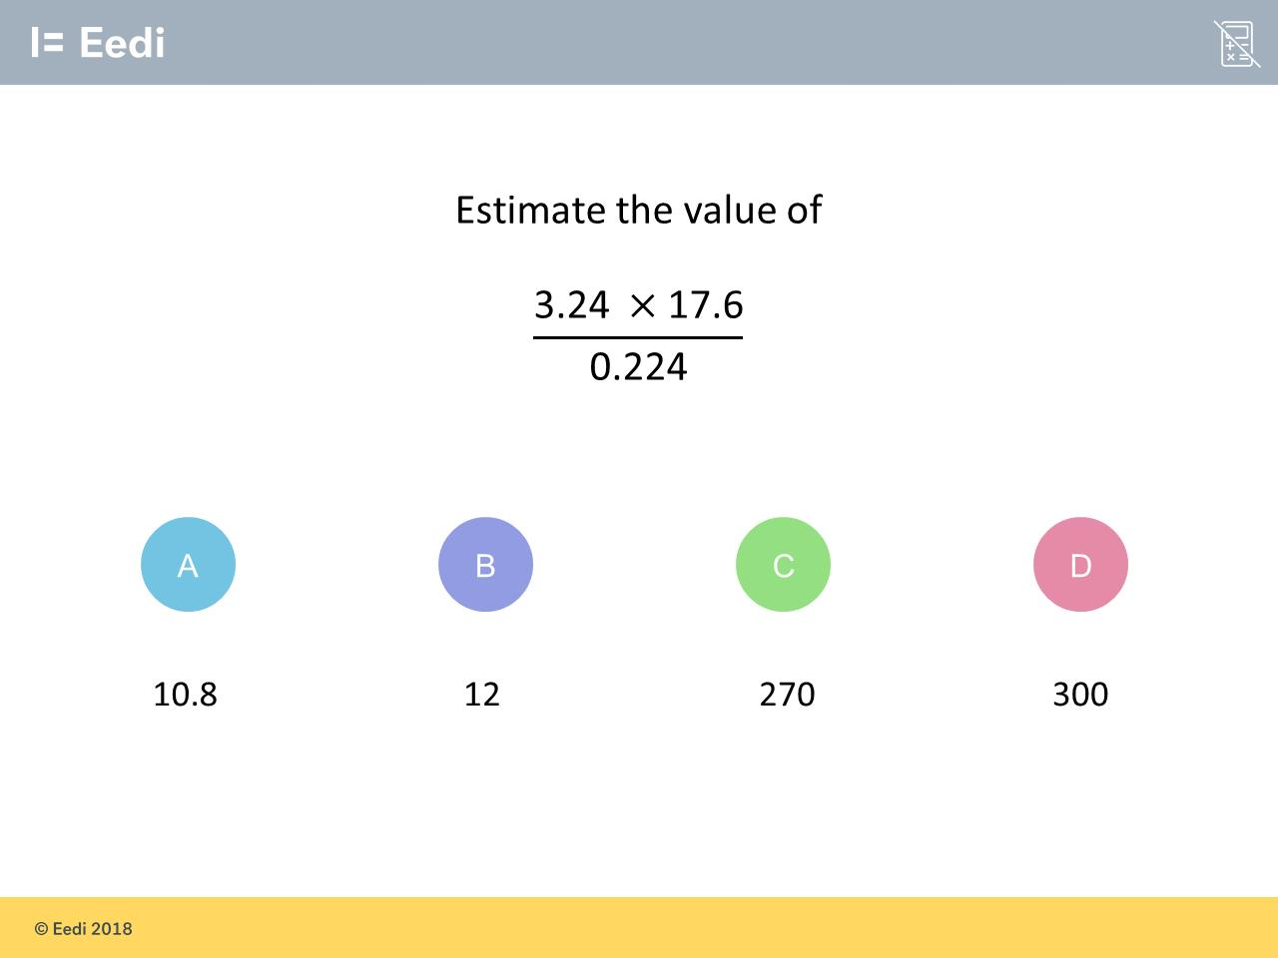
Question 15 – Estimating Calculations

Slide 31
Answer 15 – Estimating Calculations
CORRECT ANSWER | CORRECT EXPLANATION
300 | Rounding each number to 1 sig. fig. gives (3 × 20)/0.2 = 60/0.2 = 300
COMMON MISTAKES | WHAT MIGHT BE YOUR MISTAKE
10.8 | The student has rounded to the nearest whole number, rather than 1 significant figure, and has divided by 5 rather than 0.2.
12 | The student has divided by 5, rather than 0.2.
270 | The student has rounded to the nearest whole number, rather than 1 significant figure.

