Slide 1
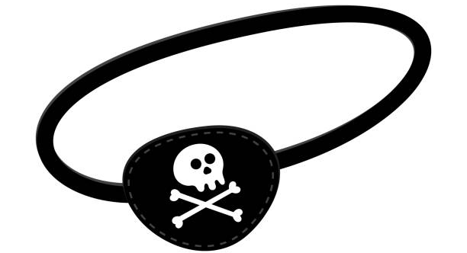
The Pirate Game
 | A | B | C | D | E | F | G
1
2
3
4
5
6
Place 42 items into the grid.
Then everyone will take a turn to call a grid reference.
You must follow out the action of the grid reference, even if you not want to.

Slide 2
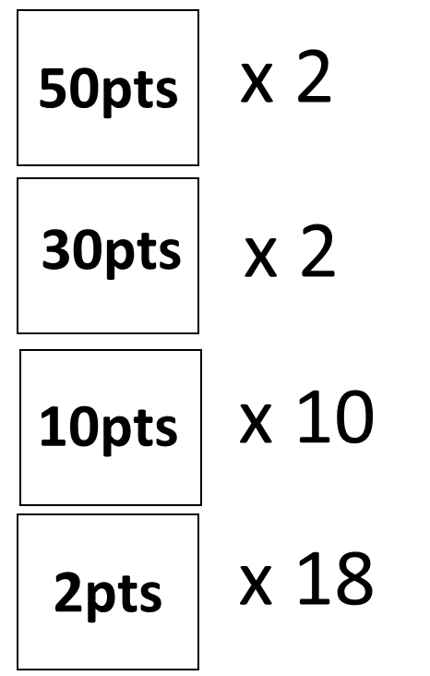
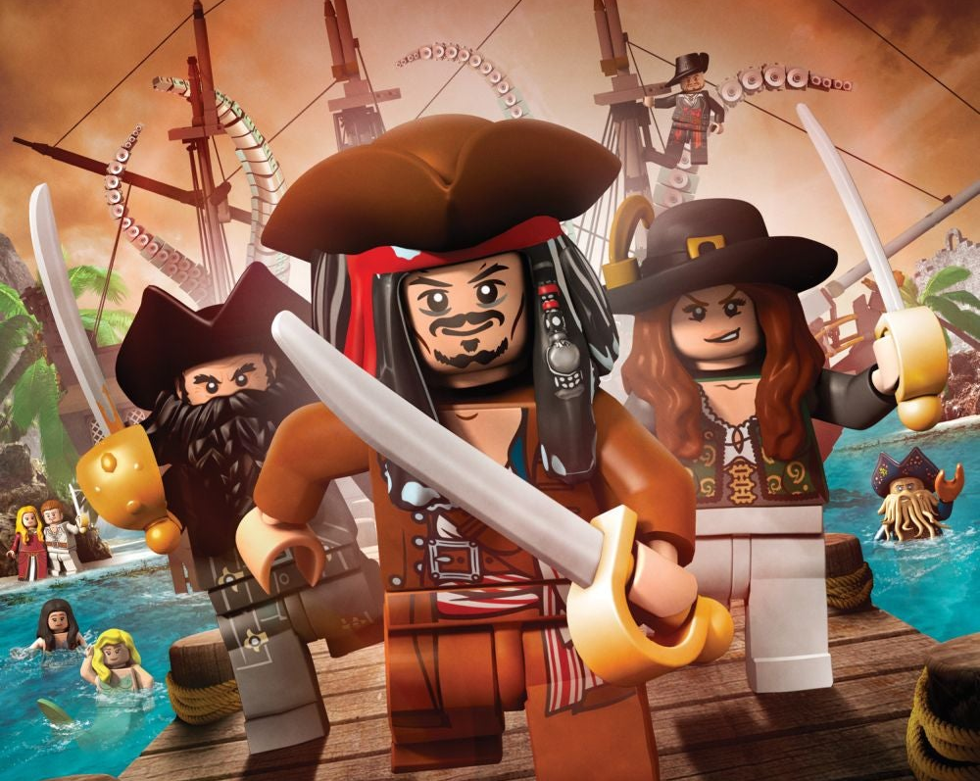
These are the cash points that you put into
your grid that you want to collect

Slide 3





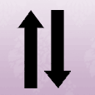
You must put your hand up if you get this symbol in your grid ref
Rob someone’s points
The Pirate Ship - this allows the player to 'rob' someone else’s cash points
Kill Someone
The Dagger - this allows the player to 'kill' someone and wipe their cash score down to 0
Present – give someone 50 points
The Present - this allows the player to give a 'present' of 50 points to another individual
Skull and Crossbones:
Skull and Crossbones – special square to be determined by the teacher at the start of the game
Swap scores
Swap points - this allows the play to swap their points with another person's

Slide 4



Shield – Block the Bad
Shield - this symbol allows the player to ‘block' any wrong doing to them. Has to be collect first then can only be used once.
Mirror – Reflect the Bad
Mirror - this symbol allows the player to 'mirror' any wrong doing to them back to the person that was doing the wrong doing. Has to be collect first then can only be used once.
Bomb – YOU go to zero
Bomb - if the player is unlucky enough to get this symbol in their grid ref their points will go to 0.
x 2
Double Your Score
x2 - this symbol doubles the players current score
B
Bank Your Score
B (Bank) - this symbol allows any cash points a player has to be banked (these points are then safe for the rest of the game and cannot be stolen or wiped out!

Slide 5
Cash
Bank
Keep you running total of points in the cash list.
In this place the points are venerable from attack.
When you land on a bank your points in your cash list get transferred to here.
Points in the bank are safe from all attacks.

Slide 6

If you are still confused, then watch this video………

