Slide 1
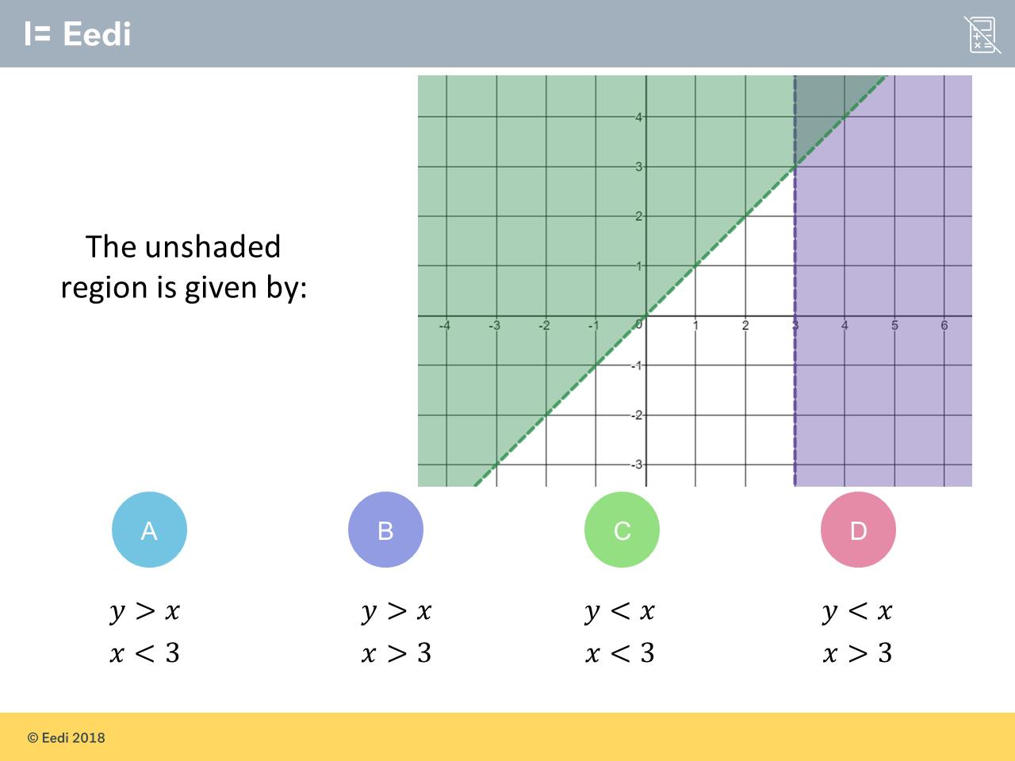
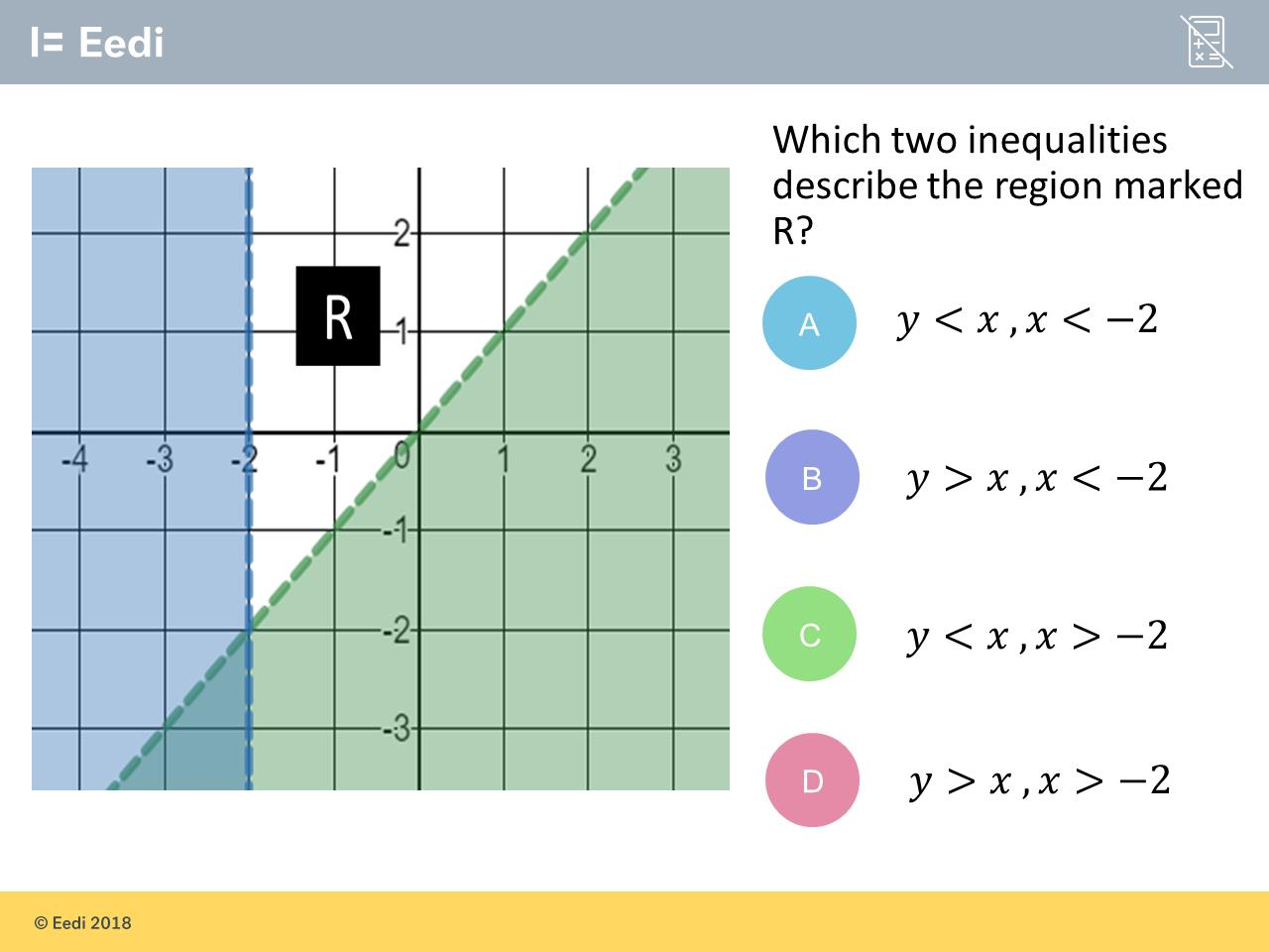
Worst answered question?
Most common wrong answer?

Slide 2
ANSWERS

Slide 3
Worst answered question?

Slide 4
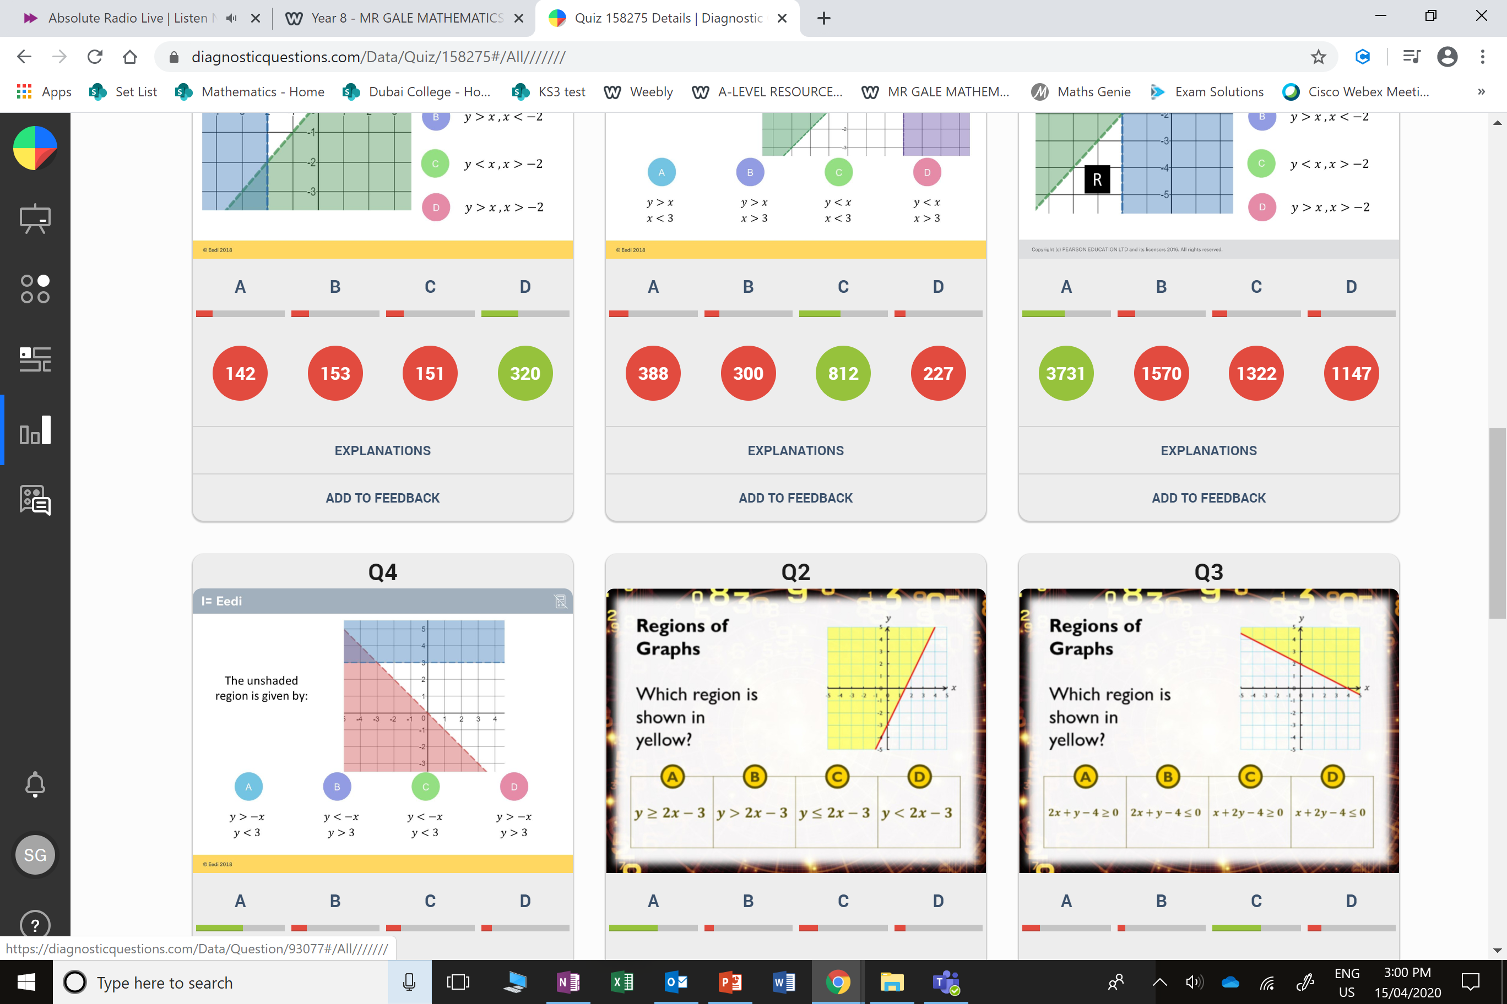
A
They described the blue and green areas.

Slide 5
B
They describe the green and purple areas.

