Slide 1
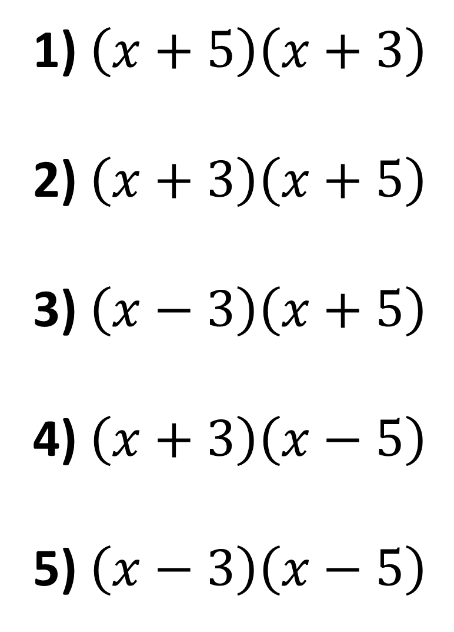
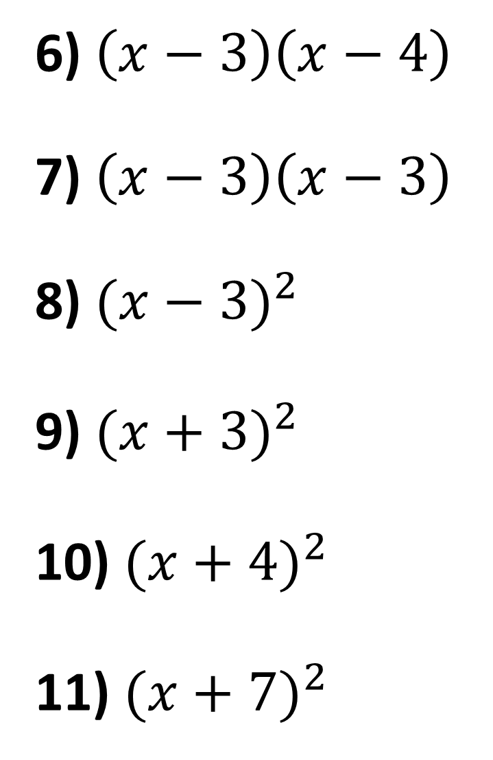
1) $\left(x+5\right)\left(x+3\right)$
2) $\left(x+3\right)\left(x+5\right)$
3) $\left(x−3\right)\left(x+5\right)$
4) $\left(x+3\right)\left(x−5\right)$
5) $\left(x−3\right)\left(x−5\right)$
6) $\left(x−3\right)\left(x−4\right)$
7) $\left(x−3\right)\left(x−3\right)$
8) ${(x−3)}^{2}$
9) ${(x+3)}^{2}$
10) ${(x+4)}^{2}$
11) ${(x+7)}^{2}$

Slide 2
ANSWERS

Slide 3


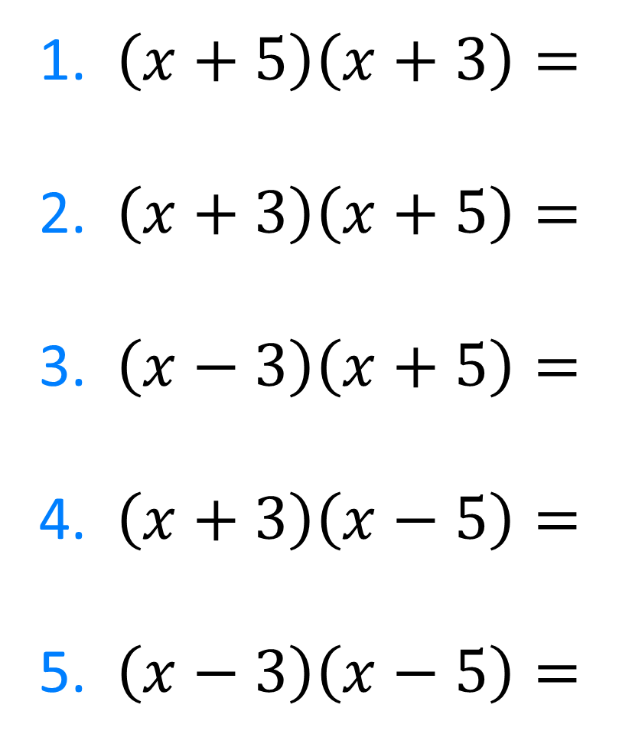








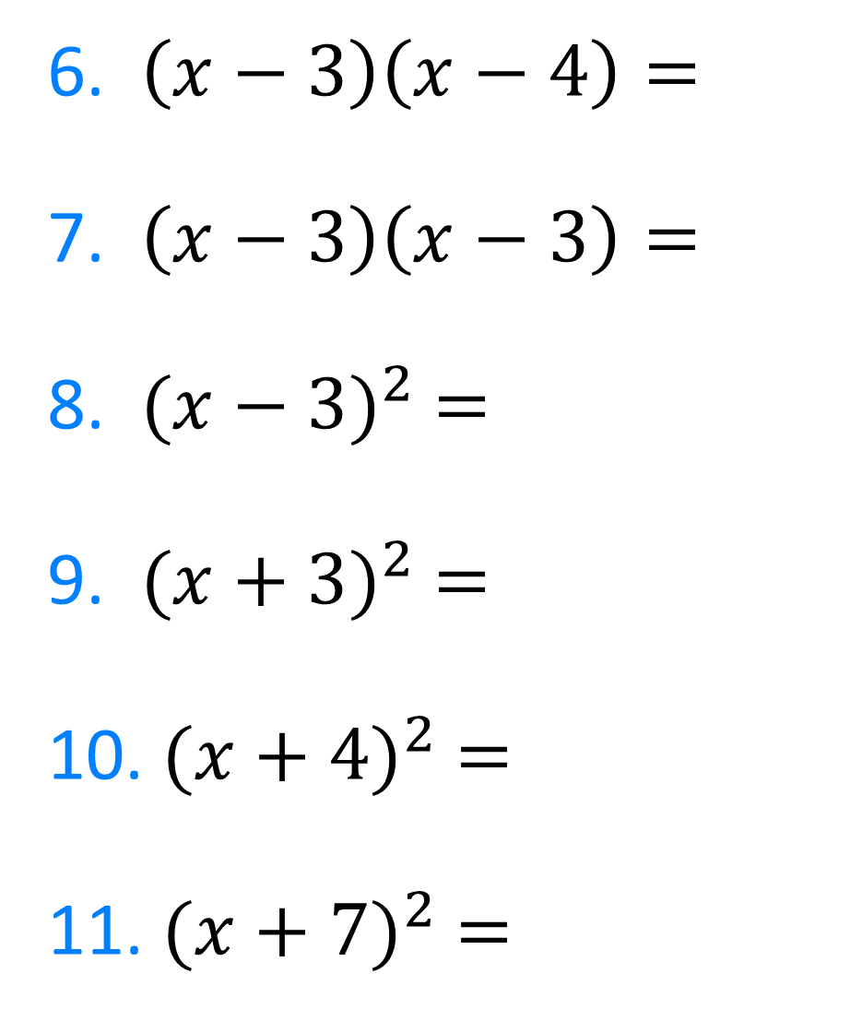

6. $\left(x−3\right)\left(x−4\right)=$
7. $\left(x−3\right)\left(x−3\right)=$
8. ${(x−3)}^{2} =$
9. ${(x+3)}^{2} =$
10. ${(x+4)}^{2} =$
11. ${(x+7)}^{2} =$
1. $\left(x+5\right)\left(x+3\right)=$
2. $\left(x+3\right)\left(x+5\right)=$
3. $\left(x−3\right)\left(x+5\right)=$
4. $\left(x+3\right)\left(x−5\right)=$
5. $\left(x−3\right)\left(x−5\right)=$
$$x^{2}−7x+12$$
$$x^{2}+8x+15$$
$$x^{2}−6x+9$$
$$x^{2}+8x+15$$
$$x^{2}−6x+9$$
$$x^{2}+2x−15$$
$$x^{2}+6x+9$$
$$x^{2}−2x−15$$
$$x^{2}+8x+16$$
$$x^{2}−8x+15$$
$$x^{2}+14x+49$$

