Slide 1
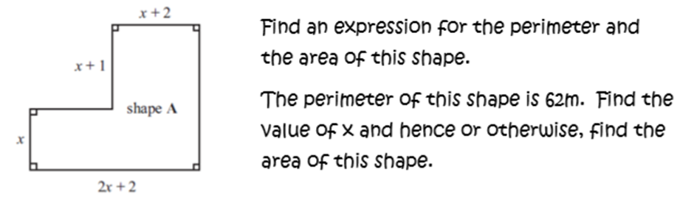
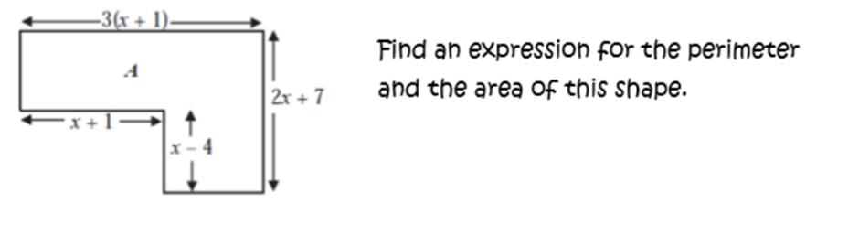
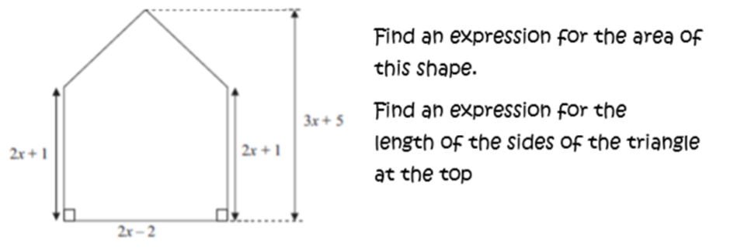
A)
B)
C)

Slide 2
ANSWERS

Slide 3
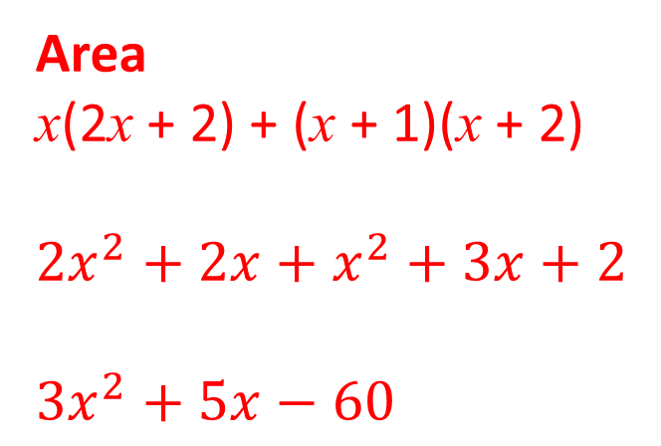


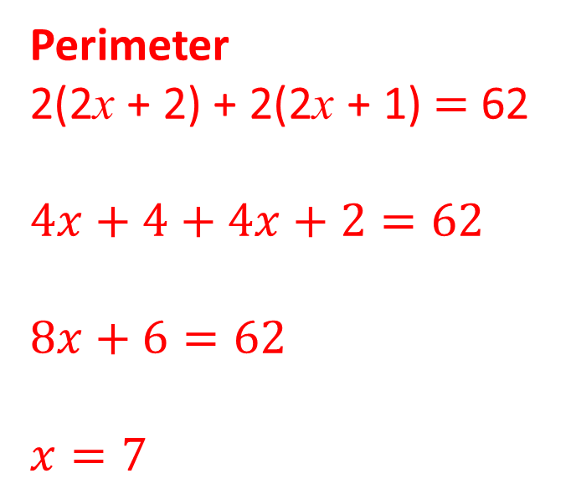
A)
Perimeter
2(2x + 2) + 2(2x + 1) $=$ 62
$$4x+4+4x+2=62$$
$8x+6=62$
$x=7$
Area
x(2x + 2) + (x + 1)(x + 2)
$${2x}^{2}+2x+x^{2}+3x+2$$
${3x}^{2}+5x−60$
$${3(7)}^{2}+5\left(7\right)−60=$$
$$122$$

Slide 4
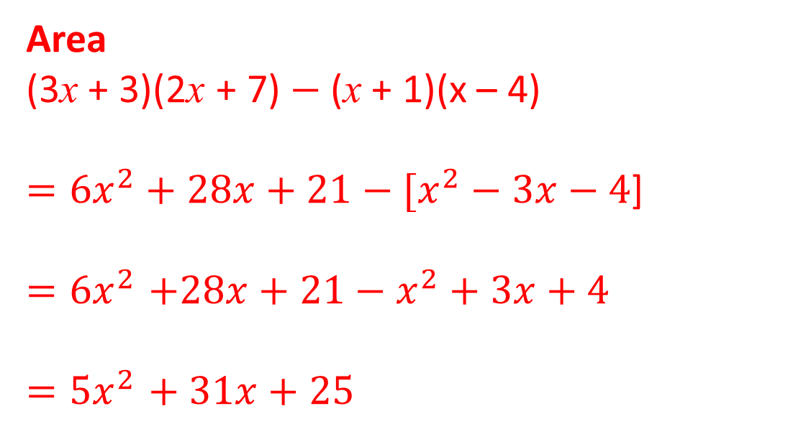
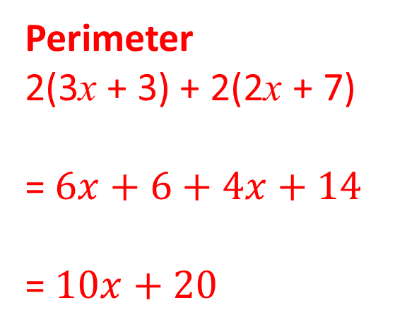
B)
Perimeter
2(3x + 3) + 2(2x + 7)
= $6x+6+4x+14$
= $10x+20$
Area
(3x + 3)(2x + 7) $−$ (x + 1)(x – 4)
$={6x}^{2}+28x+21−[x^{2}−3x−4$]
$${=6x}^{2}+28x+21−x^{2}+3x+4$$
$${=5x}^{2}+ 31x+25$$

Slide 5
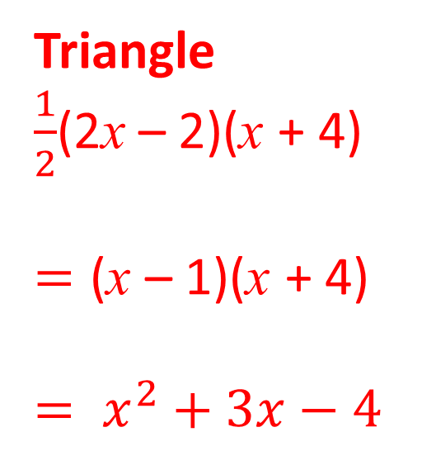
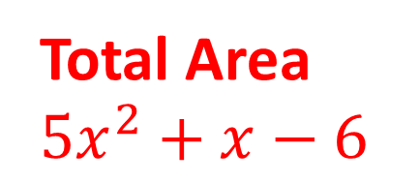
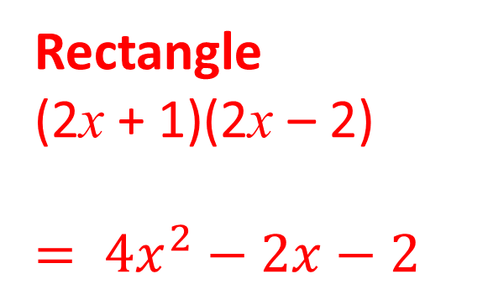
C)
Rectangle
(2x + 1)(2x – 2)
$$= {4x}^{2}−2x−2$$
Triangle
$\frac{1}{2}$(2x – 2)(x + 4)
$$=\text{(}\text{x} \text{–} \text{1}\text{)(}\text{x} \text{+ 4)}$$
$$= x^{2}+3x−4$$
Total Area
$${5x}^{2}+x−6$$

