Slide 1
LO: Mid-Point and
Length of a Line

Slide 2
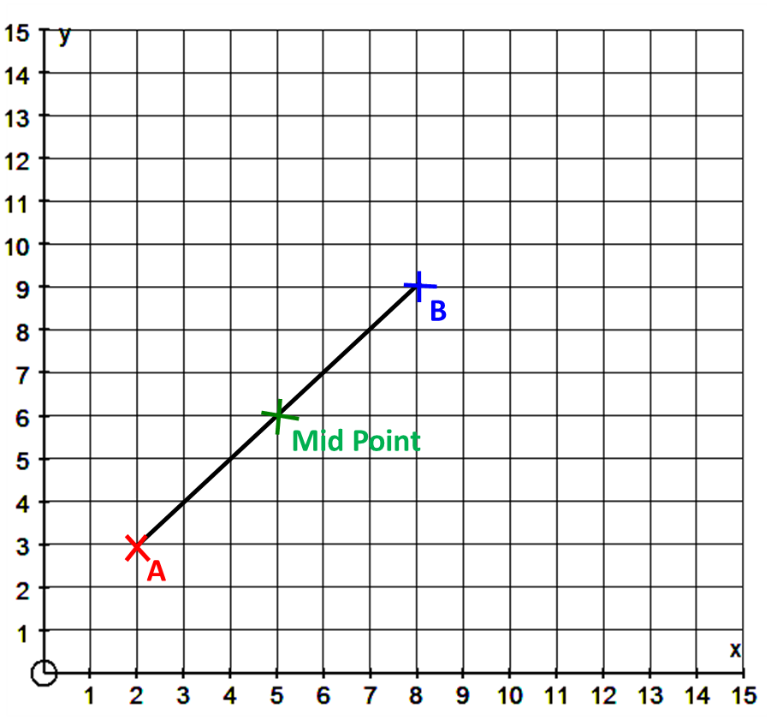
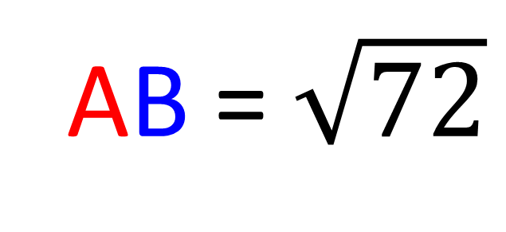
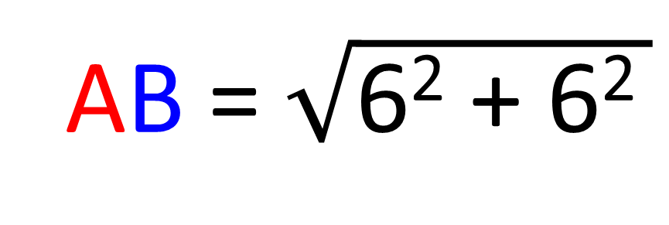
What is the length of AB?
AB = $\sqrt{\text{6}\text{2}\text{ + 6}\text{2 }}$
AB = $\sqrt{72}$
AB = 8.5 (1dp)

Slide 3
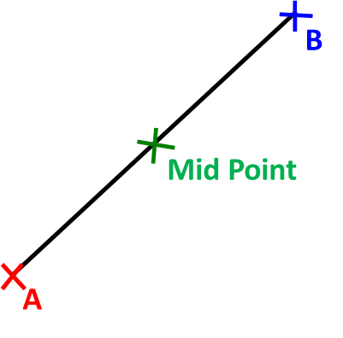

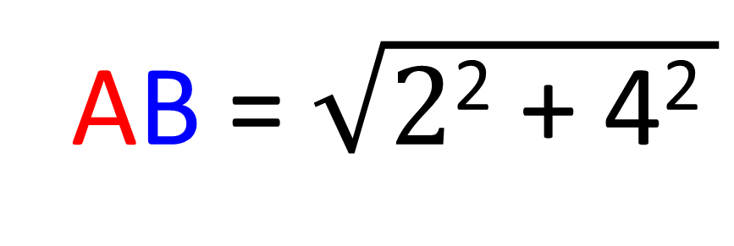
What is the length of AB?
(4,10)
AB = $\sqrt{\text{2}\text{2}\text{ + }\text{4}\text{2 }}$
AB = $\sqrt{20}$
AB = 4.5 (1dp)
(2,6)

Slide 4
What is the co-ordinate of the mid-point?
(5,6)

Slide 5
What is the co-ordinate of the mid-point?
(4,10)
(3, 8)
(2,6)

Slide 6
What is the co-ordinate of the mid-point?
(4,10)
(0, 5)
(-4,2)

Slide 7
What is the co-ordinate of point B?
(4, 10)
(3,8)
(2,6)

Slide 8
What is the co-ordinate of point B?
(7, 13)
(4,9)
(1,5)

Slide 9
What is the co-ordinate of point B?
(1,5)
(3,3)
(5, 1)

Slide 10
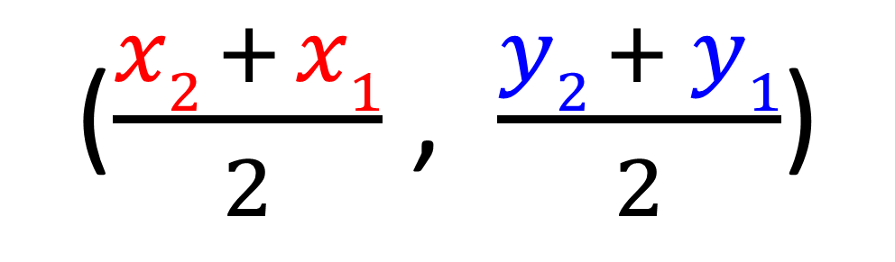
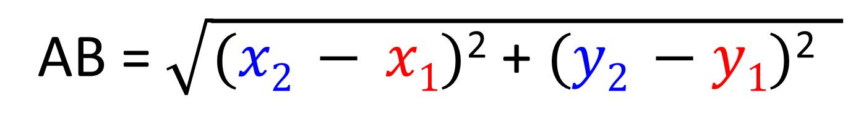
(x₂,y₂)
Mid Point
($\frac{x2 + x1}{2}$ , $\frac{y2 + y1}{2}$)
(x₁,y₁)
Length of AB
AB = $\sqrt{(x2 − x1)\text{2}\text{ + }(y2 −y1)\text{2} }$

