Slide 1
1) Prove that the sum of any three consecutive numbers is a multiple of 3.
2) Prove that the sum of any three consecutive even numbers is a multiple of 6.
3) Prove that sum of any three consecutive odd numbers is a multiple of 3.
4) Prove that half the sum of four consecutive numbers is odd.
5) Prove that the product of any odd number and any even number is even.
6) Prove the sum of the squares of any two consecutive odd numbers is even.
7) Prove that the product of any two odd numbers is odd.
8) Prove that, if the difference of two numbers is 4, then the difference of their squares is a multiple of 8.

Slide 2
ANSWERS

Slide 3
1) Prove that the sum of any three consecutive numbers is a multiple of 3.
n + n + 1 + n + 2
= 3n + 3
= 3(n + 1)
2) Prove that the sum of any three consecutive even numbers is a multiple of 6.
2n + 2n + 2 + 2n + 4
= 6n + 6
= 6(n + 1)

Slide 4
3) Prove that sum of any three consecutive odd numbers is a multiple of 3.
2n + 1 + 2n + 3 + 2n + 5
= 6n + 9
= 3(2n + 3)
4) Prove that half the sum of four consecutive numbers is odd.
½(n + n + 1 + n + 2 + n + 3)
= ½(4n + 6)
= 2n + 3
= 2n + 2 + 1
= 2(n + 1) 1

Slide 5
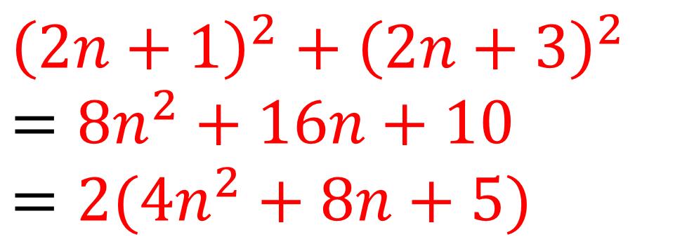
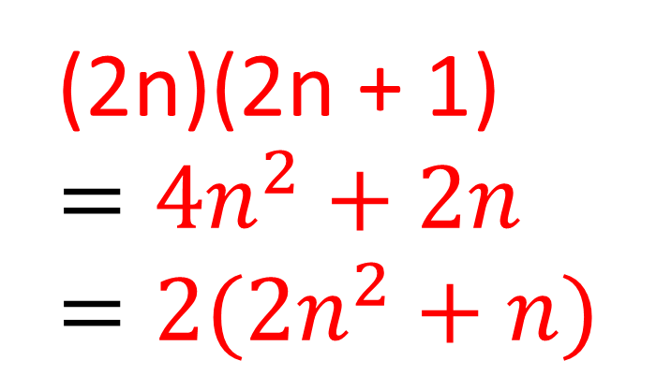
5) Prove that the product of any odd number and any even number is even.
(2n)(2n + 1)
$$=4n^{2}+2n$$
$$=2(2n^{2}+n)$$
6) Prove the sum of the squares of any two consecutive odd numbers is even.
$${\left(2n+1\right)}^{2}+{\left(2n+3\right)}^{2}$$
$$={8n}^{2}+16n+10$$
$$=2(4n^{2}+8n+5)$$

Slide 6
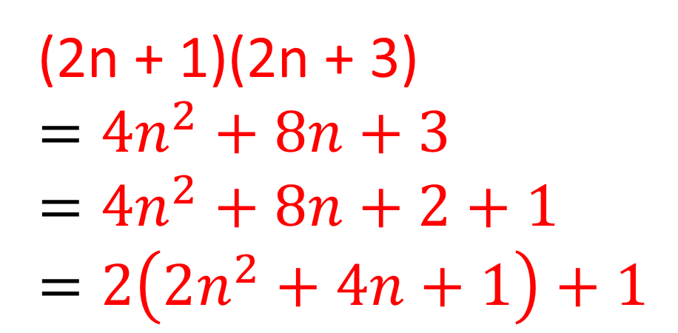
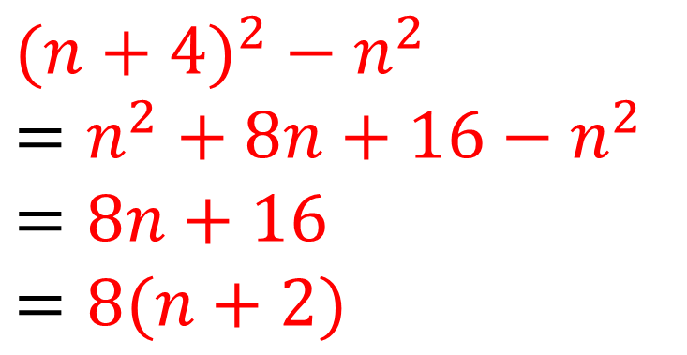
7) Prove that the product of any two odd numbers is odd.
(2n + 1)(2n + 3)
$$=4n^{2}+8n+3$$
$$=4n^{2}+8n+2+1$$
$$=2\left(2n^{2}+4n+1\right)+1$$
8) Prove that, if the difference of two numbers is 4, then the difference of their squares is a multiple of 8.
${(n+4)}^{2}$ $− n^{2}$
$=n^{2}+8n+16$ $− n^{2}$
$$=8n+16$$
$$=8(n+2)$$

