Slide 1
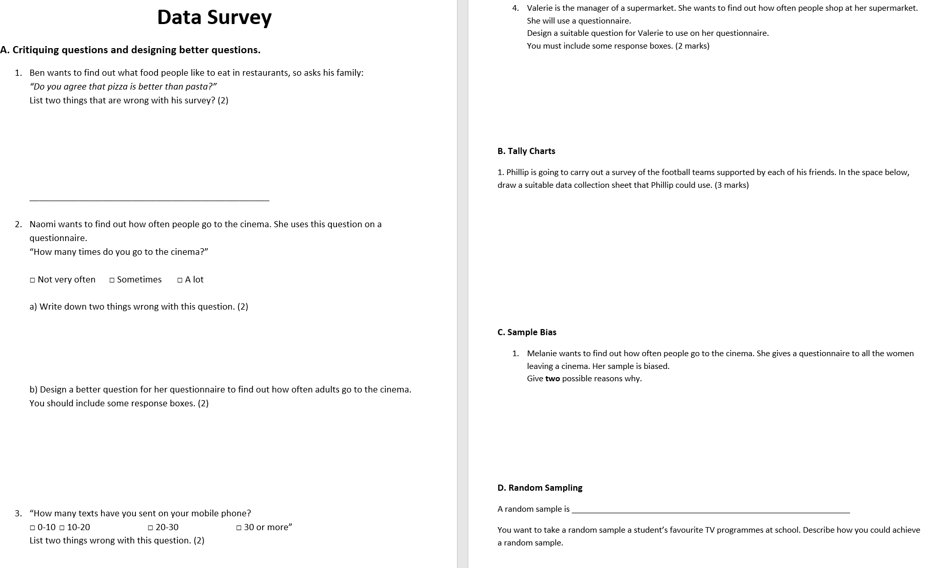

Slide 2
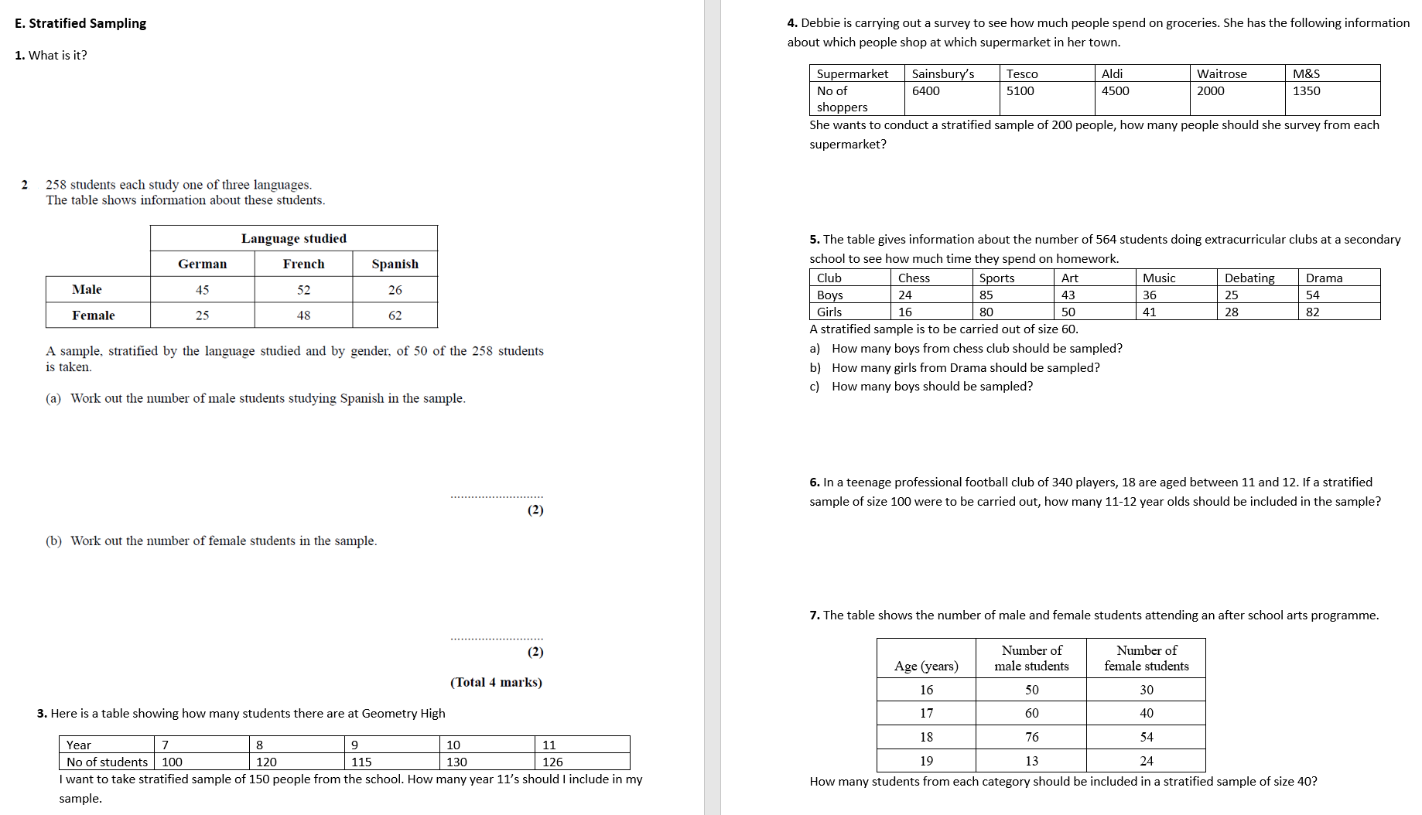

Slide 3
ANSWERS

Slide 4
1
Ben wants to find out what food people like to eat in restaurants, so asks his family:
“Do you agree that pizza is better than pasta?”
What’s wrong with his survey? (2)
2 of the following:
Biased question.
Restricted sample of people.
Doesn’t specify a range of foods.
Nothing to do with eating habits.

Slide 5
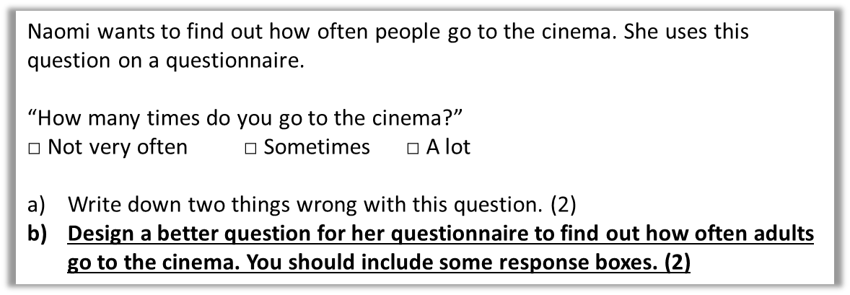
2
How many times did you go to the cinema last month?
□ 0 □ 1-2 □ 3-5 □ >5
______________________________________________
What do you think the mark scheme is looking for?
Time period must be included. (1 mark)
At least 3 non-overlapping response boxes. (1 mark)

Slide 6
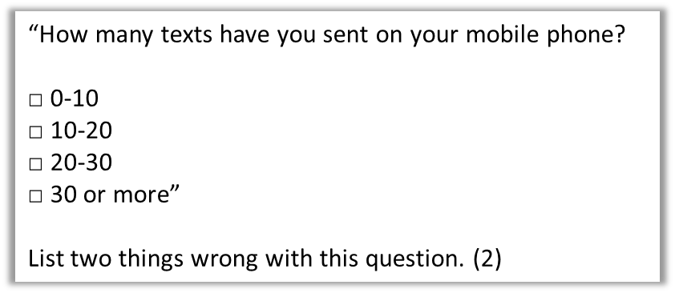
3
Overlapping regions.
No time frame.

Slide 7
4
Valerie is the manager of a supermarket.
She wants to find out how often people shop at her supermarket.
She will use a questionnaire.
Design a suitable question for Valerie to use on her questionnaire.
You must include some response boxes. (2 marks)
e.g. How many times each week do you shop at this supermarket?
0, 1, 2, 3, 4 or more
B1 for an appropriate question with a reference to a time period
OR a question with time period implied by responses.
B1 for at least 3 non-overlapping boxes (ignore if not exhaustive)
Do not accept frequency tables or data collection sheets.

Slide 8
Phillip is going to carry out a survey of the football teams supported by each of his friends. In the space below, draw a suitable data collection sheet that Phillip could use.
(3 marks)
Team
Tally
Frequency
1 mark for each column heading.

Slide 9
Melanie wants to find out how often people go to the cinema.
She gives a questionnaire to all the women leaving a cinema.
Her sample is biased.
Give two possible reasons why.
Only women were asked/you need to ask men.
Only people leaving the cinema were asked/you need to ask people in different places.

Slide 10
A random sample is:
a sample where each thing in the population is equally likely to be chosen.
You want to take a random sample a student’s favourite TV programmes at school.
Describe how you could achieve a random sample.
Since it is a random sample, you need to ensure each thing is equally likely to be chosen. Mark schemes would expect an approach such as:
Put all student names into a hat and pick them out to decide who to sample.
Use a random number generator where each number represents a student.

Slide 11
What is stratified sampling?
In stratified sampling, the population is divided into groups, and samples are taken from each group in proportion to the population.

Slide 12
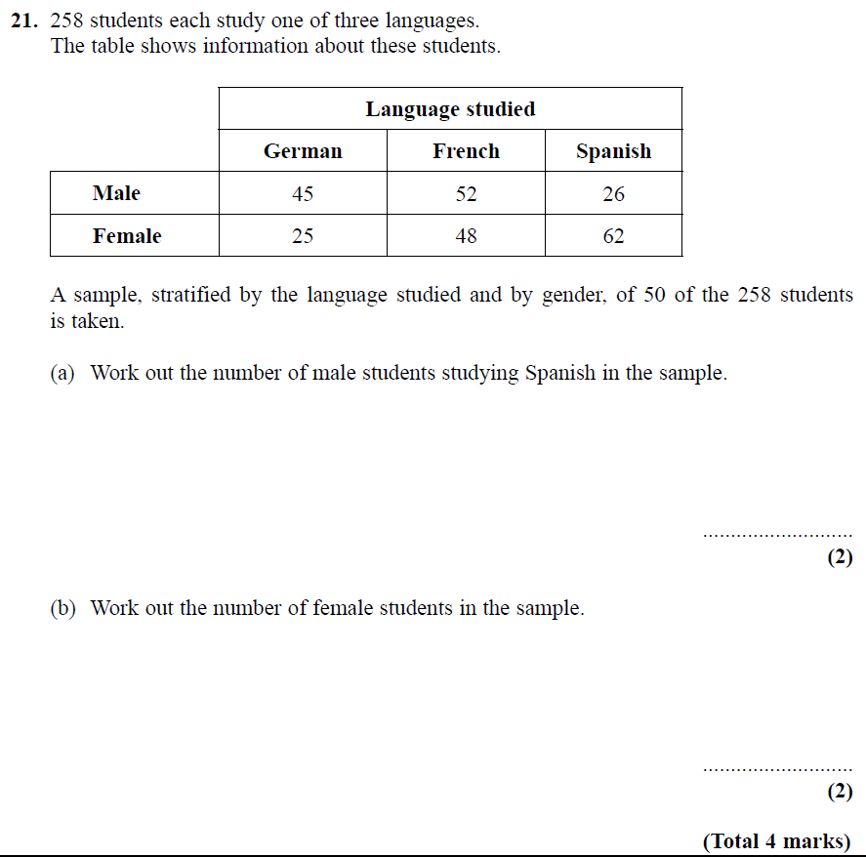
50/258 of students sampled.
26 x (50/258) = 5.039
So 5 students.
25 + 48 + 62 = 135 females.
135 x (50/258) = 26.16
So 26 students.

Slide 13
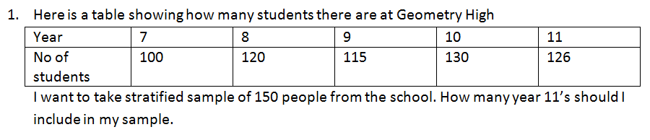
Students in school = 591
Proportion sampled = 150/591
Year 7: 100 x (150/591) = 25
Year 8: 30 Year 9: 29 Year 10: 33 Year 11: 32
(Notice that due to rounding, we in fact only sample 149 people)

Slide 14
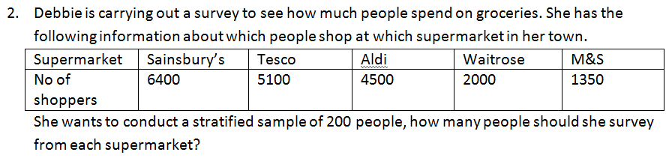
Total people = 19350
Proportion sampled = 200/19350
Sainsbury’s: 66 Tesco: 53
Aldi: 47 Waitrose: 21
M&S: 14

Slide 15
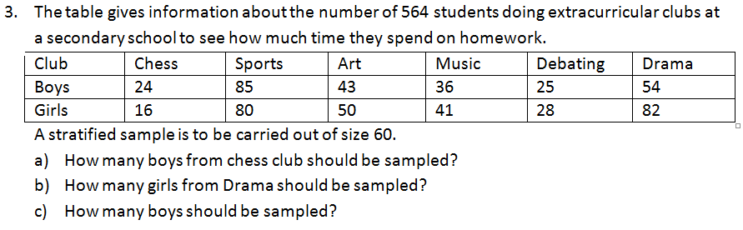
Proportion sampled = 60/564
a) 24 x (60/564) = 3
b) 9
c) 28

Slide 16
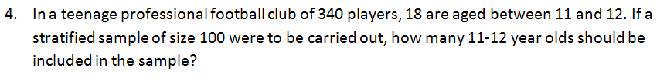
Proportion sampled = 100/340
18 x (100/340) = 5

