Slide 1
LO: Factorising
Quadratics

Slide 2
Which are quadratic expressions?
x² + 3x + 2
x² + 3x
x³ + 3x
3x³ + 3x² + 2
The highest power is 2

Slide 3
Expanding
(x + 5)(x + 2)
x² + 7x + 10

Slide 4
Expanding
(x – 5)(x + 2)
x² – 3x – 10

Slide 5
Expanding
(x – 5)(x – 2)
x² – 7x + 10

Slide 6
Expanding
(x + 1)(x + 2)
x² + 3x + 2
Factorising

Slide 7
a + b | ab | a | b
5 | 6
8 | 15
2 | –3
3 | –70
–9 | 18
7 | –18
18 | 80
2
3
3
5
3
–1
10
–7
–3
–6
–2
9
8
10

Slide 8
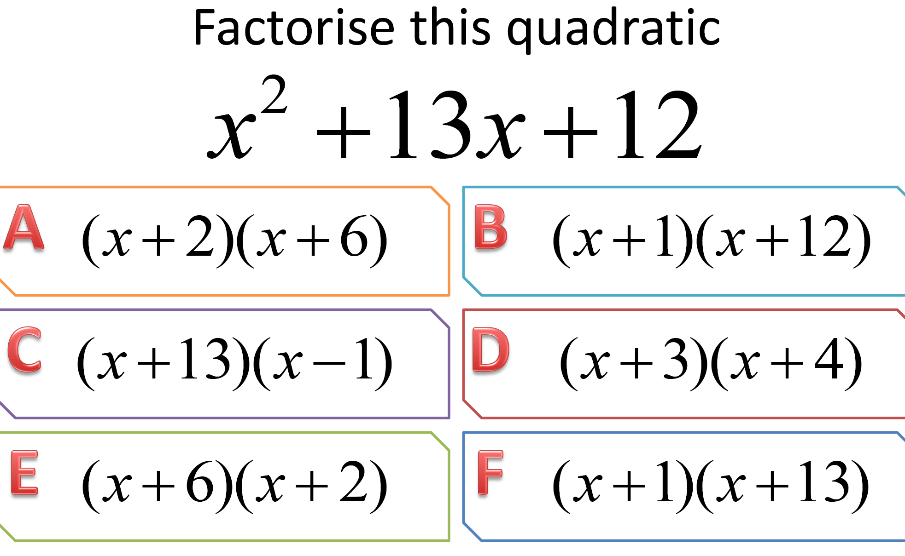

Slide 9


Slide 10
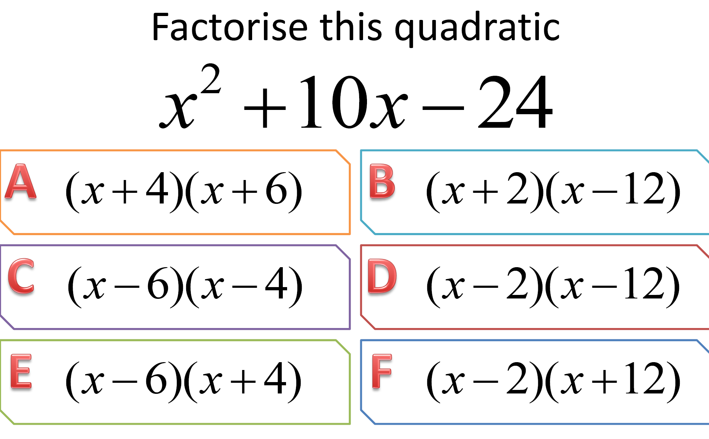

Slide 11


Slide 12
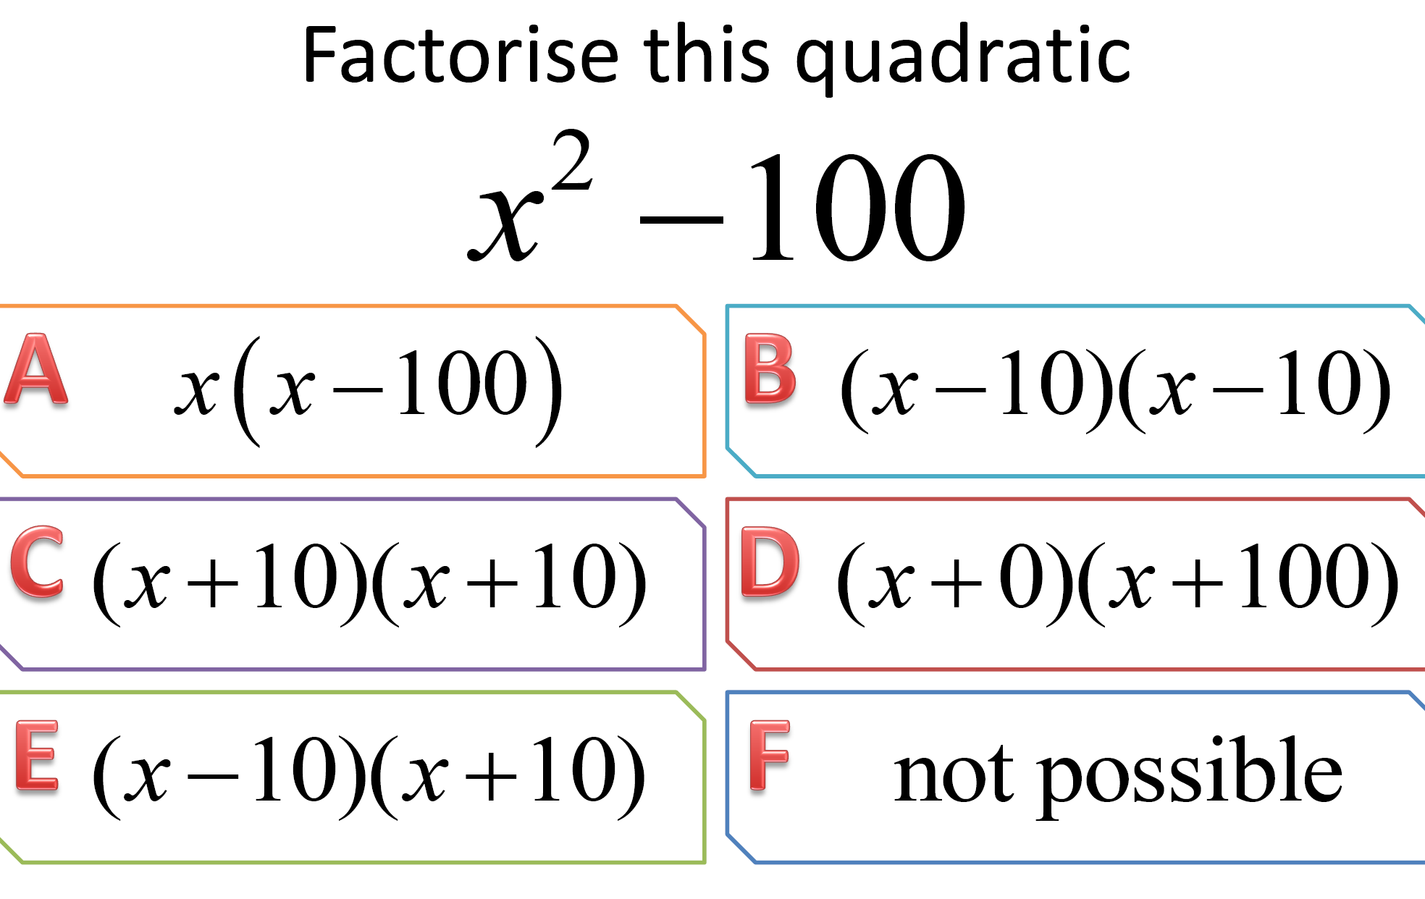

Slide 13
x² + 8x + 15
Sum = 8
8
15
Product = 15
(x + 3)(x + 5)

Slide 14
x² + 3x – 10
3
Sum = 3
–10
Product = -10
(x + 5)(x – 2)

Slide 15
x² – 5x – 14
-5
Sum = -5
-14
Product = -14
(x – 7)(x + 2)

Slide 16
x² – 9
0
Sum = -5
–9
Product = -14
(x + 3)(x – 3)

Slide 17
x² – 16
0
Sum = -5
–16
Product = -14
(x + 4)(x – 4)

