Slide 1
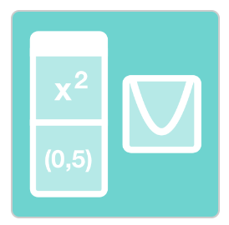
Card Sort: Parabolas
Activity: Click on the icon
Matching graphs with equations.

Slide 2
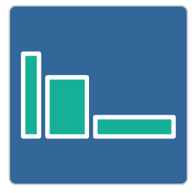
Build a Bigger Field
Activity: Click on the icon
Investigation into
area and perimeter of rectangles.

